Slide 1
Las diapositivas de Resolución de Problemas
Grado 3
Notes:
© 2024 MIND Education.Todos los derechos reservados. v2.0

Slide 2
Módulo 1
¡Comencemos con la diversión!

Slide 3
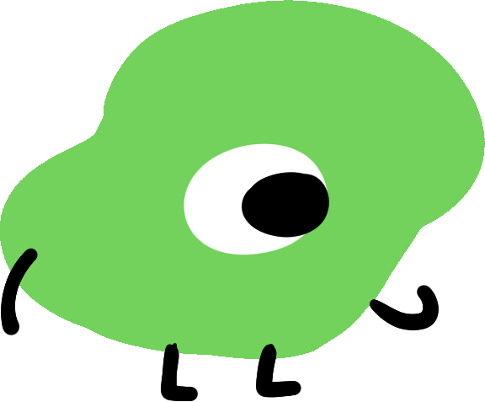
Módulo 1 - Día 1
¿Quién es JiJi?
¿Nuevo en ST Math?
Introducción guiada
Notes:
USE THIS SLIDE IF YOUR STUDENTS ARE NEW TO ST MATH
Choose one of the following ways to introduce ST Math to your students:
Show students the Guided Intro and/or Intro Video [English] [Spanish]

Slide 4
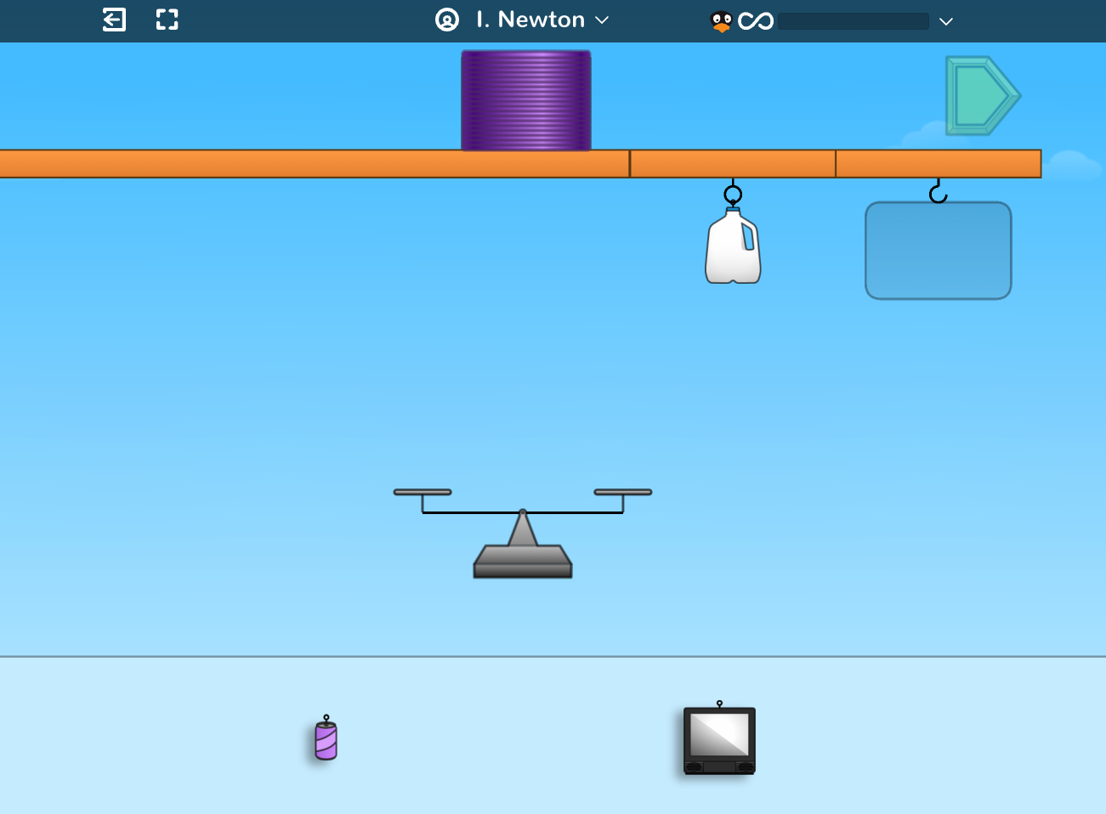
Módulo 1 - Día 1
¿Nuevo en ST Math?
Juega el juego Slinky
Notes:
USE THIS SLIDE IF YOUR STUDENTS ARE NEW TO ST MATH
Choose one of the following ways to introduce ST Math to your students.
Read students the JiJi to the Top book in Spanish.
Show a video telling the story in Spanish to introduce ST Math.
Play the Slinky game with your students. During game play explain that ST Math is a program that teaches math in a very different way.
Encourage students to look at the visual models on the screen and determine what they think they should do.
Point out the things that are clickable and that clicking on the sky makes the clickable parts shimmer.
Show them how to pause the animation to slow down the feedback.
Make sure students understand that they have to complete all the puzzles in a level before moving on to the next.
Ask students if ST Math reminds them of other math programs. Why or why not?

Slide 5
Módulo 1 - Día 1
¡Comparta la experiencia ST Math!
¿Qué sabes de ST Math?
¿Qué te gusta de ST Math?
¿Cuál es tu juego ST Math favorito? ¿Por qué?
Un consejo de ST Math que tengo es . . .
Una pregunta que tengo es. . .
Mi meta de ST Math es . . .
Me pregunto sobre. . .
Notes:
USE THIS SLIDE IF YOUR STUDENTS ARE NOT NEW TO ST MATH
If your class has been using ST Math, you will not need to do a formal introduction to the program. Instead focus on engaging them in discussions where they can share tips, encouragement, and success stories with ST Math.
Brainstorm what students like about ST Math. What tips do they have to share? What do they do when they get stuck?
Have students share their favorite games and why they like them.
Discuss goal setting with students and set a puzzles and minutes goal for this first module.
Provide students with a tracker and walk them through how to use it.
Let the students know if they will be doing the Journey, Assignments or both. Remind them that you are able to see the minutes and puzzles they have completed during the module.
Extension if time permits.
Ask students, if they like to solve puzzles. Then, have them tell about puzzle they solved.

Slide 6
Módulo 1 - Día 1
Resolución
de problemas
Problema del día
Crea un gráfico de la clase "Conociendo nuestra clase".
Notes:
Problem of the Day
Create a class “Getting to Know Our Class” chart. Ask the students questions to gather data about the class and record the information on a white board or chart. (You will use this information throughout the module so it is important that it is in a form you can refer back to.)
º Some questions you may ask to gather data might include: How many students are in this class? How many are girls? Boys? How many students have brown eyes? Blue eyes? Green eyes? How many students in the class have black hair? Brown hair? Blonde hair? Red hair? How many have pets? Siblings? Favorite subject? Favorite flavor ice cream? Favorite color?
º This is a great opportunity to practice counting, making tally marks, and comparing numbers (more/less, bigger/smaller, one more, two more, one less, two less, etc.)

Slide 7
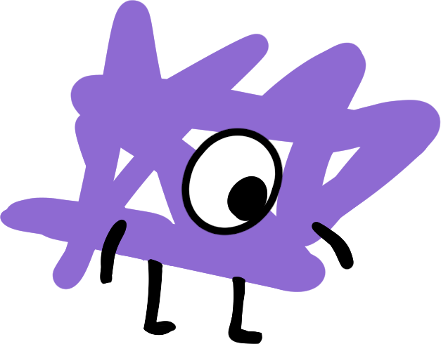
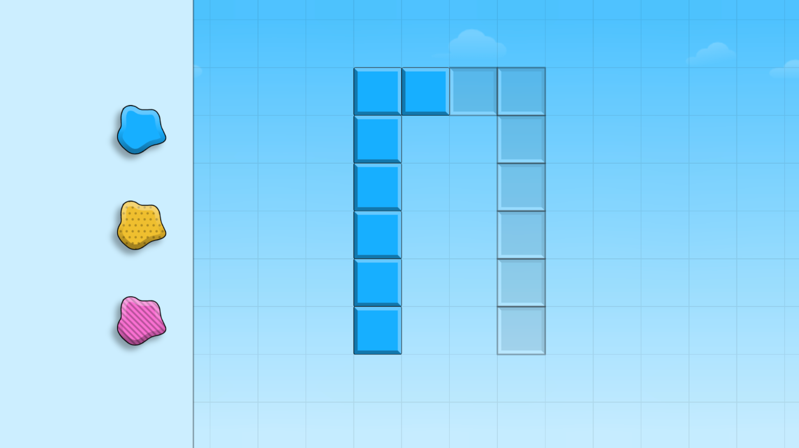
Módulo 1 - Día 2
Charla de rompecabezas
iHora de
RESOLVER PROBLEMAS!
Rompecabezas de ST Math:
Big Seed > Nivel 1
Objetivo de aprendizaje:
¿Qué sabes sobre ST Math?
Enlace de rompecabezas
Notes:
Puzzle Talk
¤ Focus on student thinking and developing problem solving skills using the Problem Solving Process.
¤ Provide students with whiteboards/dry erase markers.
Notice and Wonder
• Tell students you are going to teach them questions they can ask themselves to help think through the puzzles.
• Show the first puzzle in level 1 and encourage students to complete this sentence “I notice _____” (without suggesting a solution). Have several students share what they notice.
• Tell students that they can click the sky to make the clickable elements shimmer.
• Once students call out all the components they see on the screen, ask students what they wonder. What question is this puzzle asking?”
Predict and Justify
• Encourage students to complete this sentence “My prediction is ________ because_____”
º Have different students share their predictions and why they think those are the best prediction.
º Ask students to name or describe their strategy they will use to test their prediction (hypothesis).
For example, a student may predict that they have to fill the empty blocks. In this case they would name the strategy of flipping. “My strategy is to flip the shape to fill in the blocks.”
Test and Observe
• Try a few student strategies both correct and incorrect. Watch the feedback and discuss what they observed in the animation.
Analyze and Learn
• Facilitate students through the feedback analysis, understanding what worked and didn’t work. By examining their thinking, students either reinforce their strategies or examine their errors, which provides an opportunity for them to learn from their mistakes.
º How does this compare to what you thought would happen?
º What did you learn?
º How will you use what you learned?
• Be sure to use the playback features to pause, rewind, and fast forward the animation and discuss what they are learning from the feedback and use the annotation tools to highlight the learning.
• Encourage students to complete this sentence “Something I learned from the feedback is ________.”
• Continue to facilitate student thinking as you work through additional puzzles.
Connect and Extend
• Share solutions and discuss how puzzles are different as the levels progress. Encourage a variety of strategies/solutions and remember to facilitate, not teach, how to solve the puzzles.
• Ask the students if what they learned about how the puzzle behaves in previous levels can be applied here.
• When playing Nivel 3, ask the students if there is more than one answer to the puzzle. Explore different solutions and discuss what they thought would happen vs. what did happen.
• Before moving on, ask students to describe what is occurring in the puzzles. What are they learning? Do they notice any relationships or patterns? Chart the math concepts/words/skills that students discuss.
• Depending on how students are doing with the puzzles, you may want to skip to level 5.
• Have students work in breakout groups to complete a puzzle from Nivel 5. How did what they learned in their earlier puzzles help them solve this puzzle?

Slide 8
Módulo 1 - Día 2
Resolución
de problemas
Problema del Día
Describa la clase matemáticamente.
Notes:
Problem of the Day
Remind students about yesterday’s Problem of the Day.
How can we describe the class mathematically? Generate a list of 3-5 things students want to know about each other.
For example: Favorite ice cream flavor, favorite color, number of siblings, number of pets, favorite subject in school, month of birth, favorite sport, etc.

Slide 9
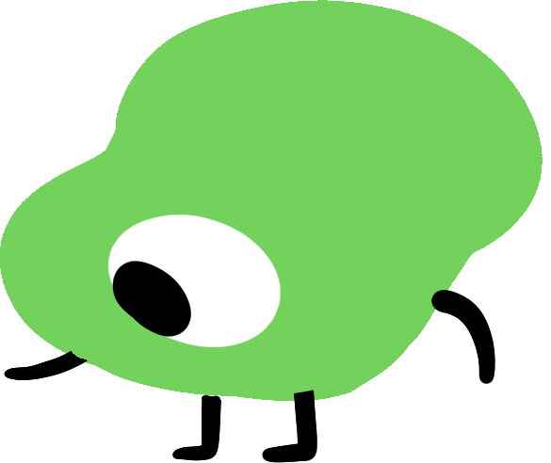
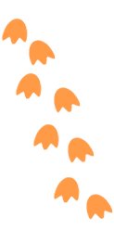
Módulo 1 - Día 3
Mi camino de razonamiento
Tema: Comparar fracciones y contar por fracciones unitarias
???
Lo que sé sobre fracciones es...
Lo que sé sobre la comparación de fracciones es...
Una cosa que aprendí es. . .
Una pregunta que tengo es. . .
Esto es como…
Esto no es como…
Me pregunto…
Notes:
My Thinking Path
Students will begin solving problems involving fractions and understanding fractions as numbers, including counting by unit fractions (fractions with a numerator of 1).
My Thinking Path Discussion:
Introduce the My Thinking Path document to students. Have them write in the topic, “Compare fractions and count by unit fractions.”
Have students begin working on the My Thinking Path page.
Discuss their ideas and allow students to add to their paper any additional thoughts they have.
From today on, begin each of Days 1-4 with time for students to reflect on their learning and prepare for the day.

Slide 10
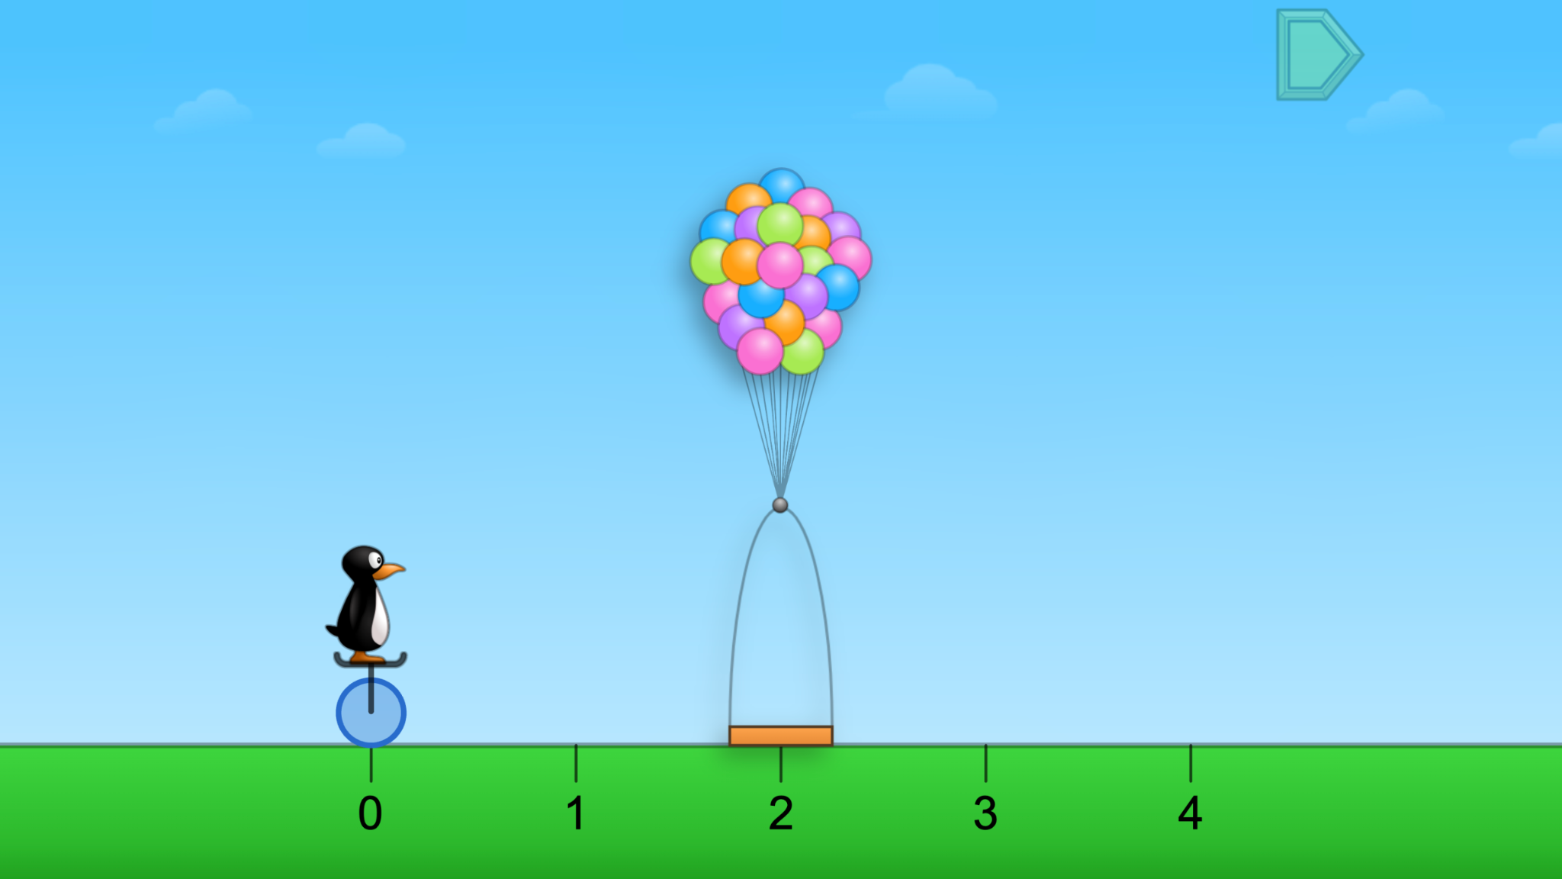
Módulo 1 - Día 3
Charla de rompecabezas
iHora de
RESOLVER PROBLEMAS!
Rompecabezas de ST Math:
JiJi Cycle Basket
Objetivo de aprendizaje:
Resolver problemas que involucran fracciones y entender fracciones como números
Enlace de rompecabezas
Notes:
Puzzle Talk
Focus on student thinking and developing problem solving skills using the Problem Solving Process.
Provide students with whiteboards/dry erase markers.
Notice and Wonder
Show a puzzle from Level 1. Ask: What do you notice? What do you wonder? Allow students to share.
Predict and Justify
Have students make a prediction and determine a strategy for solving the puzzle. Have students share their predictions, and why. Do they agree/disagree with each other?
Test and Observe
Try one of the students’ ideas and discuss the feedback. (As you try students’ strategies, be sure to try those that work and those that don’t.)
Analyze and Learn
Ask students to how what they saw happen compares to their prediction, such as “How did you know where to place the basket?”
Show a puzzle from level 2. Repeat the Problem Solving Process, guiding students to share strategies and their reasoning.
Discuss unit fractions and identify the numerator and denominator of the fraction on the number line.
Show another puzzle from level 2.
Discuss how students determine how many unit fractions to select.
Connect and Extend
Show a puzzle from level 3, asking how it is different from level 2.
Discuss unit fractions and the numerator and denominator of the fraction on the number line, and the mixed number and a/b (b>0) fraction name for the puzzles greater than 1.
Show a puzzle from level 4. Discuss how this puzzle compares to the other levels, unit fractions and the numerator and denominator of the fraction on the number line.
Continue with puzzles from levels 3 and 4.
Discuss unit fractions, mixed numbers vs. a/b (a>b, b>0), how many unit fractions are needed to make 1.
How does the student
explain how they determined the size of the fraction piece? (It would take 4 pieces this size to make a whole circle.)
count the fraction pieces? Count the fractions greater than 1? (5 one-thirds = 5/3)
determine the label for the whole numbers? (3/3 is equivalent to 1)

Slide 11
Módulo 1 - Día 3
Resolución
de problemas
Problema del Día
Compara estas fracciones y explica cómo ubicarlas en la recta numérica: 5/8, 6/8, 2/8, 9/8, 3/8.
Notes:
Problem of the Day
Engage students in problem solving discussions. Read and discuss the problem, share student work, compare strategies and make connections.
Compare these fractions and explain how to locate them on a number line. 5/8, 6/8, 2/8, 9/8, 3/8

Slide 12
Módulo 1 - Día 4
Mi camino de razonamiento
???
Lo que sé sobre fracciones es...
Lo que sé sobre la comparación de fracciones es...
Una cosa que aprendí es. . .
Una pregunta que tengo es. . .
Esto es como…
Esto no es como…
Me pregunto…
Notes:
My Thinking Path
Have students reflect on what they have learned about comparing fractions and counting by unit fractions.

Slide 13
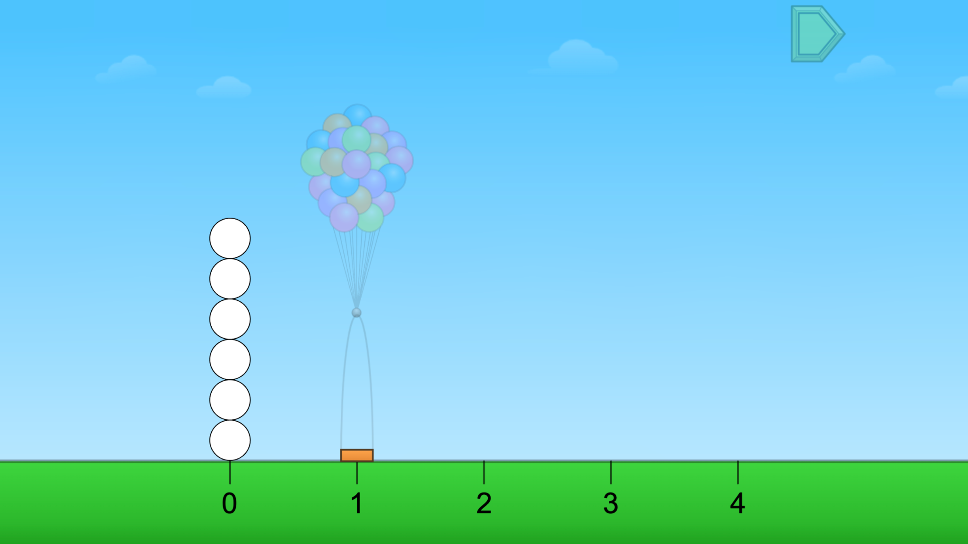
Módulo 1 - Día 4
Charla de rompecabezas
iHora de
RESOLVER PROBLEMAS!
Rompecabezas de ST Math:
JiJi Cycle
Objetivo de aprendizaje:
Resolver problemas que involucran fracciones y entender fracciones como números
Enlace de rompecabezas
Notes:
Puzzle Talk
Focus on student thinking and developing problem solving skills using the Problem Solving Process
Provide students with whiteboards/dry erase markers.
Notice and Wonder
Show a puzzle from level 1. Ask: What do you notice? What do you wonder? Allow students to share.
Predict and Justify
Have students make a prediction and determine a strategy for solving the puzzle.
Have students share their predictions, what they think will happen, and why. Do they agree or disagree with each other? Why?
Test and Observe
Try one of the students’ ideas. (As you try students’ strategies, be sure to try strategies that work and those that don’t. Analyze and discuss the feedback in both correct and incorrect solutions.)
Analyze and Learn
Ask students how what they saw happen compares to their prediction.
Show a puzzle from level 2. Discuss how this level compares to the puzzles from yesterday's game.
Have students think about and then discuss with a partner how they might solve the puzzle.
Share whole group.
Discuss unit fractions (1/b, b>0) and the numerator and denominator of the fraction on the number line.
Connect and Extend
Continue with puzzles in Levels 2, 3, and 4. Compare and contrast puzzles from the different levels and how to use what they've learned in previous levels to solve other puzzles.
Discuss how puzzles can be represented with an expression (no equals sign) or equation.
Discuss unit fractions, mixed numbers (a>b, b>0), and how many unit fractions are needed to make 1.
How does the student:
write equations to show equivalence of fractions?
discuss the size of the fractions (denominator) and the number of unit fractions (numerator) of that size to compare equivalent fractions?
partition a number line to place fractions?
add fractions to a number line?

Slide 14
Módulo 1 - Día 4
Resolución
de problemas
Problema del Día
Nancy, Bob y Devin jugaron a ver quién llegaba más lejos en una recta numérica. Cada uno lanzó un dado de fracciones. Nancy sacó 1/4 y 1. Bob sacó 3/4 y 3/4. Devin sacó 3/4 y 1/2. ¿Dónde cayó cada jugador
en la recta numérica? ¿Quién ganó?
Notes:
Problem of the Day
Engage students in problem solving discussions. Read and discuss the problem, share student work, compare strategies and make connections.
Nancy, Bob, and Devin played a game to see who could get farthest on a number line. They each rolled a fraction cube.
Nancy rolled 1/4 and 1.
Bob rolled 3/4 and 3/4.
Devin rolled 3/4 and 1/2.
Where did each player land on the number line? Who won?

Slide 15
Módulo 2
¡No puedo esperar a ver lo que hacemos!

Slide 16
Módulo 2 - Día 1
Mi camino de razonamiento
Tema: Particionar un entero en secciones iguales
???
Lo que sé sobre un número entero es...
Lo que sé sobre la partición de un entero es ...
One thing I learned is . . .
Una cosa que aprendí es. . .
A question I have is . . .
Una pregunta que tengo es. . .
This is like…
Esto es como…
This is not like….
Esto no es como…
I wonder…
Me pregunto…
Notes:
My Thinking Path
Remind students about the My Thinking Path page in their journal. Have them write in the topic, “Solving problems involving partitioning a whole into equal sections (fractions).”
Have students begin working on the My Thinking Path page.
Discuss their ideas and allow students to add to their paper any additional thoughts they have.
Begin each of Day 1-4 with time for students to reflect on their learning and prepare for the day.
Have students complete the Pre-quiz (optional).

Slide 17
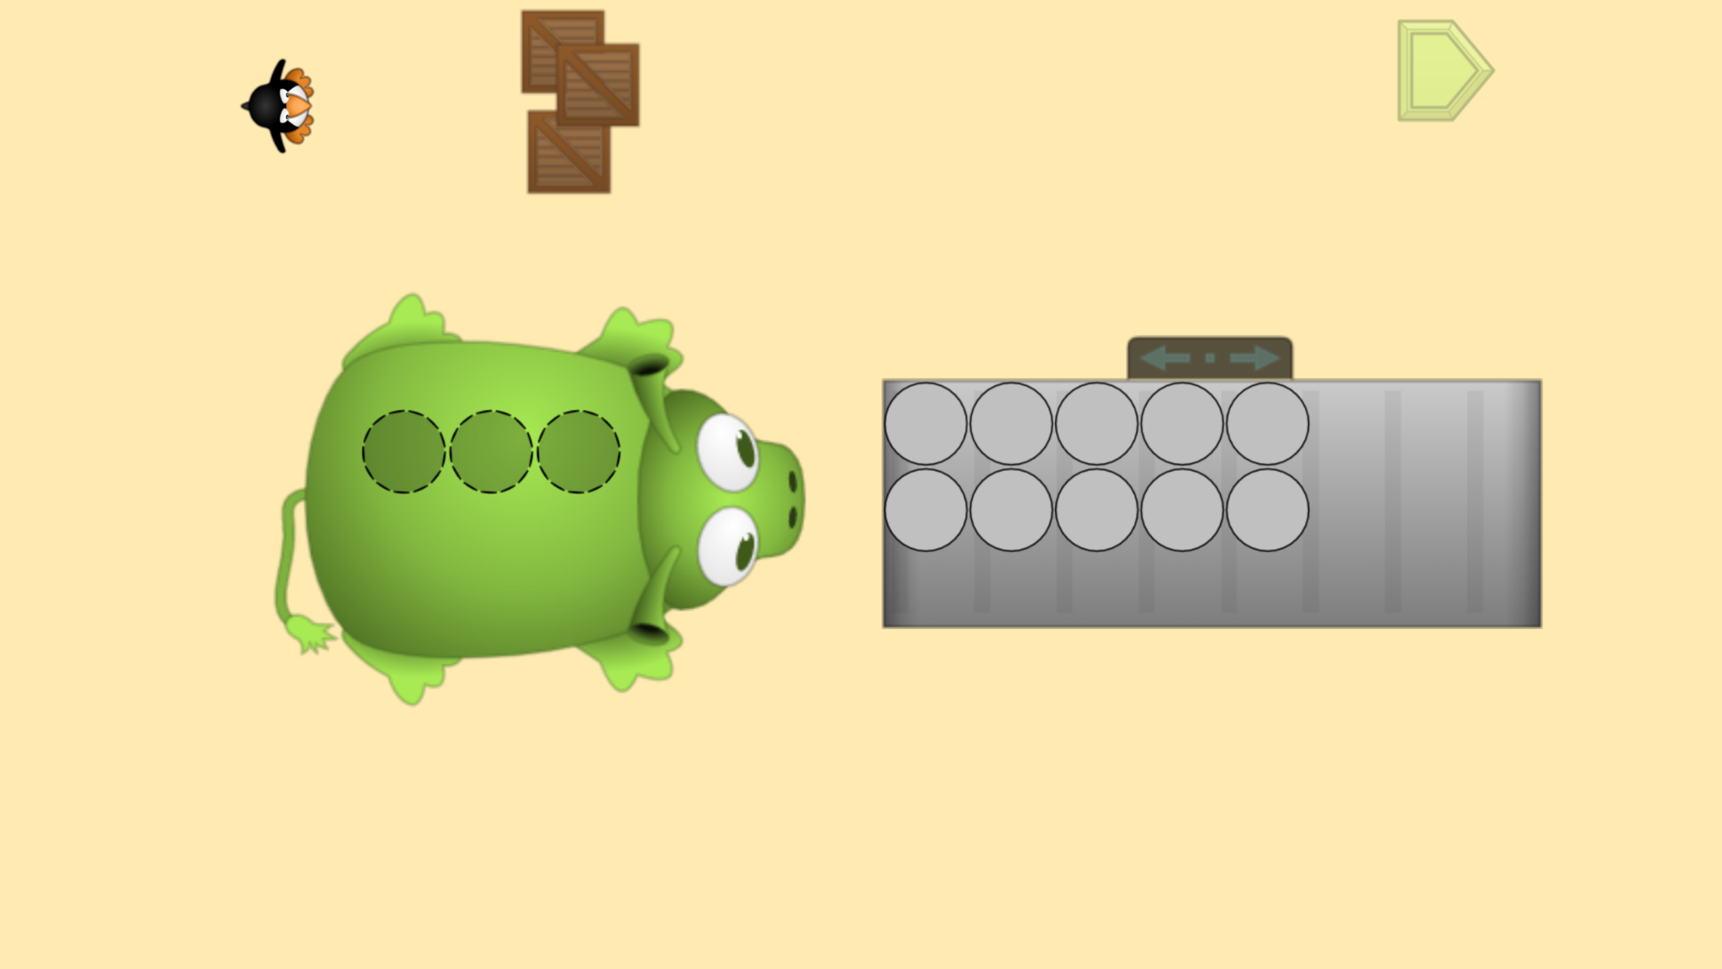
Módulo 2 - Día 1
Charla de rompecabezas
iHora de
RESOLVER PROBLEMAS!
Rompecabezas de ST Math:
Pie Monster > Nivel 1
Objetivo de aprendizaje:
Particionar un entero en secciones iguales
Enlace de rompecabezas
Notes:
Puzzle Talk
Focus on student thinking and developing problem solving skills using the Resolución de problemas Process.
Provide students with whiteboards/dry erase markers.
Notice and Wonder
Display the first puzzle in level 1. Ask: What do you notice? What do you wonder? Allow a few students to share out.
Ask students to think of their strategy for solving the puzzle and predict what will happen when they try it.
Predict and Justify
Have students Think-Pair-Share their strategy with a partner, explaining their reasoning.
Have students share out. Ask the students to think about if they agree/disagree with the strategy and why. How does it relate to their strategy?
Test and Observe
Try one of the students’ ideas. (As you try students’ strategies, be sure to try strategies that work and those that don’t.)
Watch the feedback together for correct and incorrect tries and discuss what you saw.
Analyze and Learn
Ask students to think about how what they saw happen compares to their prediction.
Show another puzzle. Have students prepare to show how they would solve it.
Share several examples. Look for students who also wrote the number OR ask students to write the number.
Look for mixed numbers and a/b (b>0) fractions. Discuss counting fractions compared to counting whole numbers, and equivalence: “How do you know this fraction is equivalent to this mixed number? (e.g., Why is 2 the same as 4/2?)”
Connect and Extend
Open up some puzzles from level 2 (make sure you include puzzles with thirds and fourths) and have students do a Think-Pair-Share with a partner about what they notice. How is it different from level 1?
Continue to show a few other puzzles in level 2 (especially partitioned into halves).
Have students share ideas on how they would solve the puzzle.
Share out several examples. Look for students who also wrote the number OR Ask students to write the number.
Look for mixed numbers and a/b fractions. Discuss counting fractions compared to whole numbers.
Discuss the equivalence.
Do the same as above but with puzzles in level 3 (showing puzzles with thirds and fourths). Questions to ask: “How many thirds/halves/fourths did you need for each whole pie? How many thirds/halves/fourths are there altogether?“
How does the student
figure out how many unit fractions are needed for one whole?
count unit fractions to find the total?
understand that the a/b (b>0) fraction is equivalent to the mixed number?

Slide 18
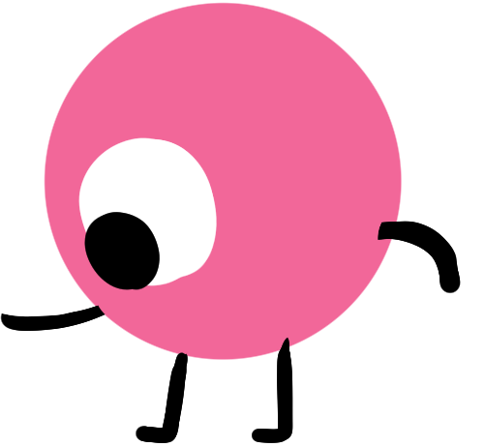
Módulo 2 - Día 1
Resolución
de problemas
Problema del Día
Joe, el panadero, horneó 2 tartas de manzana para la familia Hughes. Hay 8 personas en la familia
Hughes. La familia compartió las tartas de manera por igual. ¿Qué cantidad de tarta recibió cada
miembro de la familia?
Notes:
Problem of the Day
Engage students in problem solving discussions. Read and discuss the problem, share student work, compare strategies and make connections.
Joe the baker baked 2 apple pies for the Hughes family. There are 8 people in the Hughes family. The family shared the pies equally. How much pie did each family member get?

Slide 19
Módulo 2 - Día 2
Mi camino de razonamiento
???
Lo que sé sobre un número entero es...
Lo que sé sobre la partición de un entero es ...
One thing I learned is . . .
Una cosa que aprendí es. . .
A question I have is . . .
Una pregunta que tengo es. . .
This is like…
Esto es como…
This is not like….
Esto no es como…
I wonder…
Me pregunto…
Notes:
My Thinking Path
• Have students reflect on what they have learned about solving problems involving partitioning a whole into equal sections (fractions).

Slide 20
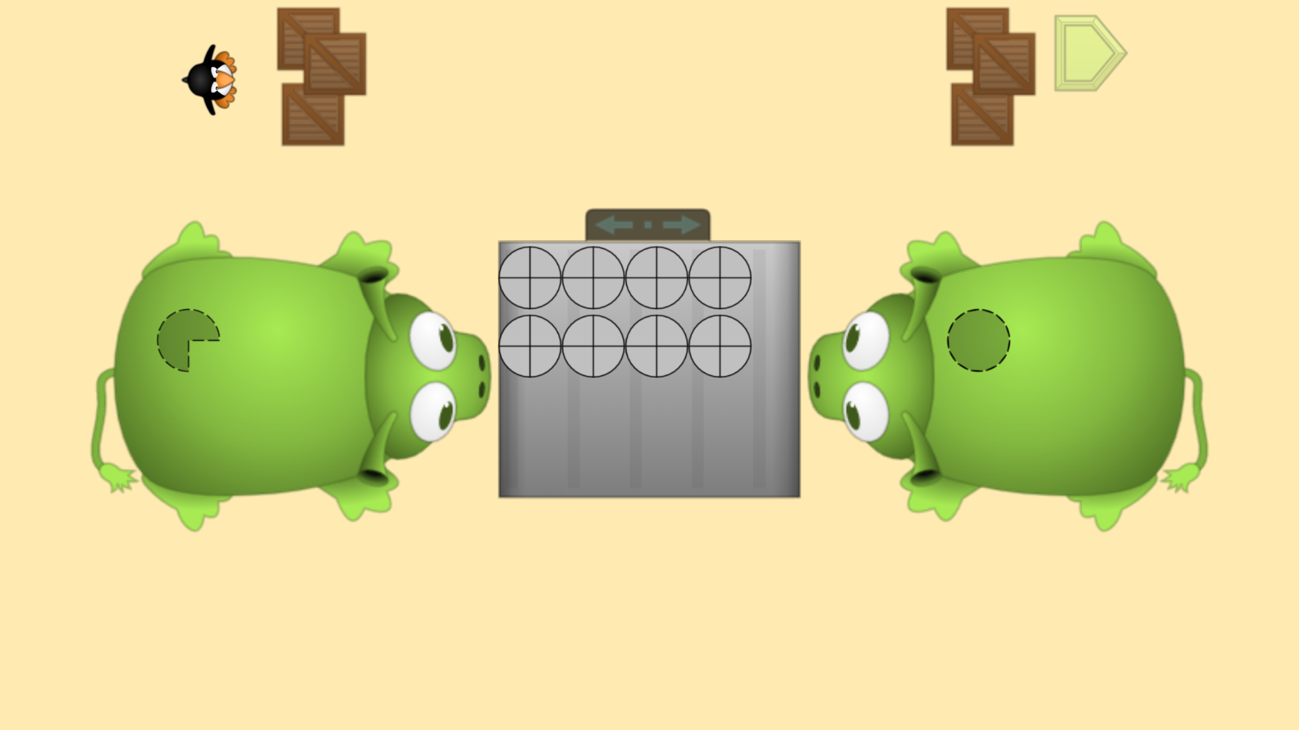
Módulo 2 - Día 2
Charla de rompecabezas
iHora de
RESOLVER PROBLEMAS!
Rompecabezas de ST Math:
Pie Monster > Nivel 3
Objetivo de aprendizaje:
Particionar un entero en secciones iguales
Enlace de rompecabezas
Notes:
Puzzle Talk
Focus on student thinking and developing problem solving skills using the Problem Solving Process.
Provide students with whiteboards/dry erase markers.
Notice and Wonder
Display the first puzzle in Level 3. Ask “What do you notice that is similar/different from the puzzle we did yesterday?”
Allow a few students to share out.
Predict and Justify
Ask students to think of their strategy for solving the puzzle and predict what will happen when they try it. Have students share out their predictions.
Test and Observe
Select a student’s solution to try and watch the feedback. Ask students, “What happened when we tried that prediction? What did you see?"
Analyze and Learn
Ask students to think about how what they saw happen compares to their prediction. Was our answer correct? What did they learn from the feedback?
Show another puzzle, and have students discuss with a partner what they think they need to do to solve the problem.
Try one of the student’s strategies. Discuss the feedback.
Continue to try level 3 puzzles and launch into a discussion with students around mixed numbers, unit fractions, and equivalence:
How can you check to make sure both monsters get enough pie?
How many thirds/halves/fourths are there altogether?
How could you write the fraction and the mixed number for monster 1 and monster 2?
How do you know this fraction is equivalent to this mixed number? (e.g., Why is 2 the same as 4/2?)
Connect and Extend
Choose some puzzles for students to write equations for on paper or whiteboard.
Ask students a challenge question: “What if Pie Monster got ___ more pies? How many pieces of pie would Pie Monster have now?”
Have students solve the new problem and then allow a few students to share their strategies and their answers.
How does the student
write equations and inequalities to compare fractions?
figure out how many unit fractions are needed for the whole and for each monster.
count unit fractions to find the total?
understand that the a/b (b>0) fraction is equivalent to the mixed number?

Slide 21
Módulo 2 - Día 2
Resolución
de problemas
Problema del Día
Joe el panadero horneó 7 tartas de manzana para vender en su tienda. Llegaron cuatro personas al mismo tiempo para comprar tarta. Joe vendió las 7 tartas a las cuatro personas. Cada persona recibió la misma cantidad de tarta. ¿Cuánta tarta compró cada uno?
Notes:
Problem of the Day
Engage students in problem solving discussions. Read and discuss the problem, share student work, compare strategies and make connections.
Joe the baker baked 7 apple pies to sell in his shop. Four people came in at the same time to buy pie. Joe sold the 7 pies to the four people. Each person got an equal amount of pie. How much pie did each person buy?

Slide 22
Módulo 2 - Día 3
Mi camino de razonamiento
???
Lo que sé sobre un número entero es...
Lo que sé sobre la partición de un entero es ...
One thing I learned is . . .
Una cosa que aprendí es. . .
A question I have is . . .
Una pregunta que tengo es. . .
This is like…
Esto es como…
This is not like….
Esto no es como…
I wonder…
Me pregunto…
Notes:
My Thinking Path
• Have students reflect on what they have learned about solving problems involving partitioning a whole into equal sections (fractions).

Slide 23
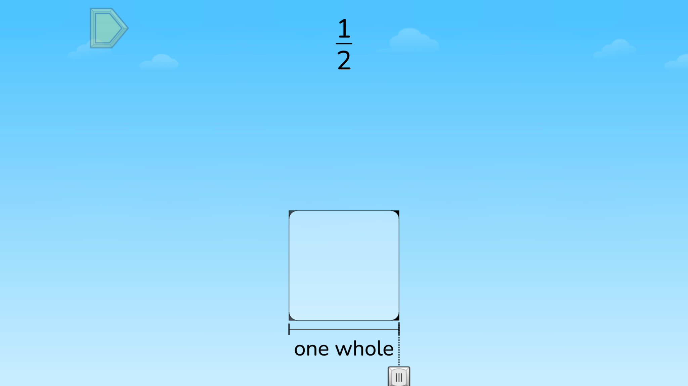
Módulo 2 - Día 3
Charla de rompecabezas
iHora de
RESOLVER PROBLEMAS!
Rompecabezas de ST Math:
Match Fraction > Nivel 1
Objetivo de aprendizaje:
Particionar un entero en secciones iguales
Enlace de rompecabezas
Notes:
Puzzle Talk
Focus on student thinking and developing problem solving skills using the Problem Solving Process.
Provide students with whiteboards/dry erase markers.
Notice and Wonder
Display the first puzzle in Level 1. Ask “What do you notice?” “What do you wonder?” Allow a few students to share out.
Predict and Justify
Ask students to predict where the rocket will go and explain their prediction.
You may probe students by asking: What does the numerator represent?
What does the denominator represent? “
Test and Observe
Select a student to share how to move the slider, how many parts they are dividing and coloring in, and why.
Analyze and Learn
Ask students to explain what they learned from the feedback about numerators, denominators and partitions. Replay the puzzle and select the same answer. This time pause the feedback. Discuss.
Ask students to share what they learned from the feedback. How can they use what they learned in the next puzzle?
Show the next puzzle. Move the slider across the square at the bottom and ask students to watch the animation. Ask: How many pieces do you want to partition this square into so that it matches the fraction in the puzzle?
Remind students that the denominator tells how many equal pieces the whole has been divided into: “The denominator is ___, so we need to divide the square into ___ equal parts.” Select the correct denominator. Remind students that the numerator counts how many of the equal pieces you have. The numerator in the puzzle is 1, which means that we just need 1 of the pieces. Ask students, “How could we represent just 1 of the pieces?” Move the cursor over the square again to show how to shade in the pieces and watch the feedback.
Solve the puzzle and watch the feedback.
How does the student
discuss the size and number of partitions created as the cursor moves from left to right?
discuss the meaning of the denominator in the fractions?
discuss the meaning of the numerator in the fractions?
discuss unit fractions and count by unit fractions?

Slide 24
Módulo 2 - Día 3
Resolución
de problemas
Problema del Día
Gordon cocinó una lasaña para su familia de 4 personas. Cortó la lasaña en ocho partes iguales. Explique cuánta lasaña puede comer cada miembro de la familia.
Notes:
Problem of the Day
Engage students in problem solving discussions. Read and discuss the problem, share student work, compare strategies and make connections.
• Gordon baked a pan of lasagna for his family of 4. He cut the lasagna into eight equal pieces. Explain how much lasagna each family member might eat.

Slide 25
Módulo 2 - Día 4
Mi camino de razonamiento
???
Lo que sé sobre un número entero es...
Lo que sé sobre la partición de un entero es ...
One thing I learned is . . .
Una cosa que aprendí es. . .
A question I have is . . .
Una pregunta que tengo es. . .
This is like…
Esto es como…
This is not like….
Esto no es como…
I wonder…
Me pregunto…
Notes:
My Thinking Path
• Have students reflect on what they have learned about solving problems involving partitioning a whole into equal sections (fractions).

Slide 26
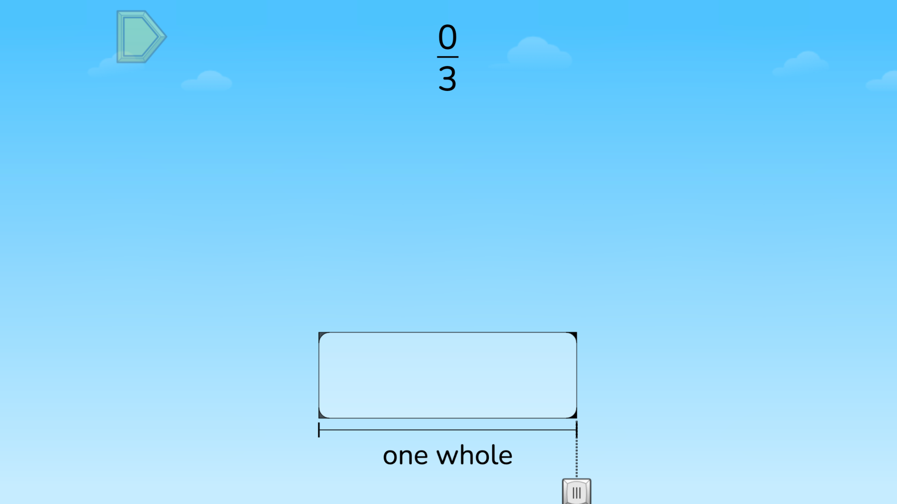
Módulo 2 - Día 4
Charla de rompecabezas
iHora de
RESOLVER PROBLEMAS!
Rompecabezas de ST Math:
Match Fraction > Nivel 2
Objetivo de aprendizaje:
Particionar un entero en secciones iguales
Enlace de rompecabezas
Notes:
Puzzle Talk
Focus on student thinking and developing problem solving skills using the Problem Solving Process.
Provide students with whiteboards/dry erase markers.
Notice and Wonder
Show a puzzle from level 2. Ask students, “What do you notice that is similar/different than the puzzles we did yesterday?
Have students predict how to solve the puzzle and share their prediction with a neighbor. Ask students, “Did your predictions match?” “What strategies did you use?”
Predict and Justify
Have students share out. Try one of the students’ ideas.
Test and Observe
Watch the feedback together and discuss what they saw. Discuss how the animation shows the numerator and denominator of the fraction.
Analyze and Learn
Ask students to think about how what they saw happen compares to their prediction. What did they learn from the feedback?
Show another puzzle from level 2. Discuss how they determine the number of partitions to select: “Where is a unit fraction? How many unit fractions is this?”
Have students write an addition equation to show that it takes a unit fraction of size 1/b to equal the a/b (b>0) fraction (e.g., 1/6 + 1/6 = 2/6)
Connect and Extend
Display the next puzzle and move the cursor along the square again. Ask students to turn to a partner and discuss, “What happens to the size of the fraction pieces as the denominator gets bigger? How many halves/thirds/fourths/fifths/sixths does it take to make 1 whole? Why”? (Show that the bigger the denominator gets, the smaller the fraction pieces become). Allow students to share their thinking whole group.
Do a share-out and try a student solution, watching the feedback. Remind students that the numerator counts how many of the equal pieces you have (e.g., a numerator of 4, means that you have 1, 2, 3, 4 of the fraction pieces.
Ask: How many of these fraction pieces does it take to make the whole? Why?
How does the student
discuss the size and number of partitions created as the cursor moves from left to right?
discuss the meaning of the denominator in the fractions?
discuss the meaning of the numerator in the fractions?
discuss unit fractions and count by unit fractions?

Slide 27
Módulo 2 - Día 4
Resolución
de problemas
Problema del Día
A Brett y a tres compañeros de clase se les entregó un tablero de anuncios para presentar su Desafío de Matemáticas. Decidieron dividir el tablero de anuncios para que cada uno de ellos tuviera la misma cantidad de espacio. Muestra dos maneras diferentes en que podrían dividir el tablero. Demuestre que una partición de su primer ejemplo de tablero de anuncios es equivalente a
una partición del segundo ejemplo.
Notes:
Problem of the Day
Engage students in problem solving discussions. Read and discuss the problem, share student work, compare strategies and make connections.
• Brett and 3 classmates were given a bulletin board to present their Math Challenge. They decided to divide the bulletin board so that each of them had an equal amount of space. Show two different ways they could partition the board. Prove that one partition from your first bulletin board example is equivalent to one partition from the second example.

Slide 28
Módulo 3
¡Aprender matemáticas sin preocupaciones!

Slide 29
Módulo 3 - Día 1
Mi camino de razonamiento
Tema: Particionar un entero y combinar fracciones
???
Lo que sé sobre la partición de un entero es ...
Lo que sé sobre la combinación de fracciones es...
One thing I learned is . . .
Una cosa que aprendí es. . .
A question I have is . . .
Una pregunta que tengo es. . .
This is like…
Esto es como…
This is not like….
Esto no es como…
I wonder…
Me pregunto…
Notes:
My Thinking Path
Have students write in the topic, “Defining and partitioning one (whole) and combining unit fractions.”
Have students begin working on the My Thinking Path page.
Discuss their ideas and allow students to add to their paper any additional thoughts they have.
Have students complete the Pre-quiz (optional).

Slide 30
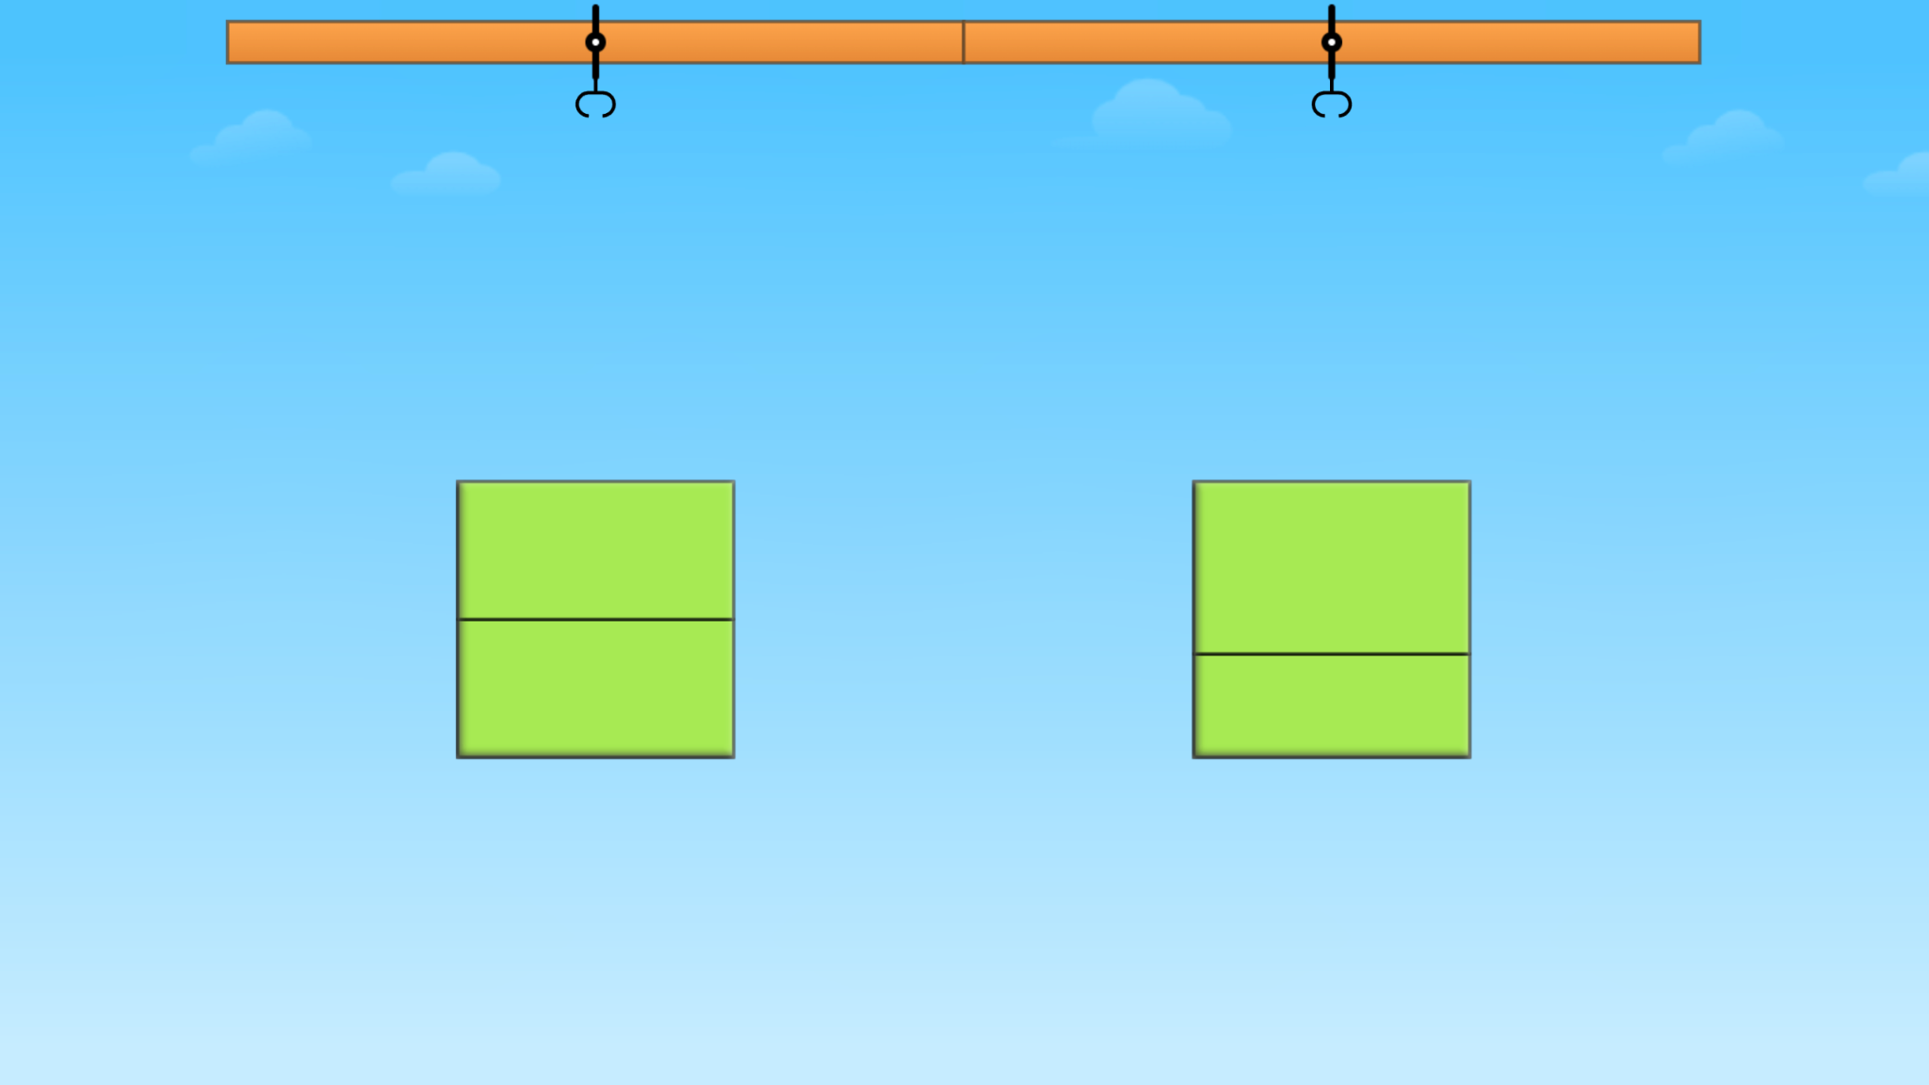
Módulo 3 - Día 1
Charla de rompecabezas
iHora de
RESOLVER PROBLEMAS!
Rompecabezas de ST Math:
Equal Areas > Nivel 1
Objetivo de aprendizaje:
Resolver rompecabezas que impliquen dividir un rectángulo en áreas iguales
Enlace de rompecabezas
Notes:
Puzzle Talk
Focus on student thinking and developing problem solving skills using the Problem Solving Process.
Provide students with whiteboards/dry erase markers.
Notice and Wonder
Display the first puzzle in level 1. Ask “What do you notice?” “What do you wonder?” Allow a few students to share out the differences between the two rectangle choices.
Predict and Justify
Have students make a prediction about which green rectangle to choose and why. They should Think-Pair-Share their prediction, strategy, and their reasoning.
Allow some students to share whole group and discuss: “How do you know the parts are equal?“
Try one of the student’s solution strategies. Before trying the strategy, discuss it with the other students (agree/disagree; what do they think will happen).
Test and Observe
Try a student’s solution and watch the feedback. Talk with students about the animation.
Analyze and Learn
Ask students to think about how what they saw happen compares to their prediction. What did they learn from the feedback about their strategy?
Solve additional puzzles in level 1.
Connect and Extend:
Display the first puzzle in level 2 and ask students which green rectangle would be correct. Discuss how each section of the rectangle would be named. Ask students, “How many parts are in this rectangle?” “Are all of the parts equal?”
With the same puzzle, tell students you want to represent the correct rectangle using a unit fraction, but need their help (A rectangle divided into 3 equal pieces is 1/3 + 1/3 + 1/3.)
If needed, explain to students that the top number of a fraction (the numerator) is the counting number. Each of these pieces is 1 piece so the numerator is 1. Explain that the bottom number (the denominator) is the cutting number. It tells how many equal pieces or parts the whole has been cut or divided into. Ask students, “How many equal parts has this rectangle been divided into?” Write the unit fraction that would represent each piece and have students write the unit fraction on their whiteboards.
Highlight the need for each section to cover the same amount of area in the shape. Do not focus on the sections being exactly alike. They do not have to be congruent.
Repeat with additional puzzles in level 2.
Display the first puzzle in level 3. Say to students, “These rectangles look different from the ones in the last puzzles we solved. Can you select the rectangle with equal parts in this puzzle?”
Solve additional puzzles in level 3 and continue asking the same questions as above.
How does the student
identify the rectangle with equal parts?
identify the total number of equal parts?
discuss the need for each section of the rectangle to cover the same area as the other sections in the rectangle in order for them to be the same fractional part?
identify each section as a unit fraction and discuss how many unit fractions are in the whole?

Slide 31
Módulo 3 - Día 1
Resolución
de problemas
Problema del Día
Muestra y explica cómo la parte coloreada de esta ilustración podría representar cada uno de estos números: 1/2, 2, 1.
Notes:
Problem of the Day
Engage students in problem solving discussions. Read and discuss the problem, share student work, compare strategies and make connections.
• Show and explain how the shaded part of this picture could represent each of these numbers. 1/2, 2, 1

Slide 32
Módulo 3 - Día 2
Mi camino de razonamiento
???
Lo que sé sobre la partición de un entero es ...
Lo que sé sobre la combinación de fracciones es...
One thing I learned is . . .
Una cosa que aprendí es. . .
A question I have is . . .
Una pregunta que tengo es. . .
This is like…
Esto es como…
This is not like….
Esto no es como…
I wonder…
Me pregunto…
Notes:
My Thinking Path
• Have students reflect on what they have learned about solving problems involving defining and partitioning one (whole) and combining unit fractions.

Slide 33
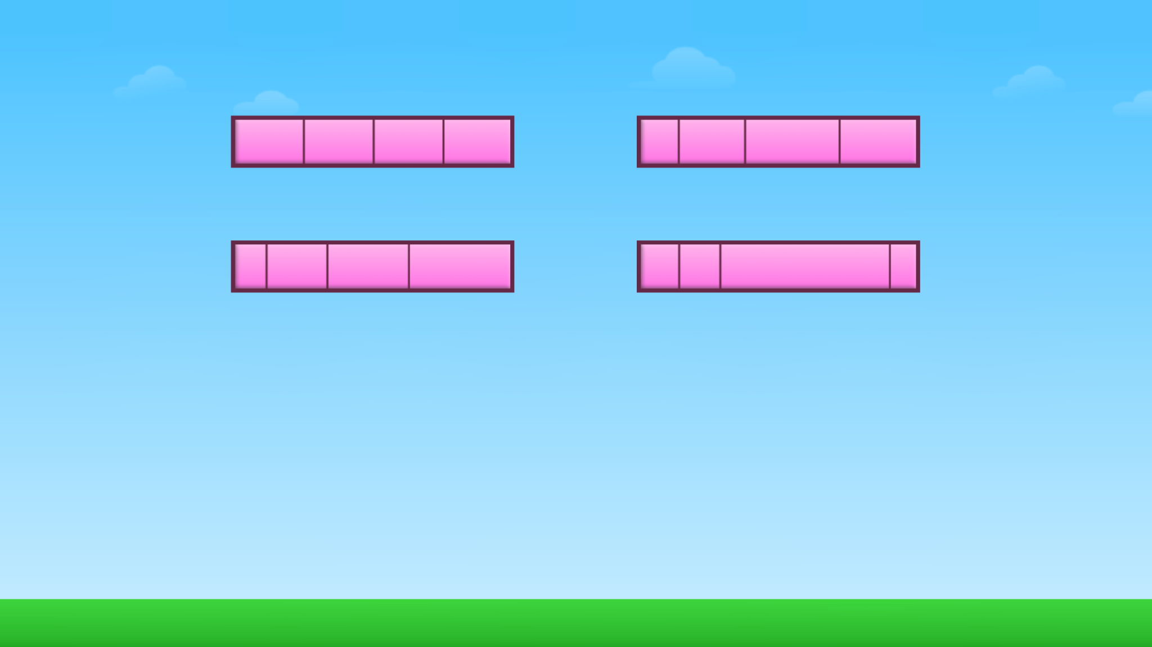
Módulo 3 - Día 2
Charla de rompecabezas
iHora de
RESOLVER PROBLEMAS!
Rompecabezas de ST Math:
Equal Division > Nivel 1
Objetivo de aprendizaje:
Resolver rompecabezas que impliquen dividir un rectángulo en áreas iguales
Enlace de rompecabezas
Notes:
Puzzle Talk
Focus on student thinking and developing problem solving skills using the Problem Solving Process.
Provide students with whiteboards/dry erase markers.
Notice and Wonder
Display the first puzzle in level 1. Ask “What do you notice?” “What do you wonder? How many equal pieces does this rectangle have? ” Allow a few students to share out.
Predict and Justify:
Have some students share their predictions. Discuss.
Test and Observe
Try a student’s solution and watch the feedback. Talk with students about what happened as they solved the puzzle. Did it match their prediction?
Analyze and Learn
Replay the puzzle with the same solution. Pause the animation. Ask students to explain what is happening with the bars and the number line.
Show the next puzzle in level 1. Ask the students “Which rectangle do you think is the correct answer and why?”
Discuss and solve some puzzles from level 1. For a few puzzles, move the cursor over the rectangle that students want to choose to solve each puzzle. Talk about how many equal parts are in the rectangle.
Discuss concepts of equal area/size and number of partitions. Name each partition as unit fraction 1/b (e.g., 1/3 if rectangle is divided into 3 equal parts)
Name different numbers of sections a/b (b>0) and discuss how to determine those by counting the unit fractions (e.g., 2/3 = 1/3 + 1/3).
Connect and Extend
Show a new puzzle and have students write a unit fraction to name each piece of the rectangle. “How could we name each of the equal pieces with a unit fraction? What would be our numerator and denominator?”
Display the first puzzle in level 2. Ask: How is this puzzle different from the puzzles we just solved? Which direction of the dashed line(s) should we move to create equal pieces? Why?
Ask students which arrow they want to choose to move the line to the left or right and why. Predict what will happen with each choice before the arrow is selected. Watch the feedback from the puzzle after the arrow is selected. Discuss whether the resulting rectangle has equal pieces.
Repeat with the remaining puzzles in level 2.
Have students draw more than one whole and partition each into the unit fractions, then name different a/b (b>0) fractions > 1.
Discuss the need for each of the wholes to be the same size.
How does the student
identify the rectangle with equal pieces?
discuss the need for each section of the rectangle to cover the same area as the other sections in the rectangle in order for them to be the same fractional part?
identify each section as a unit fraction and discuss how many unit fractions are in the whole?

Slide 34
Módulo 3 - Día 2
Resolución
de problemas
Problema del Día
Este rectángulo es 1/2. Muestra un entero.
Este rectángulo es 1/3. Muestra 1/2.
Notes:
Problem of the Day
Engage students in problem solving discussions. Read and discuss the problem, share student work, compare strategies and make connections.
• This rectangle is 1/2. Show one whole. This rectangle is 1/3. Show 1/2. (see image)

Slide 35
Módulo 3 - Día 3
Mi camino de razonamiento
???
Lo que sé sobre la partición de un entero es ...
Lo que sé sobre la combinación de fracciones es...
One thing I learned is . . .
Una cosa que aprendí es. . .
A question I have is . . .
Una pregunta que tengo es. . .
This is like…
Esto es como…
This is not like….
Esto no es como…
I wonder…
Me pregunto…
Notes:
My Thinking Path
• Have students reflect on what they have learned about solving problems involving defining and partitioning one (whole) and combining unit fractions.

Slide 36
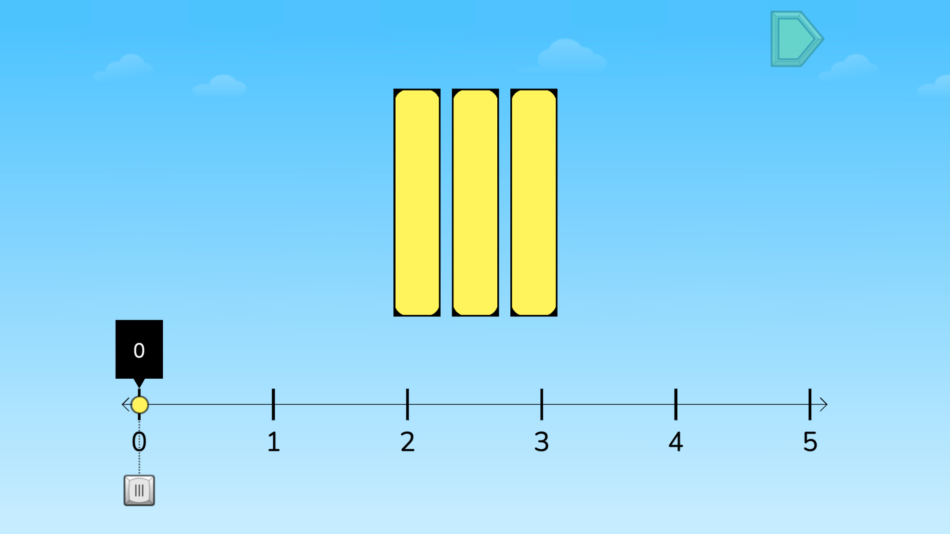
Módulo 3 - Día 3
Charla de rompecabezas
Hora de
RESOLVER PROBLEMAS!
Rompecabezas de ST Math:
Scale Fraction > Nivel 1
Objetivo de aprendizaje:
Resolver rompecabezas que impliquen dividir un rectángulo en áreas iguales
Enlace de rompecabezas
Notes:
Puzzle Talk
Focus on student thinking and developing problem solving skills using the Problem Solving Process.
Provide students with Fraction Number Lines Game Mat and whiteboards/dry erase markers.
Notice and Wonder
Display the first puzzle in level 1. Ask “What do you notice? What do you see on this number line? What do you wonder?” Allow a few students to share out.
Predict and Justify
Have some students share their predictions. Discuss.
Try one of the students’ strategies. Before trying the strategy, discuss it with the other students. Ask students if they agree or disagree with each other. Share students’ thinking as a whole class.
Test and Observe
Watch the feedback together and discuss what they saw.
Play the puzzle again choosing the same solution. Ask students, “How could you name the rectangles you see in this puzzle? How many whole numbers are on this number line? How has the number line been divided?”
Analyze and Learn
Show and have students solve other puzzles from level 1.
Now, show a puzzle from level 2. Have students discuss what they notice with a partner
On the Fraction Number Line Mat, use the 0 to 5 number line. Show another puzzle. Have students represent this puzzle on their game mat, asking “How do we show the unit fraction in the last bar on the number line? What is the denominator and numerator for this fraction?“
Discuss how they knew where to place the yellow ball.
Connect and Extend
Show a puzzle from level 3 and have students represent it on their game mat and solve it.
Ask students about their strategy (visualizing the bars moving on number line, writing numbers as a mixed number or fractions greater than 1, etc.).
How does the student
discuss strategies for finding the location on the number line?
count by unit fractions?
write numbers as fractions greater than one and mixed numbers?
determine the denominator for the unit fraction?
determine the numerator when it is not a unit fraction?

Slide 37
Módulo 3 - Día 3
Resolución
de problemas
Problema del Día
La madre de Jayla y Jayvon les hizo a cada uno un sándwich de crema de cacahuate para el almuerzo. Jayla cortó su sándwich en 4 pedazos del mismo tamaño y comió 2 de ellos. Jayvon cortó su sándwich en 2 pedazos del mismo tamaño y comió 1 de ellos. Jayla dice que ella comió más de su sándwich porque comió 2 pedazos. Jayvon no está de acuerdo. ¿Quién tiene razón? Justifica tu razonamiento.
Notes:
Problem of the Day
Engage students in problem solving discussions. Read and discuss the problem, share student work, compare strategies and make connections.
• Jayla’s and Jayvon’s mother made them each a peanut butter sandwich for lunch. Jayla cut her sandwich into 4 equal sized pieces and ate 2 of the pieces. Jayvon cut his sandwich in 2 equal sized pieces and ate one piece. Jayla said she ate more of her sandwich because she ate 2 pieces. Jayvon disagreed. Who is correct? Justify your reasoning.

Slide 38
Módulo 3 - Día 4
Mi camino de razonamiento
???
Lo que sé sobre la partición de un entero es ...
Lo que sé sobre la combinación de fracciones es...
One thing I learned is . . .
Una cosa que aprendí es. . .
A question I have is . . .
Una pregunta que tengo es. . .
This is like…
Esto es como…
This is not like….
Esto no es como…
I wonder…
Me pregunto…
Notes:
My Thinking Path
• Have students reflect on what they have learned about solving problems involving defining and partitioning one (whole) and combining unit fractions.

Slide 39
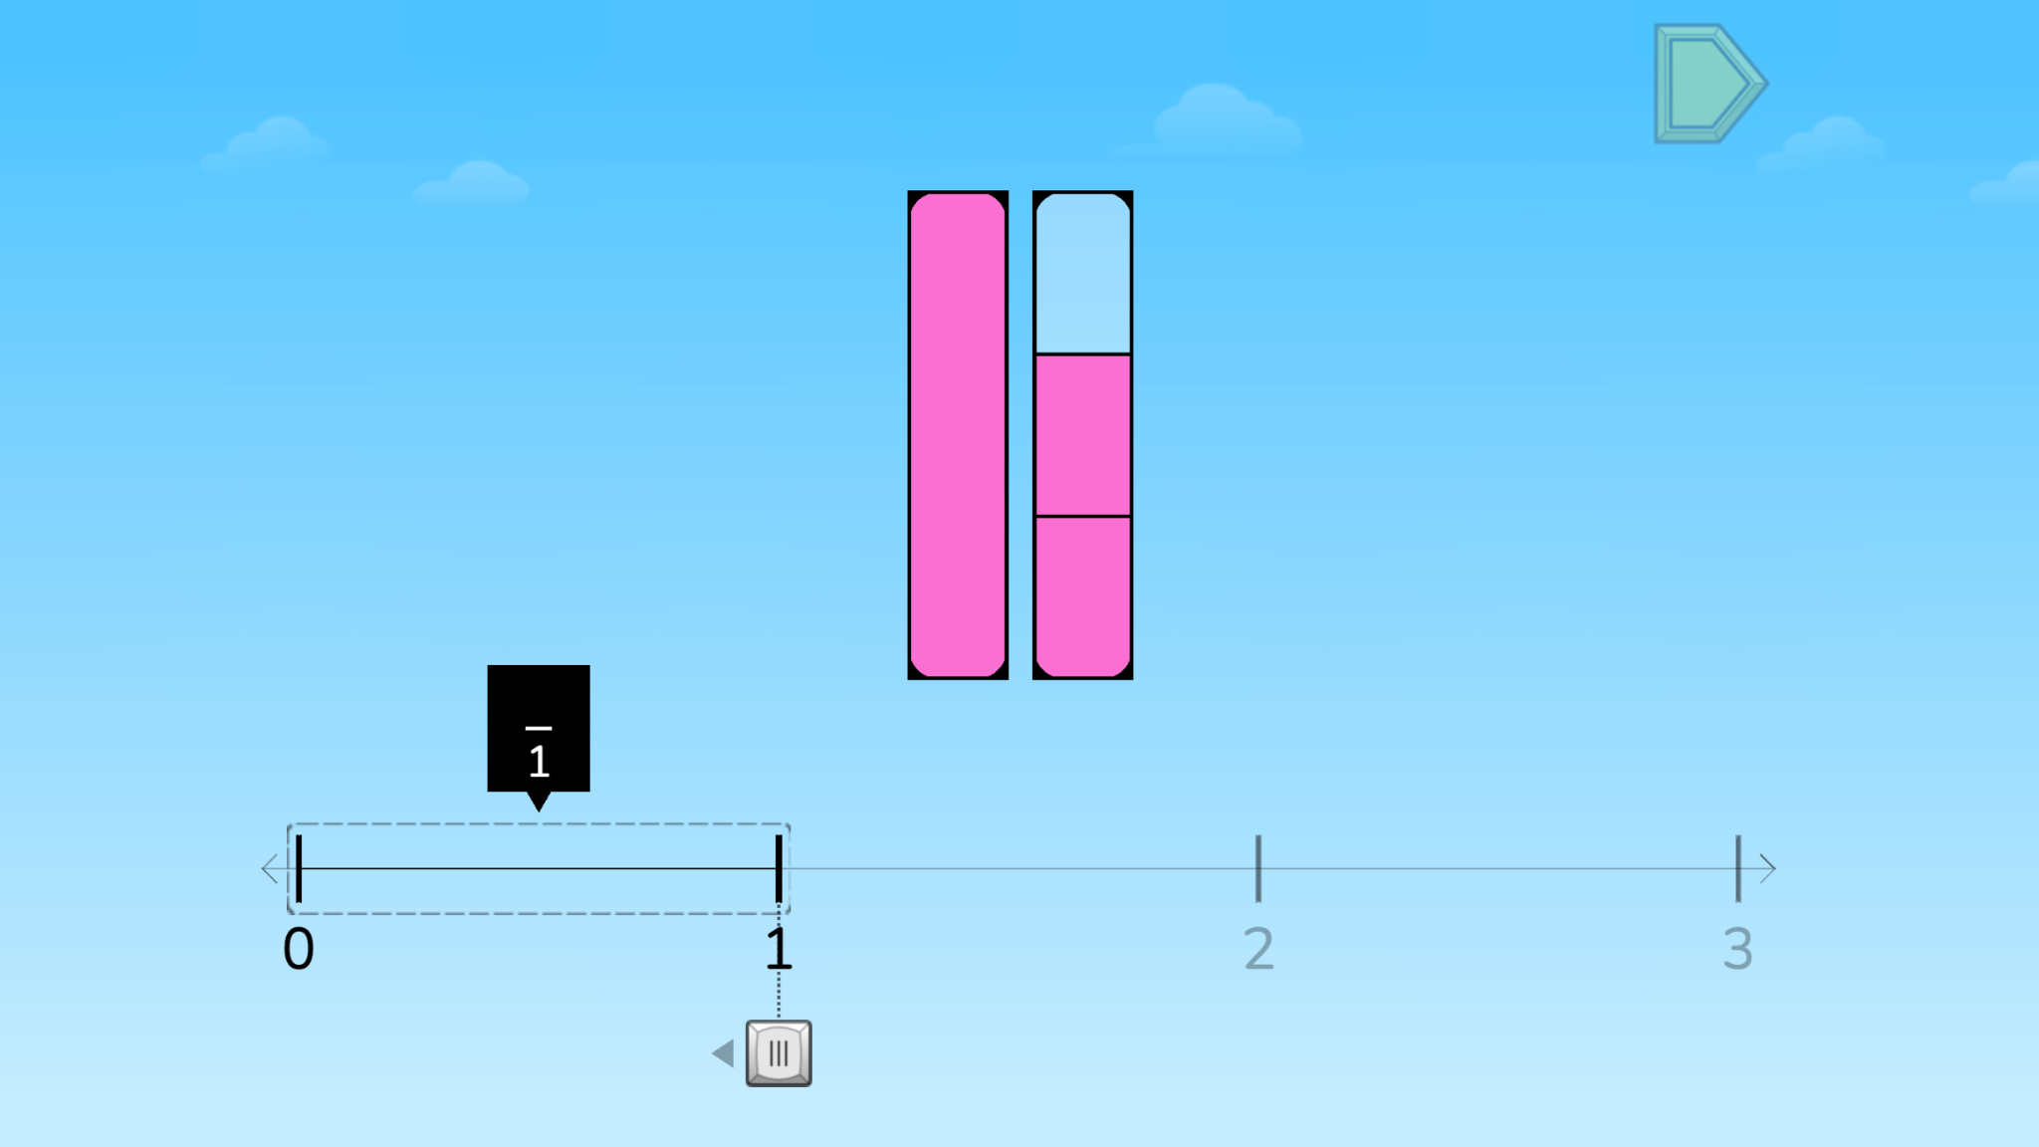
Módulo 3 - Día 4
Charla de rompecabezas
Hora de
RESOLVER PROBLEMAS!
Rompecabezas de ST Math:
Scale Fraction > Nivel 4
Objetivo de aprendizaje:
Resolver rompecabezas que impliquen dividir un rectángulo en áreas iguales
Enlace de rompecabezas
Notes:
Puzzle Talk
Provide students with whiteboards/dry erase markers.
It will be helpful to provide manipulatives during this talk (cubes, fraction strips, etc.).
Notice and Wonder
Display the first puzzle in level 1. Ask “What do you notice?” “What do you wonder?” “What do you think you need to do to solve this puzzle?” Allow a few students to share out how many pies the Pie Monster needs.
Predict and Justify
Have students Think-Pair-Share about what they would like to try, what will happen when they try it, and why they think it will work.
Ask the students to think about if they agree/disagree with the strategy and why. How does it relate to their own strategy?
Additional prompts:
What do you see on this number line?
How could you name the rectangles you see in this puzzle?
How many whole numbers are on this number line?
How has the number line been divided?
Test and Observe
Try a student’s solution and watch the feedback. Ask students to describe what happened.
Analyze and Learn
Ask students to think about how what they saw happen compares to their prediction. What did they learn from the feedback? How does this affect their strategy for solving the next puzzle?
What is the denominator for this fraction? Numerator? Why?
How did you determine where to place the yellow ball?
Connect and Extend
Show some more level 4 puzzles, and have students use their game mats to represent the puzzles.
Have student build a bar model from a puzzle that has fourths. They may use their fraction strips, connecting cubes, blocks, or Cuisenaire rods.
Discuss the different models.
Does one student’s model have to look like another student’s model?
Do all of the wholes in one student’s model have to be the same size?
How does the student
discuss strategies for finding the location on the number line?
count by unit fractions?
write numbers as fractions greater than one and mixed numbers?
determine the denominator for the unit fraction?
determine the numerator when it is not a unit fraction?

Slide 40
Módulo 3 - Día 4
Resolución
de problemas
Problema del Día
Ubica 3/4 en esta recta numérica. Sé lo más exacto posible.
Notes:
Problem of the Day
Engage students in problem solving discussions. Read and discuss the problem, share student work, compare strategies and make connections.
• Place 3/4 on this number line. Be as exact as possible.

Slide 41
Módulo 4
¡Aprendamos un poco más!

Slide 42
Módulo 4 - Día 1
Mi camino de razonamiento
Tema: Comparación de fracciones en una recta numérica
???
Lo que sé sobre comparar fracciones es…
Lo que sé sobre comparar fracciones en una recta numérica es…
One thing I learned is . . .
Una cosa que aprendí es. . .
A question I have is . . .
Una pregunta que tengo es. . .
This is like…
Esto es como…
This is not like….
Esto no es como…
I wonder…
Me pregunto…
Notes:
My Thinking Path
Have students write in the topic “Comparing fractions on a number line.”
Have students begin working on the My Thinking Path page.
Discuss their ideas and allow students to add to their paper any additional thoughts they have.
Have students complete the Pre-Quiz (optional).

Slide 43
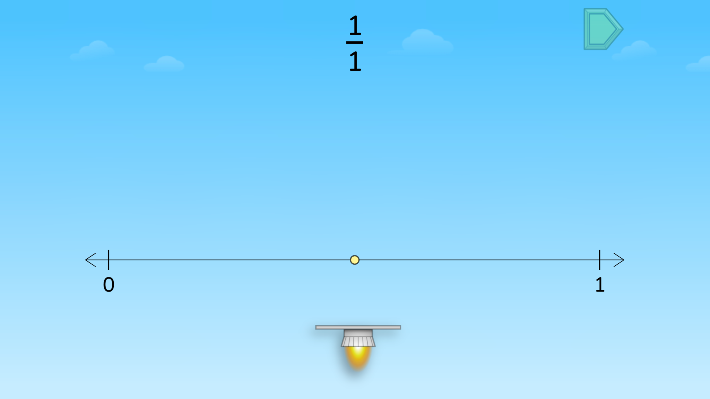
Módulo 4 - Día 1
Charla de rompecabezas
iHora de
RESOLVER PROBLEMAS!
Rompecabezas de ST Math:
Estimate Fractions on a Number Line > Nivel 1
Objetivo de aprendizaje:
Comparar fracciones en una recta numérica
Enlace de rompecabezas
Notes:
Puzzle Talk
Focus on student thinking and developing problem solving skills using the Problem Solving Process.
Provide students with Estimate Fractions Game Mat and whiteboards/dry erase markers.
Notice and Wonder
Display the first puzzle in level 1. Ask: What do you notice? What do you wonder? What do you think you need to do to solve this puzzle? Allow a few students to share out.
Predict and Justify
Have students make a prediction. After they have had some think time, have them Think-Pair-Share about what they would like to try, what will happen when they try it, and why they think it will work.
Have students share out their predictions and related strategy.
Test and Observe
Select one students’ strategy. Ask the students if they agree or disagree with the strategy and why. How does it relate to their own strategy?
Try a student’s solution and watch the feedback. Ask students to describe what happened.
Analyze and Learn
Show and have students solve other puzzles from level 1. Ask students: How do they know how many partitions to divide the number line into? (Denominator)
Give each student the Estimate Fractions Game Mat. Show a level 2 puzzle.
Connect and Extend
Have students represent this puzzle on their game mat by sliding the rocket over to the point on the number line, and discuss their reasoning with a partner.
Engage in discussions about benchmark fractions and students comparing/equivalent fractions, pausing the feedback when necessary. Chart different student responses to:
What does the denominator tell you? (How many equal parts there are between each whole.) The numerator? (How many jumps JiJi makes.)
How did you partition the number line? Why?
Where do you think this fraction is located? Why?
How do we know this is a unit fraction?
Show a puzzle in level 3. You may repeat the Problem Solving Process again for more practice, and ask additional clarifying questions, like “How is this number line different from the other number line?”
How does the student
discuss strategies for partitioning a number line into fractions?
define a unit fraction?
estimate the location of a number on a number line by counting by unit fractions?
discuss the role of the denominator in partitioning the number line?
discuss the role of the numerator to locate a number on the number line?
discuss the number of unit fractions that are equal to one?

Slide 44
Módulo 4 - Día 1
Resolución
de problemas
Problema del Día
Crea una recta numérica de 0 a 2 que incluya esos dos números y todas las mitades y cuartos. Nombra todas las mitades y cuartos. Encierra con un círculo todos los nombres de la ubicación 1 y 2. Explica por qué son equivalentes.
Notes:
Problem of the Day
Engage students in problem solving discussions. Read and discuss the problem, share student work, compare strategies and make connections.
• Create a number line including the numbers 0 to 2 and all halves and fourths. Name every half and fourth. Circle all of the names for the location of 1 and 2. Explain why these are equivalent.

Slide 45
Módulo 4 - Día 2
Mi camino de razonamiento
???
Lo que sé sobre comparar fracciones es…
Lo que sé sobre comparar fracciones en una recta numérica es…
One thing I learned is . . .
Una cosa que aprendí es. . .
A question I have is . . .
Una pregunta que tengo es. . .
This is like…
Esto es como…
This is not like….
Esto no es como…
I wonder…
Me pregunto…
Notes:
My Thinking Path
• Have students reflect on what they have learned about comparing fractions on a number line.

Slide 46
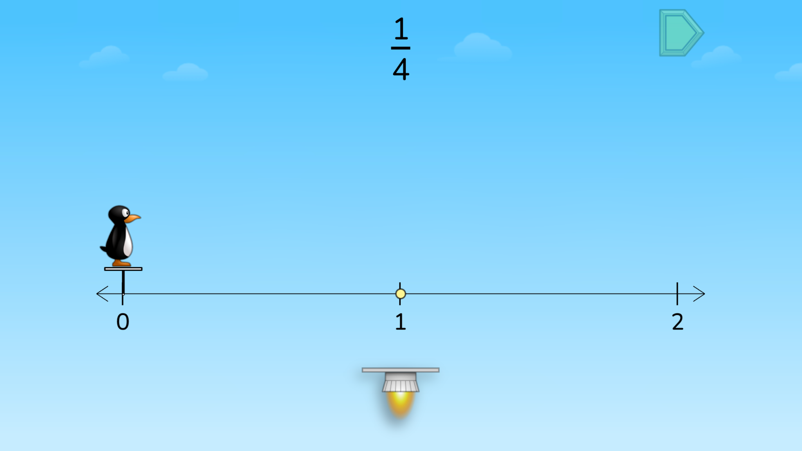
Módulo 4 - Día 2
Charla de rompecabezas
iHora de
RESOLVER PROBLEMAS!
Rompecabezas de ST Math:
Estimate Fractions on a Number Line > Nivel 4
Objetivo de aprendizaje:
Comparar fracciones en una recta numérica
Enlace de rompecabezas
Notes:
Puzzle Talk
Focus on student thinking and developing problem solving skills using the guiding questions in each step of the Problem Solving Process.
Provide students with paper or whiteboards/dry erase markers.
Notice and Wonder
Display the first puzzle in level 4 that has a fraction greater than 1. Have them reflect on the differences from yesterday’s puzzles and what they need to do to solve. Allow a few students to share out.
Ask students to draw a 0-2 number line like the one in the puzzle on their paper/whiteboard.
Ask: What do you notice about this fraction? What does it mean when the numerator is greater than the denominator? Where do you think this fraction would be placed on this number line? Why?
Predict and Justify
Have students make a prediction. After some think time, have them share with a partner their strategies and reasoning.
Have students share out their predictions and strategies as a whole group.
Test and Observe
Select one students’ strategy. Ask the students if they agree or disagree and why. How does it relate to their own? Have them turn and talk to a neighbor to discuss.
Try the student’s solution and watch the feedback. Ask students to describe what happened.
Analyze and Learn
Ask students: What did they learn from the feedback? How does this affect their strategy?
Show the next puzzle. Ask students to determine how to partition the number line.
Partition the number line to match the denominator and then count fraction pieces until you reach the fraction in the puzzle. Remind students that fractions, like numbers, go on forever, and don’t stop at 1.
Repeat with additional puzzles in level 4.
Connect and Extend
Display the first puzzle in level 5. Ask students to draw a 0-3 number line on their paper/whiteboard. Ask: How should we partition the number line? How do you know?
Use the denominator to divide the number line into equal parts. Then ask students, “How many of these equal pieces do we need?”
Use the numerator to count out the correct number of equal pieces.
Ask: Is this fraction greater than, less than, or equal to 1? How do you know?
Repeat with additional puzzles in level 5.
How does the student
visually partition the number line?
explain why do they partition the number line in this way?
determine where to place the rocket?

Slide 47
Módulo 4 - Día 2
Resolución
de problemas
Problema del Día
Usa tu recta numérica de ayer o crea una nueva. Escribe 3 declaraciones de comparación y pruébalos en la recta numérica. Ejemplo: 1 = 4/4 and 3/4 > 1/2.
Notes:
Problem of the Day
Engage students in problem solving discussions. Read and discuss the problem, share student work, compare strategies and make connections.
• Use your number line from yesterday or create a new one. Write 3 comparison statements and prove them on the number line. Example: 1 = 4/4 and 3/4 > 1/2.

Slide 48
Módulo 4 - Día 3
Mi camino de razonamiento
???
Lo que sé sobre comparar fracciones es…
Lo que sé sobre comparar fracciones en una recta numérica es…
One thing I learned is . . .
Una cosa que aprendí es. . .
A question I have is . . .
Una pregunta que tengo es. . .
This is like…
Esto es como…
This is not like….
Esto no es como…
I wonder…
Me pregunto…
Notes:
My Thinking Path
• Have students reflect on what they have learned about comparing fractions on a number line.

Slide 49
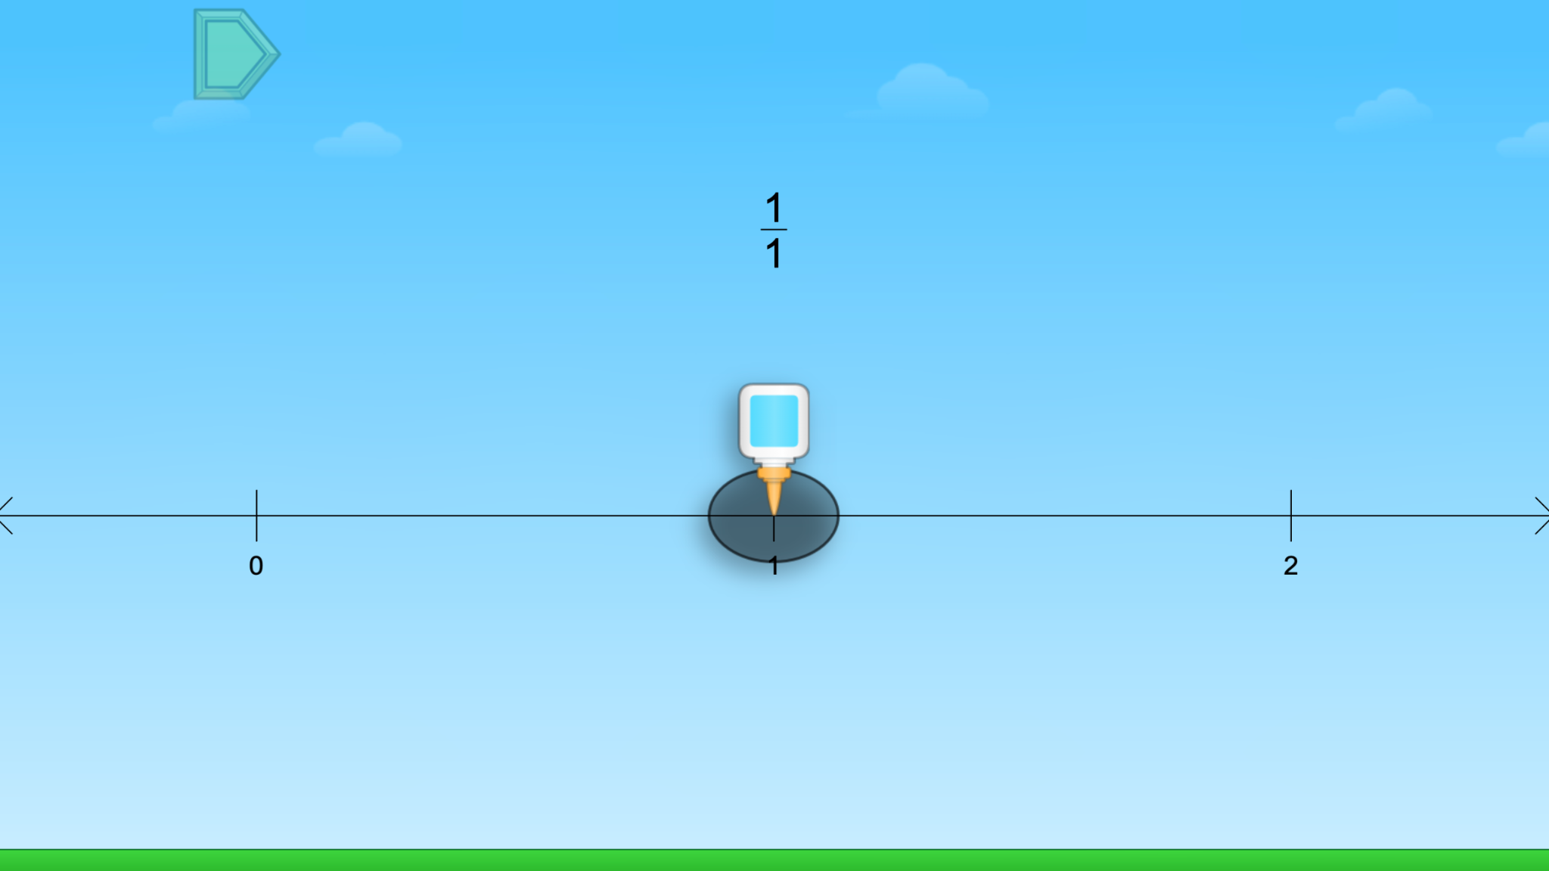
Módulo 4 - Día 3
Charla de rompecabezas
iHora de
RESOLVER PROBLEMAS!
Rompecabezas de ST Math:
Fraction Trap > Nivel 1
Objetivo de aprendizaje:
Comparar fracciones en una recta numérica
Enlace de rompecabezas
Notes:
Puzzle Talk
Focus on student thinking and developing problem solving skills using the Problem Solving Process.
Provide students with whiteboards/dry erase markers.
Notice and Wonder
Display the first puzzle in level 1. Ask “What do you notice?” “What do you wonder?” “What do you think you need to do to solve this puzzle?” Allow a few students to share out.
Predict and Justify
Have students make a prediction. After they have had some think time, have them Think-Pair-Share about what they would like to try, what will happen when they try it, and why they think it will work.
Have students share out their predictions and related strategy.
Select one students’ strategy. Ask the students to think about if they agree/disagree with the strategy and why. How does it relate to their own strategy?
Test and Observe
Try a student’s solution and watch the feedback. Ask students to describe what happened.
Analyze and Learn
Ask students to think about how what they saw happen compares to their prediction. What did they learn from the feedback? How does this affect their strategy?
Display the next puzzle in level 1. Ask students to draw a 0-2 number line to match the one in the puzzle.
Ask: What do you notice? What do you wonder? What do you know about the fraction in this puzzle? Have students Think, Pair, Share their thinking with a partner.
Share students’ thinking and solutions (e.g., drawing on their number line).
Connect and Extend
Try a student’s solution for a new puzzle and watch the feedback.
Ask students:
What do you know about this number line?
How is it different from the number line in the last puzzle?
How do we represent 1 on this number line?
What does the denominator tell us? The numerator?
Repeat with additional puzzles in level 1.
Ask students questions about the variety of fractions that show up in the puzzles. For example, “What does a numerator of 0 tell us?” “What does a numerator of 1 tell us?” “How do we know a fraction is greater than 1?”
How does the student
discuss the role of the numerator and denominator in locating a fraction on the number line?
create and partition a number line to locate fractions?
count fraction parts to place a number on a number line?
represent 1 as a fraction on a number line?
compare number lines?

Slide 50
Módulo 4 - Día 3
Resolución
de problemas
Problema del Día
5/6, 3/4, 2/3, y 10/9. Selecciona el número más cerca de 1. Dibuja una recta numérica y colócalo en ella. Explica cómo sabías que ese número es el más cerca de 1. Explica cómo sabías dónde ubicar el número en la recta numérica.
Notes:
Problem of the Day
Engage students in problem solving discussions. Read and discuss the problem, share student work, compare strategies and make connections.
• 5/6 3/4 2/3 10/9 Select the number closest to 1. Draw a number line and place it on your number line. Explain how you knew this number was closest to 1. Explain how you knew where to place the number on the number line.

Slide 51
Módulo 4 - Día 4
Mi camino de razonamiento
???
Lo que sé sobre comparar fracciones es…
Lo que sé sobre comparar fracciones en una recta numérica es…
One thing I learned is . . .
Una cosa que aprendí es. . .
A question I have is . . .
Una pregunta que tengo es. . .
This is like…
Esto es como…
This is not like….
Esto no es como…
I wonder…
Me pregunto…
Notes:
My Thinking Path
• Have students reflect on what they have learned about comparing fractions on a number line.

Slide 52
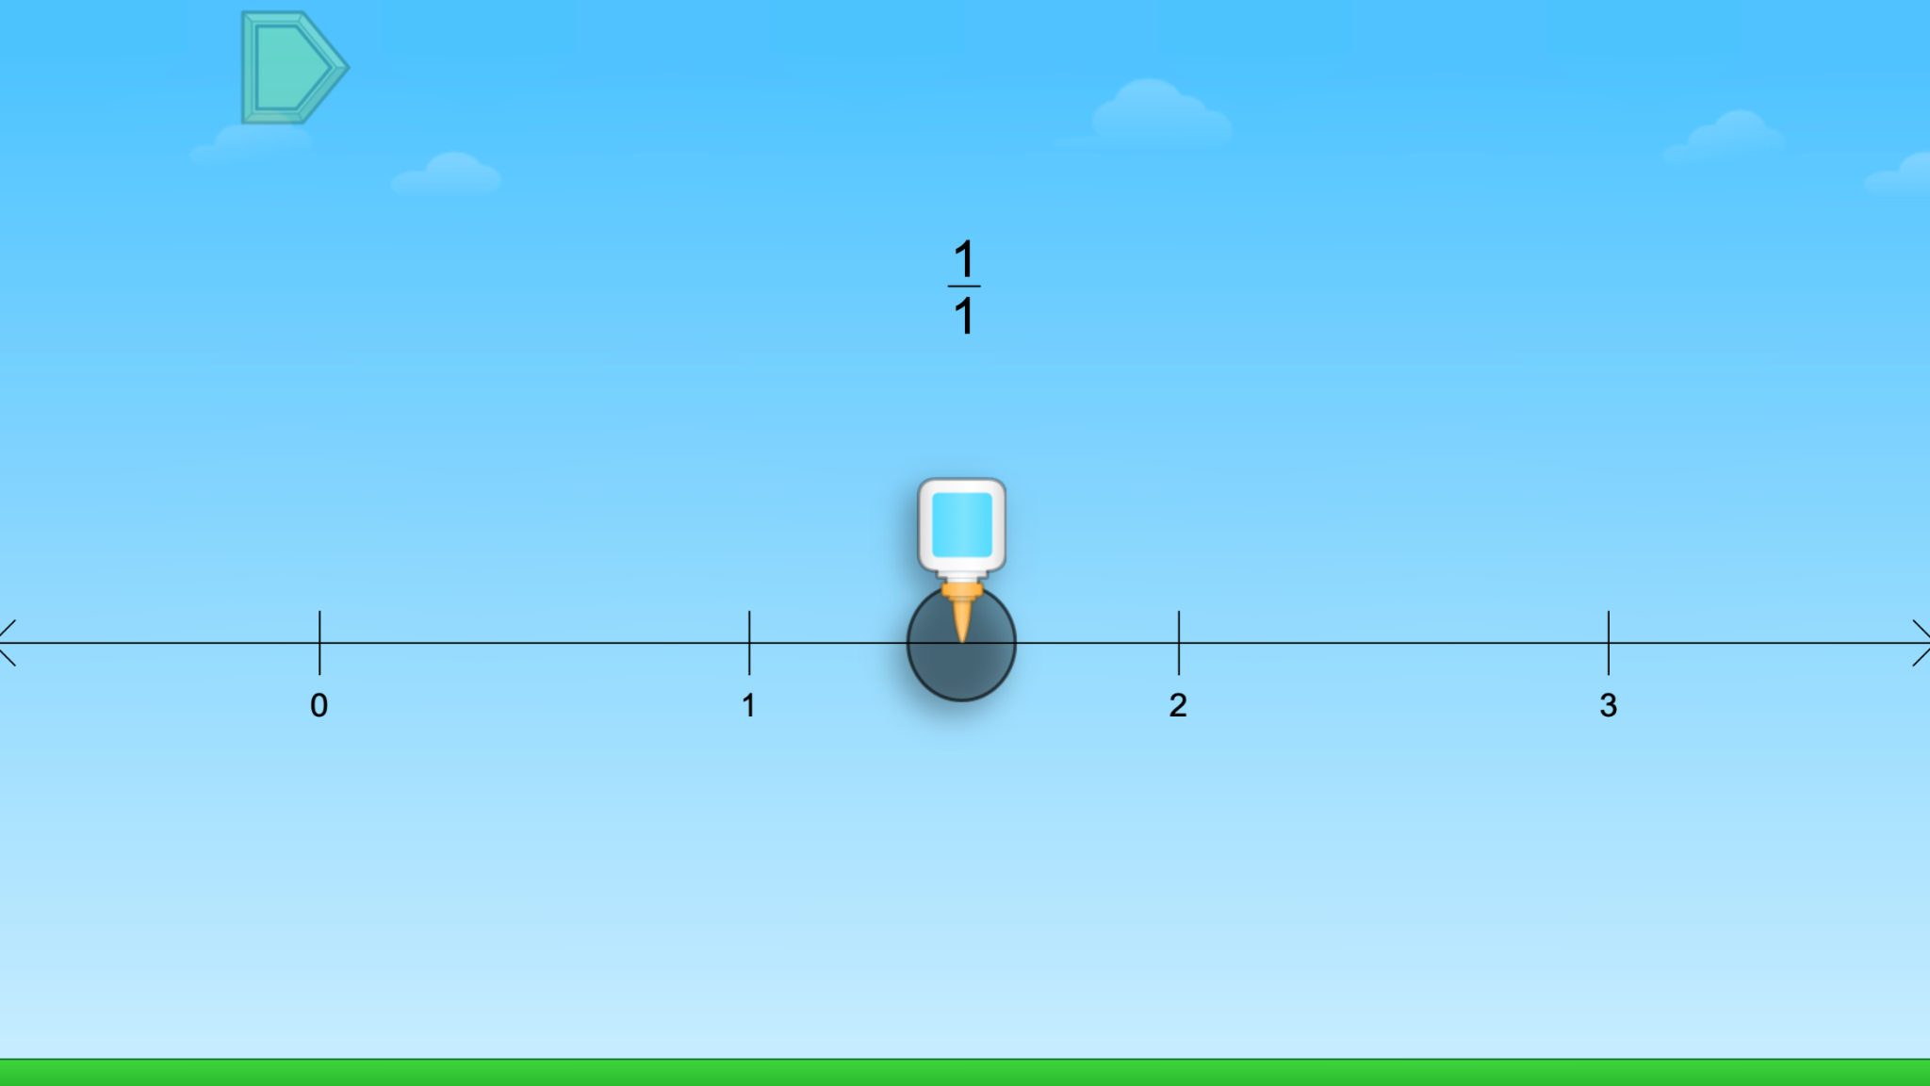
Módulo 4 - Día 4
Charla de rompecabezas
iHora de
RESOLVER PROBLEMAS!
Rompecabezas de ST Math:
Fraction Trap > Nivel 2
Objetivo de aprendizaje:
Comparar fracciones en una recta numérica
Enlace de rompecabezas
Notes:
Puzzle Talk
Focus on student thinking and developing problem solving skills using the Problem Solving Process.
Provide students with whiteboards/dry erase markers.
Notice and Wonder
Display the first puzzle in level 2. Ask “What do you notice that is similar/different to the puzzles we did yesterday?” Is this fraction greater than, less than or equal to 1? How do you know?”
Allow a few students to share out.
Predict and Justify
Have students make a prediction. After they have had some think time, have them Think-Pair-Share about what they would like to try, what will happen when they try it, and why they think it will work.
Have students share out their predictions and related strategy.
Select one students’ strategy. Ask the students to think about if they agree/disagree with the strategy and why. How does it relate to their own strategy?
Test and Observe
Try a student’s solution and watch the feedback. Ask students to describe what happened.
Analyze and Learn
Display the next puzzle in level 2. Ask students: What do you know about the fraction in this puzzle? What do you know about this number line? How is it different from the number line in the last puzzle? “
º Have students change the number line on their paper/whiteboards to match the puzzle.
Solve the puzzles in level 2, asking the same types of questions from level 1.
Display the first puzzle in level 3.
Ask: How has the number line changed? How does this change our answers? How long could the number line get? Discuss with students that as the number line extends to bigger numbers, the spaces between our whole numbers get smaller.
Connect and Extend
Ask: Is ½ in the same location on the first number line we used (0-2) as it is on this number line (0-5)? Does the size of our number line affect the size of the fraction pieces? Why or why not?
Have some students think silently first, and then take some responses to share whole group.
Explain that the location of ½ doesn’t change- it’s still halfway between 0 and 2- but the size of the ½ has gotten smaller because the size of the wholes on the number line have gotten smaller. Use an example to help the discussion like, “If we had 1/2 of a cookie or 1/2 of a pizza, they wouldn't be the same size because the wholes are different sizes.”
Solve additional puzzles in level 3.
How does the student
discuss the role of the numerator and denominator in locating a fraction on the number line?
create a and partition a number line to locate fractions?
count fraction parts to place a number on a number line?
represent 1 as a fraction on a number line?
compare number lines?

Slide 53
Módulo 4 - Día 4
Resolución
de problemas
Problema del Día
7/6, 1/4, 3/8 y 8/9. Selecciona el número más cerca de 1/2. Dibuja una recta numérica y colócalo en ella.
Explica cómo sabías que ese número es el más cerca de 1/2. Explica cómo sabías dónde ubicar el número en la recta numérica.
Notes:
Problem of the Day
Engage students in problem solving discussions. Read and discuss the problem, share student work, compare strategies and make connections.
• 7/6, 1/4, 3/8, 8/9 Select the number closest to 1/2. Draw a number line and place it on your number line. Explain how you knew this number was closest to 1/2. Explain how you knew where to place the number on the number line.

Slide 54
Módulo 5
¡Vamos a ver las matemáticas cobrar vida!

Slide 55
Módulo 5 - Día 1
Mi camino de razonamiento
Tema: Comparación de fracciones y fracciones equivalentes
???
Lo que sé sobre comparar fracciones es…
Lo que sé sobre fracciones equivalentes es...
One thing I learned is . . .
Una cosa que aprendí es. . .
A question I have is . . .
Una pregunta que tengo es. . .
This is like…
Esto es como…
This is not like….
Esto no es como…
I wonder…
Me pregunto…
Notes:
My Thinking Path
Have students write in the topic “Comparing fractions and equivalent fractions.”
Have students begin working on the My Thinking Path page.
Discuss their ideas and allow students to add to their paper any additional thoughts they have.
Have students complete this Pre-Quiz (optional).

Slide 56
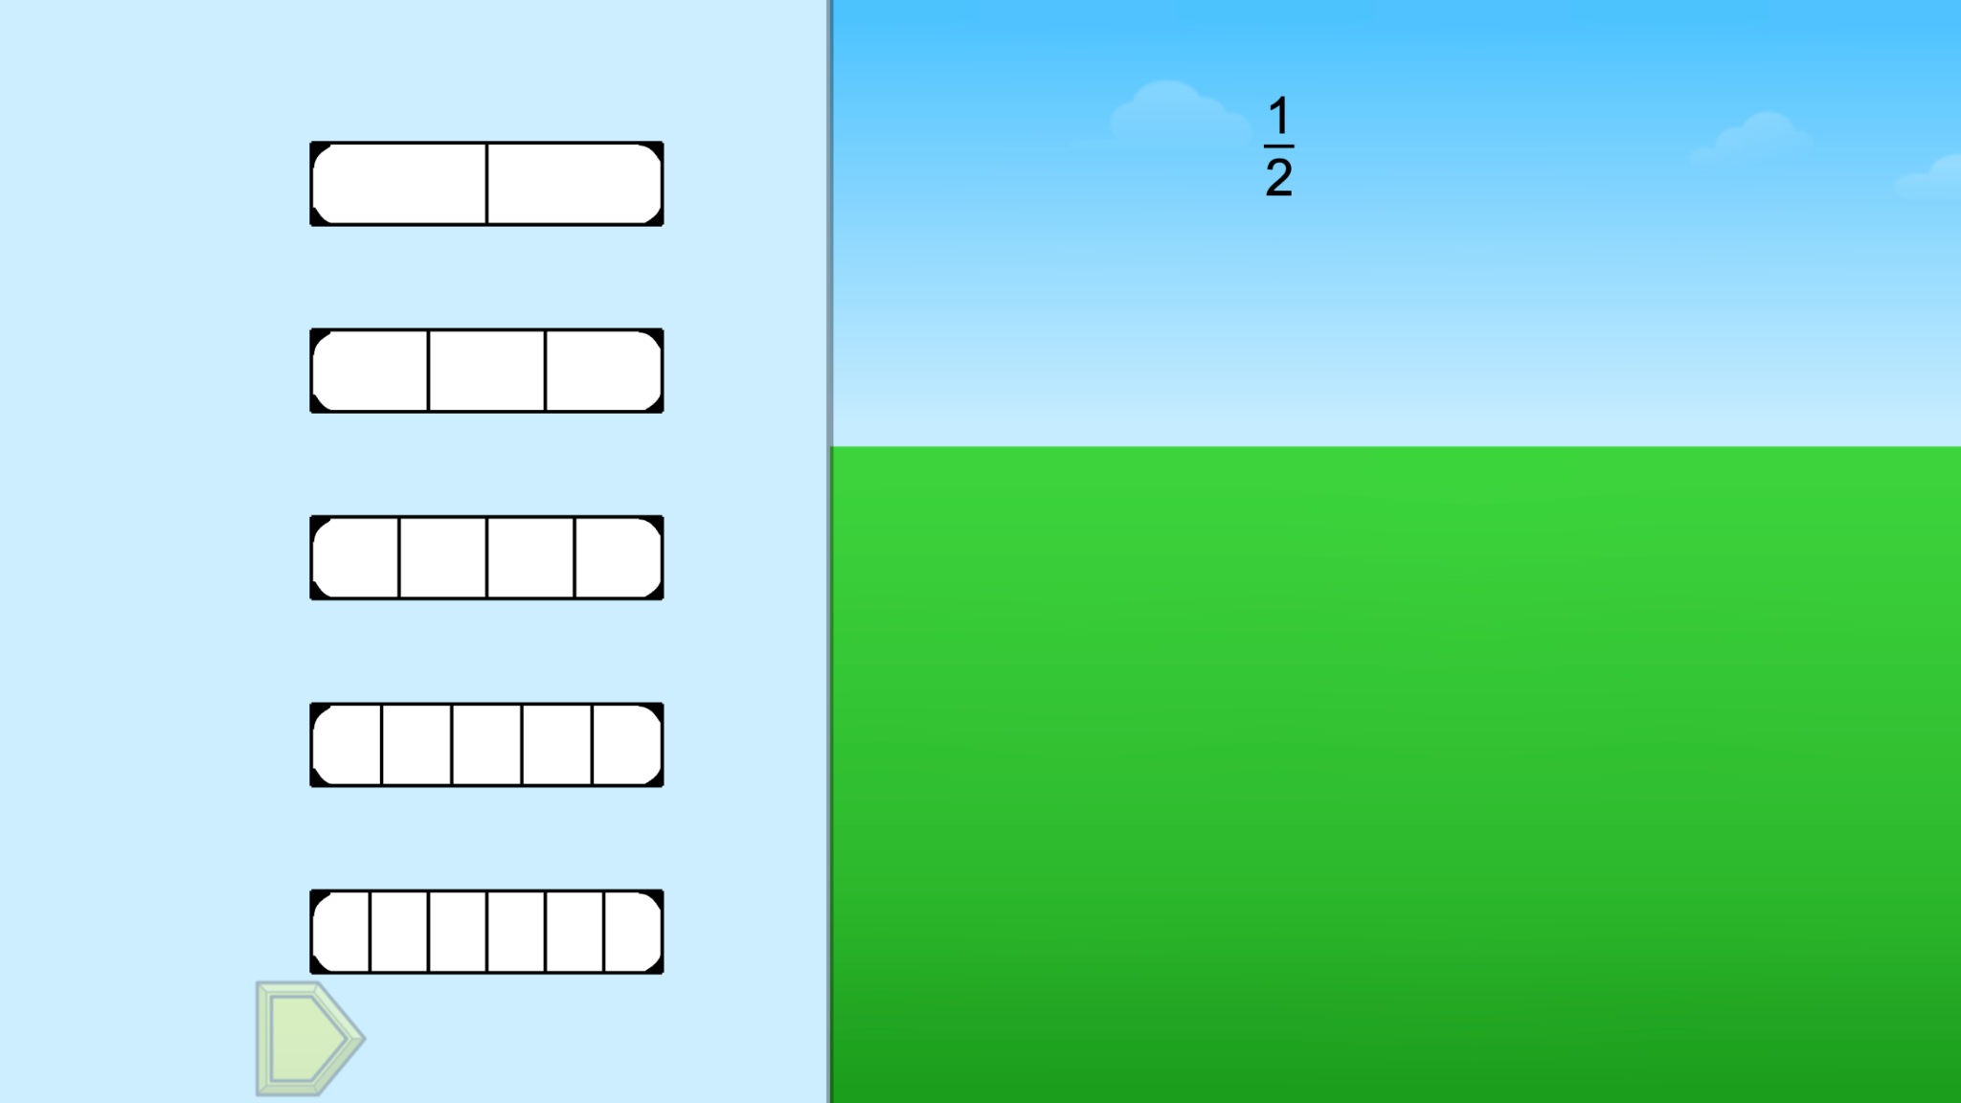
Módulo 5 - Día 1
Charla de rompecabezas
iHora de
RESOLVER PROBLEMAS!
Rompecabezas de ST Math:
Fraction Bricks > Nivel 1
Objetivo de aprendizaje:
Comparar de fracciones y fracciones equivalentes
Enlace de rompecabezas
Notes:
Puzzle Talk
Focus on student thinking and developing problem solving skills using the Problem Solving Process.
Provide students with paper or whiteboards/dry erase markers.
Notice and Wonder
Display the first puzzle in level 1. Ask “What do you notice about the fraction in the sky?” “How do we fill in the hole?” Allow a few students to share out.
Predict and Justify
Have students make a prediction. After they have had some think time, have them Think-Pair-Share about what they would like to try, what will happen when they try it, and why they think it will work.
Have students share out their predictions and related strategy.
Select one students’ strategy. Ask the students to think about if they agree/disagree with the strategy and why. How does it relate to their own strategy?
Test and Observe
Try a student’s solution and watch the feedback. Prompt students to describe what happened, and ask them “What does it mean if two fractions are equivalent?”
Analyze and Learn
Play the same puzzle again to highlight equivalent fractions, and say to students, “Is there another fraction that is equal to this fraction?” “Can you figure out which fraction will fill this hole too?”
Ask students to record the solution on their paper/whiteboards by writing a number sentence using the equal sign (e.g., 2/4 = ½ = 3/6).
If the puzzle has more equivalent fractions, have students share out the missing fractions. Discuss the name of each fraction as they are added to the hole. Record the comparisons.
Display the first puzzle in level 2. Ask students to write down the fraction they think will fill the hole.
Connect and Extend
Ask students to then write down a fraction that is less than the fraction shown and turn to their partner to share their fraction.
Share some students' solutions with the whole group.
Ask students to then write down a fraction that is greater than the fraction shown and turn to their partner to share their fraction.
Share some students’ solutions and prove they are correct.
Choose one puzzle from Nivel 2. Have students draw a number line and place the given fraction on the number line. Ask students:
How did you know where to place this fraction on the number line?
Why are equivalent fractions at the same spot on the number line?
How does the student
name each fraction before selecting it to fill the hole?
determine an equivalent fraction?
compare two fractions?
write equations to show equivalence?
discuss the numerator and denominator of each fraction
place equivalent fractions on a number line?

Slide 57
Módulo 5 - Día 1
Resolución
de problemas
Problema del Día
Kiesha, Horatio e Iris querían ver qué auto de juguete llegaba más lejos. Hicieron una pista larga y la marcaron en cada cuarto de pie. El auto de Kiesha recorrió 13/4 pies, el auto de Horatio recorrió 10/4 pies y el de Iris recorrió 17/4 pies. ¿Qué auto recorrió más distancia? ¿Cuál fue el orden de los autos?
Notes:
Problem of the Day
Engage students in problem solving discussions. Read and discuss the problem, share student work, compare strategies and make connections.
• Kiesha, Horatio, and Iris were seeing whose toy car would roll the farthest. They made a long track and marked it every fourth of a foot. Kiesha’s car rolled 13/4 foot. Horatio’s car rolled 10/4 foot. Iris’s car rolled 17/4 foot. Whose car rolled the farthest? What was the order of the cars?

Slide 58
Módulo 5 - Día 2
Mi camino de razonamiento
???
Lo que sé sobre comparar fracciones es…
Lo que sé sobre fracciones equivalentes es...
One thing I learned is . . .
Una cosa que aprendí es. . .
A question I have is . . .
Una pregunta que tengo es. . .
This is like…
Esto es como…
This is not like….
Esto no es como…
I wonder…
Me pregunto…
Notes:
My Thinking Path
• Have students reflect on what they have learned about comparing fractions and equivalent fractions.

Slide 59
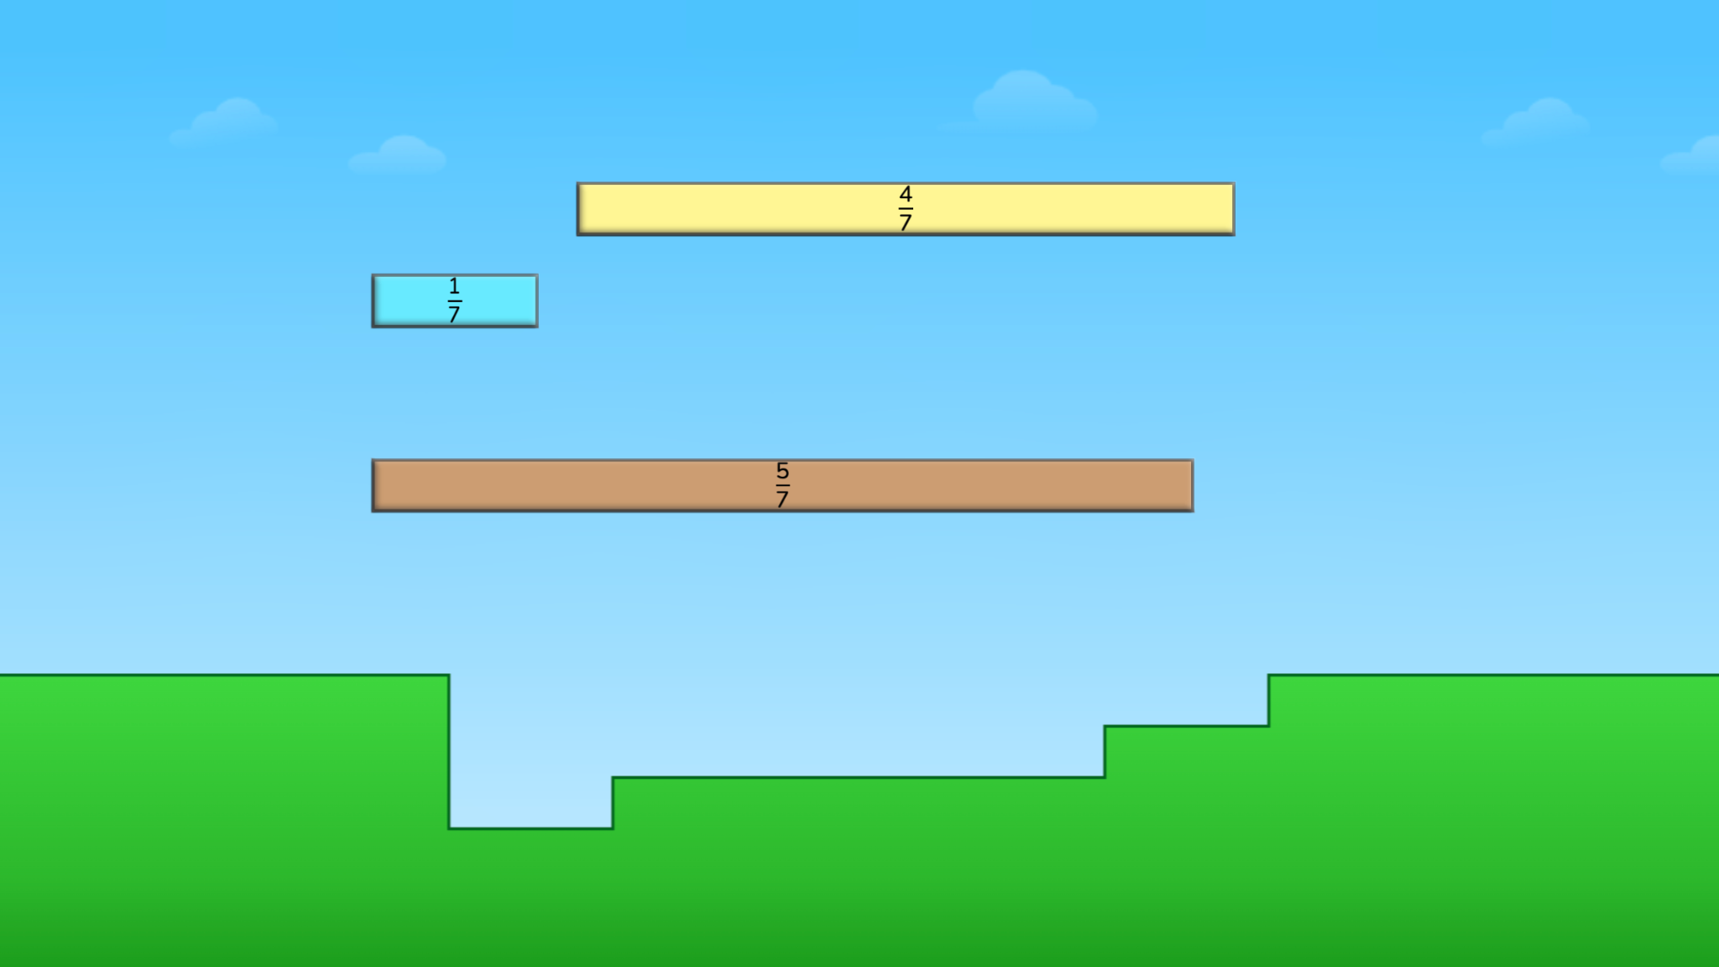
Módulo 5 - Día 2
Charla de rompecabezas
iHora de
RESOLVER PROBLEMAS!
Rompecabezas de ST Math:
Fraction Order Fill > Nivel 1
Objetivo de aprendizaje:
Comparar de fracciones y fracciones equivalentes
Enlace de rompecabezas
Notes:
Puzzle Talk
¤ Focus on student thinking and developing problem solving skills using the Problem Solving Process.
Notice and Wonder
• Display the first puzzle in Level 1. Ask “What do you notice?” “What do you wonder?” “What do you know about the three fractions in the puzzle?” Allow a few students to share out.
Predict and Justify
Have students make a prediction. After they have had some think time, have them Think-Pair-Share about what they would like to try, what will happen when they try it, and why they think it will work.
Have students share out their predictions and related strategy.
Select one students’ strategy. Ask the students to think about if they agree/disagree with the strategy and why. How does it relate to their own strategy?
Test and Observe
Try a student’s solution and watch the feedback. Ask students to describe what happened using these questions:
How can you use the numerator to help compare these fractions?
How can you use the denominator to help compare the fractions?
Analyze and Learn
What did they learn from the feedback? How does this affect their strategy?
Show the next puzzle. Ask students, “If all of these fractions have the same denominator, how can we use the numerator to compare them?”
Have students Think, Pair, Share with a partner and record the order of the fractions from least to greatest on their whiteboards. Try a student’s solution and watch the feedback.
Pause the puzzle before JiJi crosses the screen. Ask the students “How can you use what you know about 1 to order these fractions?” “How can you compare fractions with different denominators?”
Connect and Extend
Have students order fractions by writing number sentences. Discuss students’ strategies (e.g., Did they change the 1 to a fraction? Represent the fraction with a denominator of 1? Did they make a model to find a common denominator?).
Say to students, “How could we represent our solution to this puzzle using a number sentence?” Model how to write a number sentence using <, > and/or =.
Repeat the questioning and number sentences for a few puzzles in Nivels 1 and 2.
Choose one puzzle from Nivel 2 and have students draw a number line and place the three fractions on the number line. Ask students to explain how they compared fractions using a number line.
Display the first puzzle in Nivel 4, asking students, “What is different about this puzzle and the other puzzles we have solved?” How can you represent your solution to this puzzle using a number sentence?
Students should note that now the puzzles do not all have like numerators or denominators.
Have students share out their strategies for comparing the fractions (e.g., Did they use an equivalent fraction? Did they decide if one of the fractions was closer to 0, ½ or 1?, etc. Did they visualize where each fraction landed by looking at the empty spaces on the grass? Did they draw a number line?) Celebrate creative strategies whenever possible.
How does the student
discuss the role of the numerator to compare fractions and order them from least to greatest?
discuss the role of the denominator to compare fractions and order them from least to greatest?
represent the solution by writing a number sentence?
determine where to place the three fractions on a number line?

Slide 60
Módulo 5 - Día 2
Resolución
de problemas
Problema del Día
Carlos, Lionel, Jamal y Jane compararon la cantidad de leche que bebieron en el almuerzo. Carlos bebió 3/4 de su leche, Lionel bebió 1/4 de su leche, Jamal no bebió nada y Jane bebió 1/2 de su leche. Compara la fracción de leche que bebió cada niño y ordénalos de quien bebió más leche a quien bebió menos.
Notes:
Problem of the Day
Engage students in problem solving discussions. Read and discuss the problem, share student work, compare strategies and make connections.
• Carlos, Lionel, Jamal, and Jane compared the amount of milk they each drank at lunch. Carlos drank 3/4 of his milk, Lionel drank 1/4 of his milk, Jamal didn’t drink any milk, and Jane drank 1/2 of her milk. Compare the fraction of milk each person drank and put them in order from most to the least amount of milk each person drank.

Slide 61
Cartel de reflexión
Las diapositivas 62-63

Slide 62
¡Hora de
REFLEXIÓN!
VAMOS A HACER LLUVIA DE IDEAS
¿Qué conceptos matemáticos aprendiste este verano?
¿Qué vocabulario nuevo aprendiste?
¿Qué estrategias usaste cuando te quedaste atascado(a)?
¿Cómo te convertiste en un mejor
matemático(a)?
Notes:
DAY 3 - Reflection Poster

Slide 63
¡Hora de
REFLEXIÓN!
DISEÑAR UN CARTEL DE REFLEXIÓN
¡Comparte lo que sabes!
¿Qué conceptos matemáticos aprendiste este verano?
¿Qué vocabulario nuevo aprendiste?
¿Qué estrategias usaste cuando te quedaste atascado(a)?
¿Cómo te convertiste en un mejor
matemático(a)?
Haz que tus carteles sean
coloridos, interesantes e informativos.
Notes:
DAY 3 - Reflection Poster

Slide 64
Diseño de mini juegos matemáticos
Usa las diapositivas 65-69 si estás usando el programa de verano Inmersión de 4 Días

Slide 65
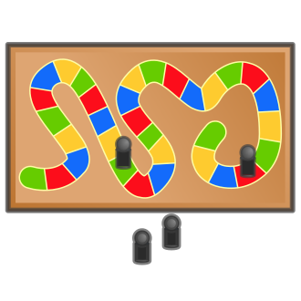
¡Vamos a crear un juego como los que jugaste este verano!
Notes:
DAY 3 - Mini Math Game Design (4-Day Summer Immersion only)

Slide 66
¡Vamos a hacer una lluvia de ideas!
¿Cuáles son algunos de los juegos que conoces?
¿Puedes pensar en cómo podrías poner las matemáticas en el juego?
¿Puedes pensar en un juego que te gustaría hacer que sea como los que conoces?
Notes:
DAY 3 - Mini Math Game Design
What are some games you know? Make a list.
From the list, decide which type of game you are going to recreate.

Slide 67
Tu juego nuevo
Cuando haces un nuevo juego, ¿qué conceptos matemáticos puedes incluir?
___ sumar
___ restar
___ formas
___ dinero
___ rompecabezas
___ hora
___ medir
___ estimación
___ el valor posicional
___ otra cosa?
Notes:
DAY 3 - Mini Math Game Design
What math concepts can you include in your game?

Slide 68
Tu nuevo juego
¿Puedes crear un juego para enseñar
o practicar un concepto matemático?
¿Cómo se llama tu juego?
¿Cuántos jugadores puedes tener?
¿Cuáles son las instrucciones y reglas para tu juego?
Notes:
DAY 3 - Mini Math Game Design
How can you make a game to teach or practice a math concept? Think about how the game will help all players develop mathematical reasoning.
Create a name for your game.
Decide how many players can play.
What are the rules and directions for your game? Make sure your rules are clear and concise.

Slide 69
¡Ahora es el tiempo de hacer un nuevo juego!
Trabajen juntos para hacer un juego que sus amigos querrán jugar.
Notes:
DAY 3 - Mini Math Game Design
Students will work in small groups to create a game. Provide them with the supplies needed. The list below are samples of items that could be used.
Dice or number cubes
Construction paper
Scissors
Poster board
Manilla folders
Index Cards
Egg cartons*
Water bottles*
Pizza circles*
Paper towel rolls*
Buttons*
Other creative items

Slide 70
Las diapositivas de exhibición de aprendizaje y celebración

Slide 71
B
ienvenidos
a
La Inmersión de ST Math
Exhibición de aprendizaje
y Celebración!
Notes:
Welcome to Learning Showcase and Celebration!
Why are we here?
Today is the last of the ST Math Summer Immersion! The Learning Showcase and Celebration is about providing students an opportunity to “show what they know.” Our students have been learning throughout the summer and will be sharing the information they have learned.
We we have invited you all to to celebrate and hear from students about what they learned. Don’t forget to use the Immersion Debriefing Bookmarks to ask questions.

Slide 72
PROGRAMA (Muestra)
10:00 am - Bienvenidos
Galería paseo de los carteles
10:15 am - Presentación
10:30 am - Hora de interrogatorio
11:00 am - Hora de jugar
11:30 am - Fin
Notes:
Sample Framework
You can make changes that work for their space. Consider how you will set up the learning showcase (grade level celebration, grade band celebration, whole school celebration). Divide the time you set aside with the following activities below:
Welcome: Introduce yourself. Share an overview of what the students did and why they are having a Learning Showcase and Celebration. We want this to be a positive and fun experience for the students.
Gallery Walk of Posters: It is recommended that the posters be hung around the room. Invite guests/classmates to walk around the room, look at the reflection posters and ask questions.
Presentations: Students summarize and present their math game design (completed during the program) and their reflection posters.
Immersion Debriefing Time: During this time, students will be asked questions about the work they did. Print and distribute the ST Math Immersion Debriefing Bookmark to visitors (which is optional). Encourage them to use it to ask students questions about their projects and what they have learned.
Game Time: Set aside time for visitors to play the games created by the students. This is a great time for students to play each other's games as well.
Note: We recommend giving students encouragement notes throughout the program.

