Slide 1
Problem Solving Slide Deck
Grade 3
Notes:
© 2024 MIND Education. All rights reserved. v1.1

Slide 2
Module 1
Let’s get started on the fun!

Slide 3
Module 1 - Day 1
Who is JiJi?
New to ST Math?
Guided Intro
Notes:
USE THIS SLIDE IF YOUR STUDENTS ARE NEW TO ST MATH
Choose one of the following ways to introduce ST Math to your students:
Show students the Guided Intro and/or Intro Video [English] [Spanish]

Slide 4
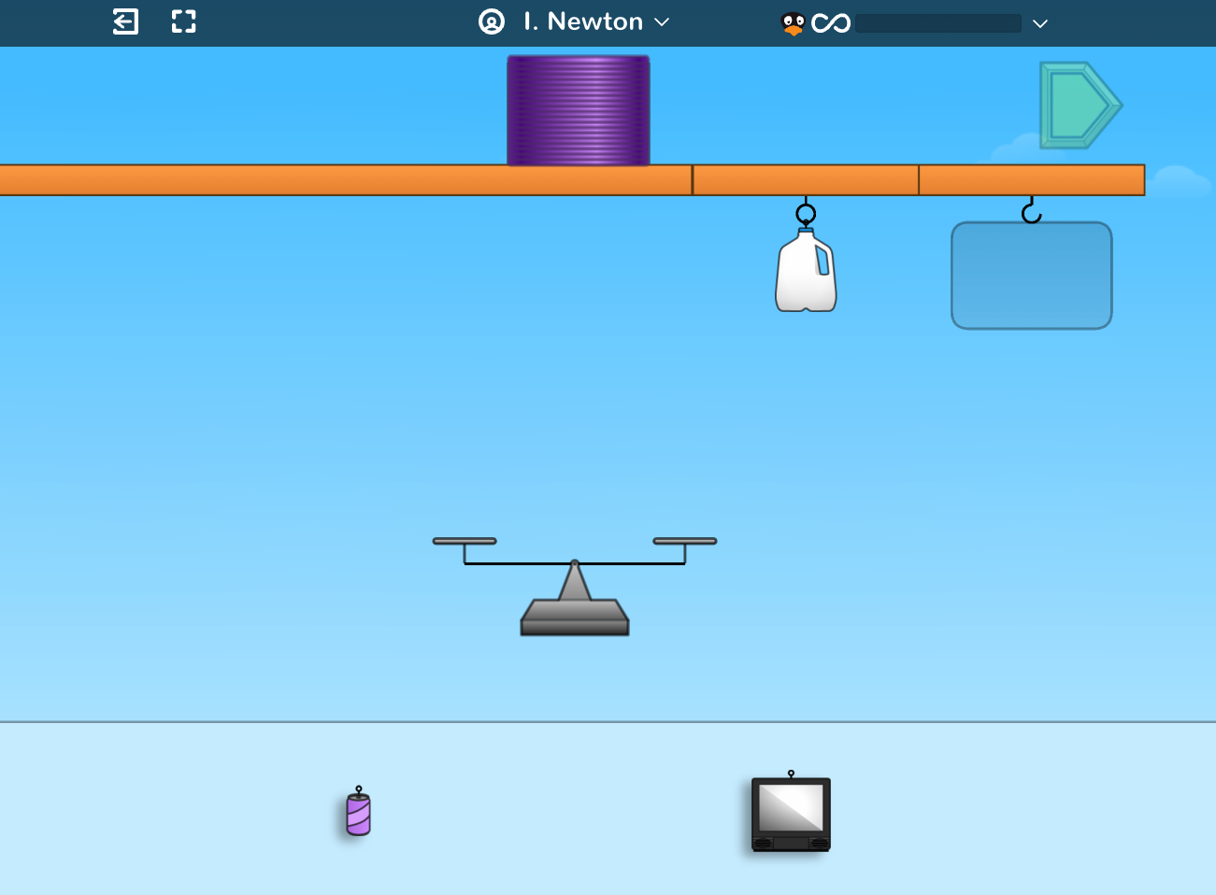
Module 1 - Day 1
New to ST Math?
Play the Slinky game
Notes:
USE THIS SLIDE IF YOUR STUDENTS ARE NEW TO ST MATH
Choose one of the following ways to introduce ST Math to your students:
Show students the Guided Intro and/or Intro Video [English] [Spanish]
Play the Slinky game with your students. During game play explain that ST Math is a program that teaches math in a very different way.
Encourage students to look at the visual models on the screen and determine what they think they should do.
Point out the things that are clickable and that clicking on the sky makes the clickable parts shimmer.
Show them how to pause the animation to slow down the feedback.
Make sure students understand that they have to complete all the puzzles in a level before moving on to the next.
Ask students if ST Math reminds them of other math programs. Why or why not?

Slide 5
Module 1 - Day 1
Share ST Math Experience!
What do you know about ST Math?
What do you like about ST Math?
What is your favorite ST Math game? Why?
One ST Math tip I have is . . .
A question I have is . . .
My ST Math Goal is . . .
I’m wondering about . . .
Notes:
USE THIS SLIDE IF YOUR STUDENTS ARE NOT NEW TO ST MATH
If your class has been using ST Math, you will not need to do a formal introduction to the program. Instead focus on engaging them in discussions where they can share tips, encouragement, and success stories with ST Math.
Brainstorm what students like about ST Math. What tips do they have to share? What do they do when they get stuck?
Have students share their favorite games and why they like them.
Discuss goal setting with students and set a puzzles and minutes goal for this first module.
Provide students with a tracker and walk them through how to use it.
Let the students know if they will be doing the Journey, Assignments or both. Remind them that you are able to see the minutes and puzzles they have completed during the module.
Extension if time permits.
Ask students, if they like to solve puzzles. Then, have them tell about puzzle they solved.

Slide 6
Module 1 - Day 1
Problem Solving
Problem of the Day
Create a class “Getting to Know Our Class” chart.
Notes:
Problem of the Day
Create a class “Getting to Know Our Class” chart. Ask the students questions to gather data about the class and record the information on a white board or chart. (You will use this information throughout the module so it is important that it is in a form you can refer back to.)
Some questions you may ask to gather data might include:
How many students are in this class? How many are girls? Boys?
How many students have brown eyes? Blue eyes? Green eyes?
How many students in the class have black hair? Brown hair? Blonde hair? Red hair?
How many have pets? Siblings? Favorite subject? Favorite flavor ice cream? Favorite color?

Slide 7
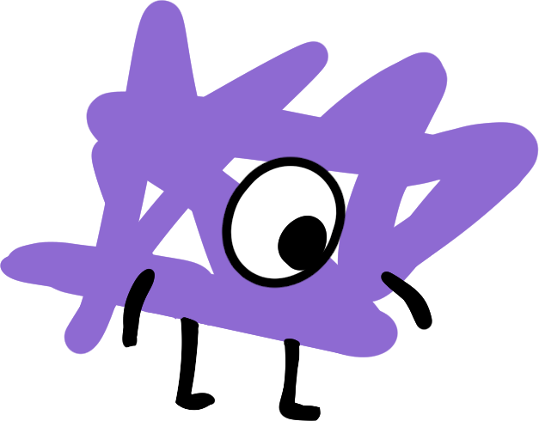
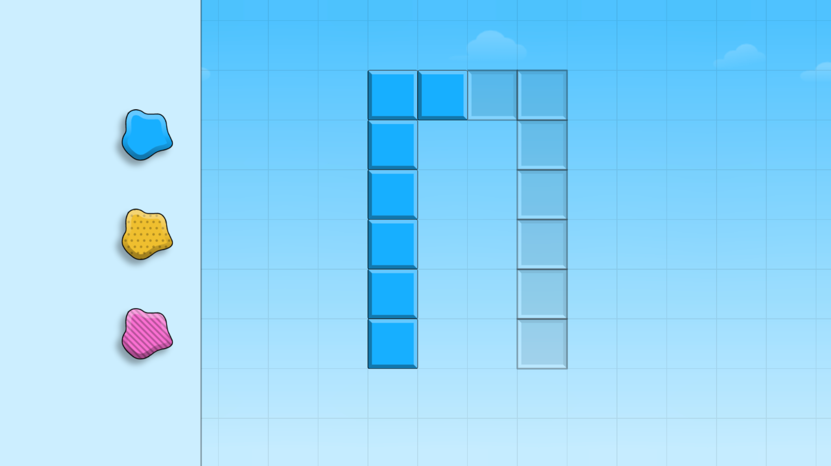
Module 1 - Day 2
Puzzle Talk
Time for
PROBLEM SOLVING!
ST Math Puzzle:
Big Seed > Level 1
Learning Objective:
What do you know about ST Math?
Puzzle Link
Notes:
Puzzle Talk
Focus on student thinking and developing problem solving skills using the Problem Solving Process.
Provide students with whiteboards/dry erase markers.
Sign in to your ST Math account to access the puzzle.
Display Third Grade > Challenge Objective > Big Seed > Level 1
Game Link: https://play.stmath.com/raft/ed/10.0.3/#/objective/96345b53-37bf-40e5-af2a-dcb54ffe176b/4343460a-fcae-4891-881a-fd6f14bcd5a8/games#game4
Notice and Wonder
Tell students you are going to teach them questions they can ask themselves to help think through the puzzles.
Show the first puzzle in Level 1 and encourage students to complete this sentence “I notice _____” (without suggesting a solution). Have several students share what they notice.
Tell students that they can click the sky to make the clickable elements shimmer.
Once students call out all the components they see on the screen, ask students what they wonder. What question is this puzzle asking?”
Predict and Justify
Encourage students to complete this sentence “My prediction is ________ because_____”
Have different students share their predictions and why they think those are the best prediction.
Ask students to name or describe their strategy they will use to test their prediction (hypothesis).
For example, a student may predict that they have to fill the empty blocks. In this case they would name the strategy of flipping. “My strategy is to flip the shape to fill in the blocks.”
Test and Observe
Try a few student strategies both correct and incorrect. Watch the feedback and discuss what they observed in the animation.
Analyze and Learn
Facilitate students through the feedback analysis, understanding what worked and didn’t work. By examining their thinking, students either reinforce their strategies or examine their errors, which provides an opportunity for them to learn from their mistakes.
How does this compare to what you thought would happen?
What did you learn?
How will you use what you learned?
Be sure to use the playback features to pause, rewind, and fast forward the animation and discuss what they are learning from the feedback and use the annotation tools to highlight the learning.
Encourage students to complete this sentence “Something I learned from the feedback is ________.”
Continue to facilitate student thinking as you work through additional puzzles.
Connect and Extend
Share solutions and discuss how puzzles are different as the levels progress. Encourage a variety of strategies/solutions and remember to facilitate, not teach, how to solve the puzzles.
Ask the students if what they learned about how the puzzle behaves in previous levels can be applied here.
When playing Level 3, ask the students if there is more than one answer to the puzzle. Explore different solutions and discuss what they thought would happen vs. what did happen.
Before moving on, ask students to describe what is occurring in the puzzles. What are they learning? Do they notice any relationships or patterns? Chart the math concepts/words/skills that students discuss.
Depending on how students are doing with the puzzles, you may want to skip to level 5.
Have students work in breakout groups to complete a puzzle from Level 5. How did what they learned in their earlier puzzles help them solve this puzzle?

Slide 8
Module 1 - Day 2
Problem Solving
Problem of the Day
Describe the class mathematically.
Notes:
Problem of the Day
Remind students about yesterday’s Problem of the Day.
How can we describe the class mathematically? Generate a list of 3-5 things students want to know about each other.
For example:
º Favorite ice cream flavor, favorite color, number of siblings, number of pets, favorite subject in school, month of birth, favorite sport, etc.

Slide 9
Module 1 - Day 3
My Thinking Path
Topic: Compare fractions and count by unit fractions
???
What I know about fractions is…
What I know about comparing fractions is…
One thing I learned is . . .
A question I have is . . .
This is like…
This is not like….
I wonder…
Notes:
My Thinking Path
Students will begin solving problems involving fractions and understanding fractions as numbers, including counting by unit fractions (fractions with a numerator of 1).
My Thinking Path Discussion:
Introduce the My Thinking Path page to students. Have them write in the topic, “Compare fractions and count by unit fractions.”
Have students complete page 2 in ther journal.
Discuss their ideas and allow students to add to their paper any additional thoughts they have.
From today on, begin each of Days 1-4 with time for students to reflect on their learning and prepare for the day.

Slide 10
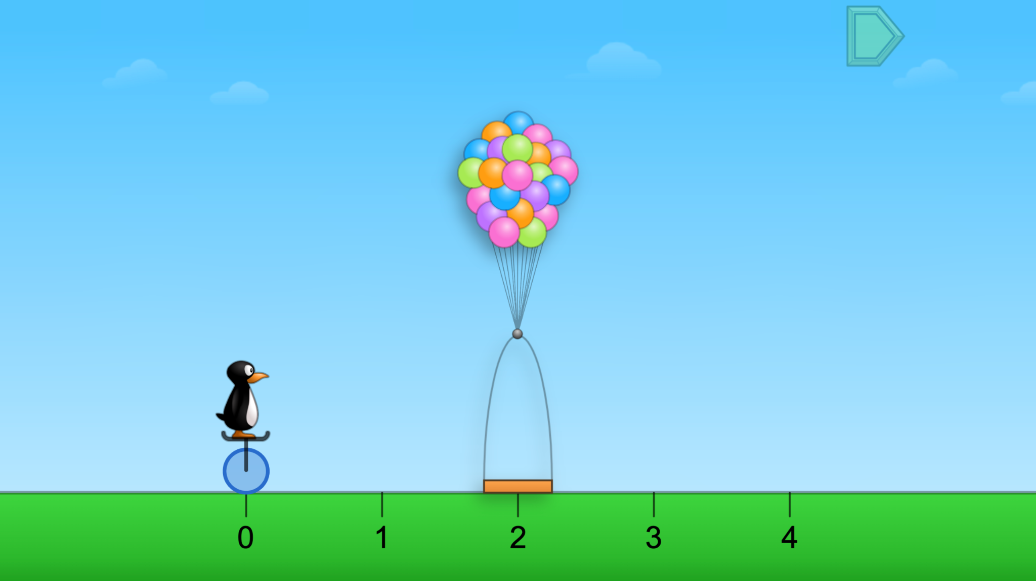
Module 1 - Day 3
Puzzle Talk
Time for
PROBLEM SOLVING!
ST Math Puzzle:
JiJi Cycle Basket > Level 1
Learning Objective:
Solving problems involving fractions and understanding fractions as numbers
Puzzle Link
Notes:
Puzzle Talk
Focus on student thinking and developing problem solving skills using the Problem Solving Process.
Provide students with whiteboards/dry erase markers.
Sign in to your ST Math account to access the puzzle.
Display Third Grade > JiJi Cycle Basket > Level 1
Game Link: https://play.stmath.com/raft/ed/10.0.3/#/objective/b991e4dd-c319-42df-9fe5-a5763e7f99d3/6ae51e25-73a2-41e1-bf7d-4bce038df136/games#game1
Notice and Wonder
Show a puzzle from Level 1. Ask: What do you notice? What do you wonder? Allow students to share.
Predict and Justify
Have students make a prediction and determine a strategy for solving the puzzle. Have students share their predictions, and why. Do they agree/disagree with each other?
Test and Observe
Try one of the students’ ideas and discuss the feedback. (As you try students’ strategies, be sure to try those that work and those that don’t.)
Analyze and Learn
Ask students to how what they saw happen compares to their prediction, such as “How did you know where to place the basket?”
Show a puzzle from level 2. Repeat the Problem Solving Process, guiding students to share strategies and their reasoning.
Discuss unit fractions and identify the numerator and denominator of the fraction on the number line.
Show another puzzle from Level 2.
Discuss how students determine how many unit fractions to select.
Connect and Extend
Show a puzzle from level 3, asking how it is different from Level 2.
Discuss unit fractions and the numerator and denominator of the fraction on the number line, and the mixed number and a/b (b>0) fraction name for the puzzles greater than 1.
Show a puzzle from level 4. Discuss how this puzzle compares to the other levels, unit fractions and the numerator and denominator of the fraction on the number line.
Continue with puzzles from levels 3 and 4.
Discuss unit fractions, mixed numbers vs. a/b (a>b, b>0), how many unit fractions are needed to make 1.
How does the student
explain how they determined the size of the fraction piece? (It would take 4 pieces this size to make a whole circle.)
count the fraction pieces? Count the fractions greater than 1? (5 one-thirds = 5/3)
determine the label for the whole numbers? (3/3 is equivalent to 1)

Slide 11
Module 1 - Day 3
Problem Solving
Problem of the Day
Compare these fractions and explain how to locate them on a number line: 5/8, 6/8, 2/8, 9/8, 3/8.
Notes:
Problem of the Day
Engage students in problem solving discussions. Read and discuss the problem, share student work, compare strategies and make connections.
Compare these fractions and explain how to locate them on a number line. 5/8, 6/8, 2/8, 9/8, 3/8

Slide 12
Module 1 - Day 4
My Thinking Path
???
What I know about fractions is…
What I know about comparing fractions is…
One thing I learned is . . .
A question I have is . . .
This is like…
This is not like….
I wonder…
Notes:
My Thinking Path
Have students reflect on what they have learned about comparing fractions and counting by unit fractions.

Slide 13
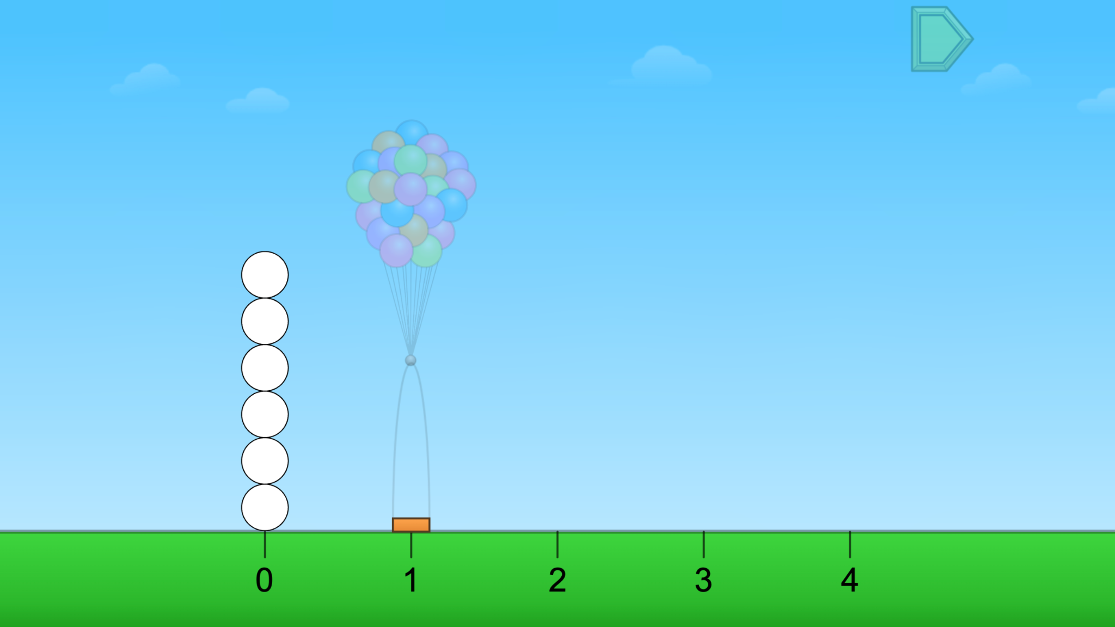
Module 1 - Day 4
Puzzle Talk
Time for
PROBLEM SOLVING!
ST Math Puzzle:
JiJi Cycle > Level 1
Learning Objective:
Solving problems involving fractions and understanding fractions as numbers
Puzzle Link
Notes:
Puzzle Talk
Focus on student thinking and developing problem solving skills using the Problem Solving Process.
Provide students with whiteboards/dry erase markers.
Sign in to your ST Math account to access the puzzle.
Display Third Grade > JiJi Cycle > Level 1
Game Link: https://play.stmath.com/raft/ed/10.0.3/#/objective/b991e4dd-c319-42df-9fe5-a5763e7f99d3/6ae51e25-73a2-41e1-bf7d-4bce038df136/games#game2
Notice and Wonder
Show a puzzle from Level 1. Ask: What do you notice? What do you wonder? Allow students to share.
Predict and Justify
Have students make a prediction and determine a strategy for solving the puzzle.
Have students share their predictions, what they think will happen, and why. Do they agree or disagree with each other? Why?
Test and Observe
Try one of the students’ ideas. (As you try students’ strategies, be sure to try strategies that work and those that don’t. Analyze and discuss the feedback in both correct and incorrect solutions.)
Analyze and Learn
Ask students how what they saw happen compares to their prediction.
Show a puzzle from Level 2. Discuss how this level compares to the puzzles from yesterday's game.
Have students think about and then discuss with a partner how they might solve the puzzle.
Share whole group.
Discuss unit fractions (1/b, b>0) and the numerator and denominator of the fraction on the number line.
Connect and Extend
Continue with puzzles in Levels 2, 3, and 4. Compare and contrast puzzles from the different levels and how to use what they've learned in previous levels to solve other puzzles.
Discuss how puzzles can be represented with an expression (no equals sign) or equation.
Discuss unit fractions, mixed numbers (a>b, b>0), and how many unit fractions are needed to make 1.
How does the student:
write equations to show equivalence of fractions?
discuss the size of the fractions (denominator) and the number of unit fractions (numerator) of that size to compare equivalent fractions?
partition a number line to place fractions?
add fractions to a number line?

Slide 14
Module 1 - Day 4
Problem Solving
Problem of the Day
Nancy, Bob, and Devin played a game to see who could get farthest on a number line. They each rolled a fraction cube. Nancy rolled 1/4 and 1. Bob rolled 3/4 and 3/4. Devin rolled 3/4 and 1/2. Where did each player land on the number line? Who won?
Notes:
Problem of the Day
Engage students in problem solving discussions. Read and discuss the problem, share student work, compare strategies and make connections.
Nancy, Bob, and Devin played a game to see who could get farthest on a number line. They each rolled a fraction cube.
Nancy rolled 1/4 and 1.
Bob rolled 3/4 and 3/4.
Devin rolled 3/4 and 1/2.
Where did each player land on the number line? Who won?

Slide 15
Module 2
Can’t wait to see what we do!

Slide 16
Module 2 - Day 1
My Thinking Path
Topic: Partitioning a whole into equal sections
???
What I know about a whole is…
What I know about partitioning a whole is…
One thing I learned is . . .
A question I have is . . .
This is like…
This is not like….
I wonder…
Notes:
My Thinking Path
Remind students of the My Thinking Path page in their journal. Have them write in the topic, “Solving problems involving partitioning a whole into equal sections (fractions).”
Have students work on the My Thinking Path page in their journals.
Discuss their ideas and allow students to add to their paper any additional thoughts they have.
Begin each of Days 1-4 with time for students to reflect on their learning and prepare for the day.
Have students complete the Pre Quiz (optional).

Slide 17
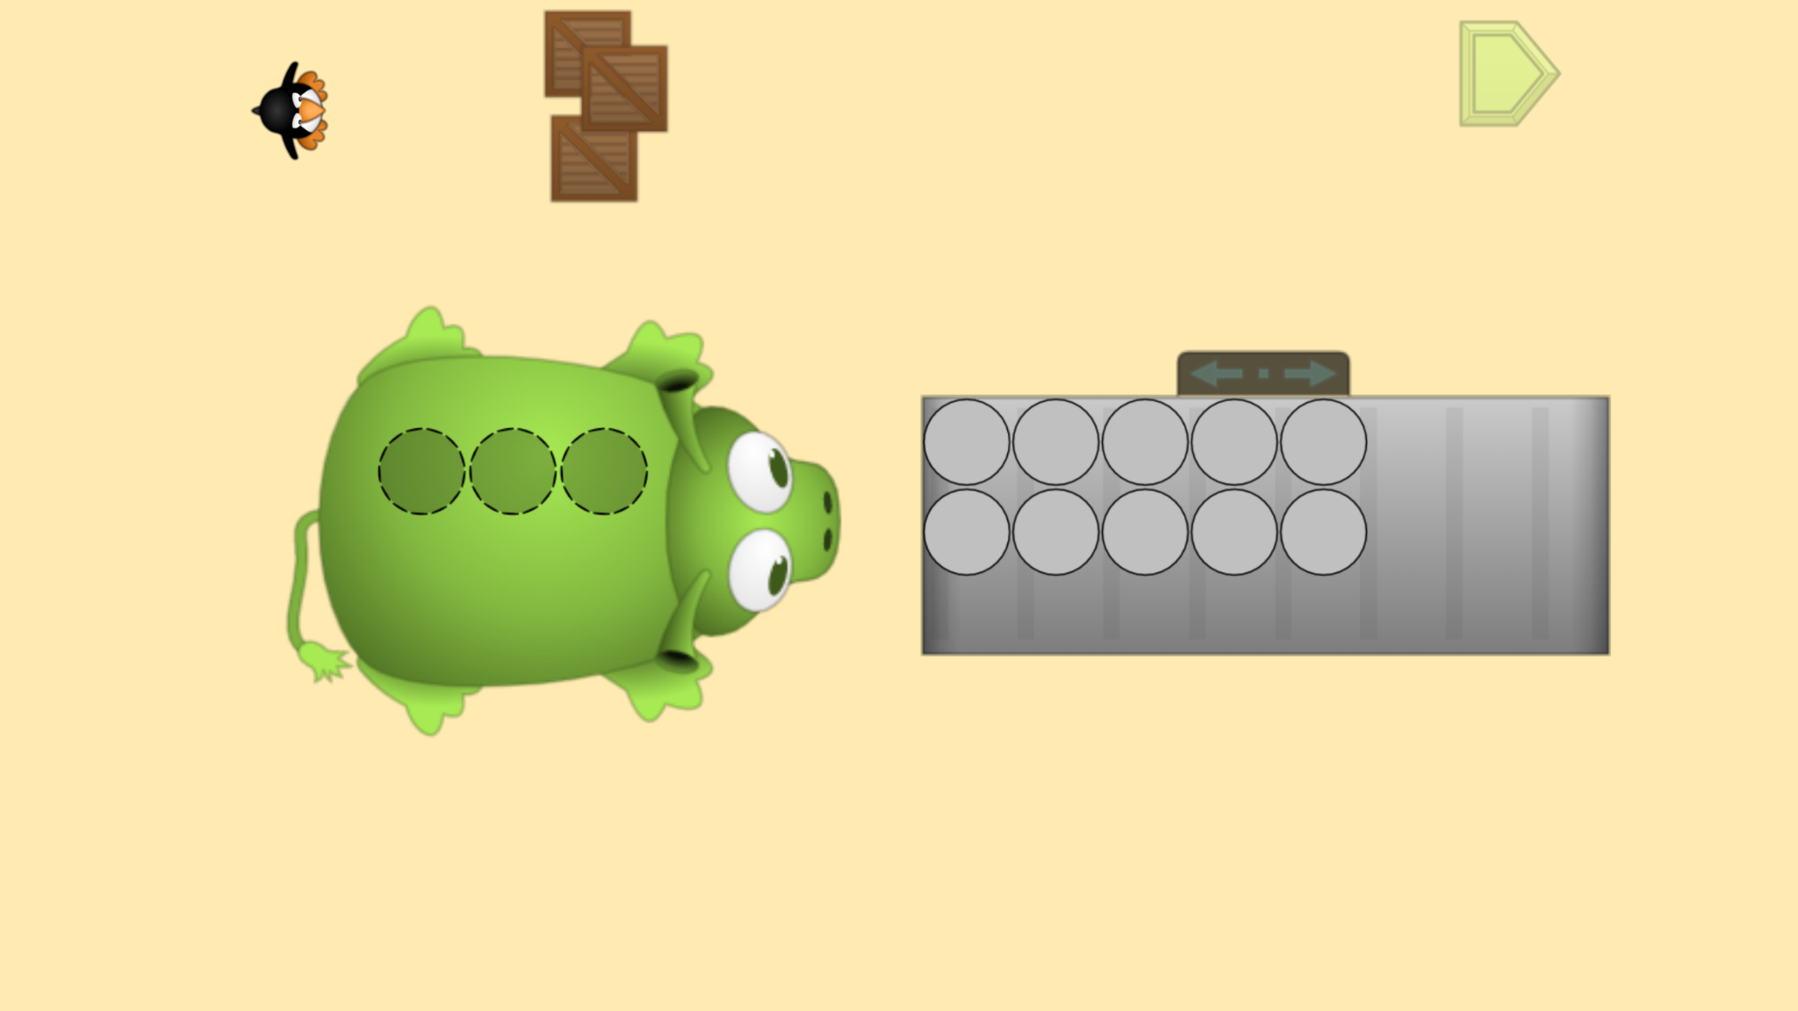
Module 2 - Day 1
Puzzle Talk
Time for
PROBLEM SOLVING!
ST Math Puzzle:
Pie Monster > Level 1
Learning Objective:
Partitioning a whole into equal sections
Puzzle Link
Notes:
Puzzle Talk
Focus on student thinking and developing problem solving skills using the Problem Solving Process.
Provide students with whiteboards/dry erase markers.
Sign in to your ST Math account to access the puzzle.
Display Third Grade > Pie Monster > Level 1
Game Link: https://play.stmath.com/raft/ed/10.0.3/#/objective/b991e4dd-c319-42df-9fe5-a5763e7f99d3/6ae51e25-73a2-41e1-bf7d-4bce038df136/games#game3
Notice and Wonder
Display the first puzzle in Level 1. Ask: What do you notice? What do you wonder? Allow a few students to share out.
Ask students to think of their strategy for solving the puzzle and predict what will happen when they try it.
Predict and Justify
Have students Think-Pair-Share their strategy with a partner, explaining their reasoning.
Have students share out. Ask the students to think about if they agree/disagree with the strategy and why. How does it relate to their strategy?
Test and Observe
Try one of the students’ ideas. (As you try students’ strategies, be sure to try strategies that work and those that don’t.)
Watch the feedback together for correct and incorrect tries and discuss what you saw.
Analyze and Learn
Ask students to think about how what they saw happen compares to their prediction.
Show another puzzle. Have students prepare to show how they would solve it.
Share several examples. Look for students who also wrote the number OR ask students to write the number.
Look for mixed numbers and a/b (b>0) fractions. Discuss counting fractions compared to counting whole numbers, and equivalence: “How do you know this fraction is equivalent to this mixed number? (e.g., Why is 2 the same as 4/2?)”
Connect and Extend
Open up some puzzles from Level 2 (make sure you include puzzles with thirds and fourths) and have students do a Think-Pair-Share with a partner about what they notice. How is it different from Level 1?
Continue to show a few other puzzles in Level 2 (especially partitioned into halves).
Have students share ideas on how they would solve the puzzle.
Share out several examples. Look for students who also wrote the number OR Ask students to write the number.
Look for mixed numbers and a/b fractions. Discuss counting fractions compared to whole numbers.
Discuss the equivalence.
Do the same as above but with Puzzles in Level 3 (showing puzzles with thirds and fourths). Questions to ask: “How many thirds/halves/fourths did you need for each whole pie? How many thirds/halves/fourths are there altogether?“
How does the student
figure out how many unit fractions are needed for one whole?
count unit fractions to find the total?
understand that the a/b (b>0) fraction is equivalent to the mixed number?

Slide 18
Module 2 - Day 1
Problem Solving
Problem of the Day
Joe the baker baked 2 apple pies for the Hughes family. There are 8 people in the Hughes family. The family shared the pies equally. How much pie did each family member get?
Notes:
Problem of the Day
Engage students in problem solving discussions. Read and discuss the problem, share student work, compare strategies and make connections.
Joe the baker baked 2 apple pies for the Hughes family. There are 8 people in the Hughes family. The family shared the pies equally. How much pie did each family member get?

Slide 19
Module 2 - Day 2
My Thinking Path
???
Question..
What I know about a whole is…
Question…
What I know about partitioning a whole is…
One thing I learned is . . .
A question I have is . . .
This is like…
This is not like….
I wonder…
Notes:
My Thinking Path
Have students reflect on what they have learned about solving problems involving partitioning a whole into equal sections (fractions).

Slide 20
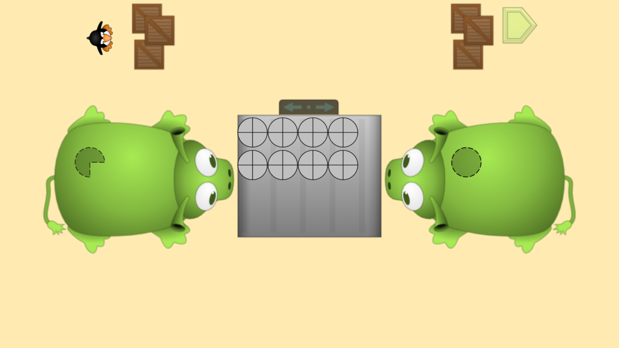
Module 2 - Day 2
Puzzle Talk
Time for
PROBLEM SOLVING!
ST Math Puzzle:
Pie Monster > Level 3
Learning Objective:
Partitioning a whole into equal sections
Puzzle Link
Notes:
Puzzle Talk
Focus on student thinking and developing problem solving skills using the Problem Solving Process.
Provide students with whiteboards/dry erase markers.
Sign in to your ST Math account to access the puzzle.
Display Third Grade > Pie Monster > Level 3
Game Link: https://play.stmath.com/raft/ed/10.0.3/#/objective/b991e4dd-c319-42df-9fe5-a5763e7f99d3/6ae51e25-73a2-41e1-bf7d-4bce038df136/games#game3
Notice and Wonder
Display the first puzzle in Level 3. Ask “What do you notice that is similar/different from the puzzle we did yesterday?”
Allow a few students to share out.
Predict and Justify
Ask students to think of their strategy for solving the puzzle and predict what will happen when they try it. Have students share out their predictions.
Test and Observe
Select a student’s solution to try and watch the feedback. Ask students, “What happened when we tried that prediction? What did you see?"
Analyze and Learn
Ask students to think about how what they saw happen compares to their prediction. Was our answer correct? What did they learn from the feedback?
Show another puzzle, and have students discuss with a partner what they think they need to do to solve the problem.
Try one of the student’s strategies. Discuss the feedback.
Continue to try Level 3 puzzles and launch into a discussion with students around mixed numbers, unit fractions, and equivalence:
How can you check to make sure both monsters get enough pie?
How many thirds/halves/fourths are there altogether?
How could you write the fraction and the mixed number for monster 1 and monster 2?
How do you know this fraction is equivalent to this mixed number? (e.g., Why is 2 the same as 4/2?)
Connect and Extend
Choose some puzzles for students to write equations for on paper or whiteboard.
Ask students a challenge question: “What if Pie Monster got ___ more pies? How many pieces of pie would Pie Monster have now?”
Have students solve the new problem and then allow a few students to share their strategies and their answers.
How does the student
write equations and inequalities to compare fractions?
figure out how many unit fractions are needed for the whole and for each monster.
count unit fractions to find the total?
understand that the a/b (b>0) fraction is equivalent to the mixed number?

Slide 21
Module 2 - Day 2
Problem Solving
Problem of the Day
Joe the baker baked 7 apple pies to sell in his shop. Four people came in at the same time to buy pie. Joe sold the 7 pies to the four people. Each person got an equal amount of pie. How much pie did each person buy?
Notes:
Problem of the Day
Engage students in problem solving discussions. Read and discuss the problem, share student work, compare strategies and make connections.
Joe the baker baked 7 apple pies to sell in his shop. Four people came in at the same time to buy pie. Joe sold the 7 pies to the four people. Each person got an equal amount of pie. How much pie did each person buy?

Slide 22
Module 2 - Day 3
My Thinking Path
???
Question..
What I know about a whole is…
Question…
What I know about partitioning a whole is…
One thing I learned is . . .
A question I have is . . .
This is like…
This is not like….
I wonder…
Notes:
My Thinking Path
• Have students reflect on what they have learned about solving problems involving partitioning a whole into equal sections (fractions).

Slide 23
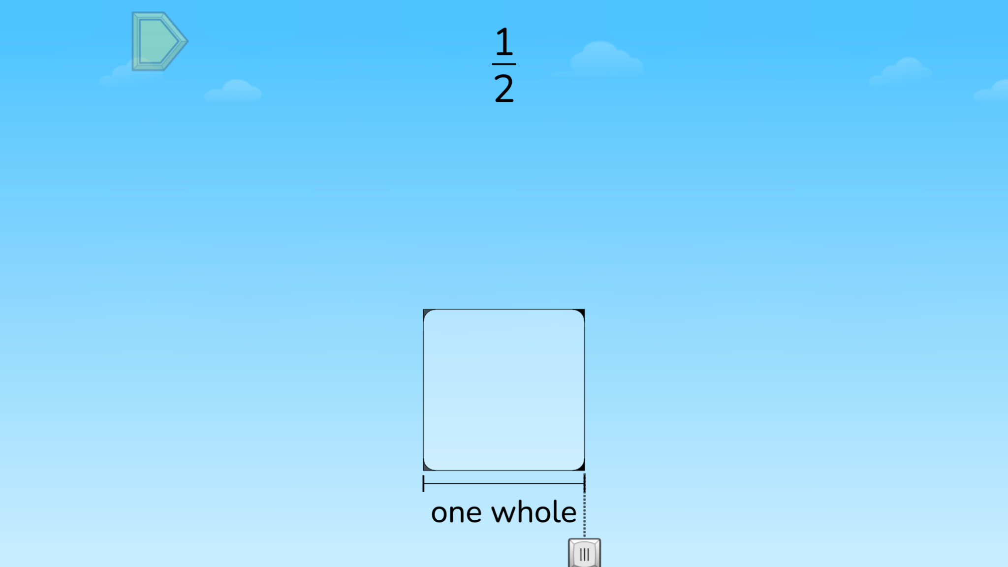
Module 2 - Day 3
Puzzle Talk
Time for
PROBLEM SOLVING!
ST Math Puzzle:
Match Fraction > Level 1
Learning Objective:
Partitioning a whole into equal sections
Puzzle Link
Notes:
Puzzle Talk
Focus on student thinking and developing problem solving skills using the Problem Solving Process.
Provide students with whiteboards/dry erase markers.
Sign in to your ST Math account to access the puzzle.
Display Third Grade > Match Fraction > Level 1
Game Link: https://play.stmath.com/raft/ed/10.0.3/#/objective/b991e4dd-c319-42df-9fe5-a5763e7f99d3/6ae51e25-73a2-41e1-bf7d-4bce038df136/games#game4
Notice and Wonder
Display the first puzzle in Level 1. Ask “What do you notice?” “What do you wonder?” Allow a few students to share out.
Predict and Justify
Ask students to predict where the rocket will go and explain their prediction.
You may probe students by asking: What does the numerator represent?
What does the denominator represent? “
Test and Observe
Select a student to share how to move the slider, how many parts they are dividing and coloring in, and why.
Analyze and Learn
Ask students to explain what they learned from the feedback about numerators, denominators and partitions. Replay the puzzle and select the same answer. This time pause the feedback. Discuss.
Ask students to share what they learned from the feedback. How can they use what they learned in the next puzzle?
Show the next puzzle. Move the slider across the square at the bottom and ask students to watch the animation. Ask: How many pieces do you want to partition this square into so that it matches the fraction in the puzzle?
Remind students that the denominator tells how many equal pieces the whole has been divided into: “The denominator is ___, so we need to divide the square into ___ equal parts.” Select the correct denominator. Remind students that the numerator counts how many of the equal pieces you have. The numerator in the puzzle is 1, which means that we just need 1 of the pieces. Ask students, “How could we represent just 1 of the pieces?” Move the cursor over the square again to show how to shade in the pieces and watch the feedback.
Solve the puzzle and watch the feedback.
How does the student
discuss the size and number of partitions created as the cursor moves from left to right?
discuss the meaning of the denominator in the fractions?
discuss the meaning of the numerator in the fractions?
discuss unit fractions and count by unit fractions?

Slide 24
Module 2 - Day 3
Problem Solving
Problem of the Day
Gordon baked a pan of lasagna for his family of 4. He cut the lasagna into 8 equal pieces. Explain how much lasagna each family member might eat.
Notes:
Problem of the Day
Engage students in problem solving discussions. Read and discuss the problem, share student work, compare strategies and make connections.
• Gordon baked a pan of lasagna for his family of 4. He cut the lasagna into eight equal pieces. Explain how much lasagna each family member might eat.

Slide 25
Module 2 - Day 4
My Thinking Path
???
Question..
What I know about a whole is…
Question…
What I know about partitioning a whole is…
One thing I learned is . . .
A question I have is . . .
This is like…
This is not like….
I wonder…
Notes:
My Thinking Path
Have students reflect on what they have learned about solving problems involving partitioning a whole into equal sections (fractions).

Slide 26
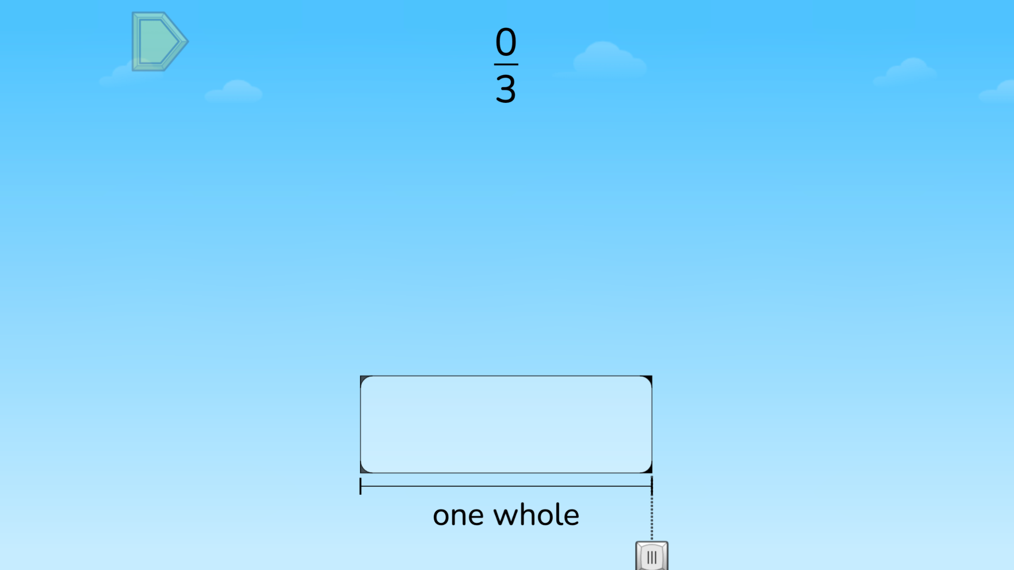
Module 2 - Day 4
Puzzle Talk
Time for
PROBLEM SOLVING!
ST Math Puzzle:
Match Fraction > Level 2
Learning Objective:
Partitioning a whole into equal sections
Puzzle Link
Notes:
Puzzle Talk
Focus on student thinking and developing problem solving skills using the Problem Solving Process.
Provide students with whiteboards/dry erase markers.
Sign in to your ST Math account to access the puzzle.
Display Third Grade > Match Fraction > Level 2
Game Link: https://play.stmath.com/raft/ed/10.0.3/#/objective/b991e4dd-c319-42df-9fe5-a5763e7f99d3/6ae51e25-73a2-41e1-bf7d-4bce038df136/games#game4
Notice and Wonder
Show a puzzle from Level 2. Ask students, “What do you notice that is similar/different than the puzzles we did yesterday?
Have students predict how to solve the puzzle and share their prediction with a neighbor. Ask students, “Did your predictions match?” “What strategies did you use?”
Predict and Justify
Have students share out. Try one of the students’ ideas.
Test and Observe
Watch the feedback together and discuss what they saw. Discuss how the animation shows the numerator and denominator of the fraction.
Analyze and Learn
Ask students to think about how what they saw happen compares to their prediction. What did they learn from the feedback?
Show another puzzle from Level 2. Discuss how they determine the number of partitions to select: “Where is a unit fraction? How many unit fractions is this?”
Have students write an addition equation to show that it takes a unit fraction of size 1/b to equal the a/b (b>0) fraction (e.g., 1/6 + 1/6 = 2/6)
Connect and Extend
Display the next puzzle and move the cursor along the square again. Ask students to turn to a partner and discuss, “What happens to the size of the fraction pieces as the denominator gets bigger? How many halves/thirds/fourths/fifths/sixths does it take to make 1 whole? Why”? (Show that the bigger the denominator gets, the smaller the fraction pieces become). Allow students to share their thinking whole group.
Do a share-out and try a student solution, watching the feedback. Remind students that the numerator counts how many of the equal pieces you have (e.g., a numerator of 4, means that you have 1, 2, 3, 4 of the fraction pieces.
Ask: How many of these fraction pieces does it take to make the whole? Why?
How does the student
discuss the size and number of partitions created as the cursor moves from left to right?
discuss the meaning of the denominator in the fractions?
discuss the meaning of the numerator in the fractions?
discuss unit fractions and count by unit fractions?

Slide 27
Module 2 - Day 4
Problem Solving
Problem of the Day
Brett and 3 classmates were given a bulletin board to present their Math Challenge. They decided to divide the bulletin board so that each of them had an equal amount of space. Show two different ways they could partition the board. Prove that one partition from your first bulletin board example is equivalent to one partition from the second example.
Notes:
Problem of the Day
Engage students in problem solving discussions. Read and discuss the problem, share student work, compare strategies and make connections.
• Brett and 3 classmates were given a bulletin board to present their Math Challenge. They decided to divide the bulletin board so that each of them had an equal amount of space. Show two different ways they could partition the board. Prove that one partition from your first bulletin board example is equivalent to one partition from the second example.

Slide 28
Module 3
Learning math carefree!

Slide 29
Module 3 - Day 1
My Thinking Path
Topic: Defining and partitioning one and combining unit fractions
???
What I know about partitioning a whole is…
What I know about combining fractions is…
One thing I learned is . . .
A question I have is . . .
This is like…
This is not like….
I wonder…
Notes:
My Thinking Path
Have students write in the topic, “Defining and partitioning one (whole) and combining unit fractions.”
Have students begin working on the first two boxes.
Discuss their ideas and allow students to add to their paper any additional thoughts they have.
Have students complete the Pre-Quiz (optional).

Slide 30
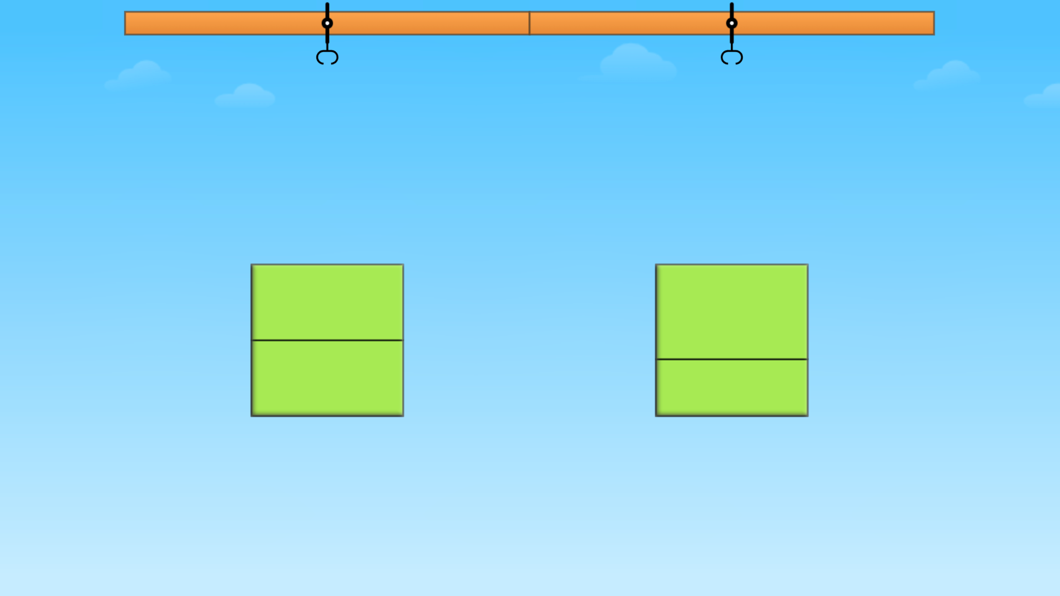
Module 3 - Day 1
Puzzle Talk
Time for
PROBLEM SOLVING!
ST Math Puzzle:
Equal Areas > Level 1
Learning Objective:
Solve puzzles involving partitioning a rectangle into equal areas
Puzzle Link
Notes:
Puzzle Talk
Focus on student thinking and developing problem solving skills using the Problem Solving Process.
Provide students with whiteboards/dry erase markers.
Sign in to your ST Math account to access the puzzle.
Display Third Grade > Equal Areas > Level 1
Game Link: https://play.stmath.com/raft/ed/10.0.3/#/objective/b991e4dd-c319-42df-9fe5-a5763e7f99d3/6ae51e25-73a2-41e1-bf7d-4bce038df136/games#game5
Notice and Wonder
Display the first puzzle in Level 1. Ask “What do you notice?” “What do you wonder?” Allow a few students to share out the differences between the two rectangle choices.
Predict and Justify
Have students make a prediction about which green rectangle to choose and why. They should Think-Pair-Share their prediction, strategy, and their reasoning.
Allow some students to share whole group and discuss: “How do you know the parts are equal?“
Try one of the student’s solution strategies. Before trying the strategy, discuss it with the other students (agree/disagree; what do they think will happen).
Test and Observe
Try a student’s solution and watch the feedback. Talk with students about the animation.
Analyze and Learn
Ask students to think about how what they saw happen compares to their prediction. What did they learn from the feedback about their strategy?
Solve additional puzzles in Level 1.
Connect and Extend:
Display the first puzzle in Level 2 and ask students which green rectangle would be correct. Discuss how each section of the rectangle would be named. Ask students, “How many parts are in this rectangle?” “Are all of the parts equal?”
With the same puzzle, tell students you want to represent the correct rectangle using a unit fraction, but need their help (A rectangle divided into 3 equal pieces is 1/3 + 1/3 + 1/3.)
If needed, explain to students that the top number of a fraction (the numerator) is the counting number. Each of these pieces is 1 piece so the numerator is 1. Explain that the bottom number (the denominator) is the cutting number. It tells how many equal pieces or parts the whole has been cut or divided into. Ask students, “How many equal parts has this rectangle been divided into?” Write the unit fraction that would represent each piece and have students write the unit fraction on their whiteboards.
Highlight the need for each section to cover the same amount of area in the shape. Do not focus on the sections being exactly alike. They do not have to be congruent.
Repeat with additional puzzles in Level 2.
Display the first puzzle in Level 3. Say to students, “These rectangles look different from the ones in the last puzzles we solved. Can you select the rectangle with equal parts in this puzzle?”
Solve additional puzzles in Level 3 and continue asking the same questions as above.
How does the student
identify the rectangle with equal parts?
identify the total number of equal parts?
discuss the need for each section of the rectangle to cover the same area as the other sections in the rectangle in order for them to be the same fractional part?
identify each section as a unit fraction and discuss how many unit fractions are in the whole?

Slide 31
Module 3 - Day 1
Problem Solving
Problem of the Day
Show and explain how the shaded part of this picture could represent each of these numbers: 1/2, 2, 1.
Notes:
Problem of the Day
Engage students in problem solving discussions. Read and discuss the problem, share student work, compare strategies and make connections.
• Show and explain how the shaded part of this picture could represent each of these numbers. 1/2, 2, 1

Slide 32
Module 3 - Day 2
My Thinking Path
???
Question..
What I know about partitioning a whole is…
Question…
What I know about combining fractions is…
One thing I learned is . . .
A question I have is . . .
This is like…
This is not like….
I wonder…
Notes:
My Thinking Path
Have students reflect on what they have learned about solving problems involving defining and partitioning one (whole) and combining unit fractions.

Slide 33
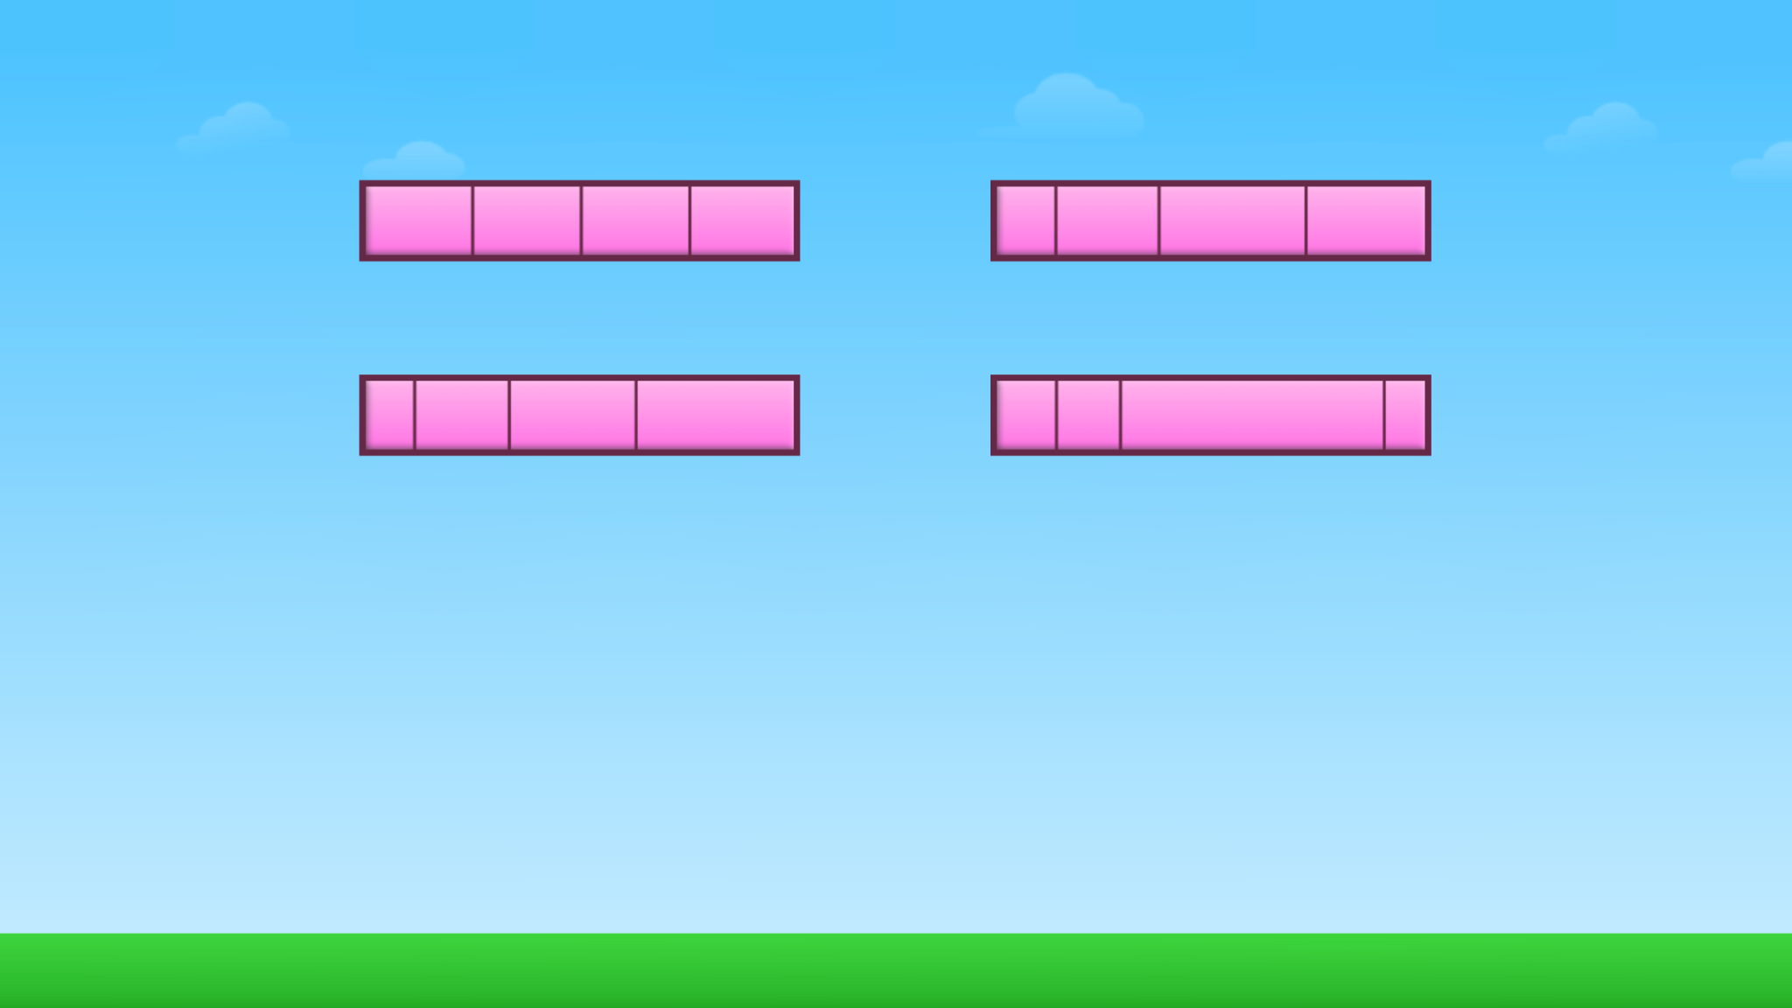
Module 3 - Day 2
Puzzle Talk
Time for
PROBLEM SOLVING!
ST Math Puzzle:
Equal Division > Level 1
Learning Objective:
Solve puzzles involving partitioning a rectangle into equal areas
Puzzle Link
Notes:
Puzzle Talk
Focus on student thinking and developing problem solving skills using the Problem Solving Process.
Provide students with whiteboards/dry erase markers.
Sign in to your ST Math account to access the puzzle.
Display Third Grade > Equal Division > Level 1
Game Link: https://play.stmath.com/raft/ed/10.0.3/#/objective/b991e4dd-c319-42df-9fe5-a5763e7f99d3/6ae51e25-73a2-41e1-bf7d-4bce038df136/games#game6
Notice and Wonder
Display the first puzzle in Level 1. Ask “What do you notice?” “What do you wonder? How many equal pieces does this rectangle have? ” Allow a few students to share out.
Predict and Justify:
Have some students share their predictions. Discuss.
Test and Observe
Try a student’s solution and watch the feedback. Talk with students about what happened as they solved the puzzle. Did it match their prediction?
Analyze and Learn
Replay the puzzle with the same solution. Pause the animation. Ask students to explain what is happening with the bars and the number line.
Show the next puzzle in Level 1. Ask the students “Which rectangle do you think is the correct answer and why?”
Discuss and solve some puzzles from Level 1. For a few puzzles, move the cursor over the rectangle that students want to choose to solve each puzzle. Talk about how many equal parts are in the rectangle.
Discuss concepts of equal area/size and number of partitions. Name each partition as unit fraction 1/b (e.g., 1/3 if rectangle is divided into 3 equal parts)
Name different numbers of sections a/b (b>0) and discuss how to determine those by counting the unit fractions (e.g., 2/3 = 1/3 + 1/3).
Connect and Extend
Show a new puzzle and have students write a unit fraction to name each piece of the rectangle. “How could we name each of the equal pieces with a unit fraction? What would be our numerator and denominator?”
Display the first puzzle in Level 2. Ask: How is this puzzle different from the puzzles we just solved? Which direction of the dashed line(s) should we move to create equal pieces? Why?
Ask students which arrow they want to choose to move the line to the left or right and why. Predict what will happen with each choice before the arrow is selected. Watch the feedback from the puzzle after the arrow is selected. Discuss whether the resulting rectangle has equal pieces.
Repeat with the remaining puzzles in Level 2.
Have students draw more than one whole and partition each into the unit fractions, then name different a/b (b>0) fractions > 1.
Discuss the need for each of the wholes to be the same size.
How does the student
identify the rectangle with equal pieces?
discuss the need for each section of the rectangle to cover the same area as the other sections in the rectangle in order for them to be the same fractional part?
identify each section as a unit fraction and discuss how many unit fractions are in the whole?

Slide 34
Module 3 - Day 2
Problem Solving
Problem of the Day
This rectangle is 1/2. Show one whole.
This rectangle is 1/3. Show 1/2.
Notes:
Problem of the Day
Engage students in problem solving discussions. Read and discuss the problem, share student work, compare strategies and make connections.
• This rectangle is 1/2. Show one whole. This rectangle is 1/3. Show 1/2. (see image)

Slide 35
Module 3 - Day 3
My Thinking Path
???
Question..
What I know about partitioning a whole is…
Question…
What I know about combining fractions is…
One thing I learned is . . .
A question I have is . . .
This is like…
This is not like….
I wonder…
Notes:
My Thinking Path
• Have students reflect on what they have learned about solving problems involving defining and partitioning one (whole) and combining unit fractions.

Slide 36
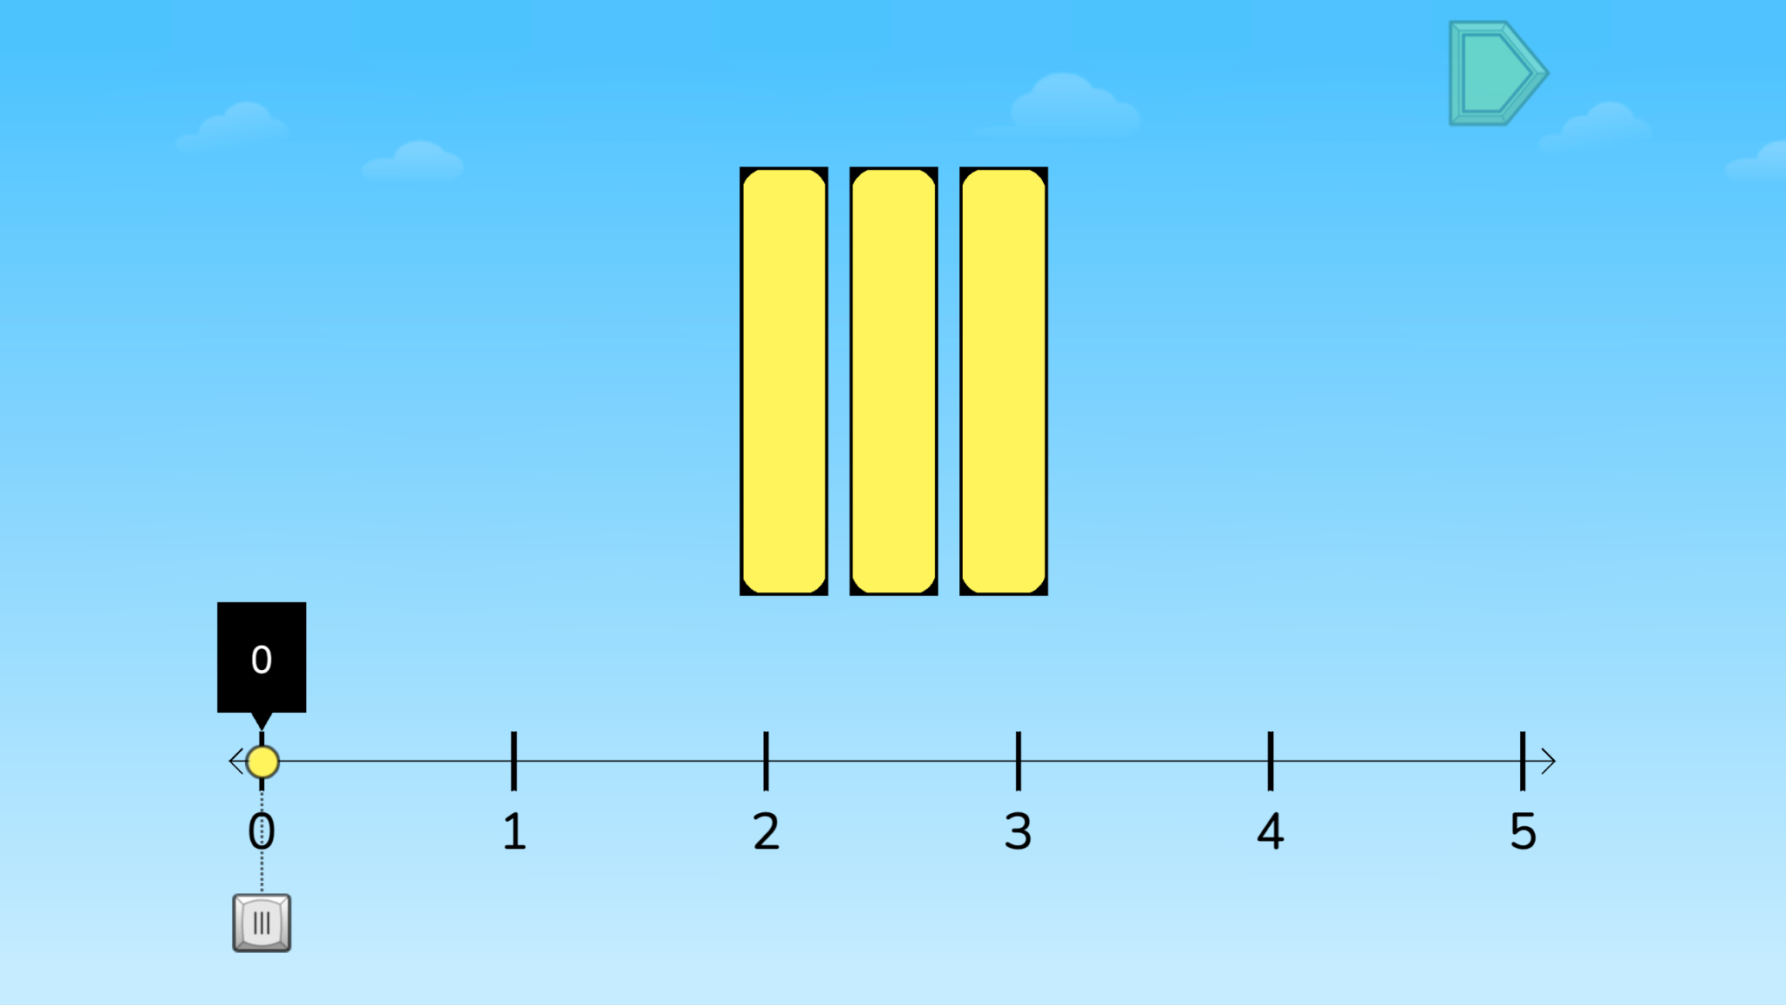
Module 3 - Day 3
Puzzle Talk
Time for
PROBLEM SOLVING!
ST Math Puzzle:
Scale Fraction > Level 1
Learning Objective:
Solve puzzles involving partitioning a rectangle into equal areas
Puzzle Link
Notes:
Puzzle Talk
Focus on student thinking and developing problem solving skills using the Problem Solving Process.
Provide students with Fraction Number Lines Game Mat and whiteboards/dry erase markers.
Sign in to your ST Math account to access the puzzle.
Display Third Grade > Scale Fraction > Level 1
Game Link: https://play.stmath.com/raft/ed/10.0.3/#/objective/b991e4dd-c319-42df-9fe5-a5763e7f99d3/6ae51e25-73a2-41e1-bf7d-4bce038df136/games#game7
Notice and Wonder
Display the first puzzle in Level 1. Ask “What do you notice? What do you see on this number line? What do you wonder?” Allow a few students to share out.
Predict and Justify
Have some students share their predictions. Discuss.
Try one of the students’ strategies. Before trying the strategy, discuss it with the other students. Ask students if they agree or disagree with each other. Share students’ thinking as a whole class.
Test and Observe
Watch the feedback together and discuss what they saw.
Play the puzzle again choosing the same solution. Ask students, “How could you name the rectangles you see in this puzzle? How many whole numbers are on this number line? How has the number line been divided?”
Analyze and Learn
Show and have students solve other puzzles from Level 1.
Now, show a puzzle from Level 2. Have students discuss what they notice with a partner
On the Fraction Number Line Mat, use the 0 to 5 number line. Show another puzzle. Have students represent this puzzle on their game mat, asking “How do we show the unit fraction in the last bar on the number line? What is the denominator and numerator for this fraction?“
Discuss how they knew where to place the yellow ball.
Connect and Extend
Show a puzzle from Level 3 and have students represent it on their game mat and solve it.
Ask students about their strategy (visualizing the bars moving on number line, writing numbers as a mixed number or fractions greater than 1, etc.).
How does the student
discuss strategies for finding the location on the number line?
count by unit fractions?
write numbers as fractions greater than one and mixed numbers?
determine the denominator for the unit fraction?
determine the numerator when it is not a unit fraction?

Slide 37
Module 3 - Day 3
Problem Solving
Problem of the Day
Jayla’s and Jayvon’s mother made them each a peanut butter sandwich for lunch. Jayla cut her sandwich into 4 equal sized pieces and ate 2 of the pieces. Jayvon cut his sandwich in 2 equal sized pieces and ate one piece. Jayla said she ate more of her sandwich because she ate 2 pieces. Jayvon disagreed. Who is correct? Justify your answer.
Notes:
Problem of the Day
Engage students in problem solving discussions. Read and discuss the problem, share student work, compare strategies and make connections.
• Jayla’s and Jayvon’s mother made them each a peanut butter sandwich for lunch. Jayla cut her sandwich into 4 equal sized pieces and ate 2 of the pieces. Jayvon cut his sandwich in 2 equal sized pieces and ate one piece. Jayla said she ate more of her sandwich because she ate 2 pieces. Jayvon disagreed. Who is correct? Justify your reasoning.

Slide 38
Module 3 - Day 4
My Thinking Path
???
Question..
What I know about partitioning a whole is…
Question…
What I know about combining fractions is…
One thing I learned is . . .
A question I have is . . .
This is like…
This is not like….
I wonder…
Notes:
My Thinking Path
• Have students reflect on what they have learned about solving problems involving defining and partitioning one (whole) and combining unit fractions.

Slide 39
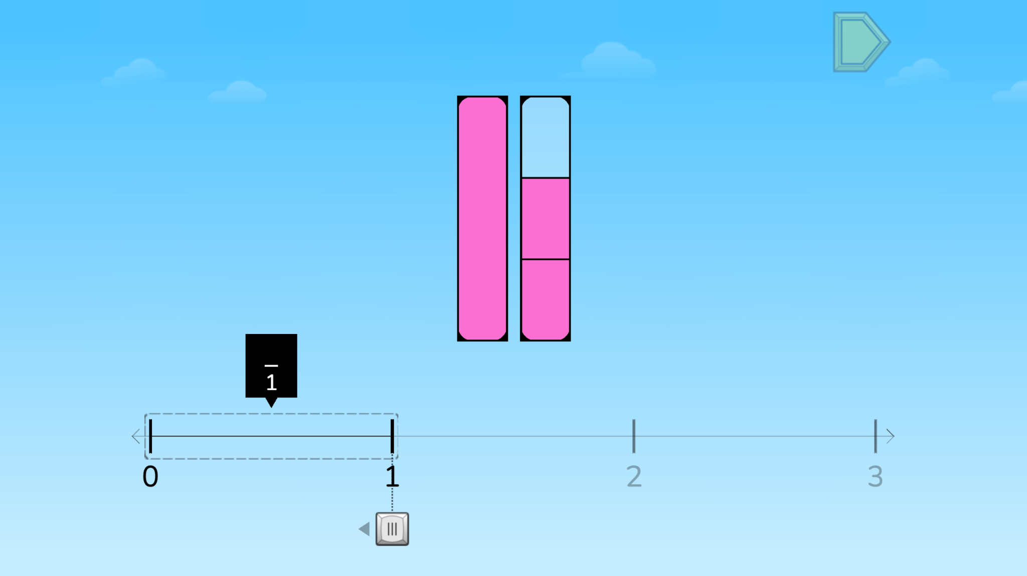
Module 3 - Day 4
Puzzle Talk
Time for
PROBLEM SOLVING!
ST Math Puzzle:
Scale Fraction > Level 4
Learning Objective:
Solve puzzles involving partitioning a rectangle into equal areas
Puzzle Link
Notes:
Puzzle Talk
Provide students with whiteboards/dry erase markers.
It will be helpful to provide manipulatives during this talk (cubes, fraction strips, etc.).
Sign in to your ST Math account to access the puzzle.
Display Third Grade > Scale Fraction > Level 4
Game Link: https://play.stmath.com/raft/ed/10.0.3/#/objective/b991e4dd-c319-42df-9fe5-a5763e7f99d3/6ae51e25-73a2-41e1-bf7d-4bce038df136/games#game7
Notice and Wonder
Display the first puzzle in Level 1. Ask “What do you notice?” “What do you wonder?” “What do you think you need to do to solve this puzzle?” Allow a few students to share out how many pies the Pie Monster needs.
Predict and Justify
Have students Think-Pair-Share about what they would like to try, what will happen when they try it, and why they think it will work.
Ask the students to think about if they agree/disagree with the strategy and why. How does it relate to their own strategy?
Additional prompts:
What do you see on this number line?
How could you name the rectangles you see in this puzzle?
How many whole numbers are on this number line?
How has the number line been divided?
Test and Observe
Try a student’s solution and watch the feedback. Ask students to describe what happened.
Analyze and Learn
Ask students to think about how what they saw happen compares to their prediction. What did they learn from the feedback? How does this affect their strategy for solving the next puzzle?
What is the denominator for this fraction? Numerator? Why?
How did you determine where to place the yellow ball?
Connect and Extend
Show some more Level 4 puzzles, and have students use their game mats to represent the puzzles.
Have student build a bar model from a puzzle that has fourths. They may use their fraction strips, connecting cubes, blocks, or Cuisenaire rods.
Discuss the different models.
Does one student’s model have to look like another student’s model?
Do all of the wholes in one student’s model have to be the same size?
How does the student
discuss strategies for finding the location on the number line?
count by unit fractions?
write numbers as fractions greater than one and mixed numbers?
determine the denominator for the unit fraction?
determine the numerator when it is not a unit fraction?

Slide 40
Module 3 - Day 4
Problem Solving
Problem of the Day
Place 3/4 on this number line. Be as exact as possible.
Notes:
Problem of the Day
Engage students in problem solving discussions. Read and discuss the problem, share student work, compare strategies and make connections.
• Place 3/4 on this number line. Be as exact as possible.

Slide 41
Module 4
Let’s learn some more!

Slide 42
Module 4 - Day 1
My Thinking Path
Topic: Comparing fractions on a number line
???
What I know about comparing fractions is…
What I know about comparing fractions on a number line is…
One thing I learned is . . .
A question I have is . . .
This is like…
This is not like….
I wonder…
Notes:
My Thinking Path
Have students write in the topic, “Comparing fractions on a number line.”
Have students begin working on the first two boxes.
Discuss their ideas and allow students to add to their paper any additional thoughts they have.
Have students complete the Pre-Quiz (optional).

Slide 43
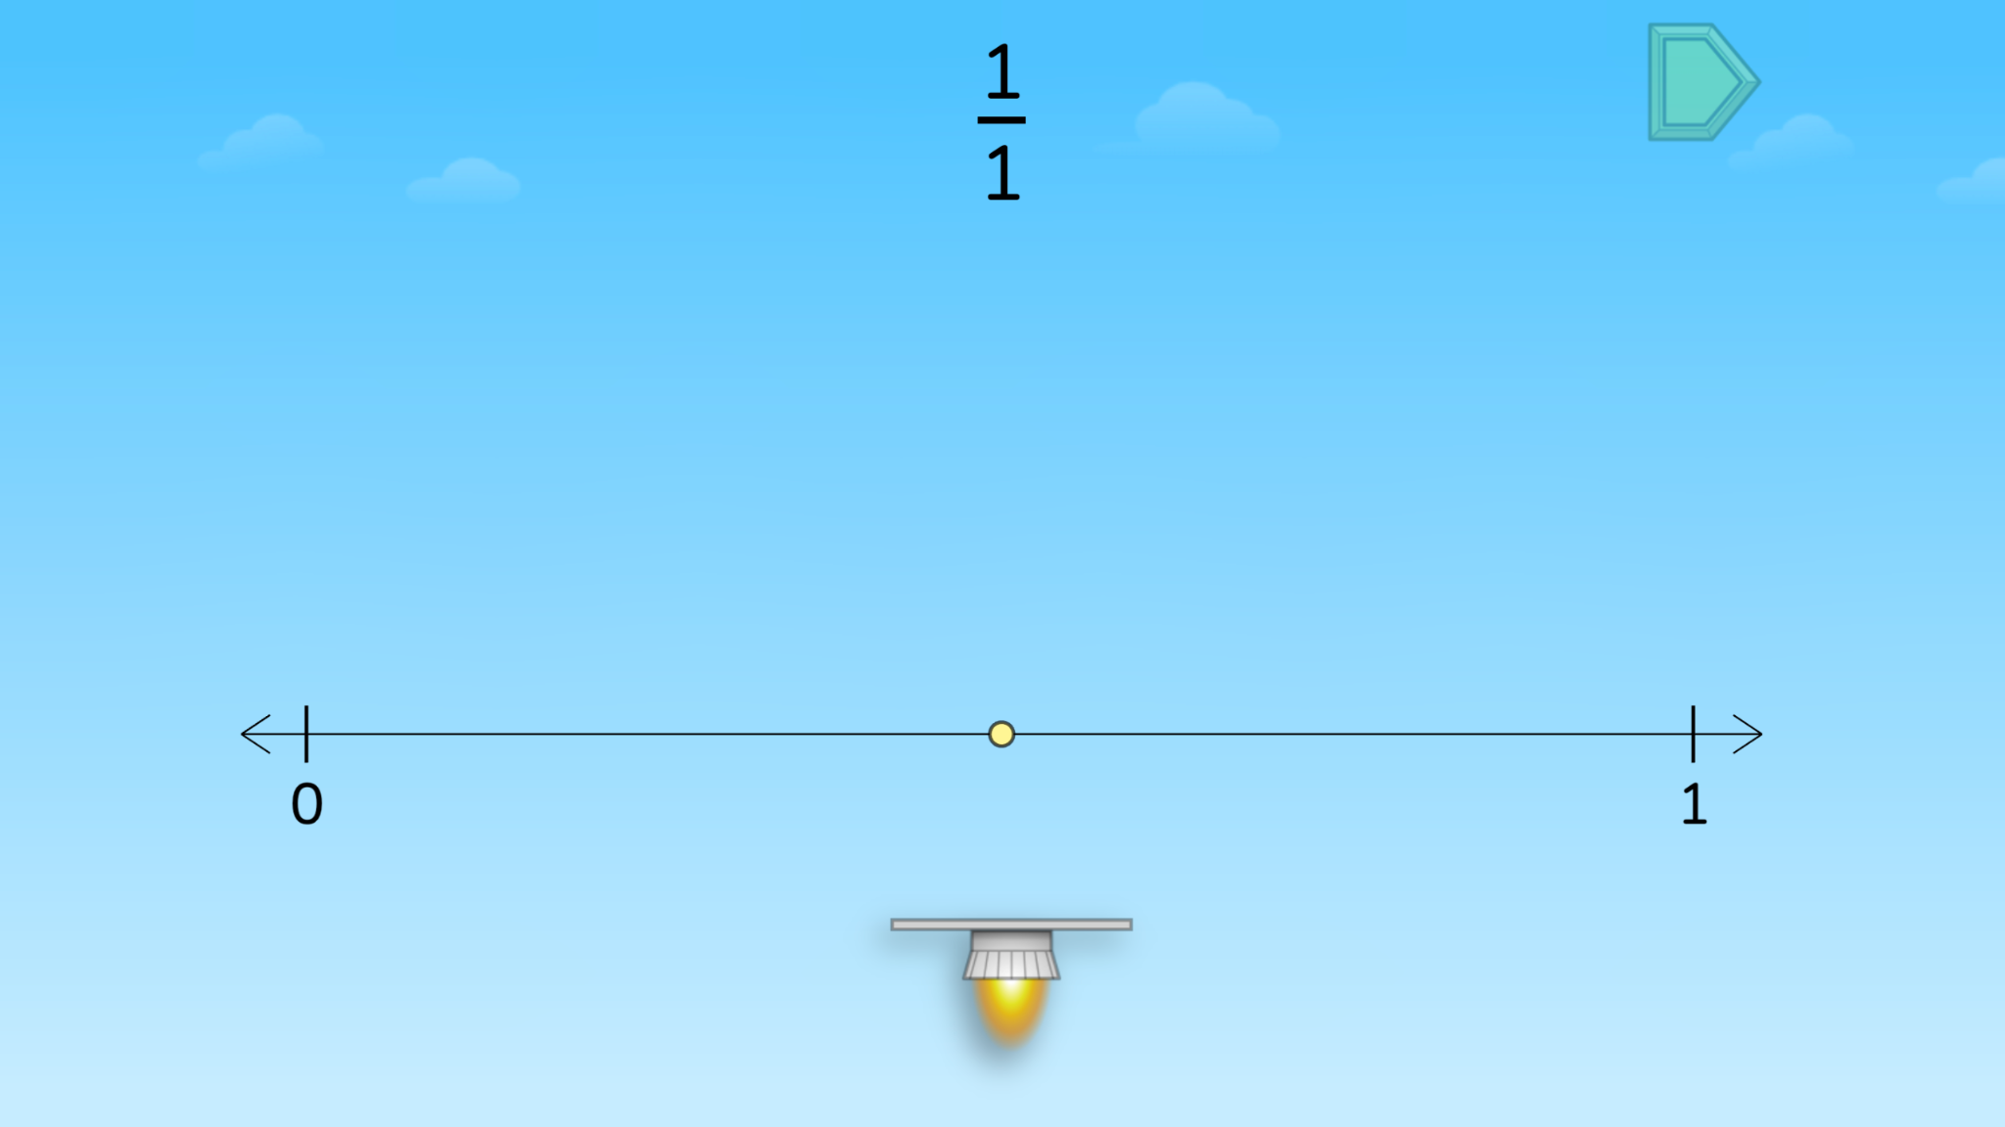
Module 4 - Day 1
Puzzle Talk
Time for
PROBLEM SOLVING!
ST Math Puzzle:
Estimate Fractions on a Number Line > Level 1
Learning Objective:
Comparing fractions on a number line
Puzzle Link
Notes:
Puzzle Talk
Focus on student thinking and developing problem solving skills using the Problem Solving Process.
Provide students with Estimate Fractions Game Mat and whiteboards/dry erase markers.
Sign in to your ST Math account to access the puzzle.
Display Third Grade > Estimate Fractions on a Number Line > Level 1
Game Link: https://play.stmath.com/raft/ed/10.0.3/#/objective/b991e4dd-c319-42df-9fe5-a5763e7f99d3/6ae51e25-73a2-41e1-bf7d-4bce038df136/games#game8
Notice and Wonder
Display the first puzzle in Level 1. Ask: What do you notice? What do you wonder? What do you think you need to do to solve this puzzle? Allow a few students to share out.
Predict and Justify
Have students make a prediction. After they have had some think time, have them Think-Pair-Share about what they would like to try, what will happen when they try it, and why they think it will work.
Have students share out their predictions and related strategy.
Test and Observe
Select one students’ strategy. Ask the students if they agree or disagree with the strategy and why. How does it relate to their own strategy?
Try a student’s solution and watch the feedback. Ask students to describe what happened.
Analyze and Learn
Show and have students solve other puzzles from Level 1. Ask students: How do they know how many partitions to divide the number line into? (Denominator)
Give each student the Estimate Fractions Game Mat. Show a Level 2 puzzle.
Connect and Extend
Have students represent this puzzle on their game mat by sliding the rocket over to the point on the number line, and discuss their reasoning with a partner.
Engage in discussions about benchmark fractions and students comparing/equivalent fractions, pausing the feedback when necessary. Chart different student responses to:
What does the denominator tell you? (How many equal parts there are between each whole.) The numerator? (How many jumps JiJi makes.)
How did you partition the number line? Why?
Where do you think this fraction is located? Why?
How do we know this is a unit fraction?
Show a puzzle in Level 3. You may repeat the Problem Solving Process again for more practice, and ask additional clarifying questions, like “How is this number line different from the other number line?”
How does the student
discuss strategies for partitioning a number line into fractions?
define a unit fraction?
estimate the location of a number on a number line by counting by unit fractions?
discuss the role of the denominator in partitioning the number line?
discuss the role of the numerator to locate a number on the number line?
discuss the number of unit fractions that are equal to one?

Slide 44
Module 4 - Day 1
Problem Solving
Problem of the Day
Create a number line including the numbers 0 to 2 and all halves and fourths. Name every half and fourth. Circle all of the names for the location of 1 and 2. Explain why these are equivalent.
Notes:
Problem of the Day
Engage students in problem solving discussions. Read and discuss the problem, share student work, compare strategies and make connections.
• Create a number line including the numbers 0 to 2 and all halves and fourths. Name every half and fourth. Circle all of the names for the location of 1 and 2. Explain why these are equivalent.

Slide 45
Module 4 - Day 2
My Thinking Path
???
What I know about comparing fractions is…
What I know about comparing fractions on a number line is…
One thing I learned is . . .
A question I have is . . .
This is like…
This is not like….
I wonder…
Notes:
My Thinking Path
Have students reflect on what they have learned about comparing fractions on a number line.

Slide 46
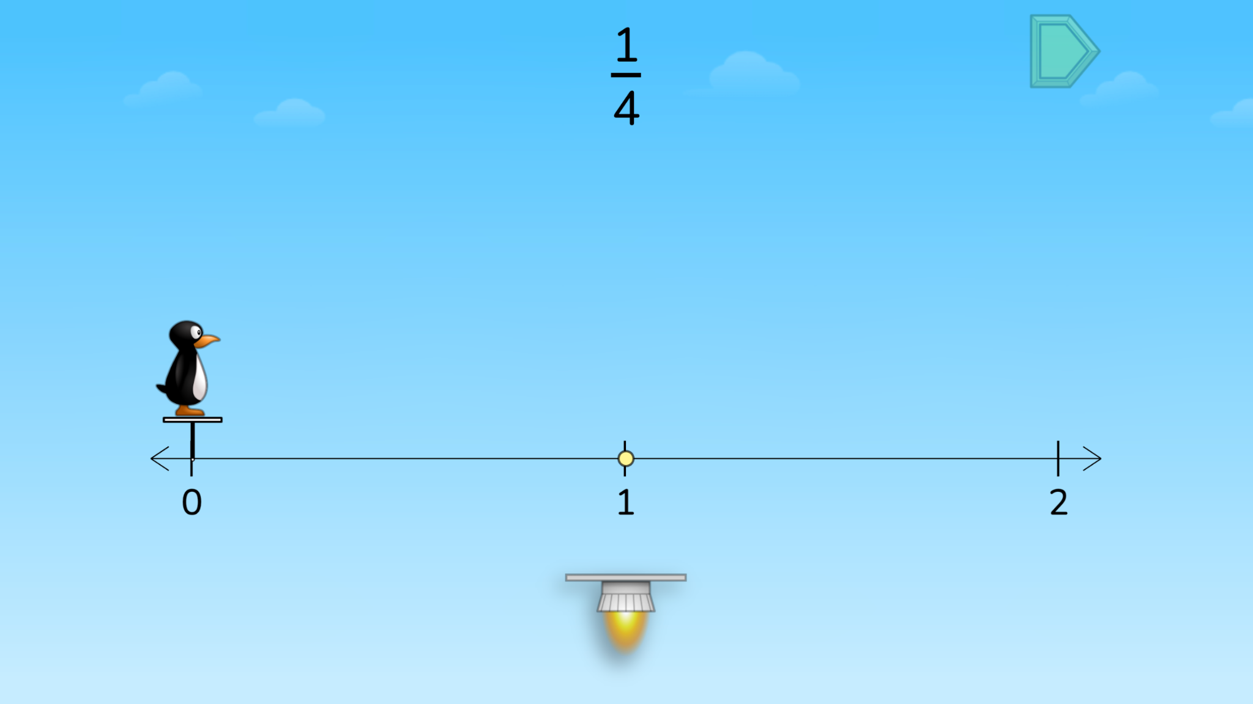
Module 4 - Day 2
Puzzle Talk
Time for
PROBLEM SOLVING!
ST Math Puzzle:
Estimate Fractions on a Number Line > Level 4
Learning Objective:
Comparing fractions on a number line
Puzzle Link
Notes:
Puzzle Talk
Focus on student thinking and developing problem solving skills using the guiding questions in each step of the Problem Solving Process.
Provide students with paper or whiteboards/dry erase markers.
Sign in to your ST Math account to access the puzzle.
Display Third Grade > Estimate Fractions on a Number Line > Level 4
Game Link: https://play.stmath.com/raft/ed/10.0.3/#/objective/b991e4dd-c319-42df-9fe5-a5763e7f99d3/6ae51e25-73a2-41e1-bf7d-4bce038df136/games#game8
Notice and Wonder
Display the first puzzle in Level 4 that has a fraction greater than 1. Have them reflect on the differences from yesterday’s puzzles and what they need to do to solve. Allow a few students to share out.
Ask students to draw a 0-2 number line like the one in the puzzle on their paper/whiteboard.
Ask: What do you notice about this fraction? What does it mean when the numerator is greater than the denominator? Where do you think this fraction would be placed on this number line? Why?
Predict and Justify
Have students make a prediction. After some think time, have them share with a partner their strategies and reasoning.
Have students share out their predictions and strategies as a whole group.
Test and Observe
Select one students’ strategy. Ask the students if they agree or disagree and why. How does it relate to their own? Have them turn and talk to a neighbor to discuss.
Try the student’s solution and watch the feedback. Ask students to describe what happened.
Analyze and Learn
Ask students: What did they learn from the feedback? How does this affect their strategy?
Show the next puzzle. Ask students to determine how to partition the number line.
Partition the number line to match the denominator and then count fraction pieces until you reach the fraction in the puzzle. Remind students that fractions, like numbers, go on forever, and don’t stop at 1.
Repeat with additional puzzles in Level 4.
Connect and Extend
Display the first puzzle in Level 5. Ask students to draw a 0-3 number line on their paper/whiteboard. Ask: How should we partition the number line? How do you know?
Use the denominator to divide the number line into equal parts. Then ask students, “How many of these equal pieces do we need?”
Use the numerator to count out the correct number of equal pieces.
Ask: Is this fraction greater than, less than, or equal to 1? How do you know?
Repeat with additional puzzles in Level 5.
How does the student
visually partition the number line?
explain why do they partition the number line in this way?
determine where to place the rocket?

Slide 47
Module 4 - Day 2
Problem Solving
Problem of the Day
Create a number line from like yesterday's number line. Write 3 comparison statements and prove them on the number line. Example: 1 = 4/4 and 3/4 > 1/2.
Notes:
Problem of the Day
Engage students in problem solving discussions. Read and discuss the problem, share student work, compare strategies and make connections.
• Use your number line from yesterday or create a new one. Write 3 comparison statements and prove them on the number line. Example: 1 = 4/4 and 3/4 > 1/2.

Slide 48
Module 4 - Day 3
My Thinking Path
???
What I know about comparing fractions is…
What I know about comparing fractions on a number line is…
One thing I learned is . . .
A question I have is . . .
This is like…
This is not like….
I wonder…
Notes:
My Thinking Path
Have students reflect on what they have learned about comparing fractions on a number line.

Slide 49
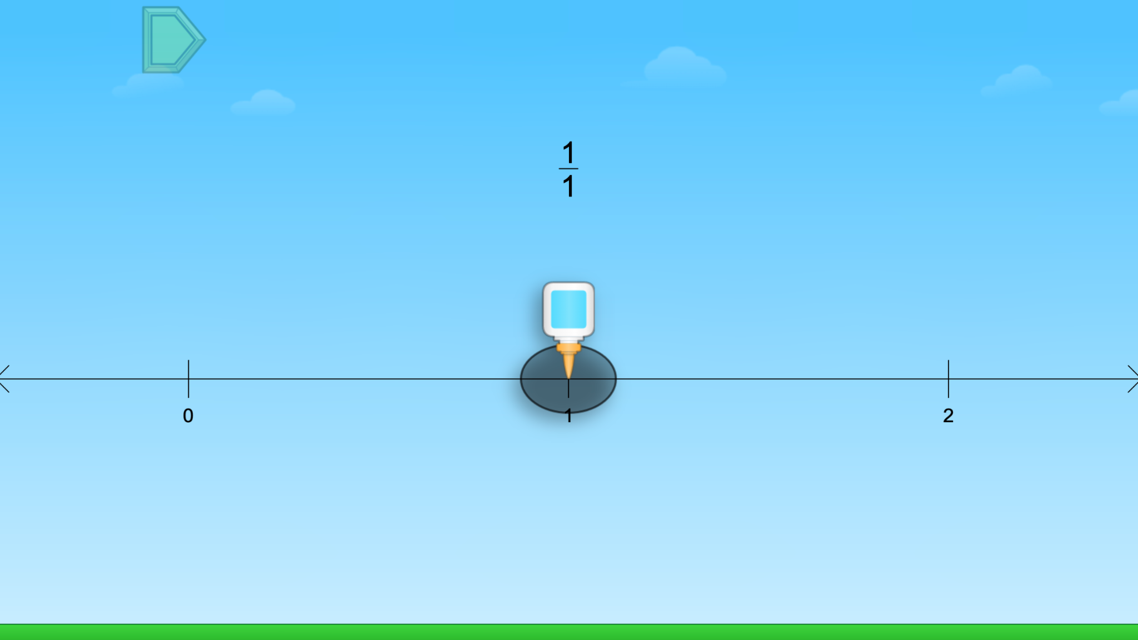
Module 4 - Day 3
Puzzle Talk
Time for
PROBLEM SOLVING!
ST Math Puzzle:
Fraction Trap > Level 1
Learning Objective:
Comparing fractions on a number line
Puzzle Link
Notes:
Puzzle Talk
Focus on student thinking and developing problem solving skills using the Problem Solving Process.
Provide students with whiteboards/dry erase markers.
Sign in to your ST Math account to access the puzzle.
Display Third Grade > Fraction Trap > Level 1
Game Link: https://play.stmath.com/raft/ed/10.0.3/#/objective/b991e4dd-c319-42df-9fe5-a5763e7f99d3/6ae51e25-73a2-41e1-bf7d-4bce038df136/games#game9
Notice and Wonder
Display the first puzzle in Level 1. Ask “What do you notice?” “What do you wonder?” “What do you think you need to do to solve this puzzle?” Allow a few students to share out.
Predict and Justify
Have students make a prediction. After they have had some think time, have them Think-Pair-Share about what they would like to try, what will happen when they try it, and why they think it will work.
Have students share out their predictions and related strategy.
Select one students’ strategy. Ask the students to think about if they agree/disagree with the strategy and why. How does it relate to their own strategy?
Test and Observe
Try a student’s solution and watch the feedback. Ask students to describe what happened.
Analyze and Learn
Ask students to think about how what they saw happen compares to their prediction. What did they learn from the feedback? How does this affect their strategy?
Display the next puzzle in Level 1. Ask students to draw a 0-2 number line to match the one in the puzzle.
Ask: What do you notice? What do you wonder? What do you know about the fraction in this puzzle? Have students Think, Pair, Share their thinking with a partner.
Share students’ thinking and solutions (e.g., drawing on their number line).
Connect and Extend
Try a student’s solution for a new puzzle and watch the feedback.
Ask students:
What do you know about this number line?
How is it different from the number line in the last puzzle?
How do we represent 1 on this number line?
What does the denominator tell us? The numerator?
Repeat with additional puzzles in Level 1.
Ask students questions about the variety of fractions that show up in the puzzles. For example, “What does a numerator of 0 tell us?” “What does a numerator of 1 tell us?” “How do we know a fraction is greater than 1?”
How does the student
discuss the role of the numerator and denominator in locating a fraction on the number line?
create and partition a number line to locate fractions?
count fraction parts to place a number on a number line?
represent 1 as a fraction on a number line?
compare number lines?

Slide 50
Module 4 - Day 3
Problem Solving
Problem of the Day
5/6, 3/4, 2/3, and 10/9. Select the number closest to 1. Draw a number line and place it on your number line. Explain how you knew this number was closest to 1. Explain how you knew where to place the number on the number line.
Notes:
Problem of the Day
Engage students in problem solving discussions. Read and discuss the problem, share student work, compare strategies and make connections.
• 5/6 3/4 2/3 10/9 Select the number closest to 1. Draw a number line and place it on your number line. Explain how you knew this number was closest to 1. Explain how you knew where to place the number on the number line.

Slide 51
Module 4 - Day 4
My Thinking Path
???
What I know about comparing fractions is…
What I know about comparing fractions on a number line is…
One thing I learned is . . .
A question I have is . . .
This is like…
This is not like….
I wonder…
Notes:
My Thinking Path
• Have students reflect on what they have learned about comparing fractions on a number line.

Slide 52
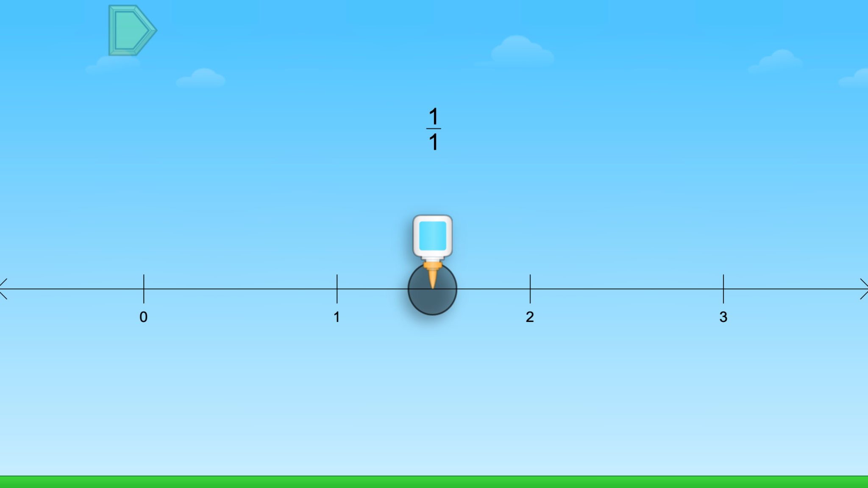
Module 4 - Day 4
Puzzle Talk
Time for
PROBLEM SOLVING!
ST Math Puzzle:
Fraction Trap > Level 2
Learning Objective:
Comparing fractions on a number line
Puzzle Link
Notes:
Puzzle Talk
Focus on student thinking and developing problem solving skills using the Problem Solving Process.
Provide students with whiteboards/dry erase markers.
Sign in to your ST Math account to access the puzzle.
Display Third Grade > Fraction Trap > Level 2
Game Link: https://play.stmath.com/raft/ed/10.0.3/#/objective/b991e4dd-c319-42df-9fe5-a5763e7f99d3/6ae51e25-73a2-41e1-bf7d-4bce038df136/games#game9
Notice and Wonder
Display the first puzzle in Level 2. Ask “What do you notice that is similar/different to the puzzles we did yesterday?” Is this fraction greater than, less than or equal to 1? How do you know?”
Allow a few students to share out.
Predict and Justify
Have students make a prediction. After they have had some think time, have them Think-Pair-Share about what they would like to try, what will happen when they try it, and why they think it will work.
Have students share out their predictions and related strategy.
Select one students’ strategy. Ask the students to think about if they agree/disagree with the strategy and why. How does it relate to their own strategy?
Test and Observe
Try a student’s solution and watch the feedback. Ask students to describe what happened.
Analyze and Learn
Display the next puzzle in Level 2. Ask students: What do you know about the fraction in this puzzle? What do you know about this number line? How is it different from the number line in the last puzzle? “
Have students change the number line on their paper/whiteboards to match the puzzle.
Solve the puzzles in Level 2, asking the same types of questions from Level 1.
Display the first puzzle in Level 3.
Ask: How has the number line changed? How does this change our answers? How long could the number line get? Discuss with students that as the number line extends to bigger numbers, the spaces between our whole numbers get smaller.
Connect and Extend
Ask: Is ½ in the same location on the first number line we used (0-2) as it is on this number line (0-5)? Does the size of our number line affect the size of the fraction pieces? Why or why not?
Have some students think silently first, and then take some responses to share whole group.
Explain that the location of ½ doesn’t change- it’s still halfway between 0 and 2- but the size of the ½ has gotten smaller because the size of the wholes on the number line have gotten smaller. Use an example to help the discussion like, “If we had 1/2 of a cookie or 1/2 of a pizza, they wouldn't be the same size because the wholes are different sizes.”
Solve additional puzzles in Level 3.
How does the student
discuss the role of the numerator and denominator in locating a fraction on the number line?
create a and partition a number line to locate fractions?
count fraction parts to place a number on a number line?
represent 1 as a fraction on a number line?
compare number lines?

Slide 53
Module 4 - Day 4
Problem Solving
Problem of the Day
7/6, 1/4, 3/8 and 8/9. Select the number closest to 1/2. Draw a number line and place it on your number line. Explain how you knew this number was closest to 1/2. Explain how you knew where to place the number on the number line.
Notes:
Problem of the Day
Engage students in problem solving discussions. Read and discuss the problem, share student work, compare strategies and make connections.
• 7/6, 1/4, 3/8, 8/9 Select the number closest to 1/2. Draw a number line and place it on your number line. Explain how you knew this number was closest to 1/2. Explain how you knew where to place the number on the number line.

Slide 54
Module 5
Let’s see math come alive!

Slide 55
Module 5 - Day 1
My Thinking Path
Topic: Comparing fractions and equivalent fractions
???
What I know about comparing fractions is…
What I know about equivalent fractions is…
One thing I learned is . . .
A question I have is . . .
This is like…
This is not like….
I wonder…
Notes:
My Thinking Path
Have students write in the topic, “Comparing fractions and equivalent fractions.”
Have students begin working on the first two boxes.
Discuss their ideas and allow students to add to their paper any additional thoughts they have.
Have students complete the Pre-Quiz (optional).

Slide 56
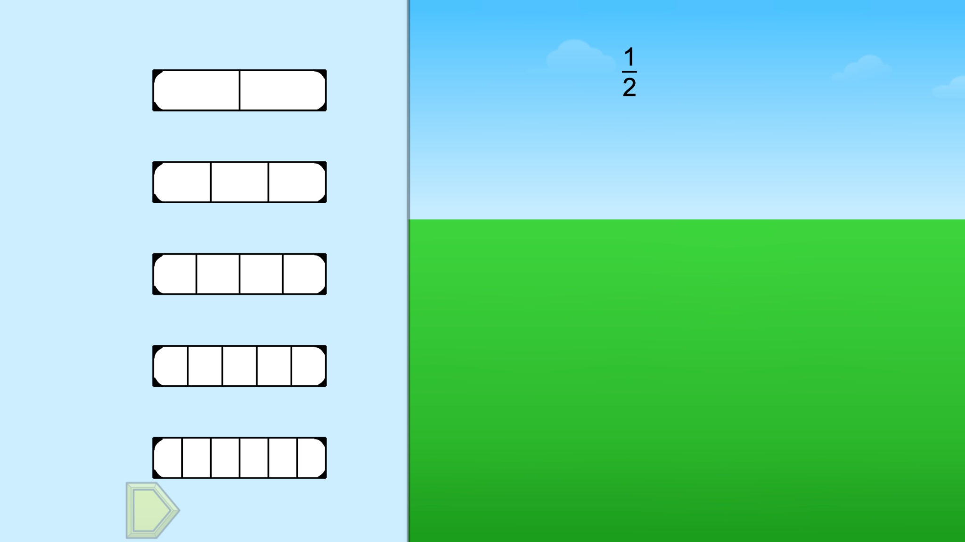
Module 5 - Day 1
Puzzle Talk
Time for
PROBLEM SOLVING!
ST Math Puzzle:
Fraction Bricks > Level 1
Learning Objective:
Comparing fractions and equivalent fractions
Puzzle Link
Notes:
Puzzle Talk
Focus on student thinking and developing problem solving skills using the Problem Solving Process.
Provide students with paper or whiteboards/dry erase markers.
Sign in to your ST Math account to access the puzzle.
Display Third Grade > Fraction Bricks > Level 1
Game Link: https://play.stmath.com/raft/ed/10.0.3/#/objective/b991e4dd-c319-42df-9fe5-a5763e7f99d3/6ae51e25-73a2-41e1-bf7d-4bce038df136/games#game10
Notice and Wonder
Display the first puzzle in Level 1. Ask “What do you notice about the fraction in the sky?” “How do we fill in the hole?” Allow a few students to share out.
Predict and Justify
Have students make a prediction. After they have had some think time, have them Think-Pair-Share about what they would like to try, what will happen when they try it, and why they think it will work.
Have students share out their predictions and related strategy.
Select one students’ strategy. Ask the students to think about if they agree/disagree with the strategy and why. How does it relate to their own strategy?
Test and Observe
Try a student’s solution and watch the feedback. Prompt students to describe what happened, and ask them “What does it mean if two fractions are equivalent?”
Analyze and Learn
Play the same puzzle again to highlight equivalent fractions, and say to students, “Is there another fraction that is equal to this fraction?” “Can you figure out which fraction will fill this hole too?”
Ask students to record the solution on their paper/whiteboards by writing a number sentence using the equal sign (e.g., 2/4 = ½ = 3/6).
If the puzzle has more equivalent fractions, have students share out the missing fractions. Discuss the name of each fraction as they are added to the hole. Record the comparisons.
Display the first puzzle in Level 2. Ask students to write down the fraction they think will fill the hole.
Connect and Extend
Ask students to then write down a fraction that is less than the fraction shown and turn to their partner to share their fraction.
Share some students' solutions with the whole group.
Ask students to then write down a fraction that is greater than the fraction shown and turn to their partner to share their fraction.
Share some students’ solutions and prove they are correct.
Choose one puzzle from Level 2. Have students draw a number line and place the given fraction on the number line. Ask students:
How did you know where to place this fraction on the number line?
Why are equivalent fractions at the same spot on the number line?
How does the student
name each fraction before selecting it to fill the hole?
determine an equivalent fraction?
compare two fractions?
write equations to show equivalence?
discuss the numerator and denominator of each fraction
place equivalent fractions on a number line?

Slide 57
Module 5 - Day 1
Problem Solving
Problem of the Day
Kiesha, Horatio, and Iris wanted to know whose toy car would roll the farthest. They made a long track and marked it every fourth of a foot. Kiesha’s car rolled 13/4 foot. Horatio’s car rolled 10/4 foot. Iris’ car rolled 17/4 foot. Whose car rolled the farthest? What was the order of the cars?
Notes:
Problem of the Day
Engage students in problem solving discussions. Read and discuss the problem, share student work, compare strategies and make connections.
• Kiesha, Horatio, and Iris were seeing whose toy car would roll the farthest. They made a long track and marked it every fourth of a foot. Kiesha’s car rolled 13/4 foot. Horatio’s car rolled 10/4 foot. Iris’s car rolled 17/4 foot. Whose car rolled the farthest? What was the order of the cars?

Slide 58
Module 5 - Day 2
My Thinking Path
???
What I know about comparing fractions is…
What I know about equivalent fractions is…
One thing I learned is . . .
A question I have is . . .
This is like…
This is not like….
I wonder…
Notes:
My Thinking Path
Have students reflect on what they have learned about comparing fractions and equivalent fractions.

Slide 59
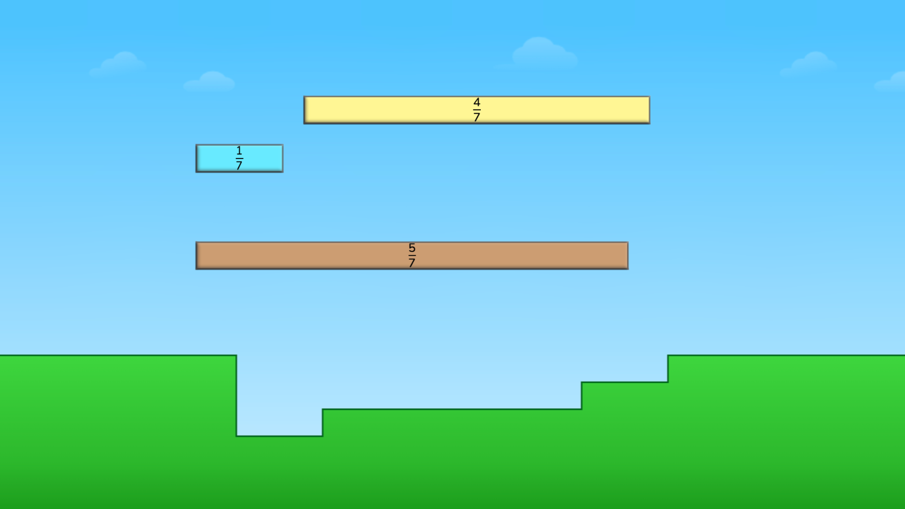
Module 5 - Day 2
Puzzle Talk
Time for
PROBLEM SOLVING!
ST Math Puzzle:
Fraction Order Fill > Level 1
Learning Objective:
Comparing fractions and equivalent fractions
Puzzle Link
Notes:
Puzzle Talk
Focus on student thinking and developing problem solving skills using the Problem Solving Process.
Sign in to your ST Math account to access the puzzle.
Display Third Grade > Fraction Order Fill > Level 1
Game Link: https://play.stmath.com/raft/ed/10.0.3/#/objective/b991e4dd-c319-42df-9fe5-a5763e7f99d3/6ae51e25-73a2-41e1-bf7d-4bce038df136/games#game11
Notice and Wonder
Display the first puzzle in Level 1. Ask “What do you notice?” “What do you wonder?” “What do you know about the three fractions in the puzzle?” Allow a few students to share out.
Predict and Justify
Have students make a prediction. After they have had some think time, have them Think-Pair-Share about what they would like to try, what will happen when they try it, and why they think it will work.
Have students share out their predictions and related strategy.
Select one students’ strategy. Ask the students to think about if they agree/disagree with the strategy and why. How does it relate to their own strategy?
Test and Observe
Try a student’s solution and watch the feedback. Ask students to describe what happened using these questions:
How can you use the numerator to help compare these fractions?
How can you use the denominator to help compare the fractions?
Analyze and Learn
What did they learn from the feedback? How does this affect their strategy?
Show the next puzzle. Ask students, “If all of these fractions have the same denominator, how can we use the numerator to compare them?”
Have students Think, Pair, Share with a partner and record the order of the fractions from least to greatest on their whiteboards. Try a student’s solution and watch the feedback.
Pause the puzzle before JiJi crosses the screen. Ask the students “How can you use what you know about 1 to order these fractions?” “How can you compare fractions with different denominators?”
Connect and Extend
Have students order fractions by writing number sentences. Discuss students’ strategies (e.g., Did they change the 1 to a fraction? Represent the fraction with a denominator of 1? Did they make a model to find a common denominator?).
Say to students, “How could we represent our solution to this puzzle using a number sentence?” Model how to write a number sentence using <, > and/or =.
Repeat the questioning and number sentences for a few puzzles in Levels 1 and 2.
Choose one puzzle from Level 2 and have students draw a number line and place the three fractions on the number line. Ask students to explain how they compared fractions using a number line.
Display the first puzzle in Level 4, asking students, “What is different about this puzzle and the other puzzles we have solved?” How can you represent your solution to this puzzle using a number sentence?
Students should note that now the puzzles do not all have like numerators or denominators.
Have students share out their strategies for comparing the fractions (e.g., Did they use an equivalent fraction? Did they decide if one of the fractions was closer to 0, ½ or 1?, etc. Did they visualize where each fraction landed by looking at the empty spaces on the grass? Did they draw a number line?) Celebrate creative strategies whenever possible.
How does the student
discuss the role of the numerator to compare fractions and order them from least to greatest?
discuss the role of the denominator to compare fractions and order them from least to greatest?
represent the solution by writing a number sentence?
determine where to place the three fractions on a number line?

Slide 60
Module 5 - Day 2
Problem Solving
Problem of the Day
Carlos, Lionel, Jamal, and Jane compared the amount of milk they each drank at lunch. Carlos drank 3/4 of his milk, Lionel drank 1/4 of his milk, Jamal didn’t drink any milk, and Jane drank 1/2 of her milk. Compare the fraction of milk each person drank and put them in order from most to the least amount of milk each person drank.
Notes:
Problem of the Day
Engage students in problem solving discussions. Read and discuss the problem, share student work, compare strategies and make connections.
• Carlos, Lionel, Jamal, and Jane compared the amount of milk they each drank at lunch. Carlos drank 3/4 of his milk, Lionel drank 1/4 of his milk, Jamal didn’t drink any milk, and Jane drank 1/2 of her milk. Compare the fraction of milk each person drank and put them in order from most to the least amount of milk each person drank.

Slide 61
Reflection Poster
Slides 62-63

Slide 62
Time for
REFLECTION!
LET’S BRAINSTORM
What math concepts did you learn this summer?
What new vocabulary did you learn?
What strategies did you use when you got stuck?
How did you become a better
mathematician?
Notes:
Reflection Poster
Students are going to create a Reflection Poster that represents the learning they have gained. The poster should reflect how their thinking and understanding has grown. It should be an opportunity for students to show what they know.
Work with students to review the thinking they have recorded in their journals (My Thinking Path, Exit Tickets, PODs, ST Math Puzzle Reflection, etc.) and discuss what they have learned during Summer Immersion. Discuss major concepts and vocabulary they learned and used during Immersion.
Have students add to their journal as you discuss things they have learned but may have not yet included in their journal. This will prepare the students to complete their poster.
Ask students to work with their group to see what they might want to include on their poster.
Instruct groups to make their posters colorful, interesting and informative so students in other classes will see what they have accomplished in the past few modules.
Give students time to begin working on their posters.
The posters will be displayed for the entire school and parents to see on Day 5.
The reflection poster is best done as a small group project because that allows students to engage in higher order thinking skills (e.g., evaluating their learning and the ideas of others, synthesizing their thoughts and the thoughts of others, reaching consensus, and working together). It can however, be done as an individual project. Have students begin to think about all of the things that they have learned and make a poster to share what they have learned.

Slide 63
Time for
REFLECTION!
DESIGN A REFLECTION POSTER
Share what you know!
What math concepts did you learn this summer?
What new vocabulary did you learn?
What strategies did you use when you got stuck?
How did you become a better mathematician?
Make your poster
colorful, interesting and informative.
Notes:
DAY 3 - Reflection Poster

Slide 64
Mini Math Game Design
Use Slides 65-69 if using the
4-Day Immersion Program

Slide 65
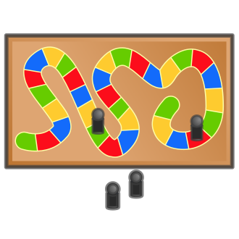
We are going to create a game like the ones you played this summer!
Notes:
Mini-Math Game Design (4-Day Immersion only)

Slide 66
Let’s Brainstorm!
What are some games you know?
Can you think of how you might put math in the game?
Can you think of a game you would like to make that is like the ones you know?
Notes:
Mini-Math Game Design (4-Day Immersion only)
What are some games you know? Make a list.
From the list, decide which type of game you are going to recreate.

Slide 67
Your New Game
When you make a new game, what math concepts can you include?
___ addition
___ subtraction
___ shapes
___ money
___puzzles
___ time
___ measuring
___ estimation
___ place value
___ something else?
Notes:
Mini-Math Game Design (4-Day Immersion only)
What math concepts can you include in your game?

Slide 68
Your New Game
Can you make a game to teach
or practice a math concept?
What is your game called?
How many players can you have?
What are the directions and rules for your game?
Notes:
Mini-Math Game Design (4-Day Immersion only)
How can you make a game to teach or practice a math concept? Think about how the game will help all players develop mathematical reasoning.
Create a name for your game. Decide how many players can play.
What are the rules and directions for your game? Make sure your rules are clear and concise.

Slide 69
Now it’s time to make a new game!
Work together to make a game that your friends will want to play.
Notes:
Mini-Math Game Design (4-Day Immersion only)
Students will work in small groups to create a game. Provide them with the supplies needed. The list below are samples of items that could be used.
Dice or number cubes
Construction paper
Scissors
Poster board
Manilla folders
Index Cards
Egg cartons*
Water bottles*
Pizza circles*
Paper towel rolls*
Buttons*
Other creative items

Slide 70
Learning Showcase and Celebration Slides

Slide 71
W
elcome
to
ST Math Immersion’s
Learning Showcase
& Celebration!
Notes:
Welcome to Learning Showcase and Celebration!
Why are we here?
Today is the last of the ST Math Summer Immersion! The Learning Showcase and Celebration is about providing students an opportunity to “show what they know.” Our students have been learning throughout the summer and will be sharing the information they have learned.
We have invited you all to to celebrate and hear from students about what they learned. Don’t forget to use the Immersion Debriefing Bookmarks to ask questions.

Slide 72
AGENDA (Sample)
10:00 am - Welcome
Gallery Walk of Posters
10:15 am - Presentation
10:30 am - Debriefing Time
11:00 am - Game Time
11:30 am - End Time
Notes:
Sample Framework
You can make changes that work for their space. Consider how you will set up the learning showcase (grade level celebration, grade band celebration, whole school celebration). Divide the time you set aside with the following activities below:
Welcome: Introduce yourself. Share an overview of what the students did and why they are having a Learning Showcase and Celebration. We want this to be a positive and fun experience for the students.
Gallery Walk of Posters: It is recommended that the posters be hung around the room. Invite guests/classmates to walk around the room, look at the reflection posters and ask questions.
Presentations: Students summarize and present their math game design (completed during the program) and their reflection posters.
Immersion Debriefing Time: During this time, students will be asked questions about the work they did. Print and distribute the ST Math Immersion Debriefing Bookmark to visitors (which is optional). Encourage them to use it to ask students questions about their projects and what they have learned.
Game Time: Set aside time for visitors to play the games created by the students. This is a great time for students to play each other's games as well.
Note: We recommend giving students encouragement notes throughout the program.

Slide 73
Resource

Slide 74
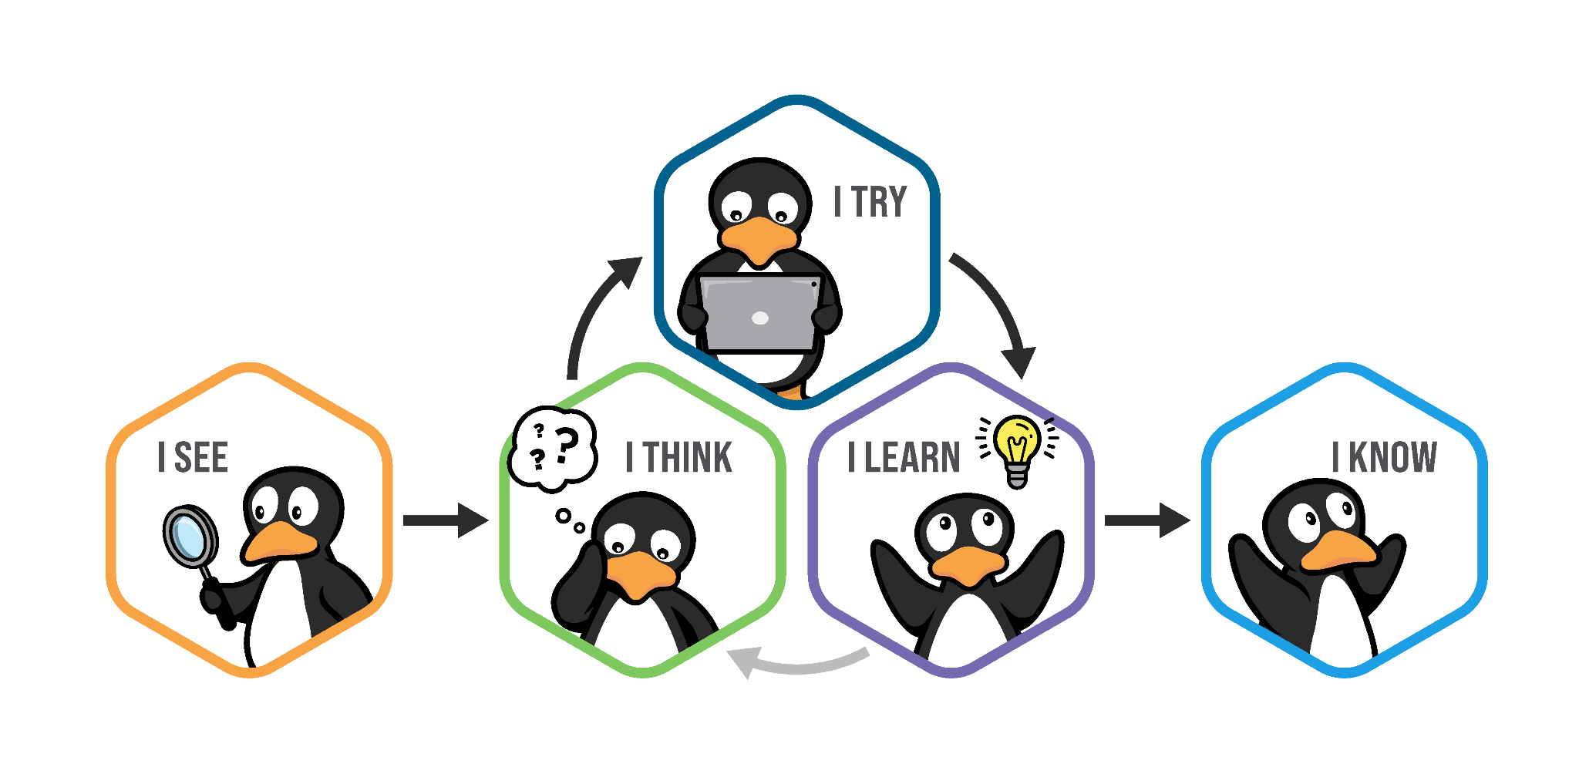
Problem Solving Process

