Slide 1
Problem Solving Slide Deck
Grade 2
Notes:
© 2024 MIND Education. All rights reserved. v2.0

Slide 2
Module 1
Let’s get started on the fun!

Slide 3
Module 1 - Day 1
Who is JiJi?
Read the book
or
Watch the video
Notes:
USE THIS SLIDE IF YOUR STUDENTS ARE NEW TO ST MATH
Choose one of the following ways to introduce ST Math to your students:
Read students the JiJi to the Top book or
Show a video telling the story to introduce ST Math.
OR
Show students the Guided Intro and/or Intro Video [English] [Spanish]

Slide 4
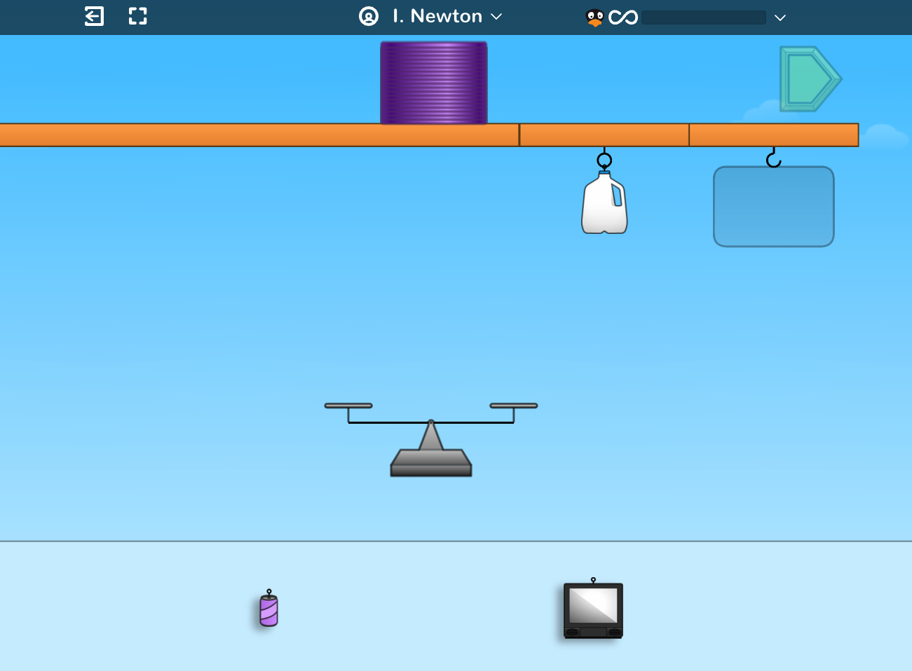
Module 1 - Day 1
New to ST Math?
Play the Slinky game
Notes:
USE THIS SLIDE IF YOUR STUDENTS ARE NEW TO ST MATH
Choose one of the following ways to introduce ST Math to your students.
Read students the JiJi to the Top book or show a video telling the story to introduce ST Math.
OR
Show students the Guided Intro and/or Intro Video [English] [Spanish]
Play the Slinky game with your students. During game play explain that ST Math is a program that teaches math in a very different way.
Encourage students to look at the visual models on the screen and determine what they think they should do.
Point out the things that are clickable and that clicking on the sky makes the clickable parts shimmer.
Show them how to pause the animation to slow down the feedback.
Make sure students understand that they have to complete all the puzzles in a level before moving on to the next.
Ask students if ST Math reminds them of other math programs. Why or why not?

Slide 5
Module 1 - Day 1
Share ST Math Experience!
What do you know about ST Math?
What do you like about ST Math?
What is your favorite ST Math game? Why?
One ST Math tip I have is . . .
A question I have is . . .
My ST Math Goal is . . .
I’m wondering about . . .
Notes:
USE THIS SLIDE IF YOUR STUDENTS ARE NOT NEW TO ST MATH
If your class has been using ST Math, you will not need to do a formal introduction to the program. Instead focus on engaging them in discussions where they can share tips, encouragement, and success stories with ST Math.
Brainstorm what students like about ST Math. What tips do they have to share? What do they do when they get stuck?
Have students share their favorite games and why they like them.
Discuss goal setting with students and set a puzzles and minutes goal for this first module.
Provide students with a tracker and walk them through how to use it.
Let the students know if they will be doing the Journey, Assignments or both. Remind them that you are able to see the minutes and puzzles they have completed during the module.
Extension if time permits.
Ask students, if they like to solve puzzles. Then, have them tell about puzzle they solved.

Slide 6
Module 1 - Day 1
Problem Solving
Problem of the Day
Create a class “Getting to Know Our Class” chart.
Notes:
Problem of the Day
Create a class “Getting to Know Our Class” chart. Ask the students questions to gather data about the class and record the information on a white board or chart.
(You will use this information throughout the module so it is important that it is in a form you can refer back to)
Some questions you may ask to gather data might include:
How many students are in this class?
How many are girls? Boys?
How many students have brown eyes? Blue eyes? Green eyes?
How many students in the class have black hair? Brown hair? Blonde hair? Red hair?
How many have pets? Siblings? Favorite subject? Favorite flavor ice cream? Favorite color?
This is a great opportunity to practice counting, making tally marks, and comparing numbers (more/less, bigger/smaller, one more, two more, one less, two less, etc.)

Slide 7
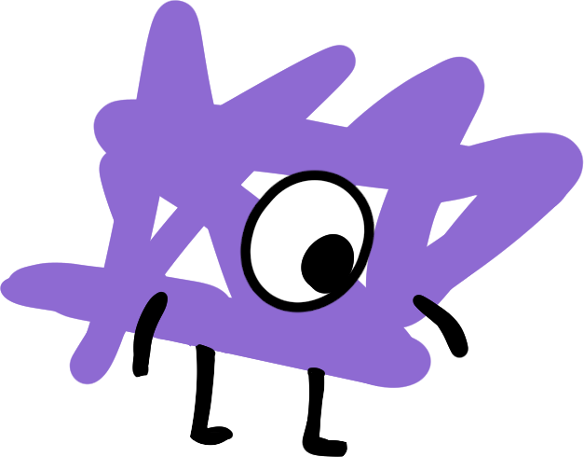
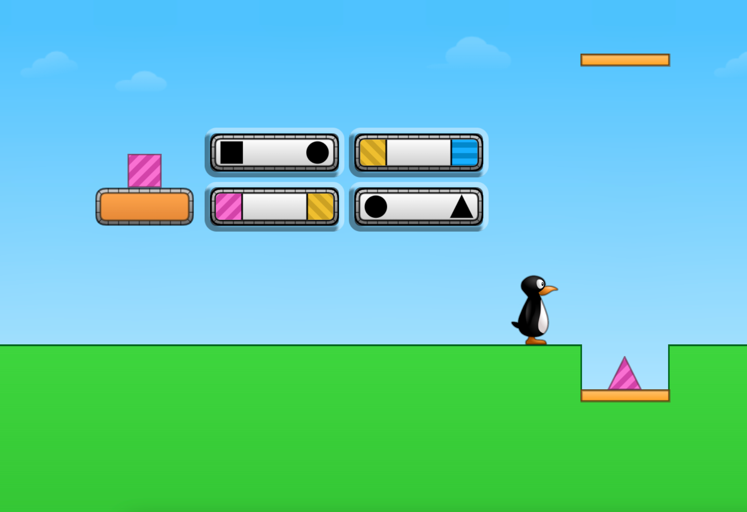
Module 1 - Day 2
Puzzle Talk
Time for
PROBLEM SOLVING!
ST Math Puzzle:
Attribute Transform > Level 1
Learning Objective:
What do you know about ST Math?
Puzzle Link
Notes:
Puzzle Talk
Focus on student thinking and developing problem solving skills using the Problem Solving Process.
Sign in to your ST Math account to access the puzzle.
Display Second Grade > Challenge Objective > Attribute Transform > Level 1
Game Link: https://play.stmath.com/raft/ed/10.0.3/#/objective/9a90669d-0e02-4798-a669-71713c4018e1/e0a180a3-3ee9-41a8-9ea7-d6bc042fe483/games#game5
Notice and Wonder
Introduce and discuss the first Attribute Transform puzzle.
Tell students you are going to teach them questions they can ask themselves to help think through the puzzles. The first question students should ask themselves is “What do I notice?”
Encourage students to complete this sentence “I notice _____.”
Have several students share what they notice, not how they would solve it.
Remind students that they can click the sky and the clickable elements will shimmer.
Predict and Justify
The next question students should ask themselves is “What is my prediction?”
Encourage students to complete this sentence “My prediction is ________ because_____.”
Have different students share their predictions and why they think theirs is the best prediction.
Ask students to name or describe the strategy they will use to test their prediction. For example, a student may predict that they have to somehow move the shape from one-side to the other. In this case they would name the strategy of matching. “My strategy is to change the color of the triangle on the left to match the color of the triangle on the right by selecting the block that has the matching color. ”
Ask students to describe what they think will happen when you test their prediction and why.
Test and Observe
Encourage students to observe and think about the results of testing their hypothesis.
Try a few student suggestions both correct and incorrect. Watch the feedback and discuss what they observed.
Analyze and Learn
Facilitate students in analyzing the feedback/results, understanding what worked and didn’t work.
How does this compare to what you thought would happen?
What did you learn?
How will you use what you learned?
Be sure to use the playback features to pause, rewind, and fast forward the animation and discuss what they are learning from the feedback.
Use the annotation tools to highlight the learning.
Connect and Extend
Do one example of each (changing color (Level 1), changing shape (Level 2), stretching (Level 3).
Help students use what they've learned to solve new puzzles.
Discuss strategies and solutions (including incorrect ones). Explore different solutions and discuss what they thought would happen vs. what did happen.
Have students create their own Attribute Transform puzzle and share it with a neighbor. Can their neighbor correctly solve it? Choose a few to share with the whole group. See who can make the most challenging one, the most unique one, the most surprising one, etc.
How does the student:
solve the puzzles? (Are students visualizing the changes to the shape as it goes over each belt? Do they struggle to keep track of the changes?)
compare the shape on the left to the shape in the ground?

Slide 8
Module 1 - Day 2
Problem Solving
Problem of the Day
Describe the class mathematically.
Notes:
Problem of the Day
Remind students about yesterday’s Problem of the Day.
How can we describe the class mathematically?
Generate a list of 3-5 things students want to know about each other.
For example: Favorite ice cream flavor, favorite color, number of siblings, number of pets, favorite subject in school, month of birth, favorite sport, etc.

Slide 9
Module 1 - Day 3
My Thinking Path
Topic: Addition and subtraction of whole numbers
???
What I know about addition is…
What I know about subtraction is…
One thing I learned is . . .
A question I have is . . .
This is like…
This is not like….
I wonder…
Notes:
My Thinking Path
Students will begin solving problems involving addition and subtraction within 100. They will write equations to represent the problems including equations with a symbol for the unknown.
My Thinking Path Discussion:
Introduce the My Thinking Path document to students. Have them write in the topic, “Addition and subtraction of whole numbers.”
Have students begin working on the first two boxes.
Discuss their ideas and allow students to add to their paper any additional thoughts they have.
From today on, begin each of Days 1-4 with time for students to reflect on their learning and prepare for the day.

Slide 10
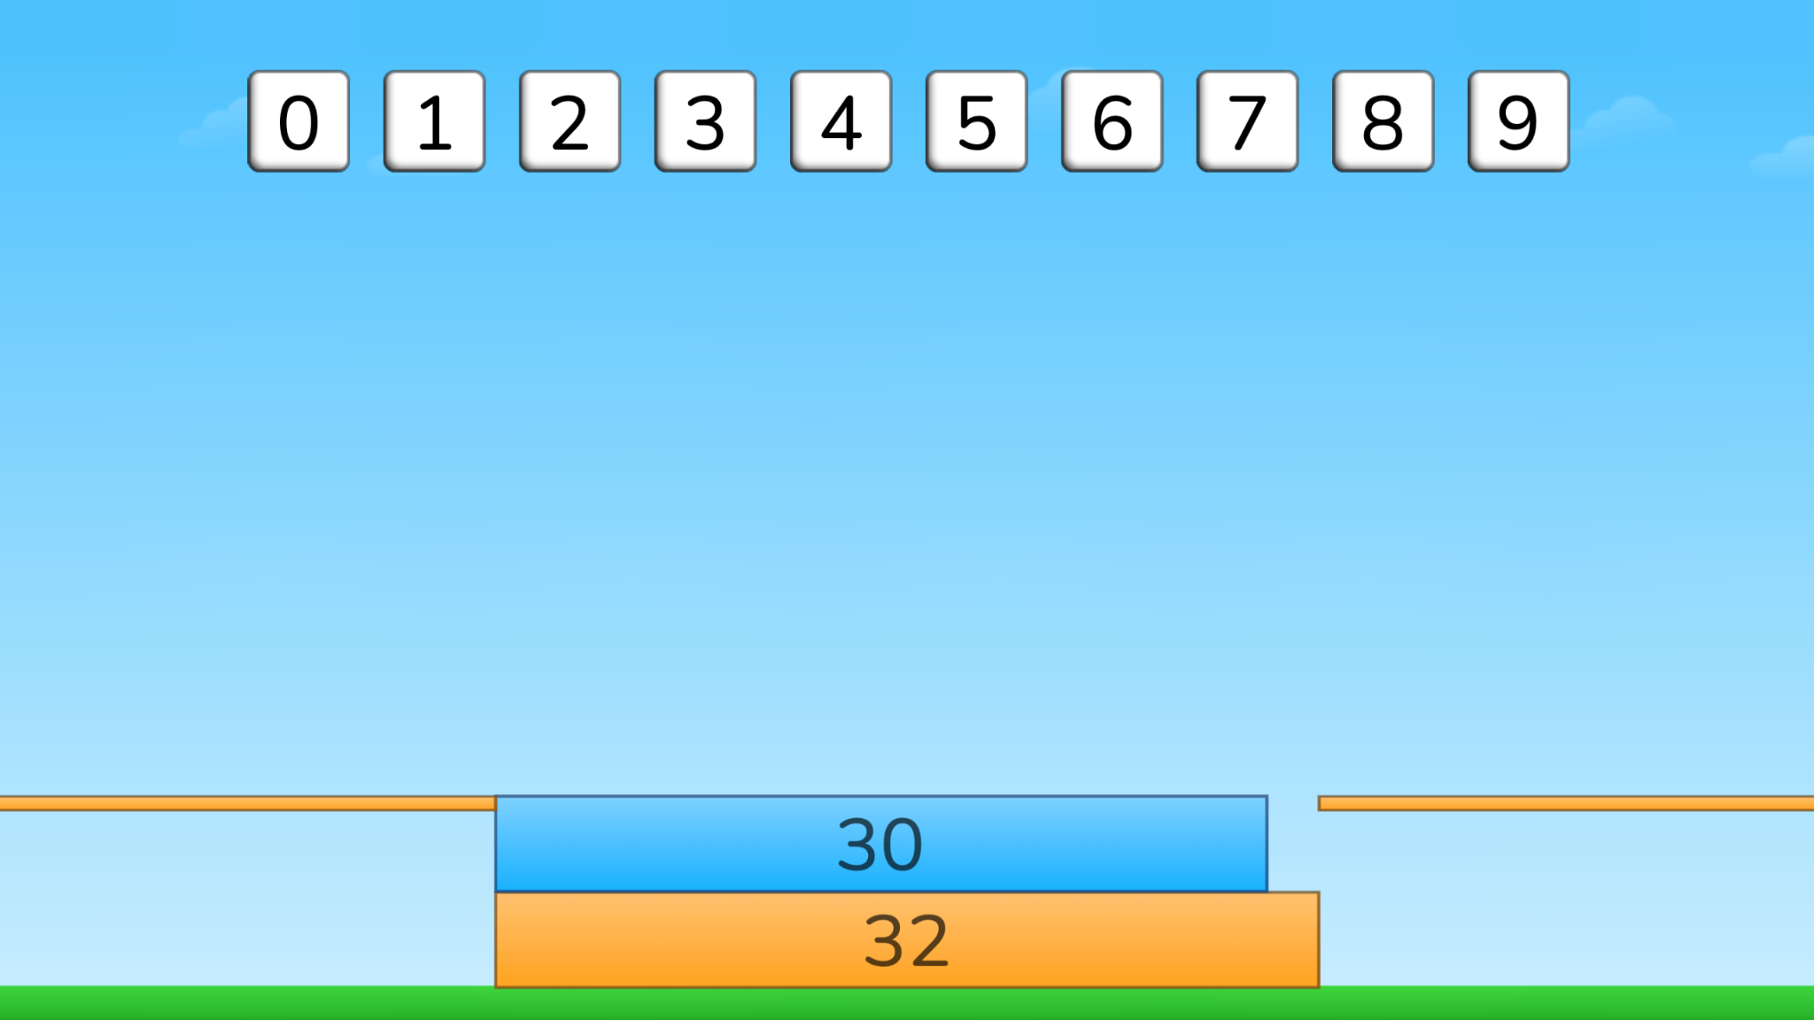
Module 1 - Day 3
Puzzle Talk
Time for
PROBLEM SOLVING!
ST Math Puzzle:
Missing Addend > Level 1
Learning Objective:
Addition and Subtraction Situations within 100
Puzzle Link
Notes:
Puzzle Talk
Focus on student thinking and developing problem solving skills using guiding questions for each step in the Problem Solving Process.
Provide students with whiteboards/dry erase markers.
Sign in to your ST Math account to access the puzzle.
Display Second Grade > Missing Addend > Level 1
Game Link: https://play.stmath.com/raft/ed/10.0.3/#/objective/264b40f1-b4fd-477e-9d7b-d21b437e255f/9d7e49a2-6498-4e3d-a9d7-6d528070773e/games#game1
Notice and Wonder
Display the first puzzle in Level 1. Ask “What do you notice?” “What do you wonder?” Allow a few students to share out.
Ask students to think of their strategy for solving the puzzle and predict what will happen when they try it.
Predict and Justify
Have students Think-Pair-Share their strategy and why they think their strategy can be used to solve this puzzle.
Have students share out. Try one of the students’ ideas. Ask students, “Why do you think the answer is ___?” Discuss strategies as a class.
Test and Observe
Solve the puzzle and have students describe what happened.
Analyze and Learn
Replay the same puzzle, pausing the puzzle before JiJi crosses the screen. Ask students: What is the unknown in this puzzle? How does the model look like a number line? Can that help us?
Repeat with the remaining puzzles in Level 1.
Connect and Extend
Display the first puzzle in Level 2. Ask students: What is different about this puzzle compared to the last ones we did? How do you think we solve this puzzle? Turn and talk to a neighbor about what you think the answer is and why.
Share students’ solutions and reflect on their process, such as "In every puzzle, we added a friendly number (a multiple of 10). Why is it easier to add a friendly number?"
Work together for the remaining puzzles in Level 2 to write equations that represent the puzzle using a variable. Explain to students that a variable (a letter or shape) represents the unknown in an equation.
How do students:
understand the relationship of addition and subtraction?
solve a start-unknown equation?
solve a change-unknown equation?
explain the purpose of an unknown/variable?

Slide 11
Module 1 - Day 3
Problem Solving
Problem of the Day
Yolanda made 48 cookies for a party.
Hector made 33 more.
How many cookies do they have altogether?
Notes:
Problem of the Day
Engage students in problem solving discussions. Read and discuss the problem, share student work, compare strategies, and make connections.
• Yolanda made 48 cookies for a party. Hector made 33 more. How many cookies do they have altogether?

Slide 12
Module 1 - Day 4
My Thinking Path
???
What I know about addition is…
What I know about subtraction is…
One thing I learned is . . .
A question I have is . . .
This is like…
This is not like….
I wonder…
Notes:
My Thinking Path
Have students reflect on what they have learned about addition and subtraction of whole numbers.

Slide 13
Module 1 - Day 4
Puzzle Talk
Time for
PROBLEM SOLVING!
ST Math Puzzle:
Missing Addend > Level 3
Learning Objective:
Addition and Subtraction Situations within 100
Puzzle Link
Notes:
Puzzle Talk
Focus on student thinking and developing problem solving skills using guiding questions for each step in the Problem Solving Process.
Provide students with a copy of the 0-100 Number Line Math Mat and Missing Addend Game Mat or provide whiteboards/dry erase markers.
Sign in to your ST Math account to access the puzzle.
Display Second Grade > Missing Addend > Level 3
Game Link: https://play.stmath.com/raft/ed/10.0.3/#/objective/264b40f1-b4fd-477e-9d7b-d21b437e255f/9d7e49a2-6498-4e3d-a9d7-6d528070773e/games#game1
Notice and Wonder
Display a puzzle in Level 3. Ask “What do you notice that is similar/different from the puzzles we played yesterday?” Allow a few students to share out.
Give students the Missing Addend Game Mat. Have them make a prediction based on the puzzle and represent that on their game mat.
Predict and Justify
Have students discuss their predictions with a neighbor: "What is the unknown in this problem?" Are their predictions similar/different? If they are different, decide which one is correct and why.
Test and Observe
Have students share out to the whole group. Try one of the students’ ideas. Watch the feedback together and discuss what they saw.
Analyze and Learn
Compare student’s predictions to what actually happened. What did they learn from the feedback?
Connect and Extend
Show the next puzzle and direct students to their Number Line Math Mat.
Discuss how the number line can be used to add and subtract numbers.
Look for students who make more than one jump to represent the solution. If no one uses multiple jumps, ask students if they could show the solution with multiple jumps.
Discuss how this strategy might help them solve more difficult problems.
Allow 2-3 volunteers to share their thinking and solution with the class. (Try to find some that are slightly different.) Discuss and compare the different ideas students shared. Ask if they are all correct.
Do a few more puzzles and reinforce key points regarding number lines (represent directed distance a number is from 0; intervals of tick marks; intervals of jumps, etc.).
How does the student:
understand the relationship of addition and subtraction?
solve a start-unknown equation?
solve a change-unknown equation?
explain the purpose of an unknown/variable?

Slide 14
Module 1 - Day 4
Problem Solving
Problem of the Day
Valerie had 67 beads.
She used some to make a necklace and the others she put in a box. How many could she have used for the necklace and how many could she have put in the box?
Explain your answer using pictures or words.
Notes:
Problem of the Day
Engage students in problem solving discussions. Read and discuss the problem, share student work, compare strategies and make connections.
• Valerie had 67 beads. She used some to make a necklace and the others she put in a box. How many could she have used for the necklace and how many could she have put in the box? Explain your answer using pictures or words.

Slide 15
Module 2
Can’t wait to see what we do!

Slide 16
Module 2 - Day 1
My Thinking Path
Topic: Solving problems with addition and subtraction
???
What I know about addition problems is…
What I know about subtraction problems is…
One thing I learned is . . .
A question I have is . . .
This is like…
This is not like….
I wonder…
Notes:
My Thinking Path
Provide My Thinking Paths to students. Have them write in the topic, “Solving problems with addition and subtraction."
Have students begin working on the first two boxes.
Discuss their ideas and allow students to add to their paper any additional thoughts they have.
From now on, each of Days 1-4 begins with time for students to reflect on their learning and prepare for the day.
Have students complete the Pre-quiz (optional).

Slide 17
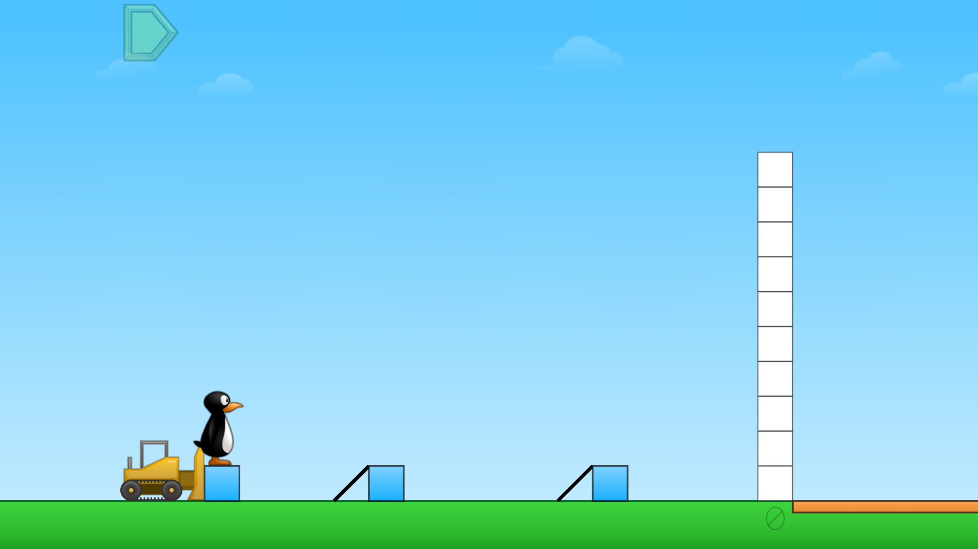
Module 2 - Day 1
Puzzle Talk
Time for
PROBLEM SOLVING!
ST Math Puzzle:
Push Box Two Operations > Level 1
Learning Objective:
Two Step Situations
Puzzle Link
Notes:
Puzzle Talk
Focus on student thinking and developing problem solving skills using guiding questions for each step in the Problem Solving Process.
Provide students with a copy of the Push Box Game Mat or whiteboards/dry erase markers.
Sign in to your ST Math account to access the puzzle.
Display Second Grade > Push Box Two Operations > Level 1
Game Link: https://play.stmath.com/raft/ed/10.0.3/#/objective/264b40f1-b4fd-477e-9d7b-d21b437e255f/9d7e49a2-6498-4e3d-a9d7-6d528070773e/games#game2
Notice and Wonder
Display the first puzzle in Level 1. Ask “What do you notice?” “What do you wonder?” Allow a few students to share out.
Predict and Justify
Give students the Push Box game mat and have them model how they would solve the problem.
Have students Think-Pair-Share their strategy for solving the puzzle with each other.
Ask a few students to share out and whether they agree or disagree with each other's strategies.
Test and Observe
Try one of the students’ ideas. Watch the feedback and have students share their observations of what happened.
Analyze and Learn
Ask students to think about how what they saw happen compares to their prediction. How many steps did it take to get to the orange blocks? If necessary, replay the puzzle using the same solution strategy and pause the animation to support the discussion.
Connect and Extend
Using the next puzzle in Level 1, have students model the puzzle and solve on their game mat.
Discuss their predictions.
Model how to write an equation to represent what is known and unknown. For example, the puzzle might show 6 + ? + 5 = 14. Ask students to work with a partner to solve the puzzle and solve for the unknown.
Repeat with additional puzzles in Level 1. As you try student's strategies, be sure to try ones that work and ones that don’t. Analyze the feedback in both correct and incorrect solutions: "How do you know you've solved for the unknown correctly?"
Display the first puzzle in Level 2. Repeat the Problem Solving Process to have students write an equation.
Do a share out of equations and strategies. Try a student’s solution and watch the feedback. Ask students, “How do we know this is a two-step addition situation?”
Using the correct equation, (e.g., 9 – 3 - ? = 4) ask students, "Which parts of the puzzle are represented in the equation?"
Repeat with additional puzzles in Level 2.
Display the first puzzle in Level 3. Say to students, “We are still doing two steps to solve this puzzle, but what do you notice about the two steps in this puzzle?”
Ask students, “What is known in this problem? What is unknown?” Have students work with a partner to write an equation (e.g., 6 + ? – 4 = 5) and solve for the unknown.
Share students’ equations and solutions. Solve the puzzle and watch the feedback together. Match each part of the puzzle to the corresponding part in the equation.
Repeat with additional puzzles in Level 3.
How does the student:
identify the two steps in the puzzle?
represent the puzzle with an equation containing an unknown?
explain what part of the puzzle each part of the equation represents?
explain their strategy for solving the puzzle?

Slide 18
Module 2 - Day 1
Problem Solving
Problem of the Day
Kayla is selling 45 brownies to raise money for a trip.
She sold 8 brownies on Monday.
On Tuesday, she sold 16 brownies.
How many brownies does she have left?
Write or draw a picture to show how you got your answer.
Notes:
Problem of the Day
Kayla is selling 45 brownies to raise money for a trip. She sold 8 brownies on Monday. On Tuesday she sold 16 brownies.
º How many brownies does she have left?
º Write or draw a picture to show how you got your answer.

Slide 19
Module 2 - Day 2
My Thinking Path
???
What I know about addition problems is…
What I know about subtraction problems is…
One thing I learned is . . .
A question I have is . . .
This is like…
This is not like….
I wonder…
Notes:
My Thinking Path
Have students reflect on what they have learned about solving problems with addition and subtraction.

Slide 20
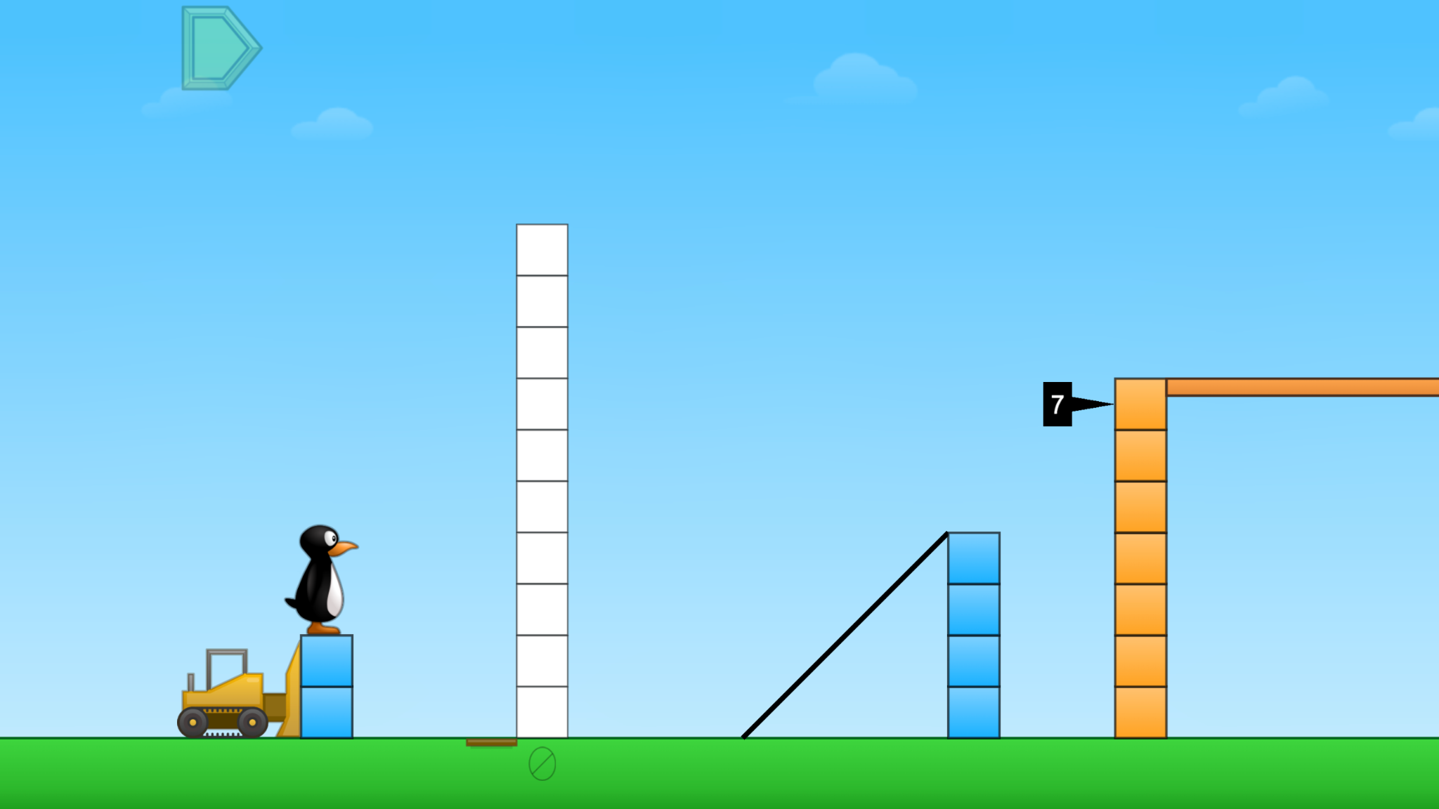
Module 2 - Day 2
Puzzle Talk
Time for
PROBLEM SOLVING!
ST Math Puzzle:
Push Box Missing Quantity > Level 1
Learning Objective:
Two Step Situations
Puzzle Link
Notes:
Puzzle Talk
Focus on student thinking and developing problem solving skills using guiding questions for each step in the Problem Solving Process.
Provide students with a copy of the Push Box Game Mat and whiteboards/dry erase markers.
Sign in to your ST Math account to access the puzzle.
Display Second Grade > Push Box Missing Quantity > Level 1
Game Link: https://play.stmath.com/raft/ed/10.0.3/#/objective/264b40f1-b4fd-477e-9d7b-d21b437e255f/9d7e49a2-6498-4e3d-a9d7-6d528070773e/games#game3
Notice and Wonder
Display the first puzzle in Level 1. Ask “What do you notice?” “What do you wonder?” Allow a few students to share out.
Predict and Justify
Give students the Push Box Game Mat and have them model how the puzzle works.
Ask students to think of their strategy for solving the puzzle and predict what will happen when they try it. Have students share out their predictions and solution strategies.
Test and Observe
Select a student’s solution to try and watch the feedback. Ask students, “What happened when we tried that prediction? What did you see?"
Analyze and Learn
Ask students: Was our answer correct? How many steps are needed to solve? Does this puzzle require addition or subtraction? Both? What is known and unknown?
Display the next puzzle in Level 1, repeating the same question.
Model how to represent the puzzle with an equation that includes a ? for the unknown (e.g., 4 + 4 + ? = 11). Ask students to use their game mat, paper, or whiteboard to solve for the unknown. Have some students share their solutions and strategies.
Repeat with the next puzzle in Level 1.
Display the first puzzle in Level 2. Ask students: How is this puzzle different from the ones we just did? How many steps does it take to solve this puzzle? What operation is happening in this puzzle? How do you know this is a subtraction problem?
Connect and Extend
Model for students how to represent the puzzle with an equation that includes a ? for the unknown (e.g., 9 – 2 - ? = 4). Ask students to use their game mat and tools to solve for the unknown.
Share students’ solutions and strategies. Repeat with the next puzzle in Level 2.
Display the first puzzle in Level 3. Repeat the same process for a few more Level 3 puzzles guiding students through questioning to write an equation as in Level 2.
Have students reflect on their strategies and how they know they have solved for the unknown.
How does the student:
identify the two steps in the puzzle?
represent the puzzle with an equation containing an unknown?
explain what part of the puzzle each part of the equation represents?
explain their strategy for solving the puzzle?
explain how they know which operation is required for each step?

Slide 21
Module 2 - Day 2
Problem Solving
Problem of the Day
Push Box Task: Create two examples of a new JiJi puzzle.
Each example must have 2 steps like the puzzles you did
earlier and result in an answer of 18.
Write your equation on the line. Then compare the two
puzzles. How are they alike? How are they different?
(next slide)
Notes:
Problem of the Day
Push Box Task:
Create two examples of a new JiJi puzzle. Each example must have 2 steps like the puzzles you did earlier and result in an answer of 18.
Write your equation on the line. Then compare the two puzzles. How are they alike? How are they different?

Slide 22
Module 2 - Day 2
Problem Solving
Problem of the Day
Write your equation on the line.
(next slide)
First equation
Notes:
Problem of the Day

Slide 23
Module 2 - Day 2
Problem Solving
Problem of the Day
Write your equation on the line.
Then compare the two
puzzles.
Second equation
Notes:
Problem of the Day

Slide 24
Module 2 - Day 3
My Thinking Path
???
What I know about addition problems is…
What I know about subtraction problems is…
One thing I learned is . . .
A question I have is . . .
This is like…
This is not like….
I wonder…
Notes:
My Thinking Path
Have students reflect on what they have learned about solving problems with addition and subtraction.

Slide 25
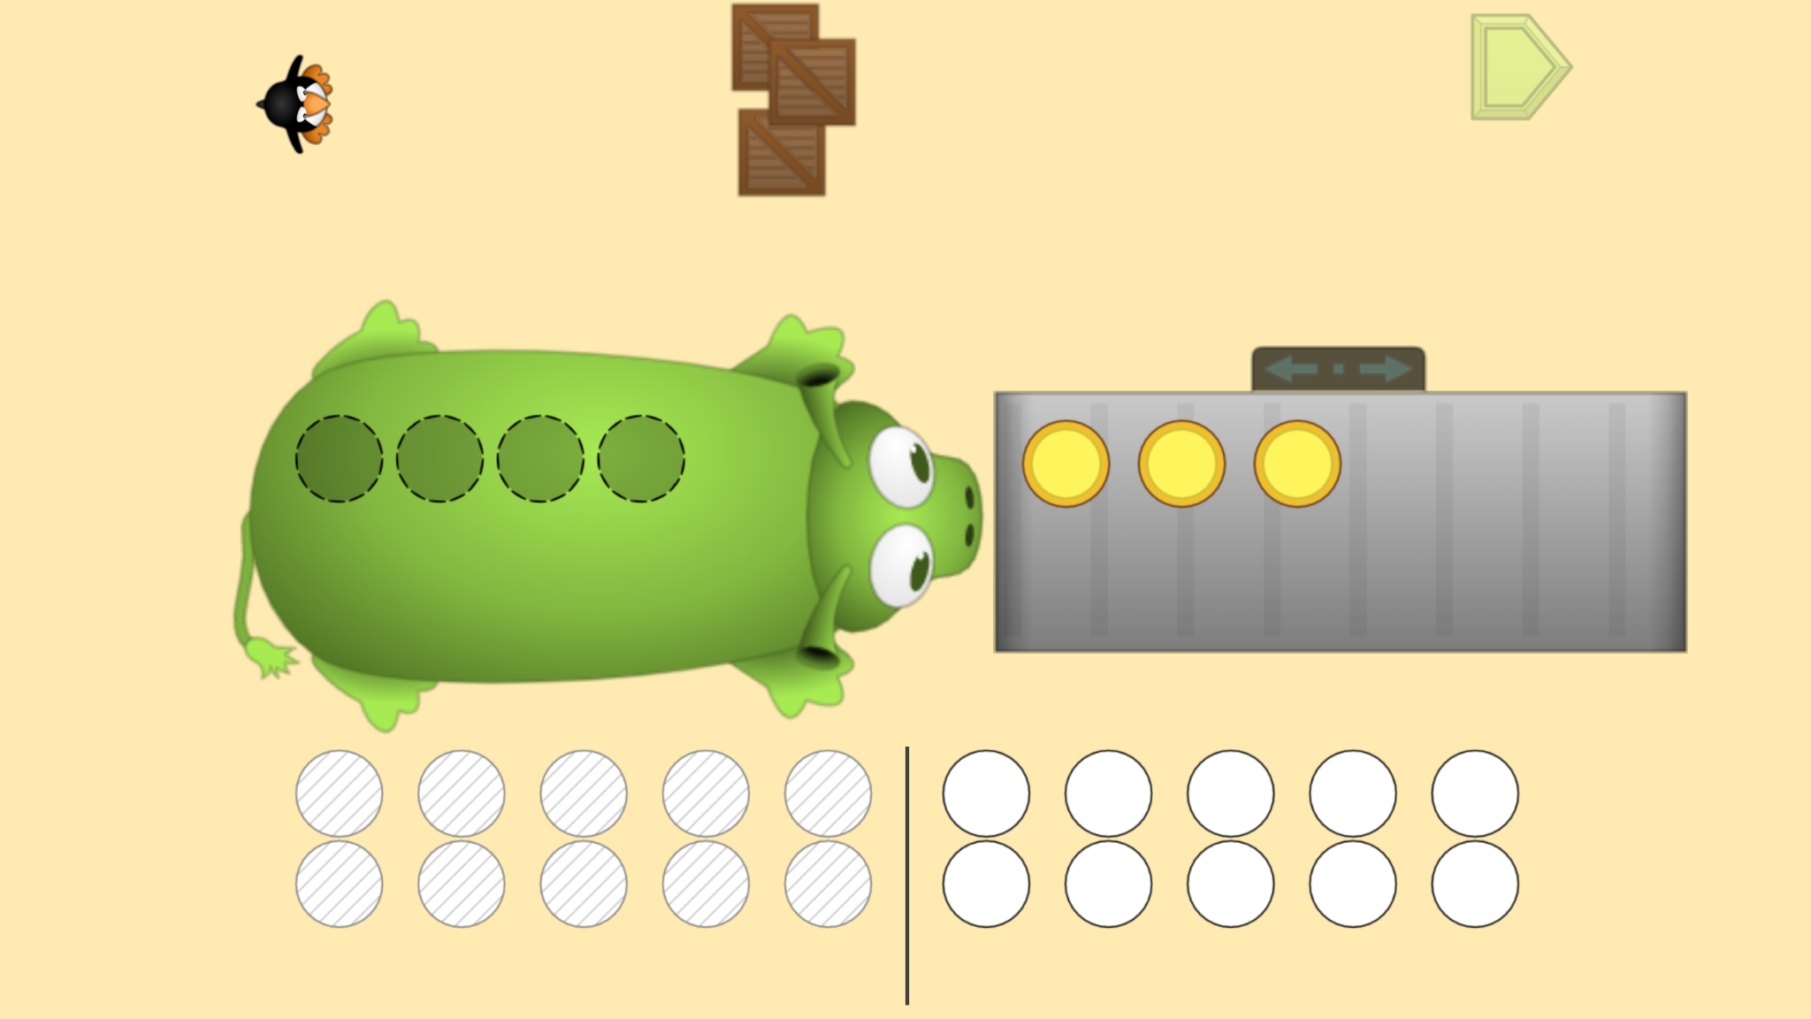
Module 2 - Day 3
Puzzle Talk
Time for
PROBLEM SOLVING!
ST Math Puzzle:
Pie Monster > Level 1
Learning Objective:
Two Step Situations
Puzzle Link
Notes:
Puzzle Talk
Focus on student thinking and developing problem solving skills using guiding questions for each step in the Problem Solving Process.
Provide students with copies of the Pie Monster Game Mats 03 and 04 or whiteboards/dry erase markers.
Sign in to your ST Math account to access the puzzle.
Display Second Grade > Pie Monster > Level 1
Game Link: https://play.stmath.com/raft/ed/10.0.3/#/objective/264b40f1-b4fd-477e-9d7b-d21b437e255f/9d7e49a2-6498-4e3d-a9d7-6d528070773e/games#game4
Notice and Wonder
Display a puzzle from Level 1.
Ask students questions such as "What do you notice? What are we trying to solve?"
Predict and Justify
Ask, 'What number are you going to choose on the Pie Monster and why?" Have students use the game mat to model their predictions.
Have the students share their thinking and predictions with a neighbor.
Ask: Did you and your neighbor select the same number? If not, can you convince your neighbor that your number is the best one to choose?
Have students share out to the whole group. Did anyone convince their neighbor? If so, what was it that convinced them?
Test and Observe
Select students to solve the problem and try their strategy. Have students watch and describe what happened.
Be sure to try both correct and incorrect solutions.
Analyze and Learn
After watching the feedback, ask students: Is that the only answer to the problem? How do you know? Discuss what students learned from the feedback and how they will apply that learning.
Play the next puzzle in Level 1. Repeat the Problem Solving Process.
Display the first puzzle in Level 2. Ask students: How is this puzzle different from the ones we just did? How many pies do we need to choose now and how do you know?
Solve the first puzzle together. Model how to represent the puzzle using an equation with a variable (e.g., 4 + ? = 6). Explain that the unknown represents the number of pies picked from the bottom.
Connect and Extend
Display the next puzzle in Level 2. Now, ask students to write their own equation for the puzzle, reminding them to use a variable for the unknown.
Discuss their equations and strategies as a whole class.
Repeat with additional puzzles in Level 2.
How does the student:
identify the two steps in the puzzle?
represent the puzzle with an equation containing an unknown?
explain what part of the puzzle each part of the equation represents?
explain their strategy for solving the puzzle?
explain how they know which operation is required for each step?

Slide 26
Module 2 - Day 3
Problem Solving
Problem of the Day
Devin has some cards in his collection.
Joe gave him 16 cards and Mark gave him 27 cards.
He has 92 cards total.
How many cards did he start with?
Use words or pictures to explain how you found your
answer.
Notes:
Problem of the Day
Devin has some cards in his collection. Joe gave him 16 cards and Mark gave him 27 cards. He has 92 cards in total.
º How many cards did he start with?
º Use words or pictures to explain how you found your answer.

Slide 27
Module 2 - Day 4
My Thinking Path
???
What I know about addition problems is…
What I know about subtraction problems is…
One thing I learned is . . .
A question I have is . . .
This is like…
This is not like….
I wonder…
Notes:
My Thinking Path
Have students reflect on what they have learned about solving problems with addition and subtraction.

Slide 28
Module 2 - Day 4
Puzzle Talk
Time for
PROBLEM SOLVING!
ST Math Puzzle:
Pie Monster > Level 3
Learning Objective:
Two Step Situations
Puzzle Link
Notes:
Puzzle Talk
Focus on student thinking and developing problem solving skills using guiding questions for each step in the Problem Solving Process.
Provide students with copies of the Pie Monster 04 Game Mat or whiteboards/dry erase markers.
Sign in to your ST Math account to access the puzzle.
Display Second Grade > Pie Monster > Level 3
Game Link: https://play.stmath.com/raft/ed/10.0.3/#/objective/264b40f1-b4fd-477e-9d7b-d21b437e255f/9d7e49a2-6498-4e3d-a9d7-6d528070773e/games#game4
Notice and Wonder
Show a puzzle from Level 3. Ask “What do you notice is the same/different from the puzzles we did yesterday?” “What do you wonder?” Allow a few students to share out.
Predict and Justify
Have students Think-Pair-Share their prediction and strategy with each other.
Have students share out. Try one of the students’ ideas.
Ask the students to think about if they agree/disagree with each other. How do other student's ideas relate to their own strategy?
Test and Observe
Watch the feedback together and discuss what they saw.
Analyze and Learn
Ask students to compare what they saw happen to what they thought would happen, trying both correct and incorrect solutions. What did they learn from the feedback?
Ask students to Turn and Talk to their partner: What would this puzzle look like with numbers and symbols?
Then have students write equations to represent their solution for the Level 3 puzzle, like yesterday. Remind students the steps with prompts like:
What is the unknown in this puzzle? What do we know? What operations are we using?
Show some puzzles from Level 4, repeating the steps above.
Have students represent the puzzles on their Pie Monster 04 Game Mat, and write equations for them.
Have students write equations for their solutions.
Connect and Extend
Use the Pie Monster 04 Game Mat to give students different scenarios to solve for an unknown. Have them model those scenarios on their mat and write an equation to represent their model. Discuss.
Brainstorm with students the math that they learned in this game. How is it like other concepts they have learned?
How does the student:
solve the puzzles? (Are they thinking flexibly about addition and subtraction? Do they struggle with specific problem types? (e.g., result unknown, change unknown, start unknown))
write an equation to represent the problem? (Great opportunity to connect the visual to the symbolic and reinforce the meaning of equality as “same as.”)
represent the puzzle? (Do they use tools? An equation with a variable?)

Slide 29
Module 2 - Day 4
Problem Solving
Problem of the Day
Brittany bought a box of cards. The box had 30 cards inside. Brittany wanted to give a card to all 17 girls on her soccer team. She also wanted to give each of her 6 friends a card. Brittany’s mom needs 8 cards for her family. Brittany says there will be enough cards for her mom to use. Is she correct?
Write or draw a picture to explain your answer.
Notes:
Problem of the Day
Brittany bought a box of cards. The box had 30 cards inside. Brittany wanted to give a card to all 17 girls on her soccer team. She also wanted to give each of her 6 friends a card. Brittany’s mom needs 8 cards for her family. Brittany says there will be enough cards for her mom to use. Is she correct? Write or draw a picture to explain your answer.

Slide 30
Module 3
Learning math carefree!

Slide 31
Module 3 - Day 1
My Thinking Path
Topic: Solve problems involving addition and subtraction within 100
???
What I know about double digit addition problems is…
What I know about double digit subtraction problems is…
One thing I learned is . . .
A question I have is . . .
This is like…
This is not like….
I wonder…
Notes:
My Thinking Path
Have students write in the topic, “Solve problems involving addition and subtraction within 100.”
Have students begin working on the first two boxes.
Discuss their ideas and allow students to add to their paper any additional thoughts they have.
Have students complete the Pre-Quiz (optional).

Slide 32
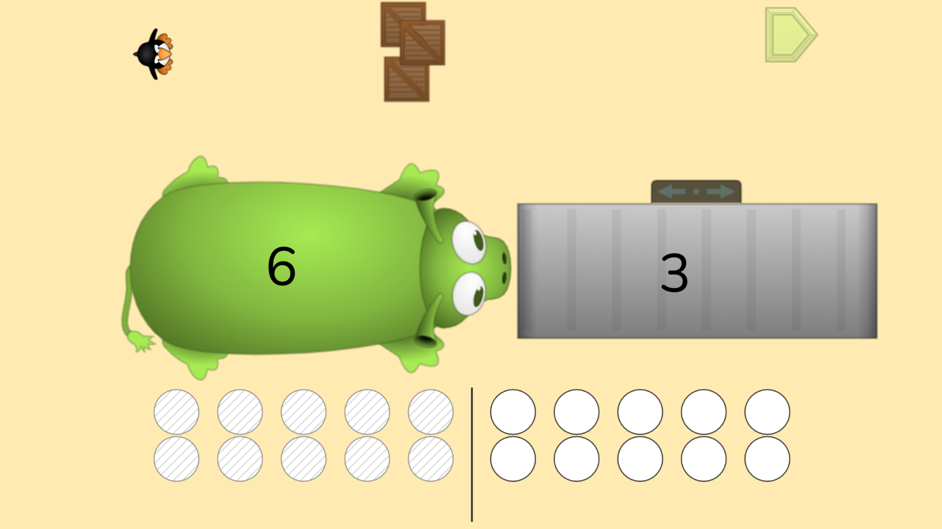
Module 3 - Day 1
Puzzle Talk
Time for
PROBLEM SOLVING!
ST Math Puzzle:
Pie Monster Symbolic > Level 1
Learning Objective:
Two Step Situations
Puzzle Link
Notes:
Puzzle Talk
Focus on student thinking and developing problem solving skills using guiding questions for each step in the Problem Solving Process.
Provide students with copies of the Pie Monster Game Mat 03 and math tools (e.g., cubes).
Sign in to your ST Math account to access the puzzle.
Display Second Grade > Pie Monster Symbolic > Level 1
Game Link: https://play.stmath.com/raft/ed/10.0.3/#/objective/264b40f1-b4fd-477e-9d7b-d21b437e255f/9d7e49a2-6498-4e3d-a9d7-6d528070773e/games#game5
Notice and Wonder
Display the first puzzle in Level 1. Ask “What do you notice?” “What do you wonder?” Allow a few students to share out.
Say to students, “What do you think each number in this puzzle represents? How many pies does the Pie Monster have? How many pies does the Pie Monster want to eat? What do we need to do to end up with the correct number of pies?”
Have students make a prediction and use their game mat and tools to model what they think they need to do to solve this puzzle.
Predict and Justify
Give them a few minutes to discuss with a partner: What do they think is going to happen and why?
Have a volunteer share their strategy. Before trying the strategy, discuss it with the other students (agree/disagree; what do they think will happen).
Test and Observe
Try a student’s solution and discuss what was observed.
Analyze and Learn
Ask students to think about how what they saw happen compares to their predictions.
Ask students to share what they learned and how they will apply that learning.
Display the next puzzle in Level 1. Discuss what is known and unknown in the puzzle and how many steps are needed.
Have students write an equation to represent the puzzle and have them solve for the unknown variable.
Display the first puzzle in Level 2. Ask students, “How is this puzzle different from the puzzles we just solved? How do you think you solve this puzzle?”
Connect and Extend
Using their game mat and tools, students will create a model to find the unknown, and eventually create an equation. Ask students to share possible solutions and equations.
Solve the puzzle and watch the feedback. Look for the two steps that are happening in the puzzle. Have students share their strategy for solving the puzzle. What was the first step? The second step?
Repeat with a few more puzzles in Level 2.
How does the student:
use the game mat and tools to help solve the puzzles?
write equations to represent the puzzles?
identify what the numbers in the puzzles represent?
explain the strategy they used to solve the puzzle?

Slide 33
Module 3 - Day 1
Problem Solving
Problem of the Day
You have 15 pieces of gum. You gave some away on Monday and you gave some away on Tuesday.
You now have 6.
Draw a picture to show a possible solution to this problem.
Explain how you found the answer.
Notes:
Problem of the Day
• You have 15 pieces of gum. You gave some away on Monday and you gave some away on Tuesday. You now have 6. Draw a picture to show a possible solution to this problem. Explain how you found the answer.

Slide 34
Module 3 - Day 2
My Thinking Path
???
What I know about double digit addition problems is…
What I know about double digit subtraction problems is…
One thing I learned is . . .
A question I have is . . .
This is like…
This is not like….
I wonder…
Notes:
My Thinking Path
Have students reflect on what they have learned about solving problems involving addition and subtraction within 100.

Slide 35
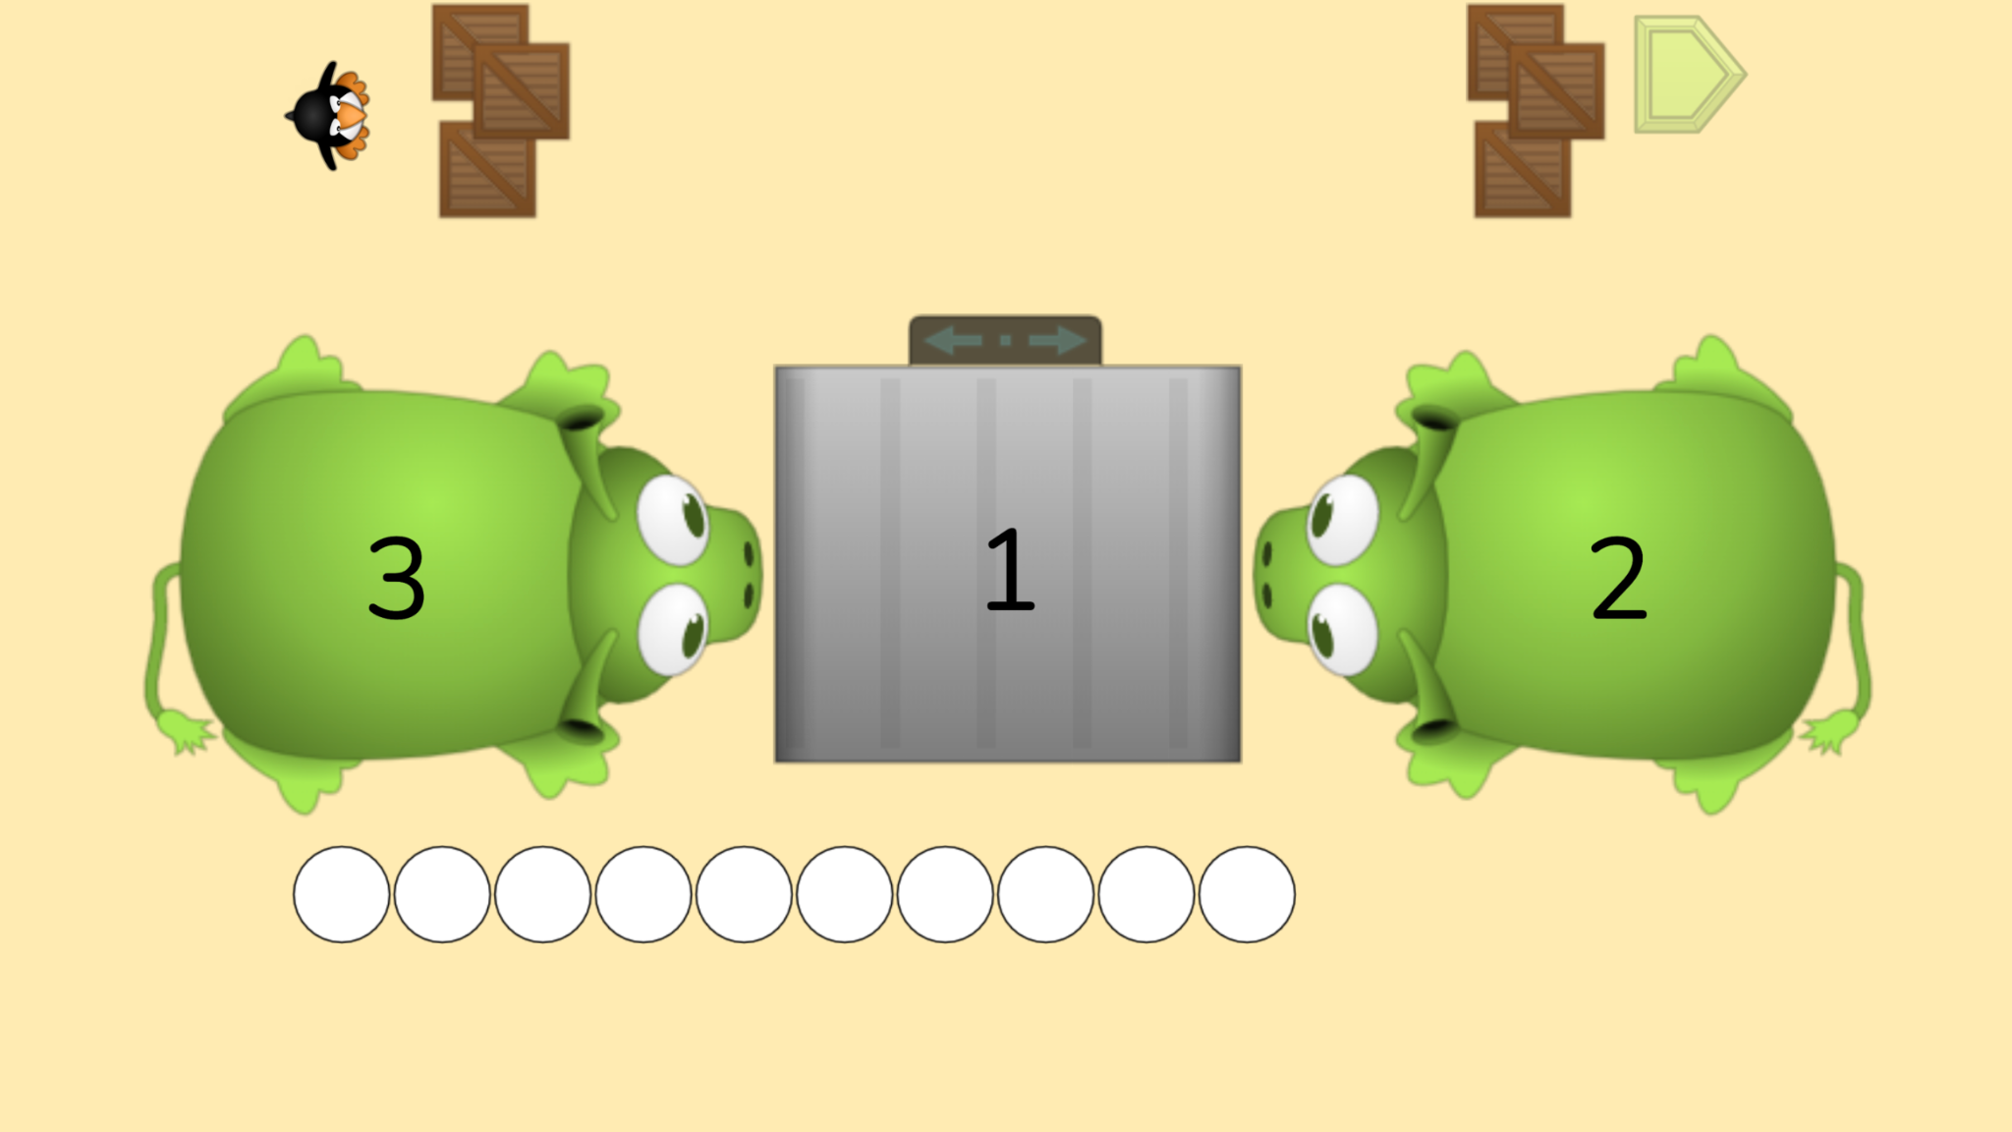
Module 3 - Day 2
Puzzle Talk
Time for
PROBLEM SOLVING!
ST Math Puzzle:
Pie Monster Symbolic > Level 2
Learning Objective:
Two Step Situations
Puzzle Link
Notes:
Puzzle Talk
Focus on student thinking and developing problem solving skills using guiding questions for each step in the Problem Solving Process.
Provide students with copies of the Pie Monster Game Mat 04 and math tools (e.g., cubes).
Sign in to your ST Math account to access the puzzle.
Display Second Grade > Pie Monster Symbolic > Level 3
Game Link: https://play.stmath.com/raft/ed/10.0.3/#/objective/264b40f1-b4fd-477e-9d7b-d21b437e255f/9d7e49a2-6498-4e3d-a9d7-6d528070773e/games#game5
Notice and Wonder
Discuss what students learned in the puzzles discussed yesterday. You may want to play one puzzle from level 2 to support the discussion.
Display a puzzle from Level 3.
Ask students how this puzzle is similar/different to the puzzles from yesterday. Do they have any wonderings about this puzzle?
Predict and Justify
Ask a volunteer to share their prediction and why they think it will work. Give them all time to think before calling on a student to share.
Test and Observe
Try a student’s solution and watch the feedback. Talk with students about what happened.
Analyze and Learn
Ask students to think about how what they saw happen compares to their prediction. What did they learn about their strategy from the feedback? What is known in this puzzle? How many steps did it take?
Show another puzzle from Level 3. Ask students to make a prediction and have them model it on their Pie Monster 04 Game Mat through drawing or using manipulatives.
Have one student share their prediction and the strategy they will use.
Ask the other students to turn and talk to a partner to write an equation to represent the strategy posed by the student.
Play the animation and pause it during the feedback. Have students compare the animation to the equation that they created. Does it represent what they are seeing visually occurring in the puzzle?
Are there other equations that would represent this same visual model? Discuss.
Connect and Extend
Show some puzzles from Level 4. Have students continue to write and share out their equations using the Analyze and Learn questions to represent their solutions for the puzzles.
Discuss similarities and differences in their equations.
How does the student:
write equations to represent the puzzles?
identify what the numbers in the puzzles represent?
explain the strategy they used to solve the puzzle?

Slide 36
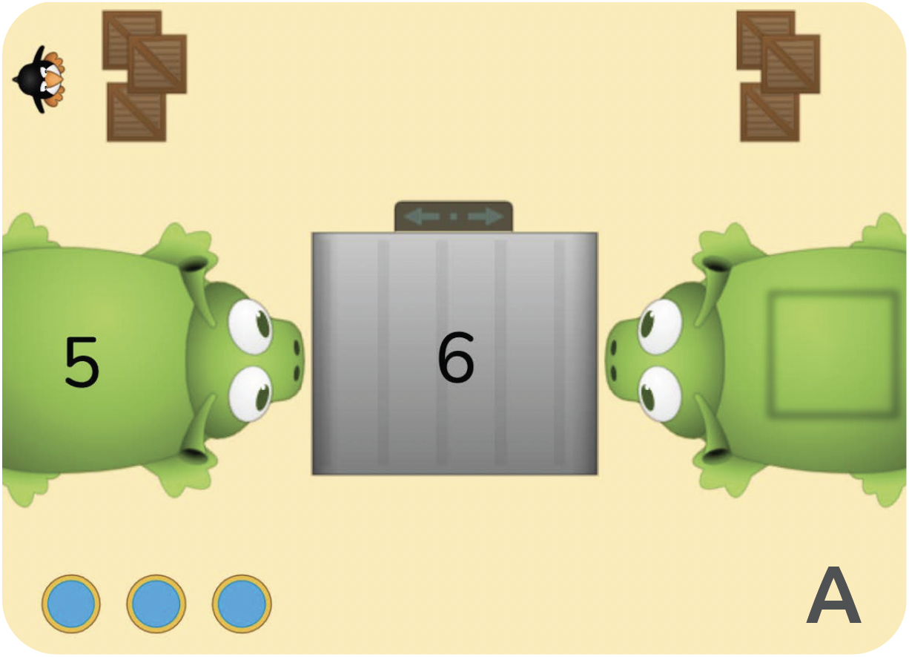
Module 3 - Day 2
Problem Solving
Problem of the Day
Fill in the blank square to solve the JiJi puzzle.
Explain how you solved the puzzle.
(next slide)
Notes:
Problem of the Day
Pie Monster Task:
Fill in the blank square to solve the JiJi puzzle. Explain how you solved the puzzle.

Slide 37
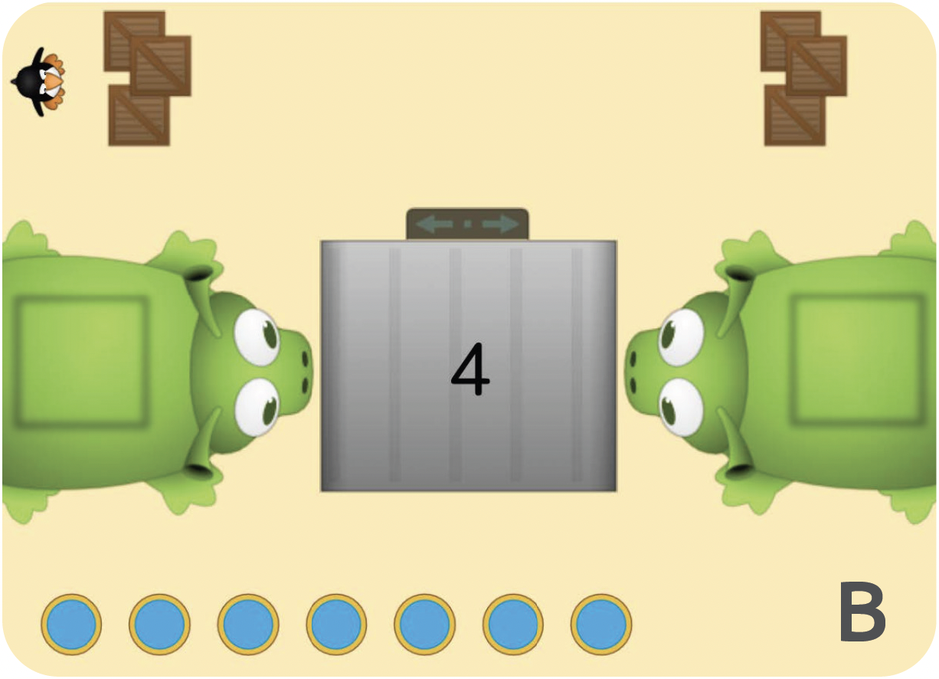
Module 3 - Day 2
Problem Solving
Problem of the Day
Fill in the blank square to solve the JiJi puzzle.
Explain how you solved the puzzle.
Notes:
Problem of the Day

Slide 38
Module 3 - Day 3
My Thinking Path
???
What I know about double digit addition problems is…
What I know about double digit subtraction problems is…
One thing I learned is . . .
A question I have is . . .
This is like…
This is not like….
I wonder…
Notes:
My Thinking Path
Have students reflect on what they have learned about solving problems involving addition and subtraction within 100.

Slide 39
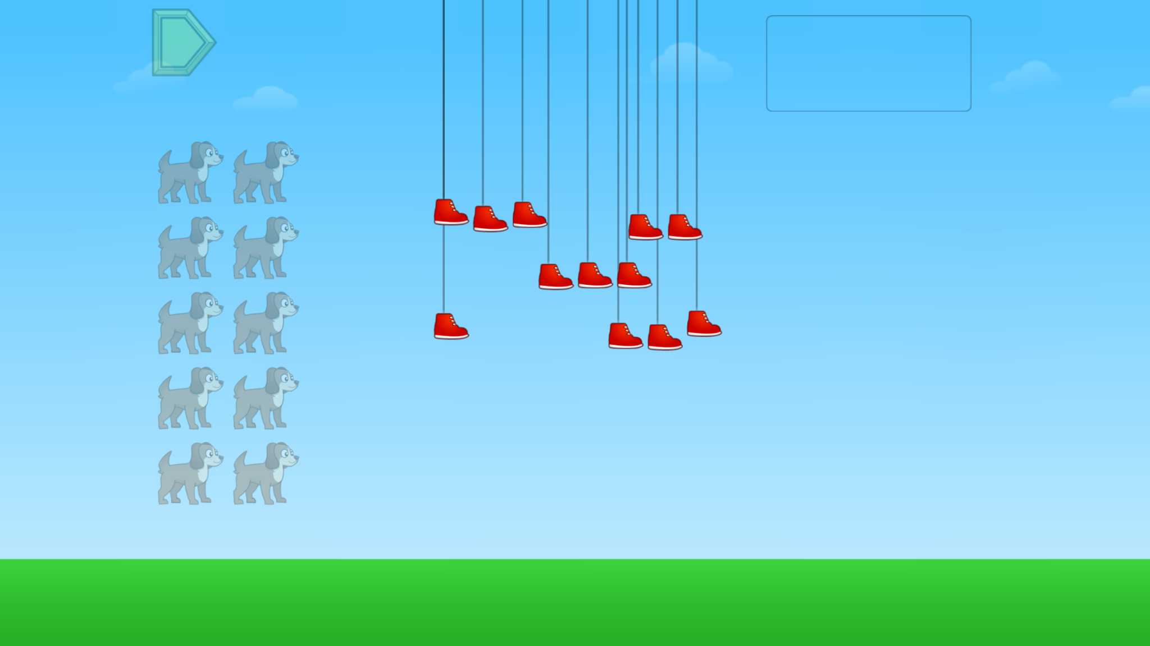
Module 3 - Day 3
Puzzle Talk
Time for
PROBLEM SOLVING!
ST Math Puzzle:
Bouncing Shoes > Level 1
Learning Objective:
Equal Groups
Puzzle Link
Notes:
Puzzle Talk
Focus on student thinking and developing problem solving skills using guiding questions for each step in the Problem Solving Process.
Provide students with a copy of the Bouncing Shoes Game Mat and whiteboards/dry erase markers.
Sign in to your ST Math account to access the puzzle.
Display Second Grade > Bouncing Shoes > Level 1
Game Link: https://play.stmath.com/raft/ed/10.0.3/#/objective/264b40f1-b4fd-477e-9d7b-d21b437e255f/9d7e49a2-6498-4e3d-a9d7-6d528070773e/games#game6
Notice and Wonder
Give students a copy of the Bouncing Shoes Game Mat.
Display the first puzzle in Level 1. Ask “What do you notice?” “What do you wonder?” Allow a few students to share out.
Predict and Justify
Ask: How would you solve this puzzle? Ask students to think of their strategy for solving the puzzle and model it on their game mat. Have students share their solution strategies with a neighbor.
Have some students share out. Discuss how students figured out how many of the creature was needed. Did students count each shoe and each leg? Did students skip count by the number of legs the creature had? Did they match each leg with a shoe?
Test and Observe
Try one of the students’ strategies. Before trying the strategy, discuss it with the other students. Ask students if they agree or disagree and what they think will happen. Share students’ thinking as a whole class.
Watch the feedback together and discuss what they saw.
Analyze and Learn
Play that puzzle again choosing the same solution. This time pause the animation and discuss the feedback.
Repeat with additional puzzles in Level 1.
Display the first puzzle in Level 2. Ask students: What do you notice is different about this puzzle and the ones we just solved? What do you know about the number that is labeled on this puzzle? Discuss.
Ask students: Is this target number even or odd?
Explain to students that an even number can be divided into two equal groups with no leftovers.
Have students draw out the target number of shoes (they can draw circles or squares for shoes) on their game mat or paper/whiteboard.
Have students divide the shoes they drew into two equal groups and determine if there are any leftovers.
Connect and Extend
Without solving each puzzle, go through all of the puzzles in Level 2 and repeat this process. Make a chart of the numbers with one column labeled “even numbers” and one column labeled “odd numbers."
How does the student:
describe the strategy they used to solve the problem?
define an even number? Odd number?
prove whether a number is even or odd
skip count?

Slide 40
Module 3 - Day 3
Problem Solving
Problem of the Day
Lacey had a collection of dolls. Her mom was making shoes for each of her doll’s feet.
If her mom made 12 shoes, how many dolls does Lacey have?
Notes:
Problem of the Day
Lacey had a collection of dolls. Her mom was making pink shoes for each of her doll’s feet. If her mom made 12 shoes, how many dolls does Lacey have?

Slide 41
Module 3 - Day 4
My Thinking Path
???
What I know about double digit addition problems is…
What I know about double digit subtraction problems is…
One thing I learned is . . .
A question I have is . . .
This is like…
This is not like….
I wonder…
Notes:
My Thinking Path
Have students reflect on what they have learned about solving problems involving addition and subtraction within 100.

Slide 42
Module 3 - Day 4
Puzzle Talk
Time for
PROBLEM SOLVING!
ST Math Puzzle:
Bouncing Shoes Bonus Game
Learning Objective:
Equal Groups
Puzzle Link
Notes:
Puzzle Talk
Focus on student thinking and developing problem solving skills using guiding questions for each step in the Problem Solving Process.
Hand out Creature Cards, cubes, and the 0-20 Number Line Mat.
Sign in to your ST Math account to access the puzzle.
Display Second Grade > Bouncing Shoes Bonus Game
Game Link: https://play.stmath.com/raft/learn/3.0.5/#/demo-arena/key/BouncingShoes/bouncing_shoes_bonus
Notice and Wonder
Remind the students of the puzzles they solved yesterday.
Look at the list of even numbers that was generated during yesterday’s discussion.
Ask students what they notice and what they wonder about all of the numbers on that list. Discuss any patterns that students see.
Predict and Justify
Pull up the Bouncing Shoes Bonus Game.
Ask students to predict if the number of shoes shown is an even or odd number.
Have students use their cubes and creature cards to help illustrate their thinking.
Have them explain and justify their predictions with a partner.
Test and Observe
Ask students to share their predictions and their solution strategy. Do the other students agree or disagree? Did they use a different strategy?
Select a prediction to test.
Watch the feedback and have students tell what they observed.
Analyze and Learn
Ask, “Was the number even or odd? Were they correct? If not, how might they change their strategy?”
Have students discuss what they learned about even and odd numbers and how that relates to equal groups.
Repeat with the other puzzles in the bonus game.
Add the target numbers to the list of even and odd numbers.
Connect and Extend
Give students a number line mat. Ask them to prove that when you skip count by 2s starting at 0 you land on all even numbers. How does this information fit with their understanding of even and odd numbers?
How does the student:
describe the strategy they used to solve the problem?
define an even number? Odd number?
prove whether a number is even or odd
skip count?

Slide 43
Module 3 - Day 4
Problem Solving
Problem of the Day
Zach has 18 pencils and 3 pencil boxes. He is putting an equal number of pencils in each box.
How many pencils will he put in each box?
Write or draw a picture to explain your answer.
Notes:
Problem of the Day
• Zach has 18 pencils and 3 pencil boxes. He is putting an equal number of pencils in each box. How many pencils will he put in each box? Write or draw a picture to explain your answer.

Slide 44
Module 4
Let’s learn some more!

Slide 45
Module 4 - Day 1
My Thinking Path
Topic: Equal groups and repeated addition
???
What I know about equal groups is…
What I know about repeated addition is…
One thing I learned is . . .
A question I have is . . .
This is like…
This is not like….
I wonder…
Notes:
My Thinking Path
Have students write in the topic, “Solving problems involving equal groups and representing numbers with repeated addition.”
Have students begin working on the first two boxes.
Discuss their ideas and allow students to add to their paper any additional thoughts they have.
Have students complete the Pre-quiz (optional).

Slide 46
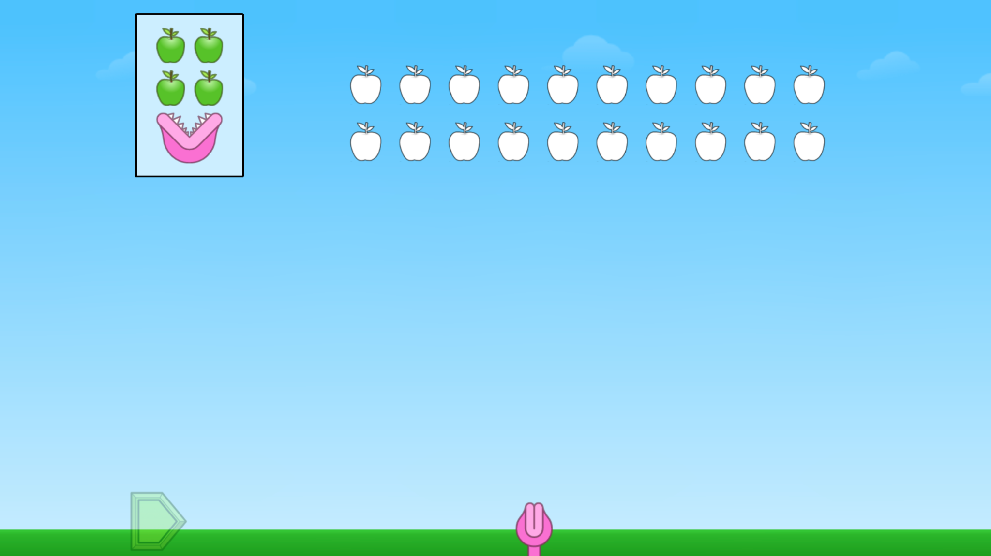
Module 4 - Day 1
Puzzle Talk
Time for
PROBLEM SOLVING!
ST Math Puzzle:
Fruit Monster > Level 1
Learning Objective:
Equal Groups* (or Even and Odd Numbers)
Puzzle Link
Notes:
Puzzle Talk
Focus on student thinking and developing problem solving skills using guiding questions for each step in the Problem Solving Process.
Provide students with a Fruit Monster Game Mat and whiteboards/dry erase markers.
Sign in to your ST Math account to access the puzzle.
Display Second Grade > Fruit Monster > Level 1
Game Link: https://play.stmath.com/raft/ed/10.0.3/#/objective/264b40f1-b4fd-477e-9d7b-d21b437e255f/9d7e49a2-6498-4e3d-a9d7-6d528070773e/games#game7
Notice and Wonder
Display the first puzzle in Level 1. Ask “What do you notice?” “What do you wonder?” Allow a few students to share out.
Predict and Justify
Have students Think-Pair-Share about their prediction, what will happen when they try it, and why they think it will work.
Have students share out their predictions and related strategy. Ask students: How did you know how much fruit to feed the Fruit Monster? How did you count the fruit? How did you count the Fruit Monsters?
Select one student's strategy. Ask the students to decide if they agree/disagree with the strategy and why. How does it relate to their own strategy?
Test and Observe
Try that student’s solution and watch the feedback. Ask students to describe what happened.
Ask students to think about how the feedback they saw compares to what they thought would happen.
Model writing a repeated addition sentence for the puzzle.
Analyze and Learn
Repeat with additional puzzles in Level 1.
Display a puzzle in Level 2 that has three Fruit Monsters.
Say to students, “Now we have more Fruit Monsters than the last puzzle. How can you figure out how much fruit to feed all three Fruit Monsters?”
Have students model the puzzle on the Fruit Monster Game Mat using manipulatives and write repeated addition sentences.
Do a share-out of models and equations.
Connect and Extend
Look for students sharing skip counting strategies. Say to students, “Why is skip counting an efficient strategy for solving this puzzle?”
Count by fruit monsters to model skip counting to find the number of fruit. For example, if there are 3 monsters that eat 4 fruit each, you could count 4, 8, 12.
How does the student:
skip count fruit or Fruit Monsters?
determine the number of fruit or Fruit Monsters needed?
represent the puzzle with a repeated addition sentence?
determine how to write the repeated addition sentence?
*This Fruit Monster puzzle can be found in both the Immersion Curriculum and current ST Math Curriculum.

Slide 47
Module 4 - Day 1
Problem Solving
Problem of the Day
Landon has 5 cars. Timothy has 3 cars. Paul has 7 cars. The boys wanted to each have the same number of cars.
In the space, below draw a picture to show how many cars each boy should have.
Notes:
Problem of the Day
• Landon has 5 cars. Timothy has 3 cars. Paul has 7 cars. The boys wanted to each have the same number of cars. In the space below draw a picture to show how many cars each boy should have.

Slide 48
Module 4 - Day 2
My Thinking Path
???
What I know about equal groups is…
What I know about repeated addition is…
One thing I learned is . . .
A question I have is . . .
This is like…
This is not like….
I wonder…
Notes:
My Thinking Path
Have students reflect on what they have learned about solving problems involving equal groups and representing numbers with repeated addition.

Slide 49
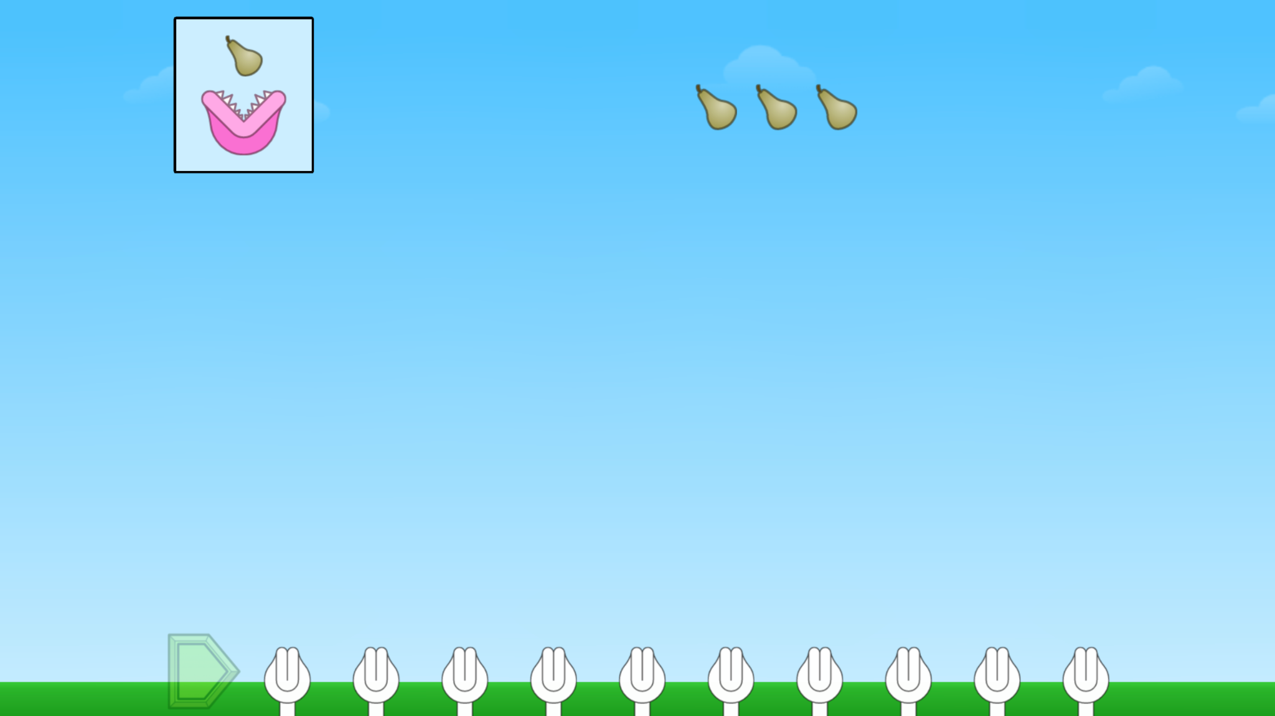
Module 4 - Day 2
Puzzle Talk
Time for
PROBLEM SOLVING!
ST Math Puzzle:
Fruit Monster > Level 3
Learning Objective:
Equal Groups (or Even and Odd Numbers)
Puzzle Link
Notes:
Puzzle Talk
Focus on student thinking and developing problem solving skills using guiding questions for each step in the Problem Solving Process.
Provide students with a Fruit Monster Game Mat and whiteboards/dry erase markers.
Sign in to your ST Math account to access the puzzle.
Display Second Grade > Fruit Monster > Level 3
Game Link: https://play.stmath.com/raft/ed/10.0.3/#/objective/264b40f1-b4fd-477e-9d7b-d21b437e255f/9d7e49a2-6498-4e3d-a9d7-6d528070773e/games#game7
Notice and Wonder
Display the first puzzle in Level 3. Ask students: What do you notice about this puzzle that is the same/different from the ones we’ve been working on? What do we need to do to solve this puzzle?
Point out that the levels build on each other so it is important to understand what we learned in the previous 2 levels.
Predict and Justify
Have students predict how to solve this puzzle and use their game mat or paper/whiteboard to show their prediction.
Think-Pair-Share: Have students share their prediction and why they think it will work with a neighbor.
Test and Observe
Try the students’ ideas (both correct and incorrect), watching the feedback.
Analyze and Learn
Ask students: Did we learn something that can help us prove that these other solutions are correct?
Display the next puzzle. Have students model it on their game mat.
Say to students, “Now we are trying to figure out how many Fruit Monsters we can feed with the fruit we have. Look at this puzzle and think about passing out the fruit to the Fruit Monsters. Could we represent the fruit with an array?”
Ask students to think about what they know about arrays. Have a volunteer explain what an array is to the group. Have students look at their own model and ask them to think about how their model is or is not related to an array.
Have students model the next puzzle as an array and talk to their neighbor about their model as to whether or not it shows an array. Using the same puzzle, work with students to write a repeated addition sentence, asking them what is known, what we are trying to find out, and how many steps it will take.
Continue through some puzzles in Levels 3 and 4.
Have students write expressions and equations to represent their puzzle, and do a share out.
Connect and Extend
Read this problem story out loud: Each Fruit Monster eats 2 bananas. I have 10 bananas so I can feed 5 Fruit Monsters. What could my equation using repeated addition look like? ( 2 + 2 + 2 + 2 + 2 = 10).
How does the student:
write equations to represent the puzzles?
identify what the numbers in the puzzles represent?
explain the strategy they used to solve the puzzle?
*This Fruit Monster puzzle can be found in both the Immersion Curriculum and current ST Math Curriculum.

Slide 50
Module 4 - Day 2
Problem Solving
Problem of the Day
Raven had 4 packs of markers. Each pack had 3 markers. How many markers does Raven have altogether? Draw a picture to show how you found your answer.
If she received 2 more packs of markers, how many markers will she have? Draw another picture to show how you found your answer.
Notes:
Problem of the Day
Raven had 4 packs of markers. Each pack had 3 markers. How many markers does Raven have altogether? Draw a picture to show how you found your answer. If she received 2 more packs of markers, how many markers will she have? Draw another picture to show how you found your answer.

Slide 51
Module 4 - Day 3
My Thinking Path
???
What I know about equal groups is…
What I know about repeated addition is…
One thing I learned is . . .
A question I have is . . .
This is like…
This is not like….
I wonder…
Notes:
My Thinking Path
Have students reflect on what they have learned about solving problems involving equal groups and representing numbers with repeated addition.

Slide 52
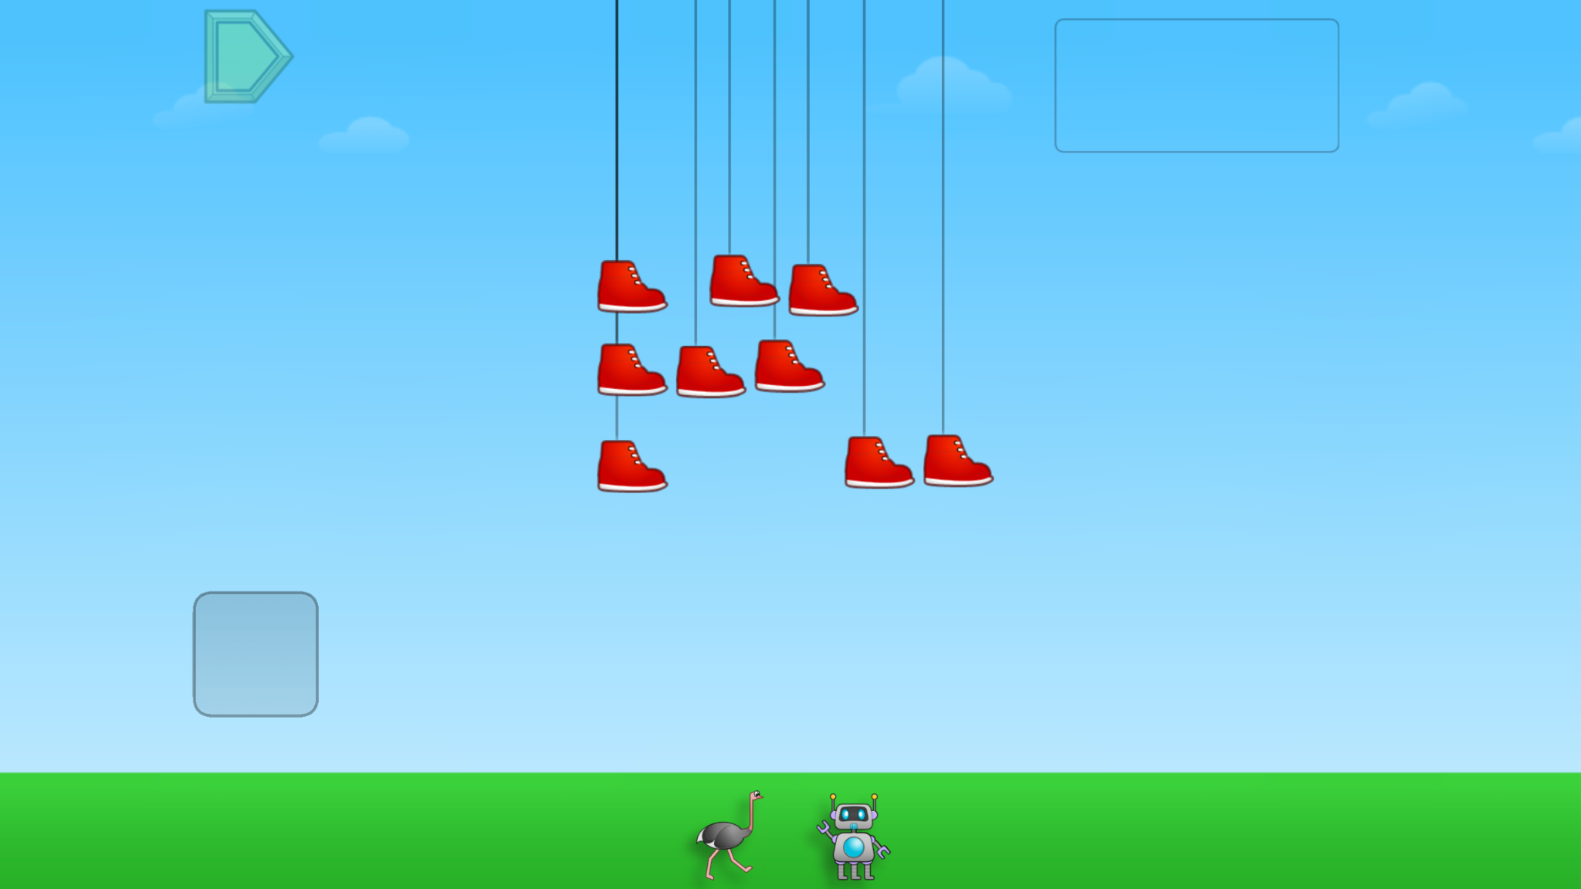
Module 4 - Day 3
Puzzle Talk
Time for
PROBLEM SOLVING!
ST Math Puzzle:
Bouncing Shoes Multiple Groups > Level 1
Learning Objective:
Equal Groups
Puzzle Link
Notes:
Puzzle Talk
Focus on student thinking and developing problem solving skills using guiding questions for each step in the Problem Solving Process.
Provide students with a Bouncing Shoes Game Mat and whiteboards/dry erase markers.
Sign in to your ST Math account to access the puzzle.
Display Second Grade > Bouncing Shoes Multiple Groups > Level 1
Game Link: https://play.stmath.com/raft/ed/10.0.3/#/objective/264b40f1-b4fd-477e-9d7b-d21b437e255f/9d7e49a2-6498-4e3d-a9d7-6d528070773e/games#game8
Notice and Wonder
Display the first puzzle in Level 1. Ask “What do you notice?” “What do you wonder?” Allow a few students to share out the things they notice.
Predict and Justify
Ask students to work in pairs to make a prediction about the puzzle and share their strategy and why it will work. Share out whole group.
Ask students to visualize what they think will happen and ask questions like: Can either creature be used to solve this puzzle? Why or why not? How did you determine which creature could be used?
Select a student's solution to try. Ask them if they agree/disagree and why. How does it relate to their answer?
Test and Observe
Try a student's solution and watch the feedback together and discuss what they saw.
Analyze and Learn
Ask students to think about how what they saw happen compares to their prediction. What did they learn from the feedback? Be sure to analyze the feedback in both correct and incorrect solutions.
Display another puzzle in Level 1 and ask, “Which creature cannot be used to solve this puzzle? Why not?” Talk with students about skip counting. Prove that skip counting by the number of legs on the chosen creature will land on the number of shoes shown.
Repeat with other puzzles in Level 1.
Display the first puzzle in Level 2. Ask students, “What is different about this puzzle and the ones we just did? How many possible answers are there? Does this mean that each creature will work to solve this puzzle?”
Have students use their game mat, creatures, or paper/whiteboard to prove that both creatures will work. Ask students to use their math tools to represent both creatures wearing the shoes (e.g., for 8 shoes: 8 groups of 1 for the eyeball and 2 groups of 4 for the dog).
Connect and Extend
Model for students how to arrange the math tools into two different arrays. Explain to students that an array is an arrangement of objects in equal rows and columns. Ask students to read their array as addition of equal groups (e.g., 1 + 1 + 1 + 1 + 1 + 1 + 1 + 1 or 4 + 4). Prove that both arrays total 8, but they are just organized in different ways.
Repeat with the remaining puzzles in Level 2.
How does the student:
create an array to model a puzzle?
discuss how the array models the puzzle?
write equations using repeated addition to represent the puzzles?
prove their answer is correct?

Slide 53
Module 4 - Day 3
Problem Solving
Problem of the Day
Mariana was arranging 24 cupcakes on a plate. Draw an array to represent one way Mariana could have arranged the cupcakes.
Write an equation using repeated addition to represent your array.
Notes:
Problem of the Day
Mariana was arranging 24 cupcakes on a plate. Draw an array to represent one way. Mariana could have arranged the cupcakes. Write an equation using repeated addition to represent your array.

Slide 54
Module 4 - Day 4
My Thinking Path
???
What I know about equal groups is…
What I know about repeated addition is…
One thing I learned is . . .
A question I have is . . .
This is like…
This is not like….
I wonder…
Notes:
My Thinking Path
Have students reflect on what they have learned about solving problems involving equal groups and representing numbers with repeated addition.

Slide 55
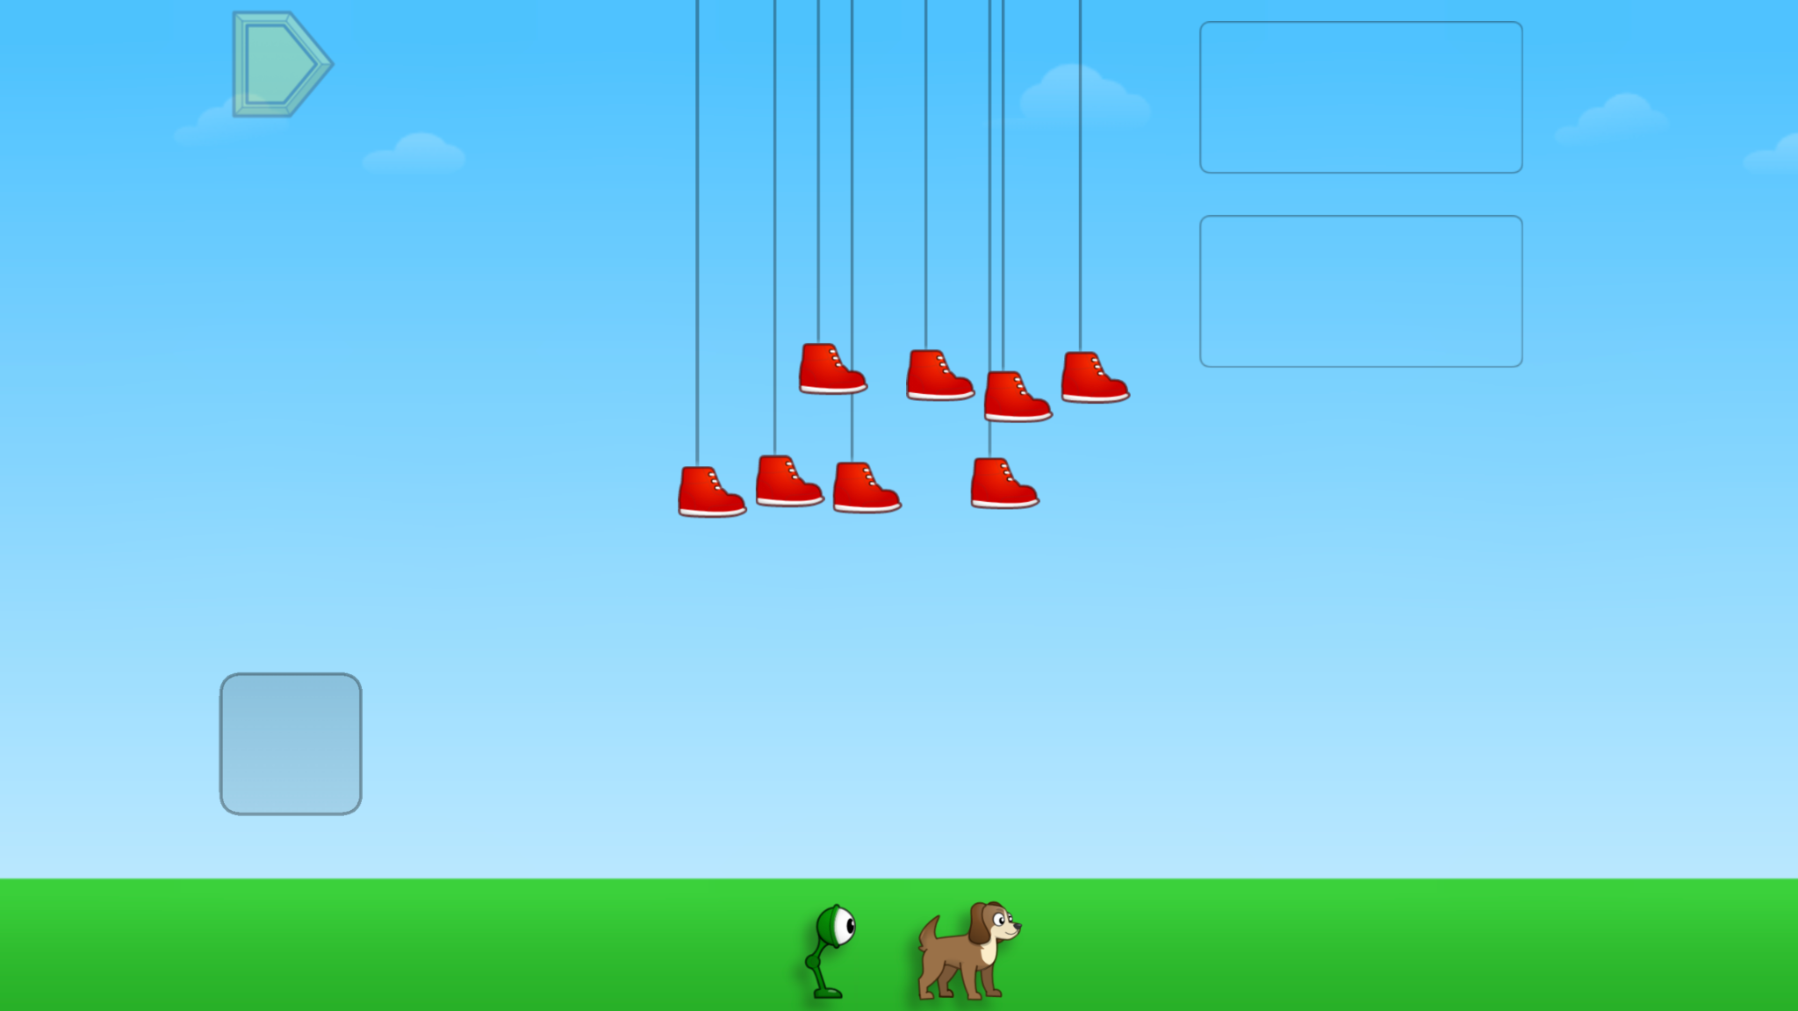
Module 4 - Day 4
Puzzle Talk
Time for
PROBLEM SOLVING!
ST Math Puzzle:
Bouncing Shoes Multiple Groups > Level 3
Learning Objective:
Equal Groups
Puzzle Link
Notes:
Puzzle Talk
Focus on student thinking and developing problem solving skills using guiding questions for each step in the Problem Solving Process.
Provide students with a Bouncing Shoes Game Mat and whiteboards/dry erase markers.
Sign in to your ST Math account to access the puzzle.
Display Second Grade > Bouncing Shoes Multiple Groups > Level 1
Game Link: https://play.stmath.com/raft/ed/10.0.3/#/objective/264b40f1-b4fd-477e-9d7b-d21b437e255f/9d7e49a2-6498-4e3d-a9d7-6d528070773e/games#game8
Notice and Wonder
Display the first puzzle in Level 3. Say to students, “Now there are two right answers but more than two creatures.”
Have students use their tools to solve each puzzle.
Have students share their prediction and why they think it will work with a neighbor. Look for students create an array for their solution.
Predict and Justify
Have students share out. Discuss different solutions to the puzzle.
Test and Observe
Select one of the students’ ideas to try. Watch the feedback together and discuss what they saw. Discuss why it was correct or incorrect.
Analyze and Learn
What did they learn from the feedback and is it different than what they thought would happen? Ask students, “Did we learn something that can help us prove that these other solutions are correct?”
Show the next puzzle. Have students model their prediction on their game mat and tools. Share students’ strategies and solutions to the puzzle.
Pull up the next puzzle. Have the students model an array with their centimeter cubes to represent the puzzle. How does their array model the problem?
Try this with a few puzzles, continuing to have students create and read an array for each correct solution.
Have students explain their array to a neighbor.
Students will then write an equation using repeated addition.
Repeat by showing additional puzzles in Level 3, having students create arrays to represent the puzzles.
Check for: Do they have the same number of shoes (centimeter cubes) as the correct answer? As you play the feedback, use the playback features to show that the number of shoes and the number in the arrays are/are not the same.
Connect and Extend
Discuss how students know how to create the arrays. What strategies are they using?
What is the mathematics that is prevalent in this problem?
Give students a number line (or draw one on board). Ask them: How can you show your solutions on a number line? Give students think time.
Discuss whole group.
How does the student:
model the problem on the Bouncing Shoes Game Mat?
represent the puzzle with numbers and symbols?
prove their answer is correct?
create the array?
connect the array to the models in the game?
model the solution on a number line?

Slide 56
Module 4 - Day 4
Problem Solving
Problem of the Day
Yesterday, Mariana moved 24 cupcakes from the plate onto a tray. She arranged the cupcakes differently.
Draw a different array and write an equation to represent your thinking. Compare the two arrays you drew. How are they alike? How are they different?
Notes:
Problem of the Day
Yesterday, Mariana moved 24 cupcakes from the plate onto a tray. She arranged the cupcakes differently. Draw a different array and write an equation to represent your thinking. Compare the two arrays you drew. How are they alike? How are they different?

Slide 57
Module 5
Let’s see math come alive!

Slide 58
Module 5 - Day 1
My Thinking Path
Topic: Representing numbers with repeated addition
???
What I know about repeated addition is…
What I know about arrays is…
One thing I learned is . . .
A question I have is . . .
This is like…
This is not like….
I wonder…
Notes:
My Thinking Path
Have students write in the topic, “Representing numbers with repeated addition.”
Have students begin working on the first two boxes.
Discuss their ideas and allow students to add to their paper any additional thoughts they have.
Have students complete the Pre-Quiz (optional).

Slide 59
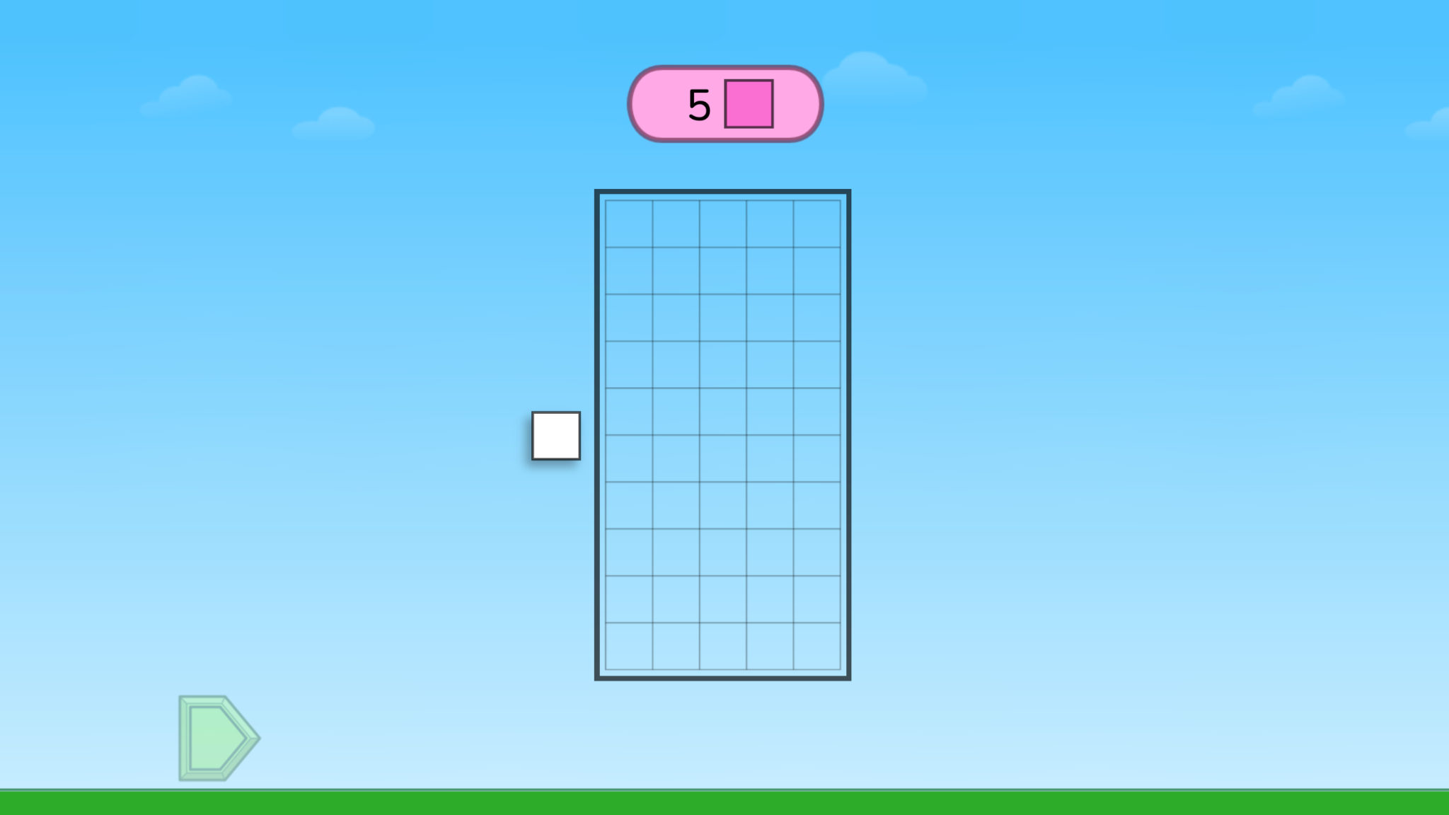
Module 5 - Day 1
Puzzle Talk
Time for
PROBLEM SOLVING!
ST Math Puzzle:
Create Multiple Rectangles > Level 1
Learning Objective:
Intro to Arrays
Puzzle Link
Notes:
Puzzle Talk
Focus on student thinking and developing problem solving skills using guiding questions for each step in the Problem Solving Process.
Provide students with the Rows and Columns Math Mat and centimeter cubes.
Sign in to your ST Math account to access the puzzle.
Display Second Grade > Create Multiple Rectangles > Level 1
Game Link: https://play.stmath.com/raft/ed/10.0.3/#/objective/264b40f1-b4fd-477e-9d7b-d21b437e255f/9d7e49a2-6498-4e3d-a9d7-6d528070773e/games#game9
Notice and Wonder
Ask, “What do you notice?” “What do you wonder?” Allow a few students to share out.
Predict and Justify
Ask students to think of their strategy for solving the puzzle and predict what will happen when they try it whole group and then Think-Pair-Share.
Have students share out. Do they agree or disagree with the strategy? Why? Does it relate to their approach?
Test and Observe
Try the students’ ideas (both correct and incorrect). Provide math mats and cubes to model their thinking.
Have students watch the feedback and describe what happened.
Analyze and Learn
Compare what students saw happen to what they thought would happen. What did they learn from the feedback?
Discuss how they would describe the rectangle that was created (e.g., 1 row of 5). Repeat with the next puzzle.
Connect and Extend
Show a puzzle that has an even number between 4 and 10 and play it using a student's suggestion. Ask if there is a different way to show the solution. Replay the puzzle and show the other solution.
Discuss what students notice about the two solutions. Ask students: How are puzzles with even numbers different?
Open up a Level 2 puzzle. Compare and contrast to Level 1.
Play a few puzzles with different solutions and discuss the feedback.
Ask students to describe the rectangles in as many ways they can: Is there a repeated addition sentence to describe the array?
Be sure to show an example of an answer that is not an array (e.g., one row of 6 and 1 square) and discuss the feedback.
How does the student:
discuss different solutions?
explain which solution is an array and which is not?
represent the array with a repeated addition sentence?
identify even and odd numbers?

Slide 60
Module 5 - Day 1
Problem Solving
Problem of the Day
A garden is pictured (on the left on this slide). Using addition, create two equations that represent the garden.
Notes:
Problem of the Day
• A garden is pictured below. Using addition, create two equations that represent the garden.

Slide 61
Module 5 - Day 2
My Thinking Path
???
What I know about repeated addition is…
What I know about arrays is…
One thing I learned is . . .
A question I have is . . .
This is like…
This is not like….
I wonder…
Notes:
My Thinking Path
Have students reflect on what they have learned about representing numbers with repeated addition.

Slide 62
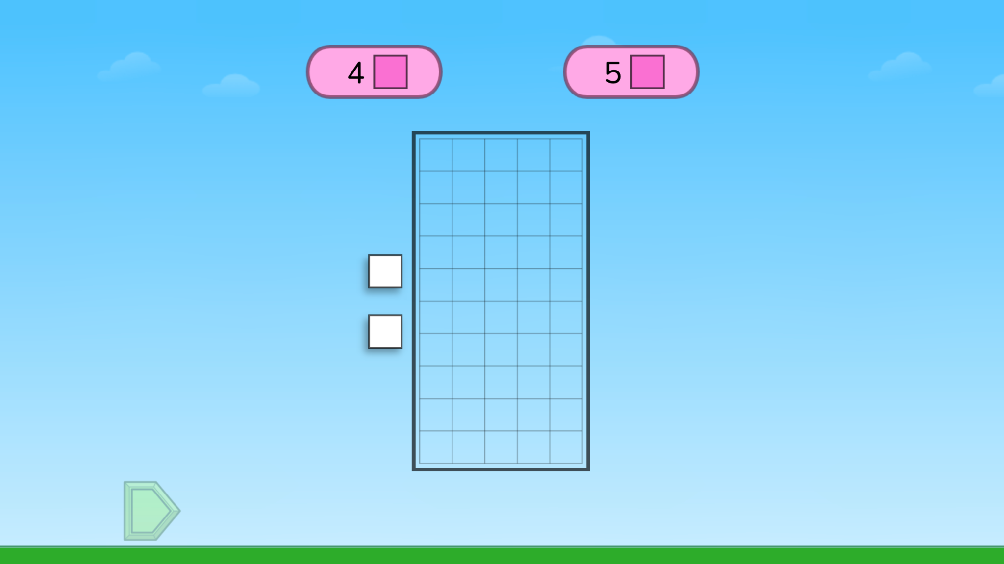
Module 5 - Day 2
Puzzle Talk
Time for
PROBLEM SOLVING!
ST Math Puzzle:
Create Multiple Rectangles > Level 2
Learning Objective:
Intro to Arrays
Puzzle Link
Notes:
Puzzle Talk
Focus on student thinking and developing problem solving skills using guiding questions for each step in the Problem Solving Process.
Provide students with the Rows and Columns Math Mat and centimeter cubes.
Sign in to your ST Math account to access the puzzle.
Display Second Grade > Create Multiple Rectangles > Level 2
Game Link: https://play.stmath.com/raft/ed/10.0.3/#/objective/264b40f1-b4fd-477e-9d7b-d21b437e255f/9d7e49a2-6498-4e3d-a9d7-6d528070773e/games#game9
Notice and Wonder
Show a puzzle from Level 2 and discuss what students remember about yesterday’s puzzles.
Show a puzzle from Level 3 with 2 numbers. Ask “What do you notice?” “How is this like the puzzle from yesterday?”
Predict and Justify
Have students make predictions and show them on the math mat. Discuss their predictions and strategies.
Test and Observe
Try one of the students’ ideas. Ask the students what they think is going to happen. Watch the feedback together and discuss what they saw.
Analyze and Learn
Ask students to think about how what they saw happen compares to what they thought would happen. What did they learn from the feedback?
Show the next puzzle. Have students represent this puzzle in two ways on their mat, if there are at least two solutions. Share and discuss several solutions.
Have students work with a partner and come up with a solution that would work for each number separately but could not work on the puzzle.
Have students share their work and explain why it will not work with the puzzle.
Connect and Extend
Show a puzzle with 3 numbers.
Have students work on their math mat to solve the problem. Share with a partner.
Share different solutions out whole group.
Discuss what students notice about the different puzzles and solutions.
How does the student:
discuss different solutions?
explain which solution is an array and which is not?
represent the array with a repeated addition sentence?
identify even and odd numbers?

Slide 63
Module 5 - Day 2
Problem Solving
Problem of the Day
A farmer planted 20 stalks of corn in a rectangular field. He had the same number of corn stalks in each row.
Draw a picture to show two ways the farmer could have planted the corn. Explain how you came up with your pictures.
Notes:
Problem of the Day
A farmer planted 20 stalks of corn in a rectangular field. He had the same number of corn stalks in each row.
º Draw a picture to show two ways the farmer could have planted the corn.
º Explain how you came up with your pictures.

Slide 64
Reflection Poster
Slides 62-63

Slide 65
Time for
REFLECTION!
LET’S BRAINSTORM
What math concepts did you learn this summer?
What new vocabulary did you learn?
What strategies did you use when you got stuck?
How did you become a better
mathematician?
Notes:
Reflection Poster
Students are going to create a Reflection Poster that represents the learning they have gained. The poster should reflect how their thinking and understanding has grown. It should be an opportunity for students to show what they know.
Work with students to review the thinking they have recorded in their journals (My Thinking Path, Exit Tickets, PODs, ST Math Puzzle Reflection, etc.) and discuss what they have learned during Summer Immersion. Discuss major concepts and vocabulary they learned and used during Immersion.
Have students add to their journal as you discuss things they have learned but may have not yet included in their journal. This will prepare the students to complete their poster.
Ask students to work with their group to see what they might want to include on their poster.
Instruct groups to make their posters colorful, interesting and informative so students in other classes will see what they have accomplished in the past few modules.
Give students time to begin working on their posters.
The posters will be displayed for the entire school and parents to see on Day 5.
The reflection poster is best done as a small group project because that allows students to engage in higher order thinking skills (e.g., evaluating their learning and the ideas of others, synthesizing their thoughts and the thoughts of others, reaching consensus, and working together). It can however, be done as an individual project. Have students begin to think about all of the things that they have learned and make a poster to share what they have learned.

Slide 66
Time for
REFLECTION!
DESIGN A REFLECTION POSTER
Share what you know!
What math concepts did you learn this summer?
What new vocabulary did you learn?
What strategies did you use when you got stuck?
How did you become a better mathematician?
Make your poster
colorful, interesting and informative.
Notes:
DAY 3 - Reflection Poster

Slide 67
Mini Math Game Design
Use Slides 65-69 if using the
4-Day Immersion Program

Slide 68
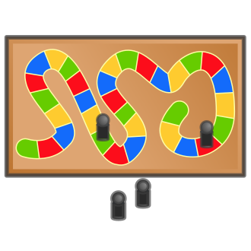
We are going to create a game like the ones you played this summer!
Notes:
Mini-Math Game Design (4-Day Immersion only)

Slide 69
Let’s Brainstorm!
What are some games you know?
Can you think of how you might put math in the game?
Can you think of a game you would like to make that is like the ones you know?
Notes:
Mini-Math Game Design (4-Day Immersion only)
What are some games you know? Make a list.
From the list, decide which type of game you are going to recreate.

Slide 70
Your New Game
When you make a new game, what math concepts can you include?
___ addition
___ subtraction
___ shapes
___ money
___puzzles
___ time
___ measuring
___ estimation
___ place value
___ something else?
Notes:
Mini-Math Game Design (4-Day Immersion only)
What math concepts can you include in your game?

Slide 71
Your New Game
Can you make a game to teach
or practice a math concept?
What is your game called?
How many players can you have?
What are the directions and rules for your game?
Notes:
Mini-Math Game Design (4-Day Immersion only)
How can you make a game to teach or practice a math concept? Think about how the game will help all players develop mathematical reasoning.
Create a name for your game. Decide how many players can play.
What are the rules and directions for your game? Make sure your rules are clear and concise.

Slide 72
Now it’s time to make a new game!
Work together to make a game that your friends will want to play.
Notes:
Mini-Math Game Design (4-Day Immersion only)
Students will work in small groups to create a game. Provide them with the supplies needed. The list below are samples of items that could be used.
Dice or number cubes
Construction paper
Scissors
Poster board
Manilla folders
Index Cards
Egg cartons*
Water bottles*
Pizza circles*
Paper towel rolls*
Buttons*
Other creative items

Slide 73
Learning Showcase and Celebration Slides

Slide 74
W
elcome
to
ST Math Immersion’s
Learning Showcase
& Celebration!
Notes:
Welcome to Learning Showcase and Celebration!
Why are we here?
Today is the last of the ST Math Summer Immersion! The Learning Showcase and Celebration is about providing students an opportunity to “show what they know.” Our students have been learning throughout the summer and will be sharing the information they have learned.
We have invited you all to to celebrate and hear from students about what they learned. Don’t forget to use the Immersion Debriefing Bookmarks to ask questions.

Slide 75
AGENDA (Sample)
10:00 am - Welcome
Gallery Walk of Posters
10:15 am - Presentation
10:30 am - Debriefing Time
11:00 am - Game Time
11:30 am - End Time
Notes:
Sample Framework
You can make changes that work for their space. Consider how you will set up the learning showcase (grade level celebration, grade band celebration, whole school celebration). Divide the time you set aside with the following activities below:
Welcome: Introduce yourself. Share an overview of what the students did and why they are having a Learning Showcase and Celebration. We want this to be a positive and fun experience for the students.
Gallery Walk of Posters: It is recommended that the posters be hung around the room. Invite guests/classmates to walk around the room, look at the reflection posters and ask questions.
Presentations: Students summarize and present their math game design (completed during the program) and their reflection posters.
Immersion Debriefing Time: During this time, students will be asked questions about the work they did. Print and distribute the ST Math Immersion Debriefing Bookmark to visitors (which is optional). Encourage them to use it to ask students questions about their projects and what they have learned.
Game Time: Set aside time for visitors to play the games created by the students. This is a great time for students to play each other's games as well.
Note: We recommend giving students encouragement notes throughout the program.

Slide 76
Resource

Slide 77
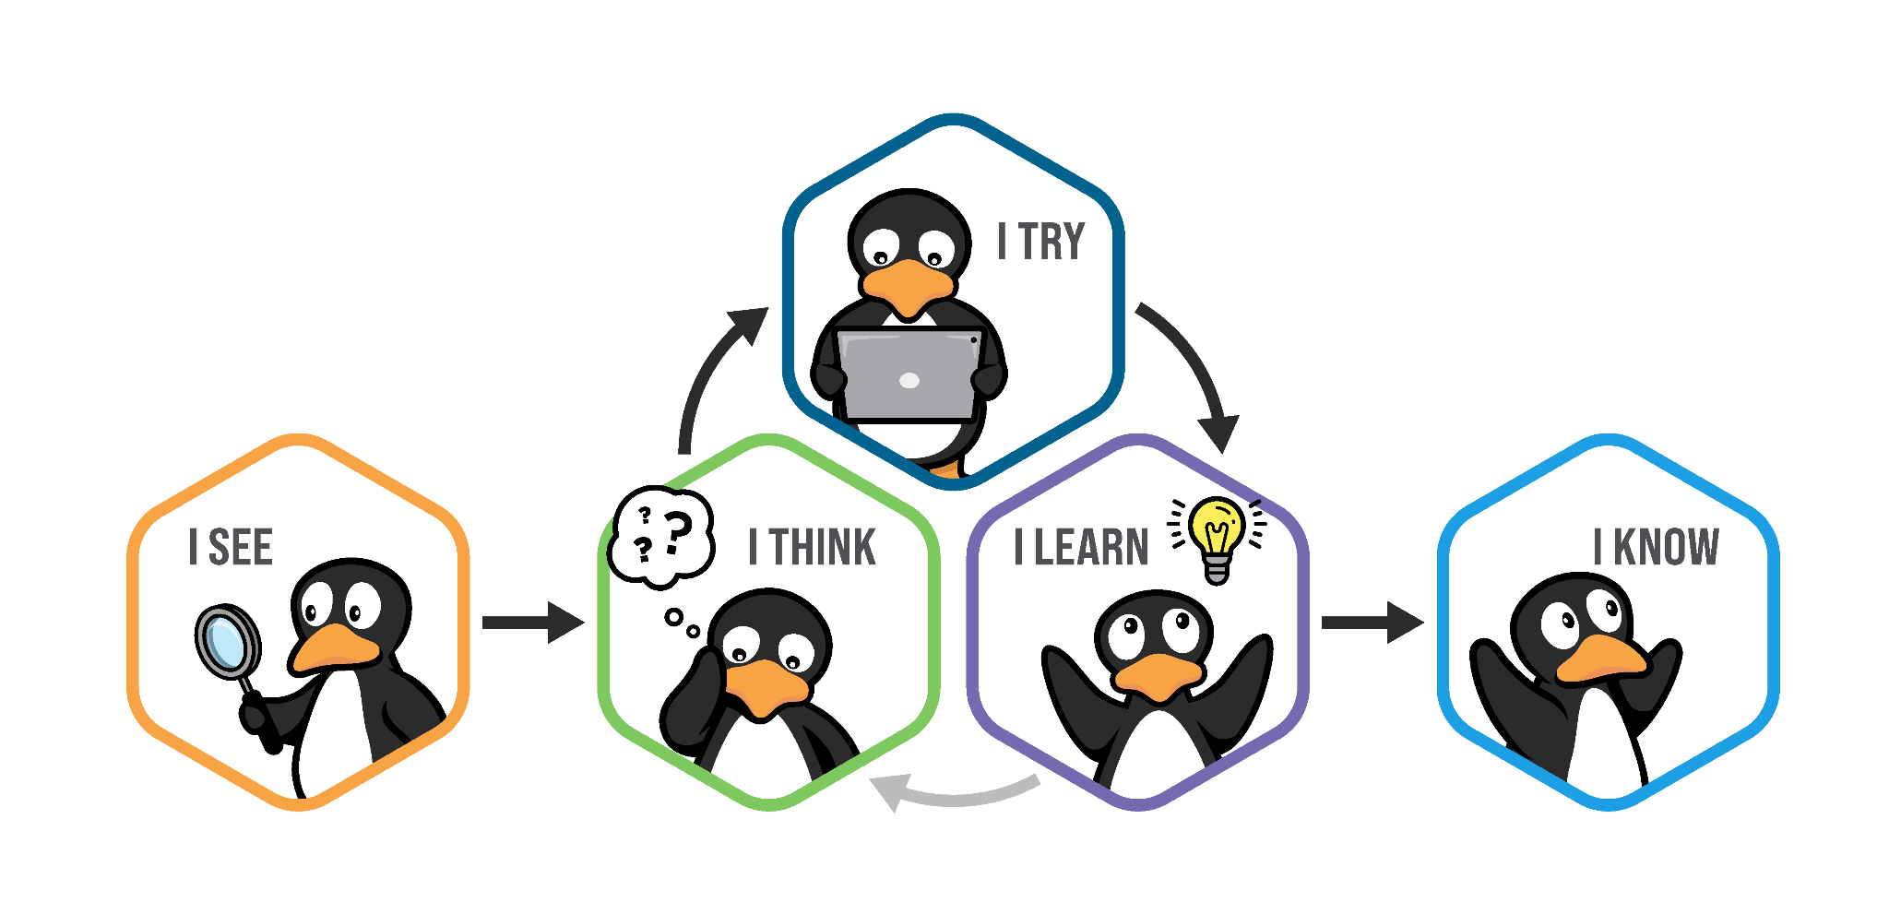
Problem Solving Process

