Slide 1
Class Meeting (K-5)

Slide 2
How to use this slide deck
This slide deck was created to be used for the class meeting each week. There are two ways to use it.
Make copies of this slide deck to use for your class meeting each week. Individualize each copy by deleting the slides you do not wish to use that week.
Use this slide deck as is and navigate to the slides you want each time. Clicking on the topics found on slide 14 while in presentation mode, will take you directly to that topics set of slides.
You may wish to upload this deck to the platform you use for your virtual program.

Slide 3
Norms
Be curious!
Be willing to try.
Embrace mistakes.
Engage in teamwork.
Adjust your thinking.
Notes:
Note: These are example norms. You will want to create your own.

Slide 4
Components of Program
Class Meeting
Puzzle Talks
Problem Solving
ST Math 1:1
Friday Math Club
Small Group Activity

Slide 5
JiJi & Friends

Slide 6
ST Math 1:1 Intro
What I like about
ST Math is . . .
One Tip I have for playing ST Math is . . .
One thing I do when I get stuck is . . .
My favorite ST Math game is . . .

Slide 7
ST Math 1:1 Intro
Read the book
Video telling of the story
Notes:
https://play.stmath.com/raft/resources/videos/jiji_to_the_top/index.html

Slide 8
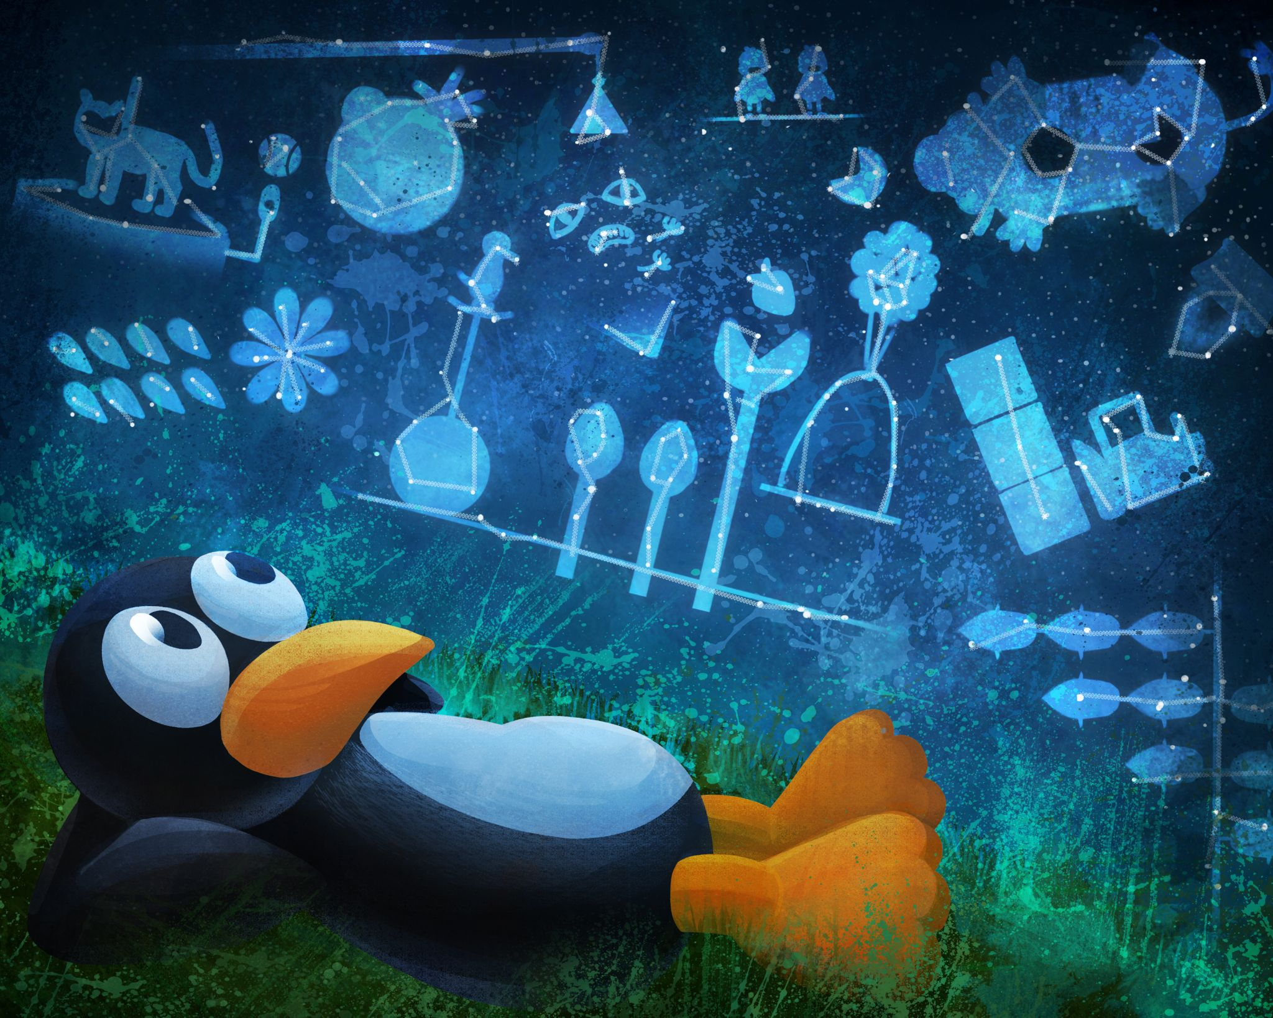
ST Math 1:1 Reflection
Something I learned during my ST Math time is. . .

Slide 9
ST Math 1:1 Reflection
One thing that helps me when I am stuck is . . .

Slide 10
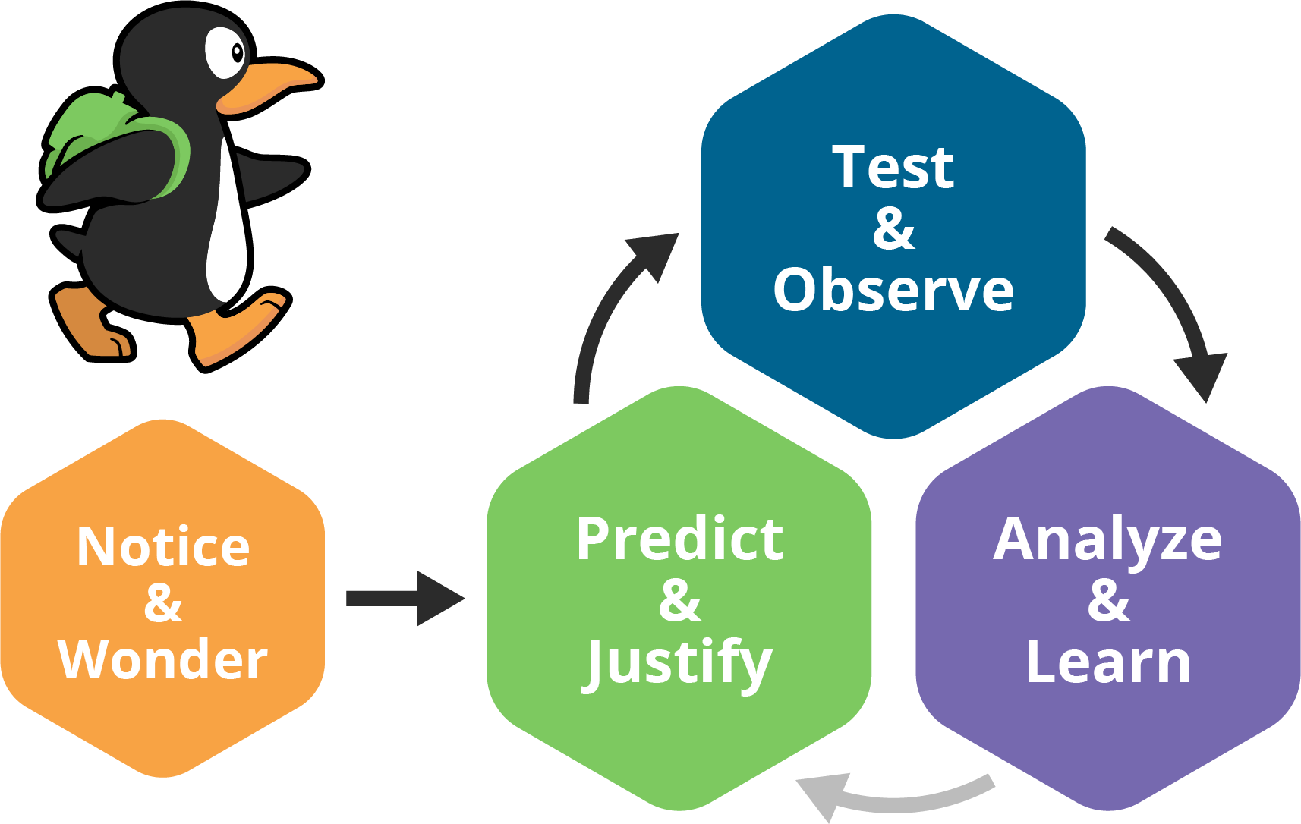
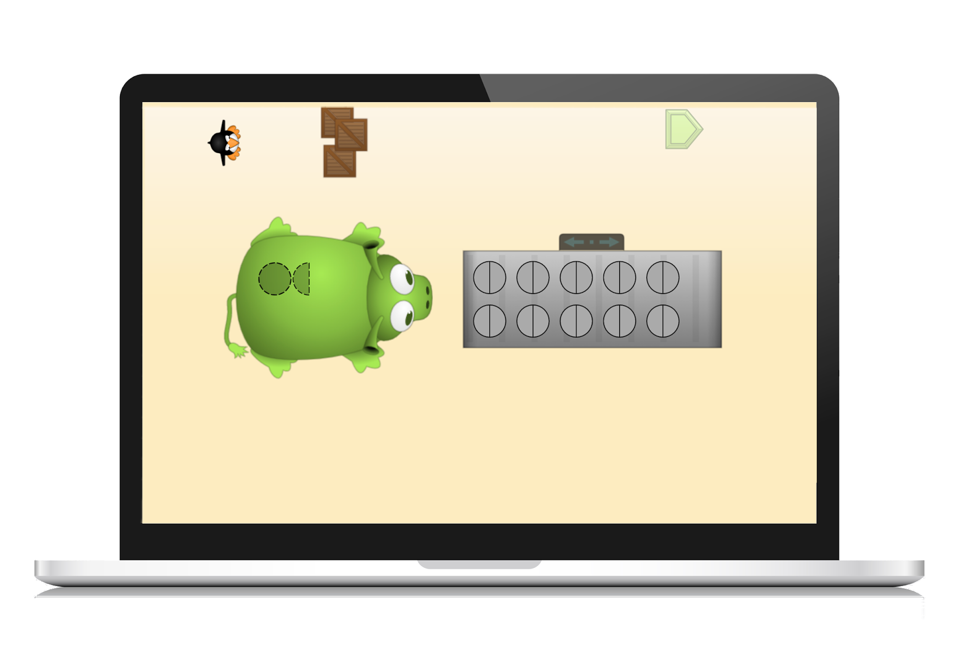
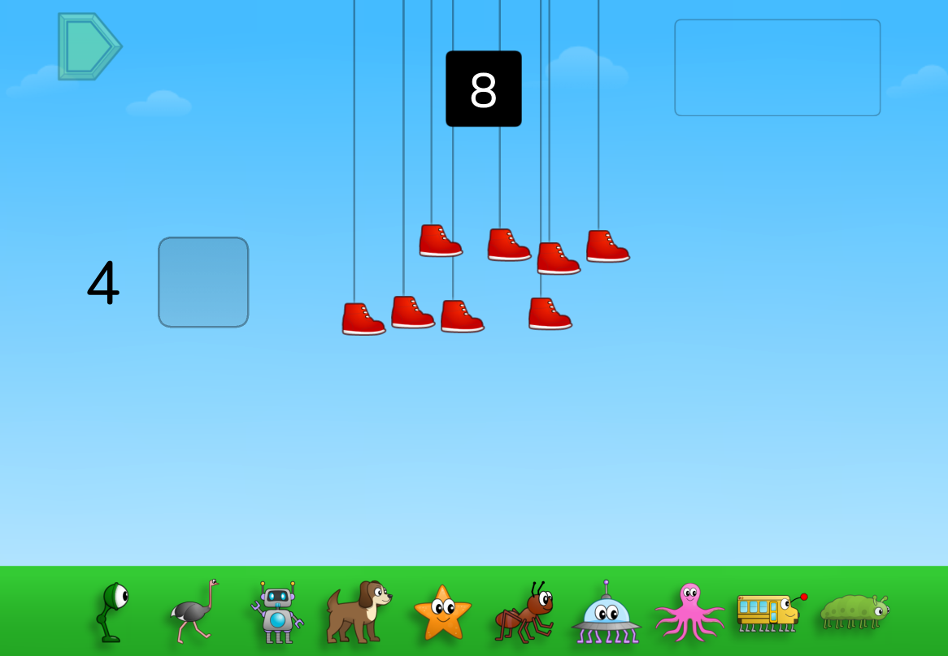
NOTICE & WONDER What do you notice?
I SEE. . .

Slide 11
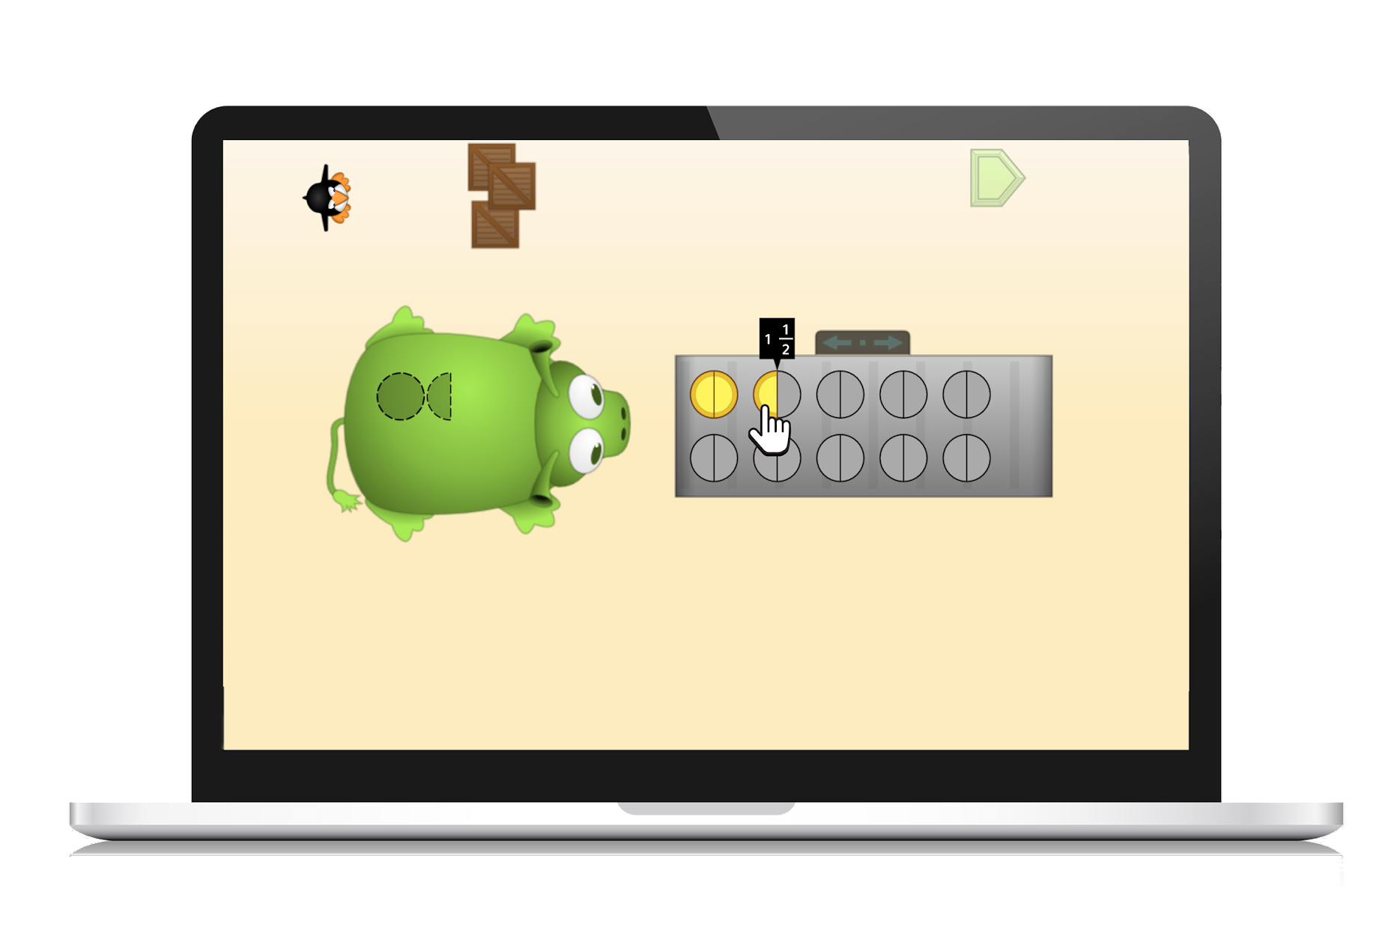
PREDICT & JUSTIFY
What is your prediction and why?
I THINK. . .

Slide 12
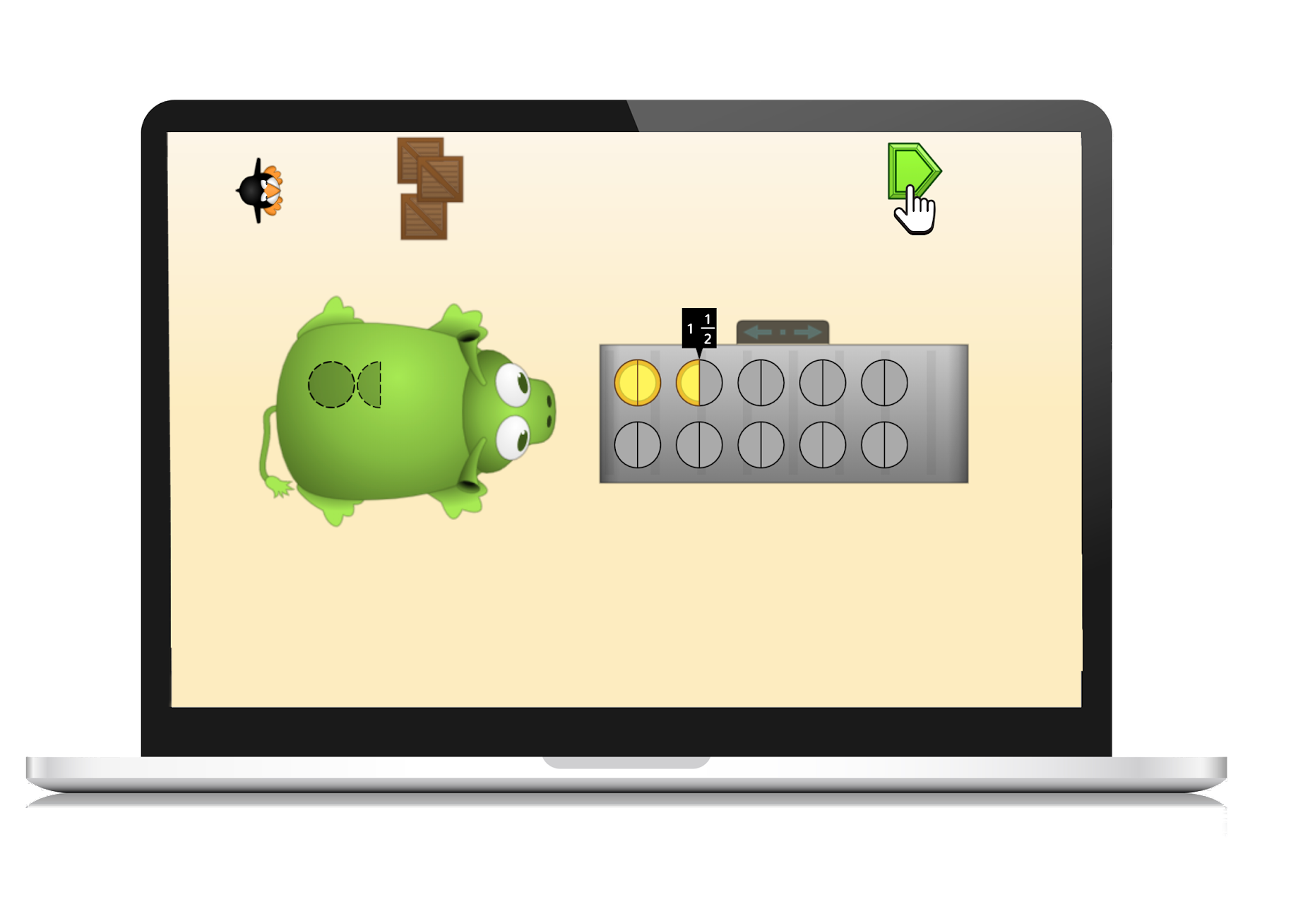
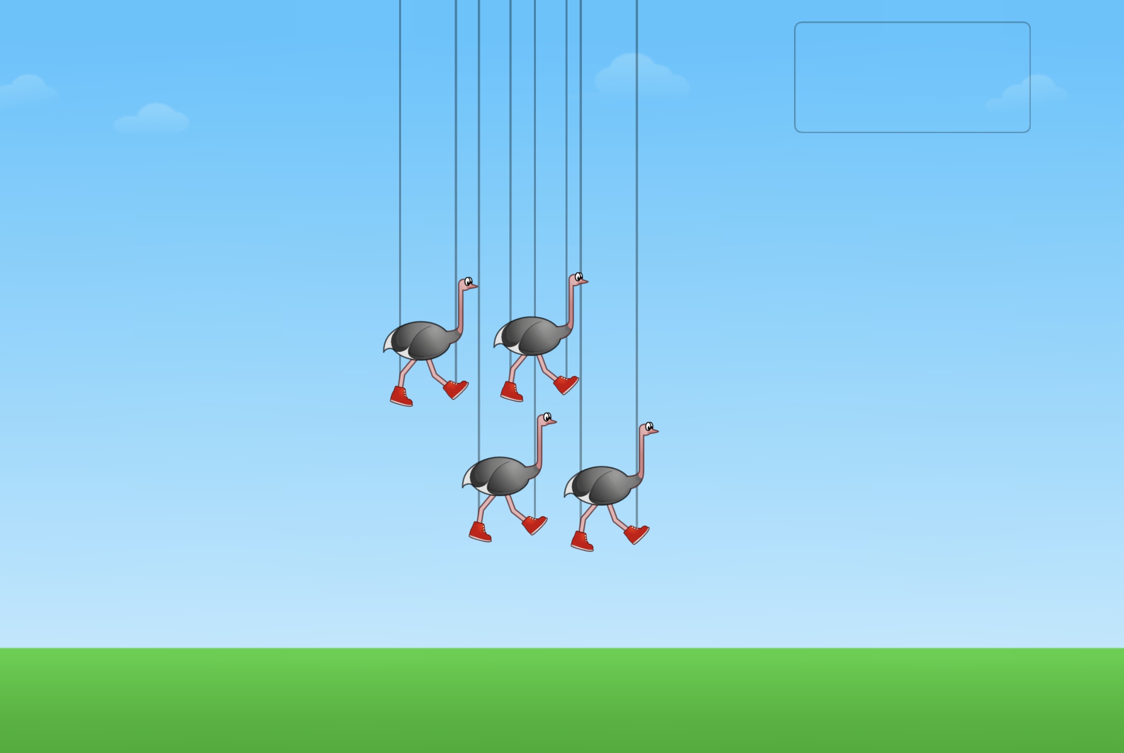
TEST & OBSERVE
Test your strategy. Tell me what happened?
I TRY. . .

Slide 13
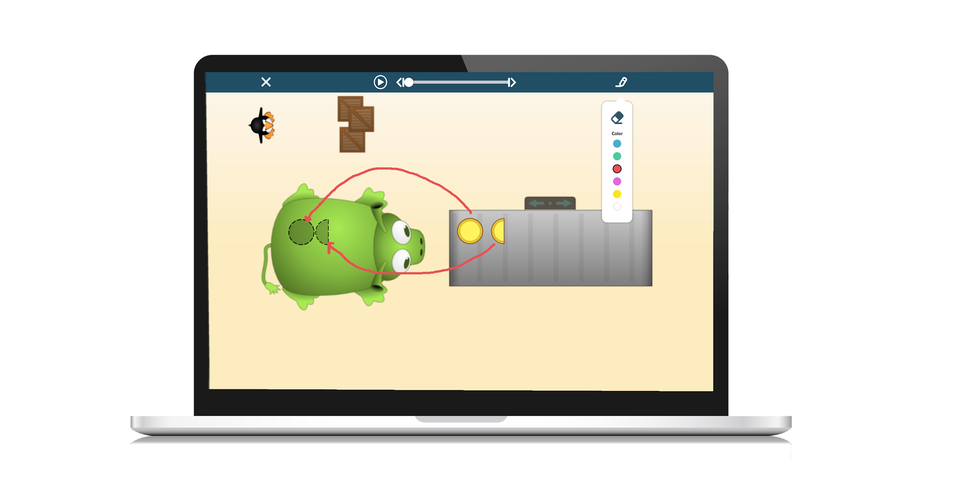
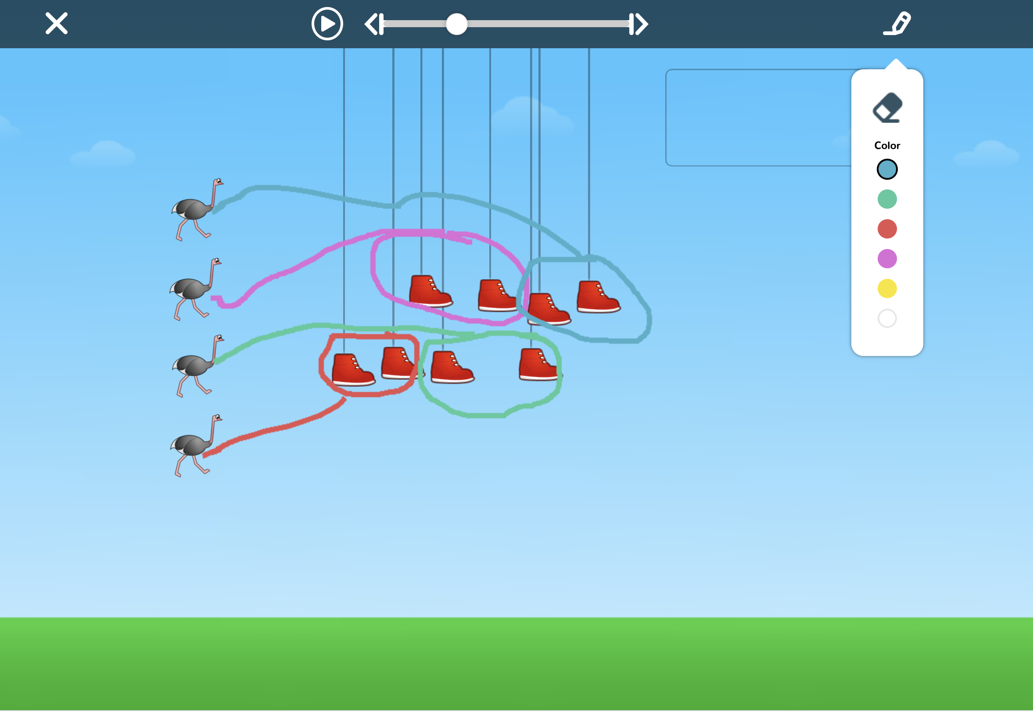
ANALYZE & LEARN
What did you learn?
I LEARN. . .

Slide 14
For today’s class meeting we will. . .
Set Goals
Find Which One
Explore Numbers
Celebrate Brilliance
Tell our Math Story
Notes:
Select one that you want to be part of today’s class meeting.
Click on it to go to that section.

Slide 15
Goal Setting
Notes:
As students progress through their ST Math journey they are building intrinsic motivation. Students develop confidence and recognize their progress and growth by setting goals. Goal setting:
Increases opportunities for student agency.
Strengthens students’ ability to communicate what they have accomplished.
Helps students identify areas for improvement.
Teaches time management.
Encourages focus on strategies to overcome challenges.
Engage students in goal setting conversations that help them to:
Establish appropriate goals.
Take action to achieve the goals.
Build strategies for monitoring progress toward the goals.
Adjust the goals based on quantitative and qualitative data to help them set future goals.
The following slides provide sentence starters to use with students as they set, monitor and evaluate their goals. The data trackers are good resources to use to support goal setting.

Slide 16
Set Goals
My goal for this week is . . .
I chose this goal because . . .
One thing I will do to help me achieve my goal is . . .
One thing you can do to help me achieve my goal is . . .
Notes:
Use the sentence starters to help students set goals. Discuss the reasonableness of their goals. You may want to select one for all students to answer, you may also want to have them discuss one or two in pairs or small breakout groups. You could also delete or change sentence starters you do not wish to use.

Slide 17
Monitor Goals
This week I am doing _____ on my goal.
Something that is helping me is . . .
Something I need to work on is . . .
Notes:
This can be used for a mid-week check so students can learn to monitor their progress on their goals. You may want to select one for all students to answer, you may also want to have them discuss one or two in pairs or small breakout groups. You could also delete or change sentence starters you do not wish to use.

Slide 18
Evaluate Goals
One thing I did well is . . .
One thing I need to work on is . . .
One way I might adjust my goal is ______ because . . .
One thing I learned about myself from setting this goal is . . .
Notes:
These sentence starters can be used to help students evaluate goals. It is not necessary to use them all. You may want to select one for all students to answer, you may also want to have them discuss one or two in pairs or small breakout groups. You could also delete or change sentence starters you do not wish to use.

Slide 19
Tell Our Math Story
Notes:
Pose an opening question that everyone can answer and have them type their answers into the chat or let them unmute and share. Focus on learning one another’s names along with interesting information about one another! Collect the data. You might collect data through a Google Form, Google Slide, Survey Monkey, Jamboard, Virtual Whiteboard. Display the data and create different ways to represent the data (tallys, graphs, tables, etc.) Use the data to tell the “math story” of the class.

Slide 20
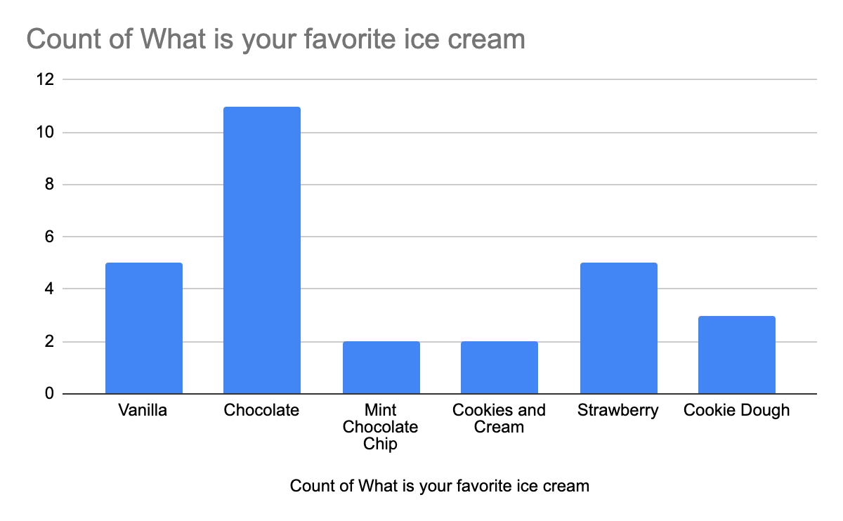
Tell Our Math Story
What is your favorite flavor of ice cream?
What is the farthest place you’ve ever traveled?
How many brothers and sisters do you have?
What is your favorite color?
If you could be any animal, what animal would you choose?
What do you like about math?
What is your favorite vegetable?
Chocolate, vanilla, or strawberry ice cream - Which is better?
Notes:
Use this slide to pose questions that allow you to collect data. Use the data to have math discussions.

Slide 21
Which One?
Notes:
Getting to know students and build relationships is an important part of the virtual environment. A great way to generate conversation is Christopher Danielson’s Which One Doesn’t Belong? In this routine, students choose one of the images that they believe does not fit with the others in the group. Any answer can be correct - as long as it is justified with mathematical reasoning. The following slides contain some examples. You may also want to make your own.

Slide 22
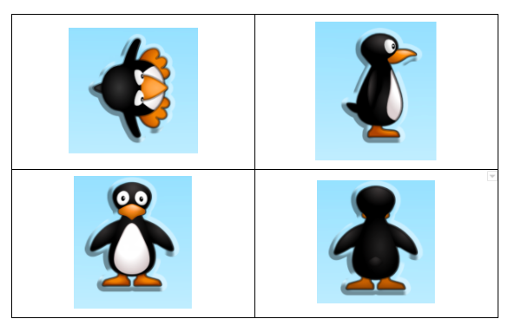
Which One Doesn’t Belong?
A
B
C
D
Notes:
Upper Left: only JiJi where you can see the tops of the feet
Upper Right: only JiJi that you can see only one of the eyes
Lower Left: only JiJi where you can see the entire face
Lower Right: only JiJi where you cannot see the eyes

Slide 23
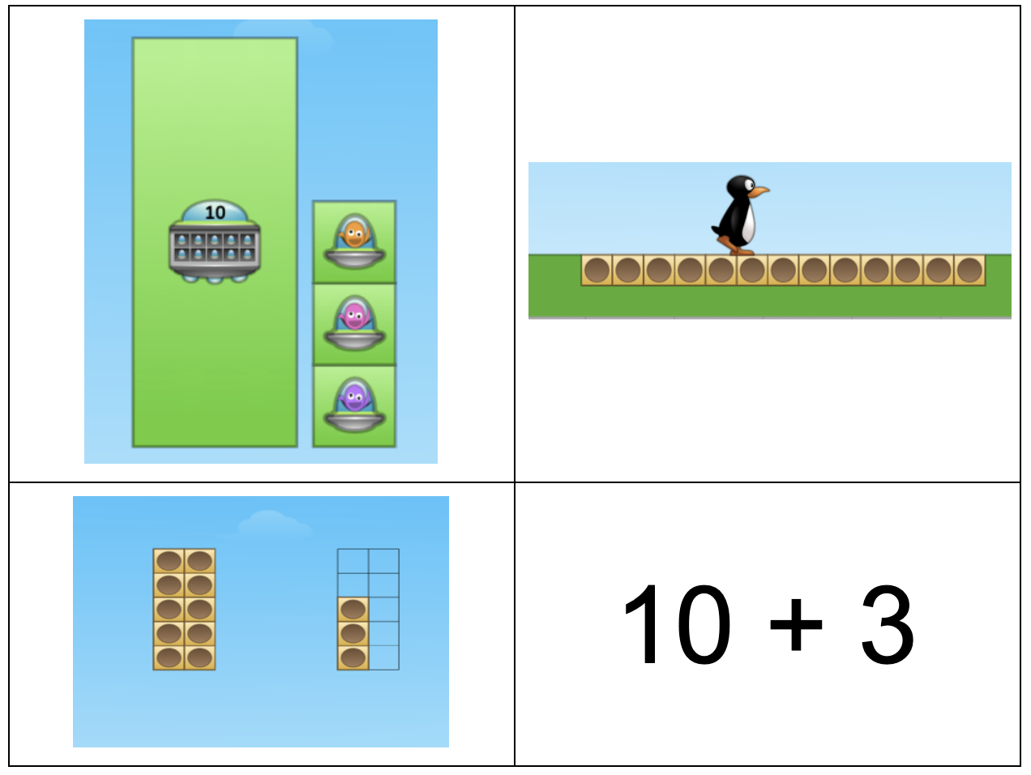
Which One Doesn’t Belong?
A
B
C
D
Notes:
Upper Left: shows the ten unitized into one group
Upper Right: shows a line of 13 objects; could be counted one-to-one
Lower Left: arranged in ten-frame and can be counted as a group of 10 and 3 ones (but can still see individual units)
Lower Right: number form

Slide 24
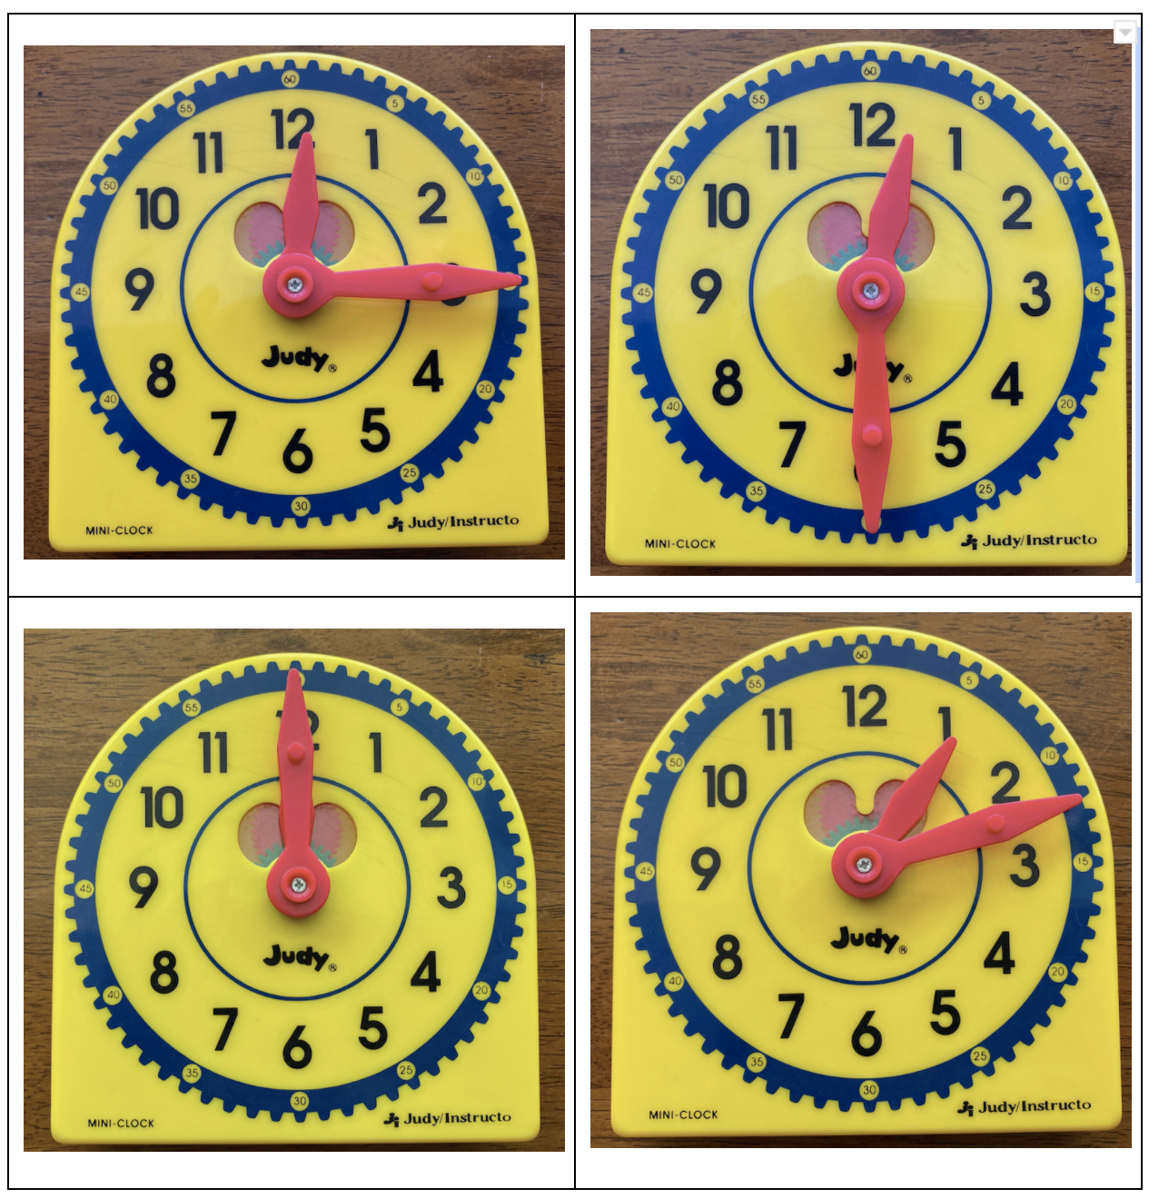
Which One Doesn’t Belong?
A
B
C
D
Notes:
Upper Left: time is on the quarter hour
Upper Right: time is on the half hour
Lower Left: time is on the hour
Lower Right: hands are not on a quarter hour marking; time past 1:00

Slide 25
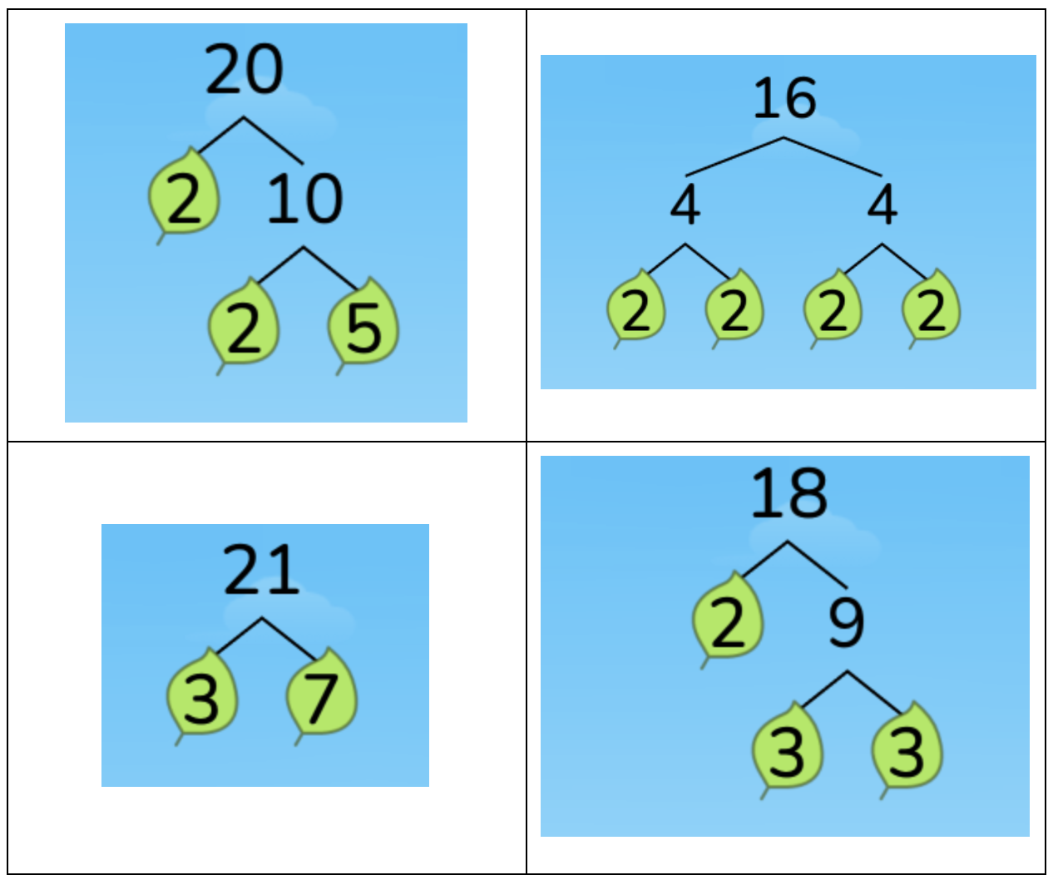
Which One Doesn’t Belong?
A
B
C
D
Notes:
Upper Left: includes 5 as a prime factor
Upper Right: all of the prime factors are the same
Lower Left: product is made of two prime factors; odd number
Lower Right: includes two prime factors that are odd but makes an even product

Slide 26
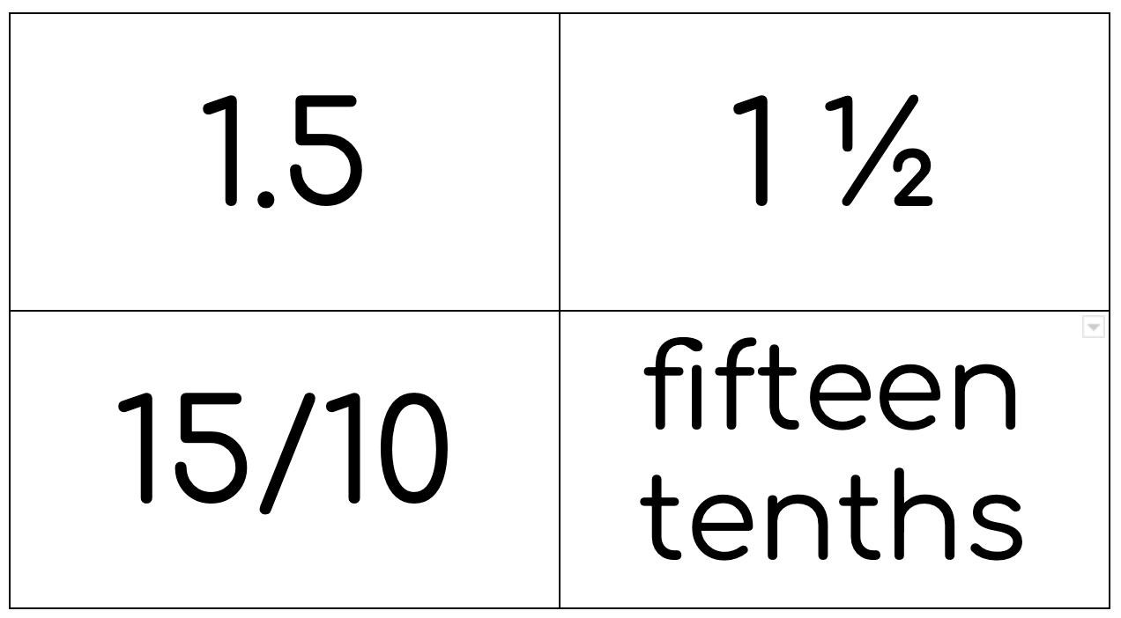
Which One Doesn’t Belong?
A
B
C
D
Notes:
Upper Left: decimal form
Upper Right: mixed number; does not include tenths in the name
Lower Left: fraction form
Lower Right: word form

Slide 27
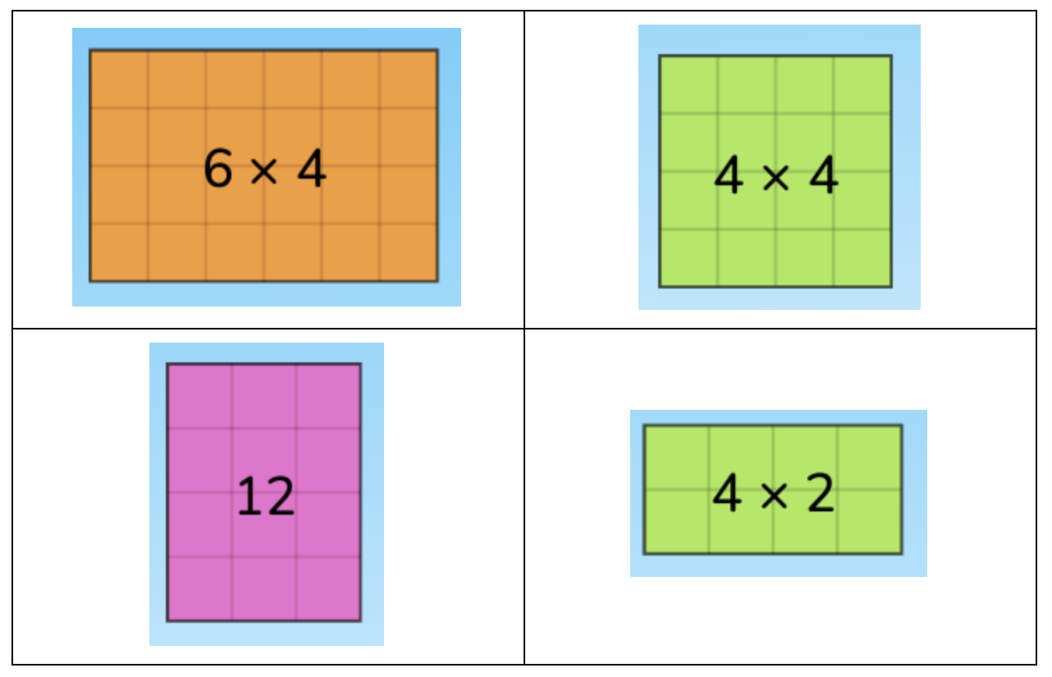
Which One Doesn’t Belong?
A
B
C
D
Notes:
Upper Left: Factor larger than 4
Upper Right: Square number; both factors are the same
Lower Left: Gives product instead of expression
Lower Right: Doubles fact

Slide 28
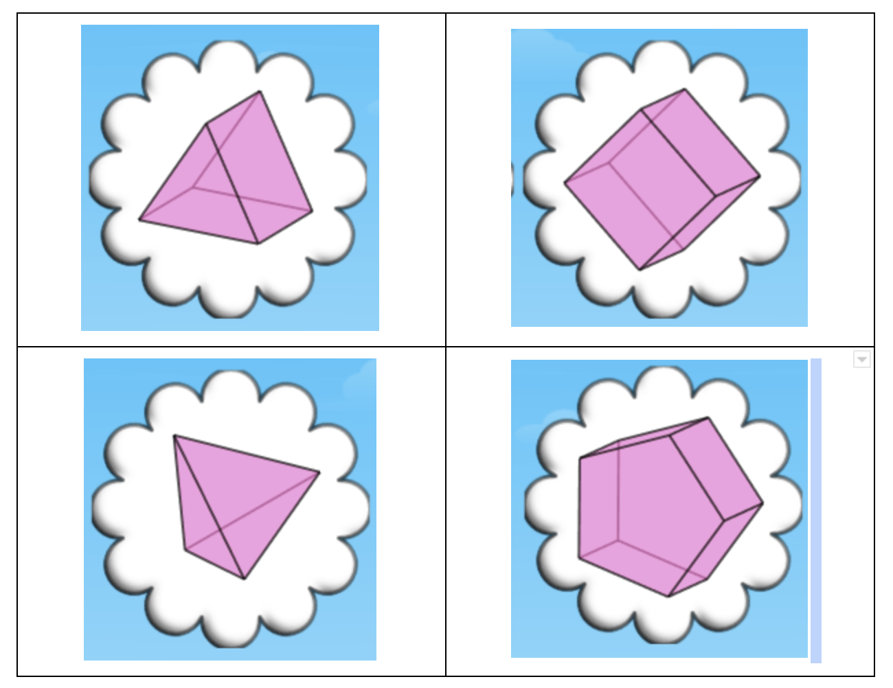
Which One Doesn’t Belong?
A
B
C
D
Notes:
Upper Left: 5 faces; only one that has a mix of triangles and rectangles for the faces
Upper Right: 6 faces; only one that has all rectangles/squares for the faces
Lower Left: 4 faces; only one that has all triangles for the faces
Lower Right: 7 faces; only one that a shape other than rectangles/triangles for the faces

Slide 29
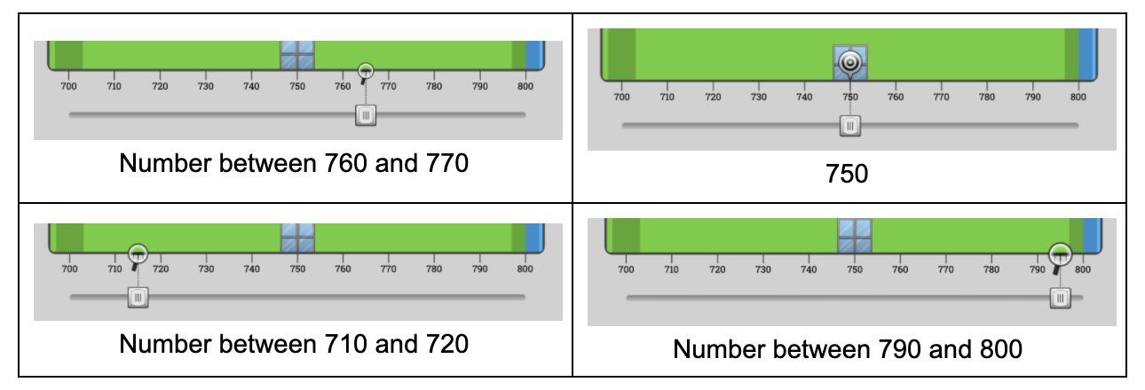
Which One Doesn’t Belong?
A
B
C
D
Notes:
Upper Left: Could round to 800, if rounding to nearest 100
Upper Right: Only value exactly on the tens mark, Could round to 800 if rounding to the nearest 100
Lower Left: Could round to 700 if rounding to nearest 100
Lower Right: Closest to 800

Slide 30
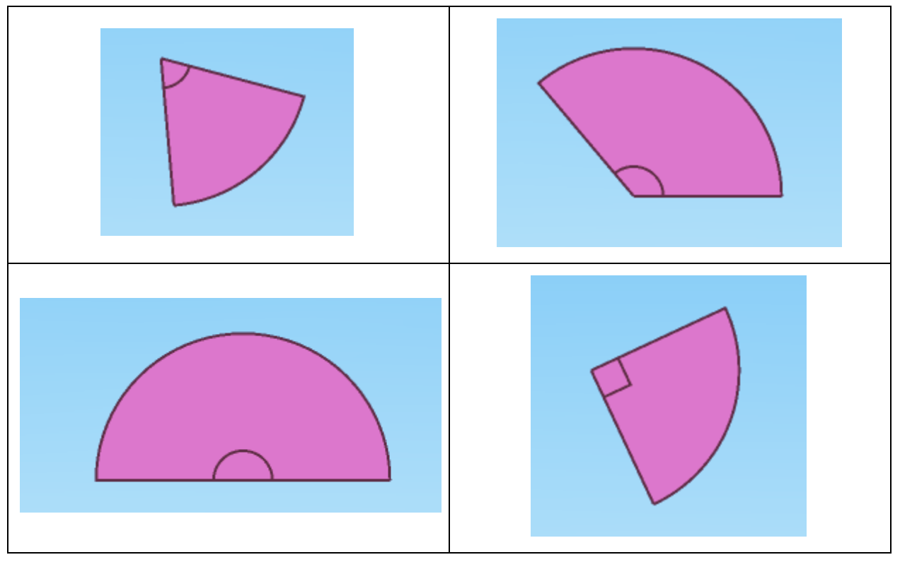
Which One Doesn’t Belong?
A
B
C
D
Notes:
Upper Left: acute angle; less than 90 degrees
Upper Right: obtuse angle; greater than 90 degrees but less than 180
Lower Left: straight angle; exactly 180 degrees
Lower Right: right angle; exactly 90 degrees

Slide 31
Which One Doesn’t Belong?
A
B
C
D
Notes:
Upper Left: length is 12 inches; segmented but no labels
Upper Right: length is one foot; no labels
Lower Left: length is 12 inches with every other inch colored; includes lines and labels
Lower Right: length is 12 inches with inches labeled and half inches shown with lines

Slide 32
Exploring Numbers
Notes:
Exploring numbers and their relationships supports students in developing a strong sense of numbers. The following slides contain numbers. Show the students the numbers and have them tell you what they know about the numbers. You can do each number separate or you could have students do both numbers and make comparisons. You can also create your own numbers.
One way to engage students in exploring numbers is to use the same set of numbers for the week. Connect them to number lines, ten frames and see how many equations students can come up with to equal one of the numbers.

Slide 33
Exploring Numbers
2
4

Slide 34
Exploring Numbers
8
18

Slide 35
Exploring Numbers
25
5

Slide 36
Exploring Numbers
10
100

Slide 37
Exploring Numbers
28
36

Slide 38
Exploring Numbers
12
4

Slide 39
Exploring Numbers
5
20

Slide 40
Exploring Numbers
15
30

Slide 41
Exploring Numbers
25
75

Slide 42
Exploring Numbers
½
¼

Slide 43
Exploring Numbers
⅓
⅙

Slide 44
Exploring Numbers
⅔
⁴/6

Slide 45
Exploring Numbers
½
³/6

Slide 46
Celebrate Brilliance
Notes:
One way to empower students and promote a positive mathematical identity is to celebrate their brilliance. On the following slides there are celebration certificates. Select one and celebrate the brilliance of students that you have noticed. Invite other students to share brilliance that they have felt themselves or seen in others. This is a great opportunity to call out those “soft skills” that students are developing in this program.

Slide 47
Celebrate Brilliance

Slide 48
Celebrate Brilliance

Slide 49
Celebrate Brilliance

Slide 50
Celebrate Brilliance

Slide 51
Celebrate Brilliance

Slide 52
Celebrate Brilliance

