Slide 1
Grade 5 Pre-Assessment

Slide 2
You will need. . .
Paper
Pencil

Slide 3
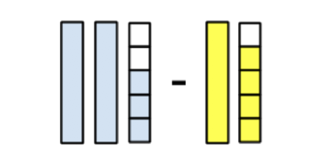
Question 1
Marti said that the answer to this subtraction problem is 1⅕. What error do you think Marti made? What would you say to Marti to help her understand the solution
to this problem? Use a number line and write an equation to show the solution.

Slide 4
Question 2
Shawna, Ryan and Dominic ate a whole pizza. Shawna ate ⅙ of the pizza, Ryan ate ½ of the pizza and Dominic ate the rest. How much pizza did Dominic eat?
Notes:
Add picture

Slide 5
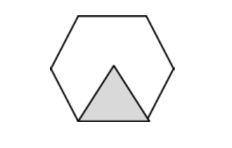
Question 3
Write the value of the hexagon.
A. If the triangle = 1/6, then the hexagon = _____________
B. If the triangle = 4/3, then the hexagon = _____________
C. If the triangle = 1½, then the hexagon = _____________
D. If the triangle = 2/8, then the hexagon = _____________
Notes:
Add picture

Slide 6
Question 4
Omni likes to run along the beach. She drinks ¾ cup of water for every mile she runs. If her water bottle holds 6 cups of water, how many miles can she run before her water bottle is empty? Prove your claim.

Slide 7
Question 5
Use the plotted points on this number line to locate ½ and 5 x ¼.
Notes:
Add picture

Slide 8
Question 6
Keisha, Maria, and Katy want to share 2½ yards of rope equally to make a jump rope. How much rope will each girl have for her jump rope?

Slide 9
Question 7
This shape represents ⅔. Draw 1½.
Notes:
Add picture

Slide 10
Question 8
Ibrahim wants to give each of his 6 friends 1¾ candy bars. How many candy bars does he need to buy?

Slide 11
Question 9
Juan had 4 candy bars for himself and 3 friends to share after lunch. 3 other friends joined them. Juan divided the 4 candy bars equally with all of his friends. How much did each person get?

Slide 12
Question 10
Write the letter next to each number to show where it goes on the number line.
1 ________
½ ________
0 ________
2 ________
1½ ________
6/3 ________
Notes:
Add picture

