Slide 1
Grade 3 Pre-Assessment

Slide 2
You will need. . .
Paper
Pencil

Slide 3
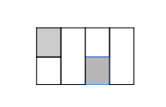
Question 1
How much of the whole area is shaded?
Notes:
Add picture

Slide 4
Question 2
Plot these numbers on the number line.
5/4, ½, 2/2, ¼, 8/4, 2½
Notes:
Add picture

Slide 5
Question 3
Anna made a bracelet using 6 pieces of yarn. Each piece of yarn was ⅛ of a foot long. How much yarn did she use? Show your work.

Slide 6
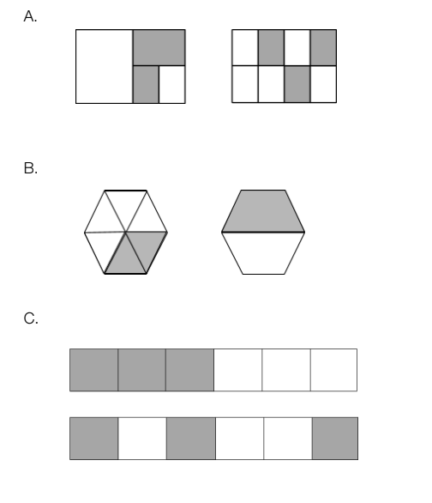
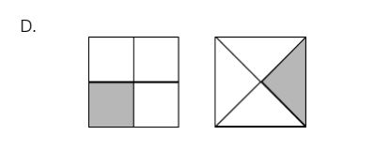
Question 4
Circle the letter for each pair of shapes that has an equal area shaded.
Notes:
Add pictures

Slide 7
Question 5
Use the plotted points on this number line to locate ½ and 1¼.
Notes:
Add picture

Slide 8
Question 6
This shape represents ⅔. Draw 6/3.
Notes:
Add picture

Slide 9
Question 7
Use one of these symbols <, >, = to make each statement true. Place the symbol in the box between the two numbers.
⅔ ___ ⅖
10/9 ___ 9/8
⅝ ___ 2/8
⅜ ___ 4/6
1/10 ___ ⅙

Slide 10
Question 8
Plot and label the following numbers on the number line.
4/3, ⅔, 2⅓, 6/3
Notes:
Add picture

Slide 11
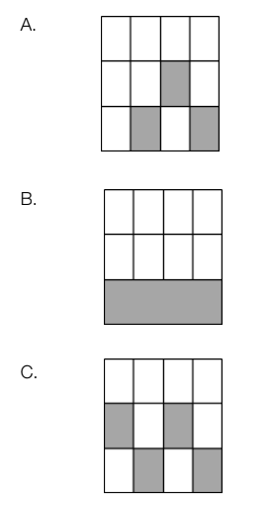
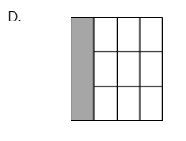
Question 9
Circle the letter beside all of the models that show ¼ shaded. Circle all that apply.
Notes:
Add pictures

Slide 12
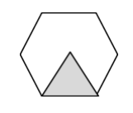
Question 10
Write the value of the hexagon.
A. If the triangle = ⅙, then the hexagon = _____________
B. If the triangle = 3/3, then the hexagon = _____________
C. If the triangle = ½, then the hexagon = _____________
D. If the triangle = ⅔, then the hexagon = _____________
Notes:
Add picture

Slide 13
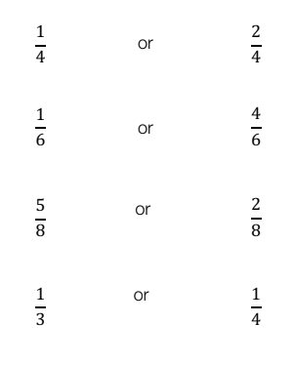
Question 11
Circle the fraction that is closer to ½ in each pair of fractions.

Slide 14
Question 12
Write the letter next to each number to show where it goes on the number line.
1 ________ ½ ________ 0 ________
2 ________ 1½ ________ 6/3 ________
Notes:
Add picture

